Slide 1

DIFFUSION THROUGH MEMBRANES
MEDICAL UNIVERSITY – PLEVEN
FACULTY OF PHARMACY
DIVISION OF PHYSICS AND BIOPHYSICS, higher
mathematics and information technologies
LECTURE No10
Simple diffusion through membranes. Permeability. Transport of water. Filtration and osmosis. Facilitated diffusion.
Prof. M. Alexandrova, DSc

Slide 2
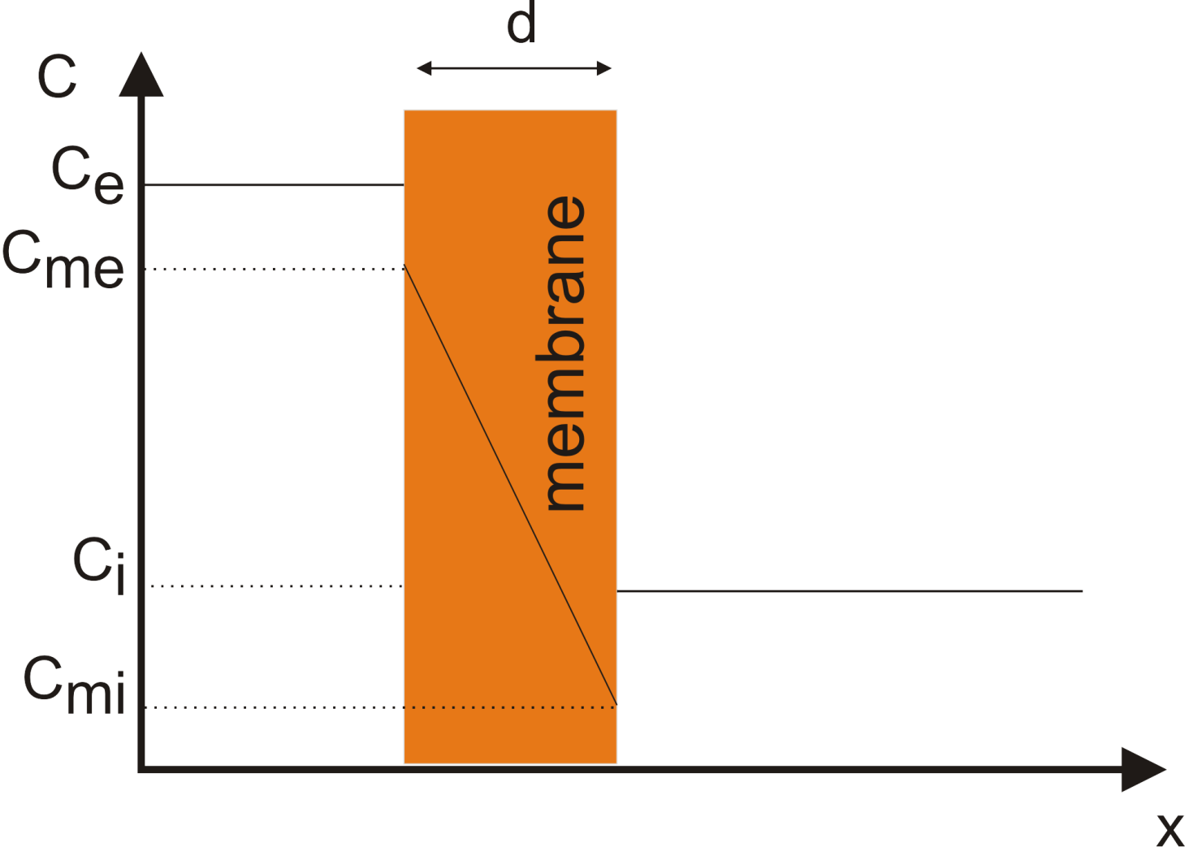
Permeability
is called the membrane permeability.

Slide 3
Facilitated Diffusion
1. Transport by carrier proteins
Transport of larger, polar molecules into a cell requires the involvement of membrane proteins known as transporters or carrier proteins.
The term ‘carrier’ is also applied to ionophores, which move passively across the membrane together with the bound ion. Transporters are as specific for their substrates as the enzymes and work by one of two mechanisms: facilitated diffusion or active transport.
Facilitated diffusion catalyzes the movement of a substrate through a membrane down a concentration gradient and does not require external energy.

Slide 4
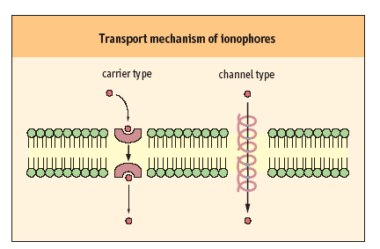
Facilitated transport can be carried by carriers and channels
Mobile carriers and channel-forming transporters
They permit net movement of molecules only down their electrochemical gradients.

Slide 5
Saturability and specificity are important characteristics of the membrane transport systems.
The rate of facilitated diffusion is generally much greater than that of simple diffusion: transport proteins catalyze the transport process.
In contrast to simple diffusion, in which the rate of transport is directly proportional to the substrate concentration, facilitated diffusion is a saturable process, characterized by a maximum transport rate, T_{max} .
When the concentration of transport substrates becomes very high, T_{max} is achieved by saturation of the transporter proteins with substrate. The kinetics of facilitated diffusion for substrates can be described by the same equations that are used for enzyme catalysis.

Slide 6
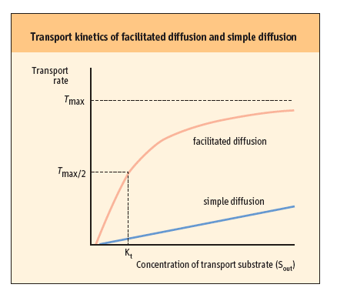

Slide 7
The transport process is usually highly specific: each transporter transports only a single species of molecules or structurally related compounds.
The red blood cell GLUT-1 transporter has a high affinity for D-glucose, but 10–20 times lower affinity for the related sugars, D-mannose and D-galactose. L-glucose is not transported; its affinity is more than 1000 times less than that of the D-form.

Slide 8
Transport by channels and pores
The speed of facilitated transport is limited by the number of protein channels available, whereas the speed of diffusion depends only on the concentration gradient.
Channels are often pictured as tunnels across the membrane, in which binding sites for ions are accessible from either side of the membrane at the same time. Conformational changes are not required for the translocation of substrates.
However, voltage changes and ligand binding induce conformational changes in channel structure that have the effect of opening or closing the channels – processes known as voltage or ligand ‘gating’.

Slide 9
Movement of molecules through channels is fast (10⁷–10⁸/s) in comparison with the rates achieved by transporters.
The terms ‘channel’ and ‘pore’ are sometimes used interchangeably.
‘Pore’ describes more open, somewhat non-selective structures that discriminate between substrates, e.g. peptides or proteins on the basis of size.
The term ‘channel’ is usually applied to describe more specific ion channels.

Slide 10
Three examples of pores important for cellular physiology
The gap junction between endothelial, muscle, and neuronal cells is a cluster of small pores, in which two cylinders of six connexin subunits in plasma membranes join each other to form a pore about 1.2–2.0 nm in diameter. Molecules < 1 kDa can pass between cells through gap junctions.
Such cell–cell communication is important for physiologic coupling, e.g. in the concerted contraction of uterine muscle during labor and delivery. These pores are usually maintained in an open state, but will close when cell membranes are damaged or the metabolic rate is depressed. Mutations of the genes encoding connexin 26 and 32 cause deafness and Charcot–Marie–Tooth disease, respectively.

Slide 11
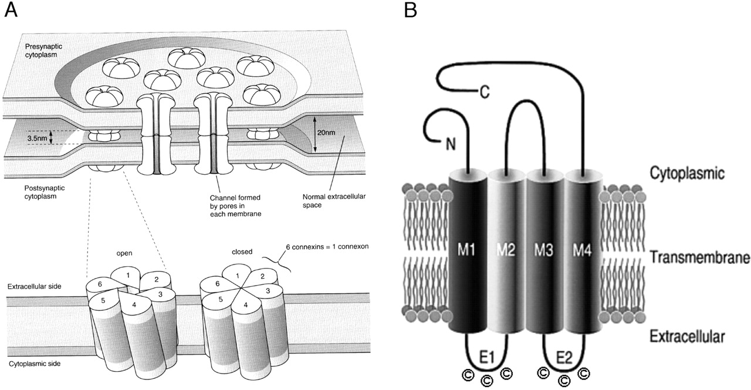
(A) Schematic drawing of gap junction channels. Each hemi-channel is formed by six protein subunits, called connexins. Six connexin subunits of the hemi-channel may coordinately change configuration to open and close the hemi-channel. Closure is achieved by connexin subunits sliding against each other and tilting at one end, thus rotating at the base in a clockwise direction. The darker shading indicates the portion of the connexon embedded in the membrane (adapted from Ref. [32]).
(B) Topological model of a connexin. The cylinders represent transmembrane domains (M1–M4).
The loops between the first and the second, as well as the third and fourth transmembrane domains, are predicted to be extracellular (E1 and E2, respectively), each with three conserved cysteine residues (adapted from Ref. [1]).

Slide 12
Three examples of pores important for cellular physiology
2. Nuclear pores have a functional radius of about
9 nm (90 Å) through which proteins and nucleic acids enter and leave the nucleus.
3. A third class of pores is important for protein sorting. Mitochondrial proteins encoded by nuclear genes are transported to this organelle through pores in the outer mitochondrial membrane.
Nascent polypeptide chains of secretory proteins and plasma membrane proteins also pass through pores in the endoplasmic reticulum membrane.

Slide 13
3. Ionophores
Ionophores are organic molecules of diverse types, often of bacterial origin, that increase the permeability of membranes to ions. These molecules often exert an antibiotic effect by discharging the vital ion concentration gradients that cells actively maintain.
Carrier ionophores increase the permeability of membranes to their selected ion by binding it, diffusing through the membrane and releasing the ion on the other side .
Channel forming ionophores form transmembrane channels or pores through which their selected ions can diffuse.

Slide 14
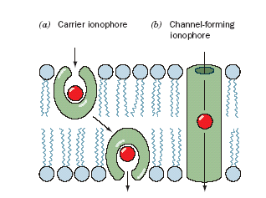

Slide 15
Antibiotics that induce ion permeability
Valinomycin is a typical example of a mobile ion carrier. It is a cyclic peptide with a lipophilic exterior and ionic interior.
It dissolves in the membrane and diffuses between the inner and outer surfaces. K⁺ binds to the central core of valinomycin, and the complex diffuses across the membrane, releasing the K⁺ and gradually dissipating the K⁺ gradient.

Slide 16
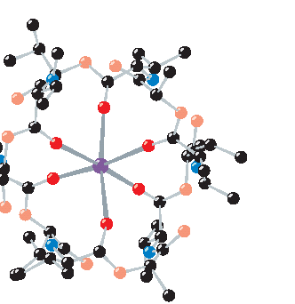
X-Ray structure of valinomycin in complex with K⁺.
Six oxygen atoms (dark red ) octahedrally coordinate the K⁺ ion (purple).

Slide 17
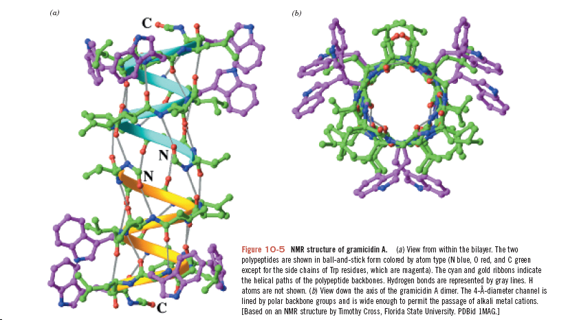
NMR structure of gramicidin A. (a) View from within the bilayer. The twoPlay polypeptides are shown in ball-and-stick form colored by atom type (N blue, O red, and C green except for the side chains of Trp residues, which are magenta). The cyan and gold ribbons indicate the helical paths of the polypeptide backbones. Hydrogen bonds are represented by gray lines. H atoms are not shown. (b) View down the axis of the gramicidin A dimer. The 4-Å-diameter channel is lined by polar backbone groups and is wide enough to permit the passage of metal cations.

