Slide 1
MEDICAL UNIVERSITY – PLEVEN
FACULTY OF PHARMACY
DIVISION OF PHYSICS AND BIOPHYSICS, higher
mathematics and information technologies
ACTIVE TRANSPORT
LECTURE No11
Primary active transport. Sodium-potassium ATP-ase. Calcium ATP-ase. Basic steps of ion transport processes. Secondary (ion gradient-driven) active transport. Lactose permease requires a proton gradient. Putative mechanism of lactose transport in E. coli.
Prof. M. Alexandrova, DSc

Slide 2
Passive-mediated transporters, including
ion channels, and proteins such as GLUT1,
facilitate the transmembrane movement of substances according to the relative concentrations of the substance on either side of the membrane.
E.g. the glucose concentration in the blood plasma (5 mM) is generally higher than in cells, so GLUT1 allows glucose to enter the erythrocyte to be metabolized.
Many substances, however, are available on one side of a membrane in lower concentrations than are required on the other side of the membrane. Such substances must be actively and selectively transported across the membrane against their concentration gradients.

Slide 3
Def. Active transport is an endergonic process, that in most cases, is coupled to the hydrolysis of ATP.
The elucidation of the mechanism by which the chemical energy released from ATP is used to drive a mechanical process has been a challenging biochemical problem.
The membrane-bound ATPases translocate cations; these proteins carry out primary active transport.
In secondary active transport, the free energy of the electrochemical gradient generated by another mechanism, such as an ion-pumping ATPase, is used to transport a neutral molecule against its concentration gradient.

Slide 4
(Na–K)–ATPase
One of the most thoroughly studied active transport systems in the plasma membranes of higher eukaryotes.
It was first characterized by Jens Skou (a Danish chemist and Nobel laureate).
This transmembrane protein consists of two types of subunits:
a 110-kD nonglycosylated α subunit that contains the enzyme’s catalytic activity and ion-binding sites, and
a 55-kD glycoprotein β subunit of unknown function.
Sequence analysis suggests that the α-subunit has eight transmembrane α-helical segments and two large cytoplasmic domains. The β subunit has a single transmembrane helix and a large extracellular domain.

Slide 5
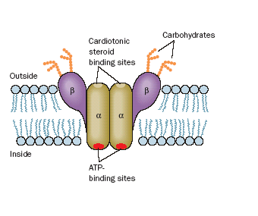
The transporter’s putative dimeric
structure and its orientation in the plasma membrane.
Cardiotonic steroids bind to the external surface of the transporter, thereby inhibiting transport.

Slide 6
The (Na-K) –ATPase is often called the (Na-K) pump because it pumps Na⁺ out of and K⁺ into the cell with the concomitant hydrolysis of intracellular ATP.
The overall stoichiometry of the reaction is:
3 Na⁺(in) + 2 K⁺(out) + ATP+ H₂O
3 Na⁺(out) + 2 K⁺(in) + ADP + P_{i}
The (Na–K)–ATPase is an antiporter that generates
a charge separation across the membrane.
The extrusion of Na⁺ enables animal cells to control their water content osmotically; without functioning (Na-K)–ATPases to maintain a low internal [Na]_{i}, water would osmotically rush in to such an extent that animal cells, which lack cell walls, would swell and burst.
The electrochemical gradient generated by (Na-K)–ATPase is also responsible for the electrical excitability of nerve cells.

Slide 7
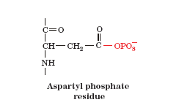
The key to the (Na–K)–ATPase is the phosphorylation of a specific Asp residue of the transport protein.
ATP phosphorylates the transporter only in the presence of Na, whereas the resulting aspartyl phosphate residue is subjected to hydrolysis only in the presence of K.
This suggests that the (Na–K)–ATPase has two conformational states (called E₁ and E₂) with different structures, different catalytic activities, and different ligand specificities.

Slide 8
The protein appears to operate in the following manner:
The transporter in the E₁ state binds 3Na⁺ inside the cell and then binds ATP to yield an E₁-ATP-3 Na⁺ complex.
ATP hydrolysis produces ADP and a “high-energy” aspartyl phosphate intermediate E₁~P-3 Na⁺ (~ indicates a “high-energy” bond).
This “high-energy” intermediate relaxes to its “low-energy” conformation, E₂-P-3 Na⁺, and releases its bound Na⁺ outside the cell.
E₂-P binds 2K⁺ ions from outside the cell to form an E₂-P - 2 K⁺ complex.
The phosphate group is hydrolyzed, yielding E₂ -2 K⁺.
E₂-2 K⁺ changes conformation, releases its two K⁺ ions inside the cell, and replaces them with three Na⁺ ions, thereby completing the transport cycle.

Slide 9
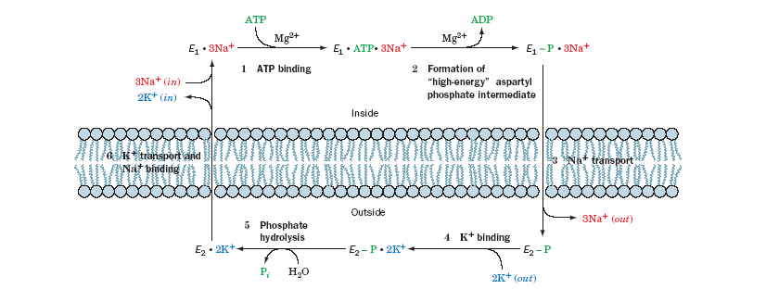

Slide 10
Cardiac glycosides - natural products that increase the intensity of heart muscle contraction.
Digitalis - an extract of purple foxglove leaves, contains a mixture of cardiac glycosides including digitoxin (long used to treat congestive heart failure).
Ouabain - a product of the East African ouabio tree (long used as an arrow poison).
These two steroids, which are still among the most commonly prescribed cardiac drugs, inhibit the (Na–K)– ATPase by binding strongly to an externally exposed portion of the protein so as to block Step 5.
The resultant increase in intracellular [Na⁺]_{i} stimulates the cardiac (Na⁺–Ca²⁺) antiport system, which pumps Na out of and Ca²⁺ into the cell, ultimately boosting the [Ca²⁺] in the sarcoplasmic reticulum.

Slide 11
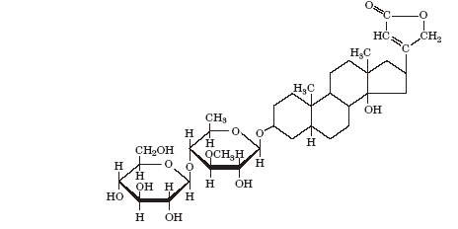
The release of Ca²⁺ to trigger muscle contraction produces a larger than normal increase in cytosolic [Ca²⁺]_{i},
thereby intensifying the force of cardiac muscle contraction.
Ouabain, which was once thought to be produced only by plants, has recently been discovered to be an animal hormone that is secreted by the adrenal cortex and functions to regulate cellular [Na]_{i} and overall body salt and water balance.
Digitoxin (digitalin)

Slide 12
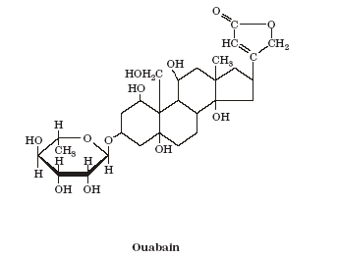

Slide 13
Ca²⁺–ATPase
Transient increases in cytosolic Ca²⁺ trigger numerous cellular responses: muscle contraction, release of neurotransmitters, glycogen breakdown, oxidative metabolism activation.
The [Ca²⁺]_{i} in the cytosol (0.1 μM) is four orders of magnitude less than it is in the extracellular spaces (1500 μM); Ca_{i}²⁺ might otherwise combine with phosphate to form Ca₃(PO₄)₂, which has a maximum solubility of only 65μM.
The large concentration gradient is maintained by the active transport of Ca²⁺ across the plasma membrane and the endoplasmic reticulum (the sarcoplasmic reticulum in muscle) by a Ca²⁺ pump.

Slide 14
Ca²⁺– ATPase actively pumps 2Ca²⁺ ions out of the cytosol at the expense of ATP hydrolysis, while countertransporting two or three protons. The mechanism resembles that of the (Na–K)–ATPase.
Two Ca²⁺ ions bind within a bundle of 10 trans-membrane helices. Three additional domains form a large structure on the cytoplasmic side of the membrane. The differences between the Ca²⁺-bound (E₁) and the Ca²⁺-free (E₂) structures indicate that the transporter undergoes extensive rearrangements during the reaction cycle.
These changes apparently mediate communication between the Ca²⁺ binding sites and the 80-Å-distant site where bound ATP is hydrolyzed.

Slide 15
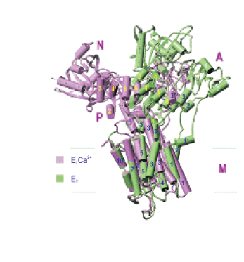
X-Ray structures of the Ca²⁺-free (E₂ ) and
Ca²⁺-bound (E₁)
Ca²⁺–ATPase.
These proteins, which are superimposed on their transmembrane domains, are viewed from within the membrane with the cytosolic side up. Ten transmembrane helices form the M (for membrane) domain, ATP binds to the N (for nucleotide-binding) domain, the Asp residue
that is phosphorylated during the reaction cycle is located on the P (for phosphorylation) domain, and the A (for actuator) domain participates in the transmission of major conformational changes. A dashed line highlights the orientation of a helix in the N domain in the two conformations and the horizontal lines delineate the membrane.

Slide 16
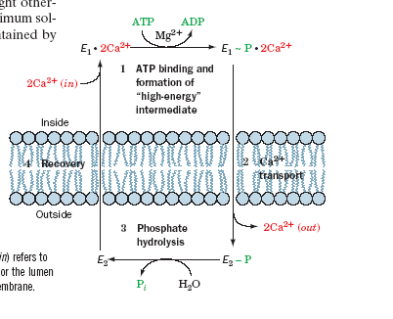

Slide 17
Ion Gradient–Driven Active Transport
Systems such as the (Na–K)–ATPase generates electrochemical gradients across membranes. The free energy stored in an electrochemical gradient can be harnessed to power various endergonic physiological processes.
For example, cells of the intestinal epithelium take up dietary glucose by Na-dependent symport. The immediate energy source for this “uphill” transport process is the Na gradient.
This process is an example of secondary active transport because the Na gradient in these cells is maintained by the (Na–K)–ATPase. The Na–glucose transport system concentrates glucose inside the cell. Glucose is then transported into the capillaries through a passive-mediated glucose uniport (which resembles GLUT1).

Slide 18
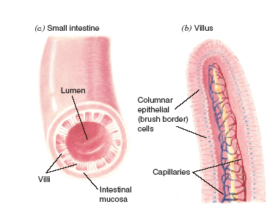
Since glucose enhances Na resorption, which in turn enhances water resorption, glucose, in addition to salt and water, should be fed to individuals suffering from salt and water losses due to diarrhea.
The brushlike villi lining the small intestine greatly
increase its surface area (a), thereby facilitating the absorption of nutrients.
The brush border cells from which the villi are formed (b) concentrate glucose from the intestinal lumen in symport with Na (c),
Fig. Glucose transport in the intestinal epithelium.

Slide 19
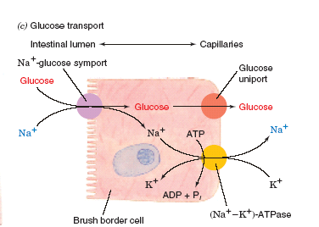
The process is driven by the (Na–K)–ATPase, which is located on the capillary side of the cell and functions to maintain a low internal [Na]_{i}. The glucose is exported to the bloodstream via a separate passive-mediated uniport system similar to GLUT1.

Slide 20
Lactose Permease Requires a Proton Gradient
Gram-negative bacteria such as E. coli contain several active transport systems for concentrating sugars. One extensively studied system, lactose permease (a.k.a galactoside permease), utilizes the proton gradient across the bacterial cell membrane to cotransport H⁺ and lactose.
The proton gradient is metabolically generated through oxidative metabolism in a manner similar to that in mitochondria. The electrochemical potential gradient created by both these systems is used mainly to drive the synthesis of ATP.

Slide 21
As does (Na–K)–ATPase, lactose permease has two major conformational states (Fig.):
1. E-1, which has a low-affinity lactose-binding site facing the interior of the cell.
2. E-2, which has a high-affinity lactose-binding site facing the exterior of the cell.
Ronald Kaback established that E-1 and E-2 can interconvert only when their H ⁺ and lactose binding sites are either both filled or both empty.This prevents dissipation of the H gradient without cotransport of lactose into the cell. It also prevents transport of lactose out of the cell since this would require cotransport of H against its concentration gradient.

Slide 22
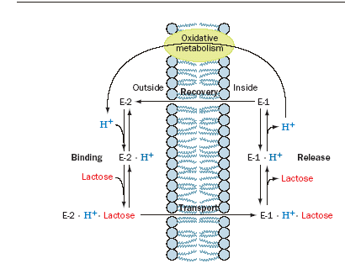
Scheme for the cotransport of H and lactose by lactose permease in E. coli.
H ⁺ binds first to E-2 outside the cell, followed by lactose. They are sequentially released from E-1 inside the cell. E-2 must bind to lactose and H ⁺ in order to change conformation to E-1, thereby cotransporting these substances into the cell. E-1 changes conformation to E-2 when neither lactose nor H ⁺ is bound, thus completing the transport cycle.

Slide 23
The X-ray structure of lactose permease in complex with a tight-binding lactose analog,
reveals that this protein consists of two structurally similar and twofold symmetrically positioned domains containing six transmembrane helices each.
A large internal hydrophilic cavity is open to the cytoplasmic side of the membrane so that the structure represents the E-1 state of the protein.The lactose analog is bound in the cavity at a position that is approximately equidistant from both sides of the membrane, consistent with the model that the lactose binding site is alternately accessible from each side of the membrane.

Slide 24
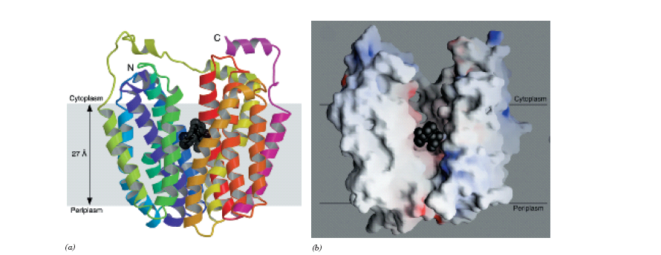
X-Ray structure of lactose permease from E. coli. (a) Ribbon diagram as viewed from the membrane with the cytoplasmic side up. The protein’s 12 transmembrane helices are colored in rainbow order with the N-terminus purple and the C-terminus pink. The bound lactose analog is represented by black spheres. (b) Surface model with the two helices closest to the viewer in Part a removed to reveal the lactosebinding cavity. The surface is colored according to its electrostatic potential with positively charged areas blue, negatively charged areas red, and neutral areas white.

