Slide 1

BIOELECTRICAL POTENTIALS
MEDICAL UNIVERSITY – PLEVEN
FACULTY OF PHARMACY
DIVISION OF PHYSICS AND BIOPHYSICS, higher
mathematics and information technologies
LECTURE No12
Diffusion potential. The Henderson equation. Time dependence of diffusion potential. Membrane (equilibrium) potential. The Nernst equation. Donnan potential. The Gibbs-Donnan equilibrium. Osmotic consequences of the Gibbs-Donnan equilibrium
Prof. M. Alexandrova, DSc

Slide 2
1. Diffusion potential

Slide 3
2. Membrane or equilibrium potential. The Nernst Equation

Slide 4
3. Donnan potential and equilibrium
A. Effect of selectively permeable and impermeable ions.
The cytoplasm has numerous ionized compounds to which the plasma membrane is essentially completely impermeable.
A typical cell is permeable to multiple ions (e.g., K⁺, Na⁺, Cl⁻). The Nernst potential for each ion in a cell can be computed individually.
However, the membrane potential of the cell is due to the presence of all the ions. As a model of this state of affairs, consider the model in which the membrane is permeable to K⁺, Cl⁻ and water, but completely impermeable to X⁻.

Slide 5
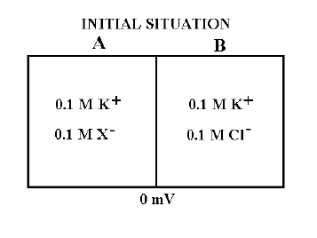
B. Effect of the electroneutrality principle. There will initially be a flow of Cl⁻ from B to A. This will create a potential difference with side A negative, that will cause K⁺ to also flow from B to A.
To preserve electroneutrality (almost) the same number of K⁺ as Cl⁻ ions must flow from B to A.
C. Approach to electrical and chemical equilibrium. Given enough time those ions that are permeable will approach electrochemical equilibrium.
That is to say dμ_{K} = 0 and dμ_{Cl} = 0

Slide 6
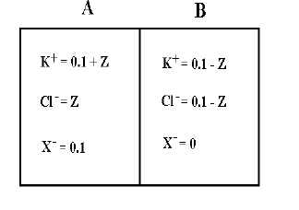
This is known as
the Donnan equilibrium.
Example of the Gibbs-Donnan Equilibrium,
If those are the initial concentrations of K⁺, Cl⁻ and X⁻, what are the final concentrations? If we suppose that the chambers
are of equal volume and that the concentration of Cl⁻ in B is diminished by Z due to flow of Cl⁻.

Slide 7
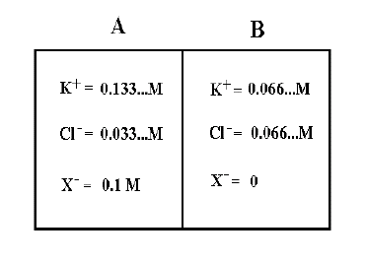
The concentration of K⁺ in B must be similarly decreased, so that the final concentrations of both K⁺ and Cl⁻ in B are 0.1-Z. This will give a Cl- concentration on side A of Z and a K⁺ concentration on side A of 0.1+Z.
Putting these concentrations into the Donnan Relation gives:
(0.1 + Z)(Z) =
(0.1 - Z) (0.1 - Z)
Solving for Z gives Z = 0.0333. This gives the final concentrations of K⁺, Cl⁻ and X- shown to the right.

Slide 8
Electrical consequences of the Gibbs-Donnan equilibrium.
Because K⁺ is twice as concentrated on side A as side B and Cl⁻ is two times more concentrated on B than A, if these two ions are to be in electrochemical equilibrium, there must be an electrical potential difference between A and B to balance the concentration forces. Using the Nernst Equation and taking log 2 = 0.3, we find that ϕ_{A}-ϕ_{A}=-18 mV will allow both K⁺ and Cl⁻ to be in equilibrium.
Osmotic consequences of the Gibbs-Donnan equilibrium.
Note that the sum of [K⁺] + [Cl⁻] on side A is greater than that on side B. In addition, there is X⁻ on side A and not on side B. Both of these factors result in there being a greater osmotic pressure on side A than on B. If water is not restrained it will flow from B to A.

Slide 9
How cells cope with the osmotic consequences of the Gibbs- Donnan Equilibrium?
Plant cells have a rigid cell wall that allows them to build up a high intracellular hydrostatic pressure.
Animal cells do not have cell walls and cope by pumping some ions out of the cytoplasm. Na⁺ is the principal ion pumped out, so that the Na⁺,K⁺- ATPase plays an important role in regulation of cell volume.

