Slide 1
A C T I O N P O T E N T I A L
MEDICAL UNIVERSITY – PLEVEN
FACULTY OF PHARMACY
DIVISION OF PHYSICS AND BIOPHYSICS, higher
mathematics and information technologies
LECTURE No14
Generation of action potential. Voltage-gated channels. Saltatory conduction
Prof. M. Alexandrova, DSc

Slide 2
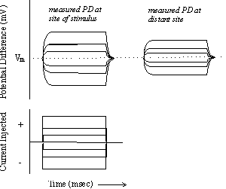
Let us manipulate the electrical PD of a cell by injecting current into the cell by means of a small, hollow glass electrode.
The propagation of this activity is said to be “decremental" (i.e., it is diminishing in magnitude).

Slide 3
Such changes in membrane potential, seen in all cell types receiving appropriate stimuli, have several names. They are called "slow waves" or "graded potentials", and are said to spread by "electronic conduction".
They share the following diagnostic characteristics:
1. They are propagated decrementally (they get smaller as they spread from the site of stimulation);
2. They can be depolarizing or hyperpolarizing;
3. They can be summed.

Slide 4
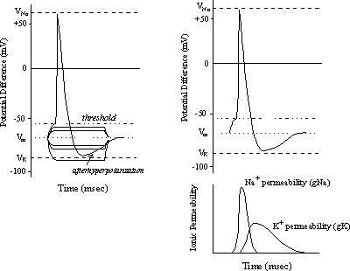
Let's repeat this experiment in an excitable cell.
When the potential reaches a particular level of depolarization, there is a rapid further depolarization during which the potential reaches and passes through zero and achieves a positive potential of +57 mV!
The potential then rapidly falls back through zero, repolarizes to a level more negative than the original resting potential, before slowly returning to the original resting level of -84 mV.

Slide 5
Thus, action potential was initiated when the PD reached a certain level referred to as the membrane threshold potential and the stimulus that moves the PD to this level is called a threshold stimulus.
At this potential, a population of voltage-gated Na channels began to open, thereby increasing the P_{Na} (g_{Na}) of the membrane. Inspection of the Goldman equation tells us what will happen if we increase P_{Na} while keeping everything else constant: the membrane will depolarize.
This depolarization, in turn, serves to activate more of the voltage-gated Na channels, leading to a further depolarization of the membrane.

Slide 6
The result is an explosive, positive feedback recruitment of Na-channels that leads to a massive increase in P_{Na,}
a process referred to as the Hodgkin-cycle.
In the squid giant axon, for example, the increase in P_{Na} is 4000-fold. If we plug this new P_{Na} into the Goldman equation, keeping everything else constant, we can calculate that the PD should shift from -84 to +57 mV, simply by changing the permeability of the membrane to Na⁺ and allowing a very, very small amount of Na⁺ to enter the cell!
The rapid repolarization of the membrane arises from two phenomena:
1. Inactivation of Na channels
2. Increase in P_{K} (g_{K})

Slide 7
Once opened Na-channels close spontaneously regardless of whether or not the original stimulus is active.
There is a population of voltage-gated K-channels in the membrane which like Na-channels, is activated by depolarization of the membrane, although it requires a greater degree of depolarization than do Na-channels.
The kinetics of activation of the K-channels is such that they take longer to open than do the Na-channels.
After the rapid closing of the Na-channels, the membrane permeability is dominated, once again, by K, so the membrane potential is brought back toward the resting PD.

Slide 8
The new voltage-activated K conductance which exists in addition to the background K-conductance from the non-gated K channels, results in an overall P_{K} that exceeds the resting condition.
Consequently, the membrane potential drops below the resting level and moves even closer to the Nernstian K equilibrium potential.
Following repolarization, the voltage-gated K channels close, so the P_{K} moves back to the resting level, as does the PD.
Transient hyperpolarization summed activity of voltage-gated and non-gated K channels afterhyperpolarization

Slide 9
In light of the mechanistic basis of the falling phase of the action potential, two reasons for prolonging it are apparent:
1. Retarding the inactivation of Na-channels that is the basis for several scorpion toxins;
2. Blocking the voltage-gated K channels; that is the basis for some sea anemone toxins.
Graded potentials can be summed. However, once an action potential has been initiated, addition of a second stimulus has no additive effect on the action potential.
Thus, the action potential is said to be
an all-or-nothing event.

Slide 10
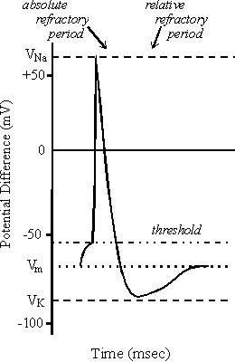
Refractoriness and Inactivation
Following the spontaneous inactivation of the Na-channels there follows a period of time during which a second action potential cannot be elicited no matter how large a stimulus is applied – this is the absolute refractory period.
There then follows a period of time during which it is possible to elicit an action potential but it requires a larger than normal stimulus – this is the relative refractory period.

Slide 11
The mechanistic basis of these phenomena involves the voltage-dependence of the inactive states of Na channels. Following the spontaneous closure of the Na-channels, the membrane must be repolarized before the channels can be prompted to open.
The period of time when all the Na channels are in this completely inactive state defines the absolute refractory period. Once the membrane has been repolarized past a certain point (specific for each cell type/channel type), Na channels begin to shift into a second inactive state, i.e. one that can be stimulated by subsequent depolarization.

Slide 12
Because all the channels do not shift to this state at once (there is inherent variability between the activity of Na channels), there exists a period of time when some channels are available and some are not. During this period, it takes a larger than normal stimulus to recruit the necessary number of channels to fire an action potential from the reduced pool of available channels; this is the relative refractory period.
The activity of the voltage gated K channels also supports and extends the period of relative refractoriness. As long as some of these channels are open it will take a larger than normal stimulus to depolarize the membrane to threshold. It is only when all the Na channels have reset, and all the voltage gated K channels have closed and a normal threshold stimulus is adequate to elicit a new action potential.

Slide 13
Consider a case involving local ischemia in the brain or heart where cells are tightly packed together and extracellular space is a small fraction of intracellular space.
Intracellular ATP is quickly (a few seconds) depleted resulting in inhibition of the (Na-K) ATPase. The ion gradients immediately begin to collapse; Na enters and K leaves the cell. The [K]_{out} can quickly rise to 6- 7 mM. Furthermore, that quick rise in [K]_{out} can occur before there has been much change in [K]_{in} simply because the extracellular space is rather small compared to cytoplasm in some tissues.

Slide 14
On absolute terms, the change in [K]_{in} is not great but the ratio of [K]_{in} to [K]_{out} is markedly affected.
If K inside changes from 140 to 138 mM, and outside changes from 4 to 7 mM, the Nernstian K potential shifts from -93 to -78 mV.
Such a gradual shift of "resting" potential can have a profound effect on the inactivation status of Na channels, thereby influencing the ability of these cells to fire action potentials. This turns out to be a serious issue in cardiac tissues following ischemic events (e.g., myocardial infarction).

Slide 15
Nerves Transmit Information as Action Potentials
Action potential is a temporary change in the membrane potential that is transmitted along the axon.
Travels in one direction normally. (Axon can potentially conduct in both directions, but connections usually prevent this).
Membrane potential depolarizes (becomes more positive) producing a spike. After that the membrane repolarizes (becomes more negative).
The potential becomes more negative than the resting potential (negative afterpotential) and then returns to normal.
The action potentials of most nerves last 5-10 ms (action potentials of cardiac muscle are much longer).The conduction velocity of action potentials is about 1-100 m/s.

Slide 16
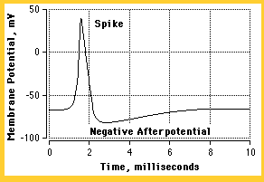

Slide 17
Action Potentials are Initiated
by Many Different Types of Stimuli
Sensory nerves respond to stimuli of many types: chemical, light, electricity, pressure, touch, stretch, etc.
In the central nervous system (brain&spinal cord) most nerves are stimulated by chemical activity at synapses.
Stimuli Must be Above a Threshold Level
to Set off an Action Potential
Very weak stimuli cause only a small local electrical disturbance.
When the stimulus strength is increased to reach the threshold level an action potential appears.

Slide 18
The Spike of the Action Potential is Caused by Opening of Na Channels
The (Na-K) pump produces gradients of Na and K ions - both are used to produce action potential;
Na is high outside the cell and low inside;
Excitable cells have special Na and K channels with gates that open and close in response to the membrane voltage (voltage-gated channels);
Opening gates of Na channels allows Na to rush into the cell, carrying + charge. This makes the membrane potential positive (depolarization), producing the spike.

Slide 20
The Membrane Recovers by Closing
Na Channels and Opening K Channels
The Na spike does not last long.
Two things bring the voltage back to negative values (repolarization): 1. Na channels close. They have a second slow gate that closes when the voltage becomes positive. 2. Potassium channels open when the voltage becomes positive.
K channels are slower than Na channels, so Na has the initial advantage, but later K brings things back to normal. Because K permeability is higher than in the resting state the membrane has a negative afterpotential.

Slide 21
The Action Potential is Conducted
in an All-or-None Manner
If you take a piece of string and soak it in a salt solution it will conduct electricity. If you apply an electrical stimulus at one end, the magnitude of the impulse falls as it travels along the string.
A simple string would not be very good for long distance conduction of an electrical impulse.
If you apply a stimulus to a nerve the action potential stays the same magnitude all along the nerve. This is called the all-or none-law.
Nerves are designed for long distance conduction of electrical impulses.

Slide 22
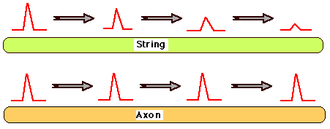

Slide 23
Aspects of the all-or-none law:
If the stimulus is too low there is no action potential.
If the stimulus is above a threshold the action potential is always the same size - it does not get larger for stronger stimuli.
As the action potential travels along the axon it does not die out, but stays the same size. As the action potential travels along it triggers the next section of axon to fire. Like a burning fuse: the heat of the burning section is sufficient to cause the next section of fuse to start burning.

Slide 24
Conduction Velocity is Increased by a Myelin Sheath
Many nerves have an insulating layer called the myelin sheath. Gaps are left every few mm - called Nodes of Ranvier. In a myelinated nerve the impulse jumps from node to node.
Advantage: conduction velocity increases 10 to 100 x
Conduction velocity for ordinary nerve = ~1 m/s. (depends upon diameter)
Conduction velocity for myelinated nerve = ~100 m/s.
Demyelinating diseases cause severe nerve defects.
Autoimmune diseases: immune system attacks nerves.
Multiple sclerosis: demyelination in the central nervous system - delayed or blocked conduction in some nerves.

Slide 25
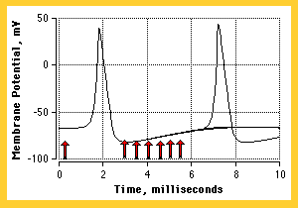
The Nerve Has a Refractory Period
After a nerve has fired there is a refractory period during which it cannot be stimulated - it must recover before it can fire again.
The refractory period controls the rate at which a membrane can fire (long refractory period - slow firing rate).

Slide 26
Review of properties of the action potential
AP is triggered by depolarization
Depolarization must exceed threshold value to trigger AP
AP is all-or-none
AP propagates without decrement
AP involves reversal ("overshoot") of membrane potential
AP is followed by refractory period

Slide 27
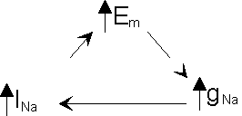
Mechanism of Initiation
Relationship between membrane potential (E_{m}), sodium conductance (g_{Na}), and sodium current (I_{Na}) is one of positive feedback.
AP is triggered by depolarization.

Slide 28
Idea of Voltage-gated conductance
Sodium channels activation: increase in g_{Na} due to depolarization
Increase in conductance reflects a voltage-induced change in the shape of the sodium channel.
Displacement of a highly charged region called the m gate.
The displacement acts as if to open a pore, thus the m gate is said to be opened by depolarization.

Slide 29
Where does the initial depolarization come from?
at initial segment, stimulus is the summed depolarizations produced by post-synaptic potentials
at other segments, stimulus is current sourced by approaching AP
in sensory neurons, depolarization is coupled to the action of a stimulus, such as the stretch of a muscle or the deformation of the skin

Slide 30
If depolarization is too small, no action potential is triggered. Why?
Exiting potassium current exceeds entering sodium current.
recall that depolarization will increase I_{K}
if increase in I_{Na} < increase in I_{K} then E_{m} will return to resting value
At threshold, I_{Na} = -I_{K};
As soon as I_{Na} exceeds I_{K}, positive feedback sets in, and an action potential is initiated.

Slide 31
Mechanism of termination
Na channel "turns itself off“.
Where is E_{m} headed before AP begins to turn itself off?
towards E_{Na}
E_{m} never quite gets there. Why?
Sodium channels inactivation
sodium channel includes an h gate as well as an m gate
h gate closes as a result of depolarization
however, closing of h gate is a slower process than the opening of m gate

Slide 32
thus, g_{Na} increases transiently following a supra-threshold depolarization
evidence that m and h gates are in different parts of channel
proteolytic enzyme disables inactivation (h gate), but only if applied intracellularly
effects of altering gene that codes for channel.

Slide 33
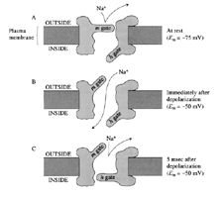
A
outside
Plasma
membrane
m gate
At rest
(Em= -75 mV)
h gate
inside
B
outside
m gate
Immediately after depolarization
(Em= 50 mV)
inside
h gate
C
outside
m gate
outside
5ms after depolarization
(Em= 50 mV)
h gate
inside

Slide 34
Repolarization
What brings E_{m} back to resting value?
K⁺ efflux
in mammalian myelinated axon via "leak"
in squid via voltage-gated channels
n gate opens slowly with depolarization. At peak of action potential, there is an instant when E_{m} is not changing. At this instant, I_{Na} = -I_{K}.
Note that at peak of AP, there is a very large driving force operating on potassium and a much smaller driving force operating on sodium.

Slide 35
Thus, the opening of K channels has a large effect on the membrane potential, pulling it back towards E_{K}. At end of AP, increased g_{k} has not yet dissipated. This contributes to "undershoot" (depends both on g_{K} and g_{Na}).
The (Na-K) pump is not responsible for repolarization. Thousands of APs can be produced in large axon following poisoning of the pump. Pump is responsible for long-term maintenance of concentration gradients, not short-term changes in membrane potential.

Slide 36
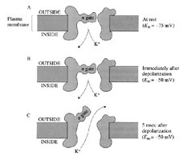
A
outside
Plasma
membrane
n gate
At rest
(E_{m}= -75 mV)
inside
B
outside
n gate
Immediately after depolarization
(E_{m}= 50 mV)
inside
C
outside
n gate
outside
5ms after depolarization
(E_{m}= 50 mV)
inside

Slide 37
During the absolute refractory period, Na⁺ channels are closed. Thus, g_{Na} is too low for I_{Na} to exceed I_{K} at any E_{m} . During the relative refractory period (RRP), some Na⁺ channels are open. Increased g_{K} may contribute as well.

Slide 38
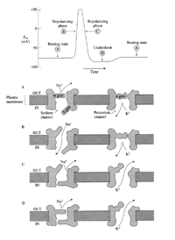
Review state of the Na channel (m and h gates) and K channel (n gate) during the action potential in squid giant axon

