Slide 1

THERMODYNAMICS
MEDICAL UNIVERSITY – PLEVEN
FACULTY OF MEDICINE
DIVISION OF PHYSICS AND BIOPHYSICS
LECTURE No2
SUBJECTS OF THERMODYNAMICS.
BASIC THERMODYNAMIC TERMS
Thermodynamic system, variables, state, thermodynamic equilibrium, conjugate variables, total and partial derivatives
Prof. M. Alexandrova, DSc

Slide 2
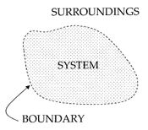
Basic thermodynamic terms
Thermodynamic system
A system is the region of the universe under study.
A system is separated from the remainder of the universe by a boundary which may be imaginary or not, but which by convention delimits a finite volume and through which
heat or other forms of energy may pass.
Regions outside the boundaries of the system are termed surroundings.

Slide 3
There are three dominant classes of systems:
Isolated System – there is no exchange of either matter or energy in between the system and the surroundings.
Closed System – exchange of energy in between the system and surroundings is possible but matter can neither enter into nor leave the system.
Open System – matter as well as energy can cross the boundary and thus there can be exchange of these with its surroundings.

Slide 4
A system is said to be homogenous when it has same chemical composition throughout, e.g. mixture of gases.
Heterogeneous - a system consisting of two or more different phases which are homogenous in themselves and are separated from one another by definite bounding surfaces, e.g. ice in contact with water.

Slide 5
Thermodynamic variables and thermodynamic state
A system is said to be in a particular state when specific values of the properties of the system called as "variables of state" are known. These variables of state are four in number, namely: Temperature; Pressure; Volume; Composition.
If the values of these four variables of a system are known, all other properties such as mass, viscosity, density etc. are thereby definitely fixed.
Thermodynamic state may be thought of as the instantaneous quantitative description of a system with a set number of variables held constant.

Slide 6
The variables of the system can be further classified as intensive and extensive variables.
An intensive variable is a physical quantity whose value does not depend on the amount of the substance but depends upon the nature of the substance, e.g. T, P, d, η, c, n, etc.
An extensive variable is a physical quantity, whose value is proportional to the size (quantity of matter) of the system it describes. Such a property can be expressed as the sum of the quantities for the separate subsystems that compose the entire system. Dividing one type of extensive quantity by a different type of extensive quantity will in general give an intensive quantity (m/V=ρ).

Slide 7
Changes in a system are often characterized by differentials of its state variables. A differential describes a very small change of a dependent variable (dy), if in a function y=f(x), a small change in the variable (dx) occurs. It can be calculated from the product of the first derivative of the function f(x),multiplied by dx: dy=f’(x)dx.
Most thermodynamic equations are functions with several variables. Hence, the derivatives can be obtained with respect to one variable if the others are kept constant. This procedure is called partial differentiation. It has a special notation with the parameters that are to be kept constant put as subscript to the symbols in parentheses. The following example demonstrates this:

Slide 8
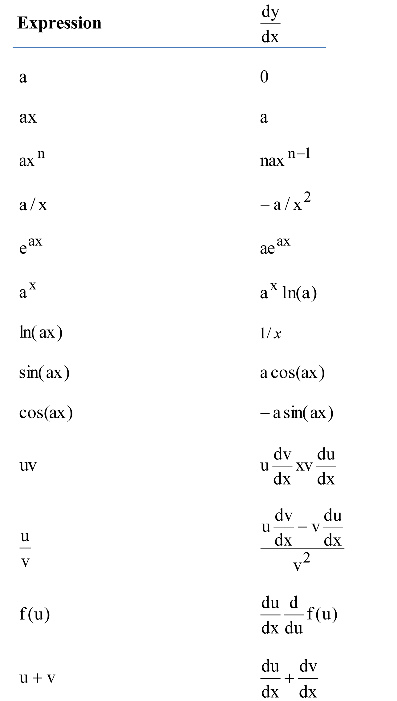

Slide 9
The mathematical definition of the total differential is of great physical importance to thermodynamics. This will be indicated by the following chain of reversible logical deductions:
dG is a total differential
G is a state function
G depends only on the state of the system,
not on the way in which that state was achieved
The central concept of thermodynamics is that of energy, the ability to do work.
It may be transferred into a body by heating, compression, or addition of matter, and extracted from a body either by cooling, expansion, or extraction of matter. For comparison, in mechanics, energy transfer results from a force which causes displacement, the product of the two being the amount of energy transferred.

Slide 10
Similarly thermodynamic systems can be thought of as transferring energy as the result of a generalized force causing a generalized displacement, with the product of the two being the amount of energy transferred.
These thermodynamic force-displacement pairs are known as conjugate variables. The most common conjugate thermodynamic variables are pressure-volume (mechanical parameters), temperature-entropy (thermal parameters), and chemical potential-particle number (material parameters).
Thermodynamic equilibrium
For isolated systems, as time goes by, internal differences in the system tend to even out; P and T tend to equalize, as do density differences.

Slide 11
A system in which all equalizing processes have gone practically to completion, is considered to be in a state of thermodynamic equilibrium. The system can be in:
a) Thermal equilibrium - Its temperature should not change with time.
b) Chemical equilibrium - Its chemical composition should not change with time.
c) Mechanical equilibrium - There should not be any movement of particles of the constituents of the system in itself and in between itself and surroundings.
Systems in equilibrium are much simpler and easier to understand than systems which are not in equilibrium.

Slide 12
Thermodynamic process
A thermodynamic process may be defined as the energetic evolution of a thermodynamic system proceeding from an initial state to a final state.
An isobaric process occurs at constant P.
An isochoric process occurs at constant V.
An isothermal process occurs at a constant T.
An isentropic process occurs at a constant S.
An isenthalpic process occurs at a constant H.
An adiabatic process occurs without loss or gain of Q .
Often, when analyzing a thermodynamic process, it can be assumed that each intermediate state in the process is at equilibrium. This will considerably simplify the situation. Thermodynamic processes which develop so slowly as to allow each intermediate step to be an equilibrium state are said to be reversible processes.

Slide 13
Thermodynamic considerations of biological processes require an extension of the classical thermodynamics of equilibrium towards the direction of thermodynamics of irreversible processes .
This extension was taken in two steps: 1. Only small deviations away from equilibrium are taken into consideration. In this case, linear relationships between forces and fluxes can be assumed. 2. In contrast to these linear approaches, the thermodynamics of non-linear processes can calculate systems far from equilibrium, where steep gradients of potentials exist. In this case, the so-called dissipative structures appear, which are stationary states with completely new qualities.
It seems important to stress here that although the far-from-equilibrium condition of an organism represents an absolute precondition of life, nevertheless, subsystems in the organism exist, which can be properly calculated using equilibrium thermodynamics or thermodynamics of linear approaches.

