Slide 1

BIOENERGETICS
Energy Transfer in Living Systems
MEDICAL UNIVERSITY – PLEVEN
FACULTY OF PHARMACY
DIVISION OF PHYSICS AND BIOPHYSICS, higher
mathematics and information technologies
LECTURE No8
Energy. Metabolism. Oxidation as a source of metabolic energy. ATP and energy transduction. Oxidative phosphorylation reactions
Prof. M. Alexandrova, DSc

Slide 2
Bioenergetics
Bioenergetics is a term used to describe the science of energy formation, transfer and use within a biological system

Slide 3
Energy
Capacity to perform work.
Two examples:
1. Kinetic energy
2. Potential energy

Slide 4
Kinetic Energy
Energy in the process of doing work.
Energy of motion.
Examples:
1. Heat
2. Light energy
SUN

Slide 5
Potential Energy
Energy that matter occupies because of it’s location, arrangement, or position.
Energy of position.
Examples:
1. Water behind a dam
2. Chemical energy (gas)
GAS

Slide 6
Energy is used to:
1.Synthesize organic molecules;
2. Drive active transport across membranes;
3. Drive endocytosis;
4. Drive muscle contractions and other bodily functions (cell division, growth etc.).

Slide 7
Cellular Metabolism
The total sum of the chemical activities of all cells.
Endergonic and Exergonic reactions
2 Examples:
1. Anabolic Pathways
2. Catabolic Pathways

Slide 8
Metabolism means:
to obtain chemical energy from environment by degradation of energy rich nutrients (animals) or by capturing solar energy (plants)
to convert nutrient molecules into building blocks
to assemble building blocks into macromolecules (protein, nucleic acids, lipids, polysaccharides)
to assemble macromolecules into cells

Slide 9
Stages to catabolism/anabolism
nutrient molecules are hydrolyzed to building blocks;
building blocks are converted to easily oxidized forms---acetyl-CoA being the most important end product of glycolysis;
energy is captured by linking ATP synthesis to electron transport pathway;
new molecules are resynthesized using energy derived from ATP;
cells are constantly breaking down and resynthesizing molecules.

Slide 10
Catabolic Pathway
Metabolic reactions which release energy (exergonic) by breaking down complex molecules in simpler compounds.
Example:
1. Cellular Respiration
C₆H₁₂O₆ + 6O₂ → 6CO₂ + 6H₂O +
energy
ATP
(glucose)

Slide 11
Anabolic Pathway
Metabolic reactions, which consume energy (endergonic), to build complicated molecules from simpler compounds.
Example:
1. Photosynthesis
6CO₂ + 6H₂O → C₆H₁₂O₆ + 6O₂
light
energy
SUN
(glucose)

Slide 12
Exergonic Reactions
Chemical reactions that release energy.
Example:
1. Cellular Respiration
C₆H₁₂O₆ + 6O₂ → 6CO₂ + 6H₂O +
Energy
ATP
(glucose)

Slide 13
Endergonic Reactions
Chemical reaction that requires a net input of energy.
Example:
1. Photosynthesis
6CO₂ + 6H₂O → C₆H₁₂O₆ + 6O₂
Light
Energy
SUN
photons
(glucose)

Slide 14
Question:
What is ATP?

Slide 15
Answer:
adenosine triphosphate (ATP)
Components:
1. adenine: nitrogenous base
2. ribose: five carbon sugar
3. phosphate group
adenine
phosphate group
P
P
P
ribose

Slide 16
Question:
How does ATP work?

Slide 17
Answer:
Works by the direct chemical transfer of a phosphate group.
This is called “phosphorylation”.
The exergonic hydrolysis of ATP is coupled with the endergonic processes by transferring a phosphate group to another molecule.

Slide 18
Hydrolysis of ATP
ATP + H₂O → ADP + P (exergonic)
Adenosine triphosphate (ATP)
P
P
P
Hydrolysis
(add water)
P
P
+
P
Adenosine diphosphate (ADP)

Slide 19
Dehydration of ATP
ADP + P → ATP + H₂O (endergonic)
Adenosine triphosphate (ATP)
P
P
P
Dehydration synthesis
(remove water)
P
P
+
P
Adenosine diphosphate (ADP)

Slide 20
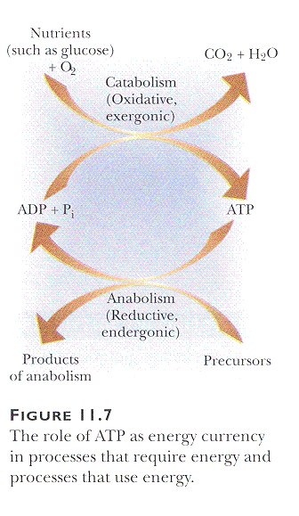

Slide 21
Coupled reactions
Glycerol + HPO₄²⁻ --> (Glycerol-3-Phosphate)²⁻ + H₂O | dGº= +9.2 kJ (nonspontaneous) | (1)
+ ATP⁴⁻ + H₂O -->ADP³⁻ + HPO₄²⁻ + H⁺ | dGº= -30.5 kJ (spontaneous) | (2)
Glycerol + ATP⁴⁻ --> (Glycerol-3-Phosphate)²⁻ +ADP³⁻ + H⁺ | dGº= -21.3 kJ (spontaneous) | (3)

Slide 22
ATP is a useful free-energy currency because the dephosphorylation reaction is very spontaneous; i.e., it releases a large amount of free energy (30.5 kJ/mol).
Thus, the dephosphorylation reaction of ATP to ADP and inorganic phosphate (Equation 2) is often coupled with nonspontaneous reactions (e.g., Equation 1) to drive them forward.
The body's use of ATP as a free-energy currency is a very effective strategy to cause vital nonspontaneous reactions to occur.

Slide 23
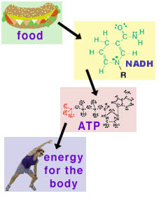
The energy used by the body for its many activities ultimately comes from the chemical energy in our food. The chemical energy in our food is converted to reducing agents (NADH and FADH₂). These reducing agents are then used to make ATP. ATP stores chemical energy, so that it is available to the body in a readily accessible form.

Slide 24
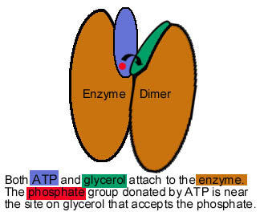
The enzyme glycerol kinase is a dimer (consists of 2 identical subuits).
There is a deep cleft between the subunits where ATP and glycerol bind.
Since ATP and glycerol are physically so close together when they are bound to the enzyme, the phosphate can be transferred directly from ATP to glycerol.
The processes of ATP losing a phosphate (spontaneous) and glycerol gaining a phosphate (nonspontaneous) are coupled together as one spontaneous process.
A schematic representation of ATP and glycerol bound (attached) to glycerol kinase.

Slide 25
Mechanism of coupling the oxidative
phosphorylation reactions
The individual reactions of interest for oxidative phosphorylation are:
phosphorylation | ADP³⁻ + HPO₄²⁻ + H⁺ --> ATP⁴⁻ + H₂O | dGº= +30.5 kJ (nonspontaneous)
oxidation | NADH --> NAD⁺ + H⁺ + 2e⁻ | dGº= -158.2 kJ (spontaneous)
reduction | ¹/₂ O₂ + 2H⁺ + 2e⁻ --> H₂O | dGº= -61.9 kJ (spontaneous)

Slide 26
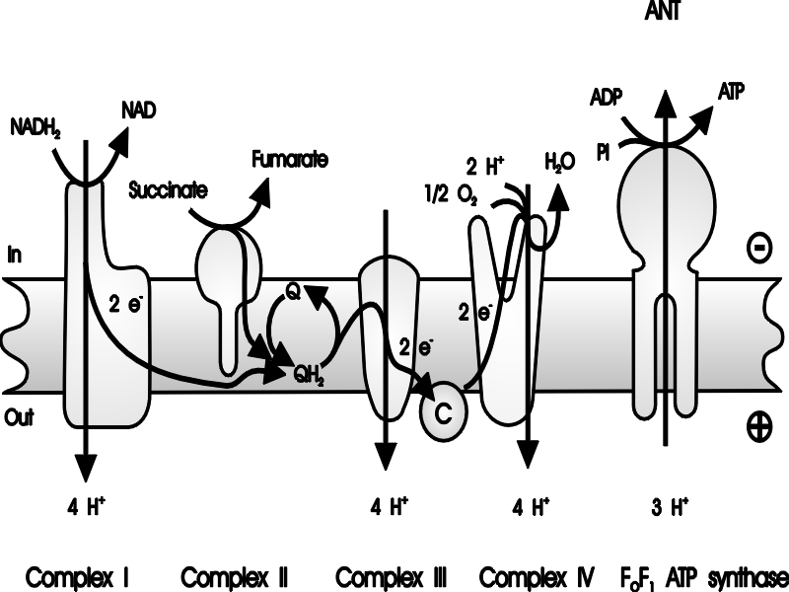
Mechanism of coupling the oxidative phosphorylation reactions
The electron transport chain components involved in oxidative phosphorylation are located within the mitochondrial inner membrane. C, cytochrome c; Q, ubiquinone.

Slide 27
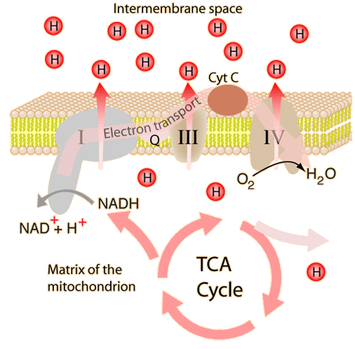
Mechanism of coupling the oxidative phosphorylation reactions
TCA cycle in the context of what is happening in the inner mitochondrial membrane.
It's role can be seen as giving energy to the reduced coenzyme NADH which then powers the electron transport process in the membrane. The energy is used by the protein complexes to produce a proton gradient which in turn powers ATP synthase in its role of producing the needed ATP.

Slide 28
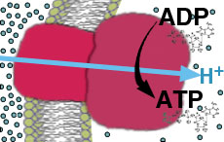
a. Electron transport (oxidation-reduction reactions) through a series of proteins in the inner membrane of mitochondria
Basic steps
b. Generation of H+ (proton) concentration gradient across the inner mitochondrial membrane during the electron-transport process (via a proton pump) (which occurs simultaneously with step a.
c. Synthesis of ATP using free energy released from spontaneous diffusion of H⁺ back to the matrix inside the inner mitochondrial membrane

Slide 29
Summary
In this lecture, we have learned that the ability of the body to perform daily activities is dependent on thermodynamic concepts. These activities, which are typically based on nonspontaneous chemical reactions, are performed by using free-energy currency. The common free-energy currency is ATP, which is a molecule that easily dephosphorylates (loses a phosphate group) and releases a large amount of free energy. In the body, the nonspontaneous reactions are coupled to this very spontaneous dephosphorylation reaction, thereby making the overall reaction spontaneous. As the coupled reactions occur (i.e., as the body performs daily activities), ATP is consumed and the body regenerates ATP by using energy from the food we eat.

Slide 30
The breakdown of glucose (glycolysis) obtained from the food we eat cannot by itself generate the large amount of ATP that is needed for metabolic energy by the body. However, glycolysis and the subsequent step, the citric-acid cycle, produce two easily oxidized molecules: NADH and FADH₂. These redox molecules are used in an oxidative-phosphorylation process to produce the majority of the ATP that the body uses. This oxidative-phosphorylation process consists of two steps: the oxidation of NADH (or FADH₂) and the phosphorylation reaction which regenerates ATP.

Slide 31
Oxidative phosphorylation occurs in the mitochondria, and the two reactions (oxidation of NADH or FADH₂ and phosphorylation to generate ATP) are coupled by a proton gradient across the inner membrane of the mitochondria . The oxidation of NADH occurs by electron transport through a series of protein complexes located in the inner membrane of the mitochondria. This electron transport is very spontaneous and creates the proton gradient that is necessary to then drive the phosphorylation reaction that generates ATP.
Hence, oxidative phosphorylation demonstrates that free energy can be easily transferred by proton gradients. Oxidative-phosphorylation is the primary means of generating free-energy currency for aerobic organisms, and as such is one of the most important subjects in the study of bioenergetics (the study of energy and its chemical changes in the biological world).

