Slide 1
CRUSH SYNDROME
Лектор: доц. д-р В. Данчева, дм

Slide 2
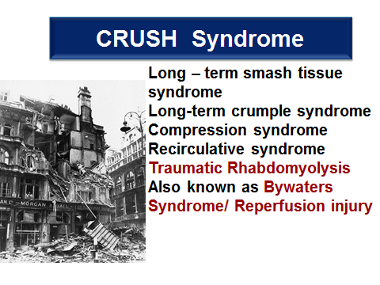

Slide 3
Rhabdomyolysis - destruction of striated muscle. Breakdown of muscle fibers, specifically of the sarcolemma of skeletal muscle, resulting in release of myoglobin.
A crush syndrome is the systemic manifestation of muscle cell damage, resulting from pressure or crushing.

Slide 4
Crush Syndrome
  Crush syndrome is the clinical condition caused by compression of muscle with subsequent rhabdomyolysis which can then cause the complications of electrolyte disturbances, fluid sequestration, and myoglobinuria.
  Crush syndrome is a reperfusion injury as a
  result of traumatic rhabdomyolysis!

Slide 5
Causes (Muscle Breakdown)
RHABDOMYOLYSIS
Traumatic/Compression
Nontraumatic
Multiple Trauma
Crush Injury
Surgery
Coma
Immobilization
Exertional
Nonexertional
-Exertion
-Heat illness
-Seizures
-Metabolic myopathies
-Malignant hyperthermia
-Drugs
-Infection
-Electrolytes
Notes:
There are several causes of rhabdomyolysis attributable to muscle breakdown. These can be broken down into traumatic and nontraumatic causes. Nontraumatic causes can be further broken down into exertional and nonexertional causes.

Slide 6
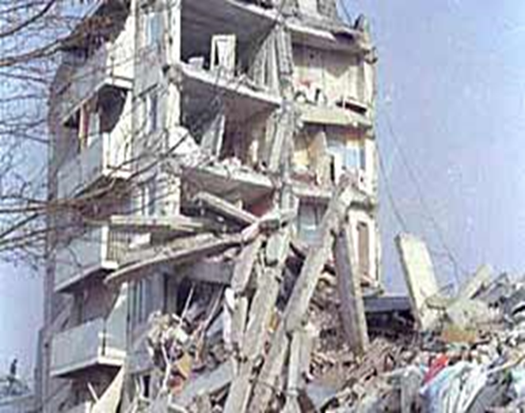
Based on 3 criteria
Any injury that has:
Involvement of Muscle Mass
Prolonged Compression
usually 4-6 hours
3. Compromised
local circulation

Slide 7


Epidemiology
Earthquakes
Bombings
Structural Collapse
Trench Collapse

Slide 8
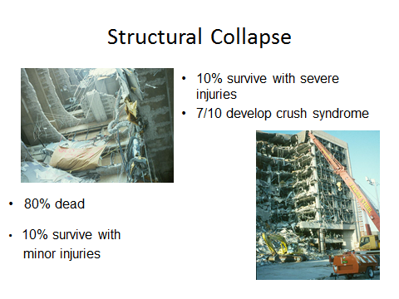

Slide 9
PATHOGENESIS
CRUSHING INJURY
ISCHAEMIC DAMAGE TO MUSCLES
RELEASE OF TOXIC METABOLITES

Slide 10
Severity of syndrome is relative to muscle mass involved (requires 4-6 h of compression)
Limb compression
Myoglobinemia
ARF
Local Pressure
Local Tamponade
Muscle necrosis
Capillary necrosis
Edema
SHOCK
Acidosis & Hyperkalemia
Muscle Ischemia
Muscle Infarction
Extracellular Fluid Shifts
Cardiac
Arrhythmia

Slide 11
Mechanisms of muscle cell injury:
  ♦ Immediate cell disruption
  ♦ Direct pressure on muscle cells
  ♦ Vascular Compromise (4 hours)
    Microvascular pressure
    Edema and/or Compartment Syndrome
    Bleeding
    Crushed +/- ischemic muscle
    ♦ Deficiency in ATP
    ♦ Failure of Na/K ATPase
    ♦ Sarcolemma Leakage (Influx of Ca)
    ♦ Lysis of muscle cell membrane
    ♦ Leaks K, Ca, CK, myoglobin
Hypovolemia
Fluid Sequestration
Increased osmoles in EC space

Slide 12
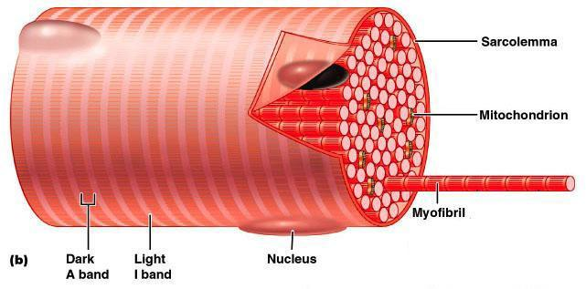
Pathogenesis
♠ Compressive forces leads to cellular hypoperfusion and hypoxia
♠ Decrease in ATPase → failure of ATPase pump and sarcolemma leakage
♠ Lysed cells release inflammatory mediators
♠ Platelet aggregation
♠ Vasoconstriction
♠ vascular
permeability

Slide 13
Not usually directly due to ischemia.
Main cause is stretch of the muscle sarcolemma.
Sarcolemma permeability increases.
Influx of sodium, water, and extracellular calcium into the sarcoplasm
Results in cellular swelling, increased intracellular calcium, disrupted cellular function and respiration, decreased ATP production, and subsequent myocytic death.
Muscle swelling can then cause early or even days delayed compartment syndrome.

Slide 14
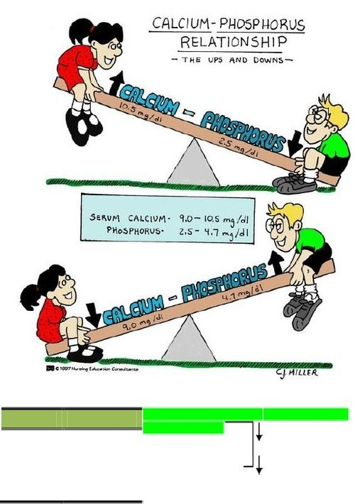
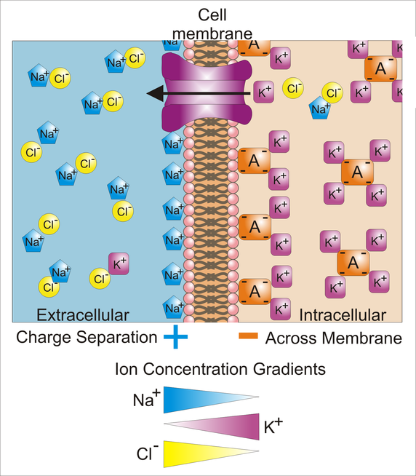
Lysed cells release
Potassium
Phospate
Creatine kinase
Myoglobin
Electrolyte disturbances
Hyperkalaemia
Hypocalcaemia
Hyperphosphatemia
Hyperuricaemia
Metabolic acidosis

Slide 15
Revascularization
Fluids trapped in damaged tissue
Oedema of affected limb
Haemoconcentration and shock
Myoglobin, potassium, phosphate enter venous circulation

Slide 16
Products of Muscle Breakdown
Amino acids and other organic acids
  Acidosis
  Aciduria
  Dysrhythmias
Creatine phosphokinase
  laboratory marker for crush injury
Free radicals, superoxides, peroxides
  further tissue damage

Slide 17
Products of Muscle Breakdown
Histamines:
  Vasodilation
  Bronchoconstriction
Lactic acid
  acidosis
  Dysrhythmias
Leukotrienes
  lung injury
  hepatic injury.
Lysozymes
  cell-digesting enzymes that cause further cellular injury
Myoglobin
  precipitates in kidney tubules, especially in the setting of acidosis with low urine pH; leads to renal failure
Nitric oxide
  causes vasodilation which worsens hemodynamic shock

Slide 18
Products of Muscle Breakdown
Phosphate
  hyperphosphatemia causes precipitation of serum calcium
  Hypocalcemic dysrhythmias
Potassium
  Dysrhythmias
  Worsened when associated with acidosis and hypocalcemia.
Prostaglandins
  Vasodilatation
  lung injury
Purines (uric acid)
  Nephrotoxic
Thromboplastin
  disseminated intravascular coagulation (DIC)

Slide 19


Metabolic Disorders from Crush Syndrome
Hypovolemia (fluid sequestration in damaged muscle)
Hyperkalemia
Hypocalcemia (due to calcium deposition in muscle)
Hyperphosphatemia
Metabolic acidosis
Myoglobinemia / myoglobinuria

Slide 20

Systemic Sequelae of Crush Injury
Result from death of muscle cells and leak of intracellular metabolites into the systemic circulation ("reperfusion injury“).
Superoxide anions (free radicals) then cause further membrane injury.
May not manifest until just after entrapped part of body is extricated

Slide 21
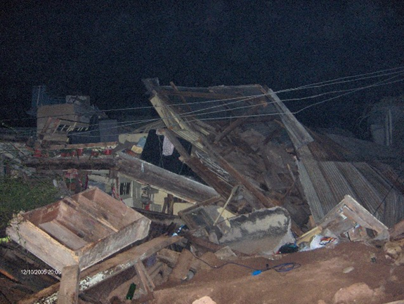
Cell Death
Platelet Aggregation
Vasoconstriction
Hemorrhage
Increased Vascular Permeability
Edema
Hypoxia

Slide 22
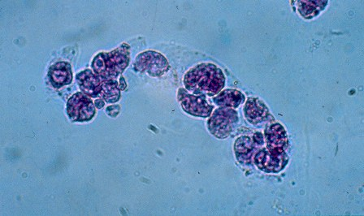
Mechanisms of Acute Renal Failure (ARF) in Crush syndrome
♦ Renal vasoconstriction with diminished renal perfusion
♦ Cast formation leads to tubular obstruction
♦ Direct Myoglobin nephrotoxicity
▪ Haem - produced free radicals
Tubular epithelial cell cast

Slide 23
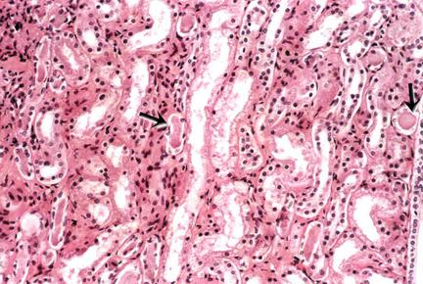
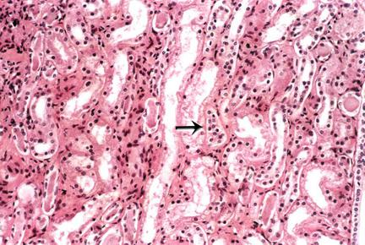
Acute tubular necrosis. Intratubular cast formation.
Formation of granular casts, a feature of acute tubular necrosis

Slide 24

Renal Toxicity of Myoglobin
Crush syndrome studies showed acid urine is required for myoglobin to cause renal injury.
At pH < 5.6, myoglobin dissociates into its 2 components :
  Globin (shown nontoxic if infused)
  Ferrihemate (probably the toxic component)
  Myoglobin can precipitate (particularly with hypovolemia and acidosis) and directly obstruct renal tubular flow.
  Myoglobin is also directly toxic to the renal tubular cells.

Slide 25
Clinical Signs and Symptoms
Range from asymptomatic to acute renal failure and DIC
Triad : muscle pain, weakness, dark urine !!!
Musculoskeletal signs: pain (incl. joint pain), weakness, swelling
General manifestations:
Malaise
Fever
Tachycardia
Nausea
Vomiting
Seizures

Slide 26
There are three periods of long-term smash tissue syndrome
Early – shock manifestation (till day 3rd after trauma);
Intermediate - acute renal failure;
Late (convalescence) – 2nd week – 1-2 months after crushing injury.

Slide 27

After shock an intermediate or light period can be observed. The patient’s condition is getting better. There is no pain, normalization of a pulse and blood pressure. Body temperature is 37,6 - 38,5°C. An oliguria appears. It can be also in a hard form, leading to death.

Slide 28

This period is followed by next stage of crush syndrome (till 4 – 5 days after trauma) when signs and symptoms of ARF (insufficiency) become exhibited: hyperazotemia, hyperkalemia, metabolic acidosis. Diuresis diminished distinctly till critical level (30-20 ml/h). Also there are anemia, hyponatremia (Na), hypocalcaemia. Albumin content decreased. ARF can be observed also at those cases, when there is no shock.

Slide 29
Generalized and long-term process of microcirculation damage causes fat globules and micro thrombus formation in the micro vessel gap. After resuming the hemodynamics, a large quantity of these globules were spread by blood flow in different organs and tissues causing an obstruction of microcirculatory system and disorganization of different organs and tissues (brain, lungs, liver, kidneys, etc.) So, long-term smash tissue syndrome is many-sided, intricate for diagnosis.

Slide 30
Pathological changes due to direct cell destruction appear immediately, but during ischemic injuries of muscle, they appear some hours later. Because the medium-term of ischemic death of striated muscles is near 6 hours, so the cause of early necrosis (first hours) is mechanical factor, but later it is hypoxya. Because of direct tissue destruction, intracellular substances get into blood. During the compressive-and ischemic muscle injuries, ischemic toxins penetrate into blood flowing (metabolites of anaerobic glycolysis). In both cases, direct and ischemic injuries, destroying the blood circulation and breathing appear.

Slide 31
Complications
Early
Hypovolaemia
Hyperkalaemia
Hypocalcaemia
Cardiac arrhythmias
Cardiac arrest
Compartment syndrome
Late (12-72 hrs)
Acute renal failure
DIC
ARDS
Sepsis

Slide 32
Laboratory Findings
Creatine Kinase (CK)
Serum reference values:
male: 38-174/200 IU/L or 2.86 SI units (mkat/L);
female: 26-140 IU/L or 2.42 SI units (mkat/L)
Rises within 2 to 12 hours following the onset of muscle injury and reaches its max within 24 to 72 hours. A decline is usually seen within 3-5 days of cessation of muscle injury.
Hyperkalemia
Hyperphosphatemia
Hypocalcemia
Hyperuricemia (uric acid)
Myoglobinuria

Slide 33

Other muscle markers
Measuring myoglobin level in serum or urine
Appears in urine when plasma concentration exceeds 1.5 mg/dl
Urine becomes dark red –brown colour > 100mg/dl
Myoglobin has short T_{1/2} (2-3 hours)
Serum levels return to normal after 6-8 hours
ECG as early as possible to look for signs of hyperkalemia

Slide 34

Other clinical syndromes with similar effects as Crush Syndrome
Tumor lysis syndrome
Heat stroke
Exertional rhabdomyolysis
High voltage (> 1000 volts) electrical injury

Slide 35
Other Injuries in the Crush Syndrome Patient
High incidence of associated injuries
Extremity fractures and lacerations are most common
With crush injury to trunk, can have internal abdominal injuries in addition to abdominal wall muscle compression injury
May have "traumatic asphyxia" if chest compressed
Dust inhalation common in concrete building collapse
Fires common with earthquakes, so may have burns, smoke inhalation, and CO poisoning
Hypothermia or hyperthermia

Slide 36
First aid at the crush-syndrome
Remove the compressing factor
Apply a proximal tourniquet to prevent a spread of toxins to the organism
Prescribe the narcotic analgetics to prevent the formation of pain shock
Intensive therapy during crush syndrome should be started in the earliest phase, because the characteristic changes are formed during 5-6 hours after trauma.

Slide 37
TREATMENT
Algorithm
-Initial Resuscitation: 1-2 L/hr
-100-200 ml/hr (if hemolysis
induced injury)
-Correct electrolyte abnormalities
CK>5000
Isotonic Saline
Titrate IVF
Diuresis goal: 200-300ml/hr
Renal output
Serial CK measurements
CK<5000
Stop Treatment
Notes:
Keep in mind, volume status. Though initial volume resuscitation is warranted, maintaining volume status is equally important. The keys here that one wants to achieve are hemodynamic stability and adequate urine output.

Slide 38
Nowadays in system of pre-hospital measures during crush syndrome special accent is put on early base infusion into the organism. But there must be excluded solutions containing potassium (Ringer’s, Hartmann’s solutions).

Slide 39
Bicarbonate
Bicarbonate: Forced alkaline diuresis
May reduce renal heme toxicity;
May also decrease the release of free iron from myoglobin, the formation of vasoconstricting F₂-isoprostanes, and the risk for tubular precipitation of uric acid. Alkalinization increases the solubility of myoglobin and promotes its excretion;
Bicarbonate is used to raise the urine pH to 6.5 thereby increasing solubility of heme pigments;
Add 50 ml 8.5% sodium bicarbonate to each liter;
No clear clinical evidence that an alkaline diuresis is more effective than a saline diuresis in preventing acute kidney insufficiency.

Slide 40
Mannitol: Forced diuresis
May minimize intratubular heme pigment deposition and cast formation;
May scavenge free radicals in muscle thus limiting necrosis;
Positive inotropic effect on the heart;
May help eliminate myoglobin from the kidney and prevent renal failure;
May be useful to initiate diuresis;
Most important may help decompression of compartment syndrome by mobilizing fluid from damaged muscle (thereby preventing need for fasciotomy).

Slide 41
Mannitol
Prerenal effects:
Intravascular volume expansion
Increased cardiac output and contractility
Possibly reduction in intracompartment pressure in compartment syndrome
Renal effects:
Increases glomerular filtration rate
Increases intratubular pressure and flow
Dilatation of renal vasculature
Osmotic diuresis

Slide 42
Contraindications to Mannitol
Established anuric renal failure;
Severe congestive heart failure;
These patients may require pressors such as dopamine in order to tolerate the fluid load required for treatment, or may need early dialysis

Slide 43
Mannitol Dosage for Crush Syndrome
Mannitol 20 % solution 0.25 grams per kg IV over 10 to 30 minutes;
Diuresis should start in 15 to 30 minutes;
If urine output thereafter drops again, hypovolemia should be assumed, and only after aggressive rehydration a second dose of mannitol should be given;
Maximum dose : 2 g/kg/d (or 200 grams per day)

Slide 44


Hyperkalemia in Crush Syndrome
Can occur soon after extrication
Can be quickly fatal
May occur before manifestations of renal failure
May occur without obvious signs of compartment syndrome
May require emergent prehospital treatment

Slide 45
Treatment of hyperkalemia at hospital:
IV infusion of hypertonic (40%) solution of glucose (50 ml) with insulin
10% solution of Calcium chloride or Ca gluconate (30 ml for 20 min – cardiac membrane stabilizing effect, hyper/K – hypo/Ca
nebulized albuterol (2.5 mg in 3 cc) - potassium-lowering effect for hyperkalemia in renal failure (beta 2-adrenergic stimulation on potassium metabolism)
If the level of potassium in blood plasma is more than
7 mmol/L an emergent hemodialysis may be needed. Special attention should be paid to diuresis control.

Slide 46

If the response on diuresis stimulation is absent, you
should not prescribe Furosemide (Lasix) or
Mannitol one more time, because there is already
tubular necrosis in kidneys. Haemoabsorption, and
Haemodialysis are needed.
Large attention is paid to simple and safe method of
detoxication – haemo - and lymphosorption. During
sorptions the content of potassium, magnesium,
phosphorus and some toxic substances decrease.

Slide 47
Haemoabsorption and Haemodialysis
Moderate and severe forms - an indication for haemoabsorption
Development of acute renal insufficiency – haemodialysis.
During treatment of patients with severe form of crush
syndrome it is necessary to provide both procedures, absorption
and dialysis.
Absorption helps to eliminate encephalopathy, improves general
condition, but it hardly changes level of urea and kreatinine in
blood.
Haemodialysis effectively eliminates hyperazotemia and
hyperhydration.
Dangerous hyperkalemia and hyperhydration are absolute
indications for “artificial kidney” usage – remove urea and potassium.

Slide 48
Additional Treatment for Crush Injury
oxygen supplementation (even if the patient is not
hypoxemic, O₂ may help ischemic muscle)
pain medication
tetanus immunization
Acetazolamide (a carbonic anhydrase inhibitor: 250
mg PO). May help excretion of bicarbonate in the urine.
Furosemide may initiate diuresis but not favored
since it makes acid urine

Slide 49
Hyperbaric oxygen – At high pressure, physically dissolved levels of oxygen increases in the plasma, tissue viability is enhanced, some vasoconstriction occurs and so fluid outflow from the vascular compartments decrease thus reducing tissue edema. It directly assists wound healing by fibroblast proliferation. Finally it can reduce anaerobic bacterial growth in necrosed muscle. The usual dose is about 2.5 atmospheres for about one and half hours twice a day for a week.
Plasmapheresis in complex treatment - high effectiveness of liquidation of DIC-syndrome, and detoxication of the organism.

Slide 50
Free radical scavengers and antioxidants
The magnitude of muscle necrosis caused by ischemia-reperfusion injury has been reduced in experimental models by the administration of free-radical scavengers.
Many of these agents have been used in the early treatment of crush syndrome to minimize the amount of nephrotoxic material released from the muscle.
Pentoxyphylline is a xanthine derivative used to improve microvascular blood flow. In addition, pentoxyphylline acts to decrease neutrophil adhesion and cytokine release.
Vitamin E , vitamin C, lazaroids (21-aminosteroids) and minerals such as zinc, manganese and selenium all have antioxidant activity and may have a role in the treatment of the patient with rhabdomyolysis.

Slide 51

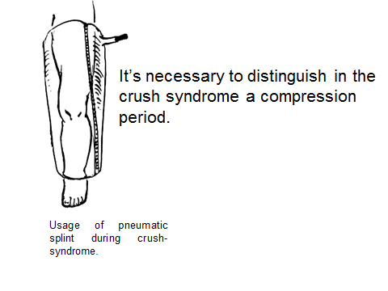
Treatment of infections
Multiple broad spectrum non nephrotoxic antibiotics may be needed.
Combined antibiotic therapy (combination of two antibiotics)
Fx need fixation and conservative amputations may have to be performed either as emergencies or as an elective measure.

Slide 52
Prognosis Related to Crush Syndrome
Major risk factors for renal failure :
  2 or more limbs crushed
  Insufficient early IV fluid
  Delayed in presentation to hospital
Children at lesser risk may need dialysis
50 % or more may have severe long term limb disability if fasciotomy done
Patients often need long term physical therapy

Slide 53
Delayed Causes of Death
ARF
ARDS
Sepsis
Ischemic Organ Injury
DIC
Electrolyte Disturbances

Slide 54
Crush Syndrome
Lecture Summary
Start IV fluids prior to extrication if possible
Assess quickly for hyperkalemia and
associated injuries
If extrication > 6 hours after injury, do not
perform fasciotomy for compartment syndrome
Perform careful monitoring after admission to
hospital

Slide 55
Major Mass Casualty Events with Reports of Crush Syndrome
Earthquakes :
  Tangshan, China 1976
  Armenia 1988
  Iran 1990 and 2003
  Northridge, California 1994
  Kobe, Japan 1995 ("Hanshin-Awaji")
  Turkey 1992 (Izmir, "Marmara" 1999)
Terrorist bombings :
  Israel
  Lebanon
  Saudi Arabia

Slide 56
Compartment syndrome
Crush injury
Crush syndrome
Compartment syndrome
A crushing injury can cause either Compartment Syndrome (CS) or Crush Syndrome

Slide 57
Compartment syndrome
Defined as an “increased pressure within a confined space that leads to micro-vascular compromise and ultimately to cell death as a result of oxygen starvation”
Acute compartment syndrome can have severe consequences, including paralysis, loss of limb or loss of life

Slide 58
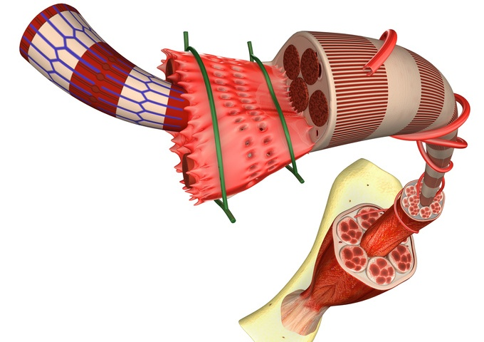
Pathophysiology
Muscle groups - including the nerves and blood vessels that flow through them- are covered by a tough membrane (strong webs of connective tissue) called fascia that does not readily expand -this area is called a compartment.
Compartment syndrome occurs when excessive pressure builds up inside an enclosed muscle space in the body. Compartment syndrome usually results from bleeding or swelling after an injury. The dangerously high pressure in compartment syndrome impedes the flow of blood to and from the affected tissues.

Slide 59
Epidemiology
Acute CS is the most common type of Compartment syndrome.
Trauma - Fractures, hematoma, animal/insect bites, crush injury, surgery to blood vessels of an arm or leg
Edema related - frostbite, burns, overuse injuries
Coagulopathies - genetic, iatrogenic or acquired; a blood clot in a blood vessel in an arm or leg
Other external compression - overly tight bandaging, prolonged compression of a limb during a period of unconsciousness, extremely vigorous exercise (extension under pressure). Taking anabolic steroids can also contribute to developing compartment syndrome.

Slide 60
Abdominal compartment syndrome almost always develops after a severe injury, surgery, or during critical illness. Some conditions associated with abdominal compartment syndrome include:
Trauma, especially when it results in shock
Abdominal surgery, particularly liver transplant
Burns
Sepsis (an infection causing inflammation throughout the body)
Severe ascites or abdominal bleeding
Pelvic fracture
As the pressure in the abdominal compartment rises, blood flow to and from the abdominal organs is reduced. The liver, bowels, kidneys, and other organs may be injured or permanently damaged.

Slide 61
Compartment Syndrome: Signs and Symptoms
Presents as the Five “Ps”
Pain - is most common and consistent sign; described as diffuse and intense, exacerbated with movement, touch, pressure, stretch;
Paresthesias (or anesthesia) - loss of feeling below CS area and radiating farther away;
Passive Stretch - severe pain when muscles in affected compartment are stretched
Pressure - palpable tenseness in affected compartment (very tight to feel, sometimes warm), not recommended palpation for diagnosis
Pulselessness - least reliable and often late stages; CS affects microvasculature, typically, major vessels not affected
CS is TYPICALLY a localized injury!

Slide 62
Treatment
Pre-hospital Treatment (BLS)
Oxygen; high flow
Do NOT ice; ice increases vasoconstriction
Do NOT elevate; keep in position where found or
position of comfort
Splint for comfort and protection only when
necessary (i.e. long transport)
Transport to appropriate medical facility

Slide 63
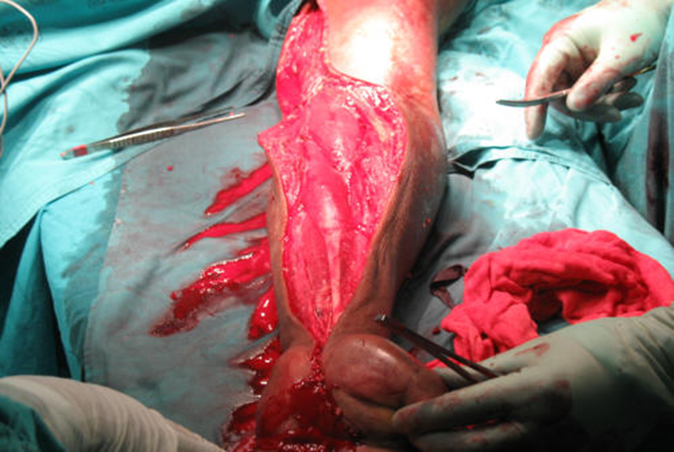
Pre-hospital Treatment (ALS)
Same as BLS
Keep vеnous infusion line open (infusion of IV fluids)
Pain relief - Fentanyl is preferred because it provides same pain control as Magnesium sulphate without vasodialation
USAR/Military Protoco l- field fasciotomy may be performed;
Fasciotomy to relieve compartment syndrome

Slide 64
Compartment Syndrome: Sequelae after initial injury
Tissue damage - irreversible tissue death within 4-12 hours depending on tissue type and compartmental pressure;
Amputation - sometimes tissue is irreversibly damaged and only measure to prevent gangrene and death is amputation
Renal failure and/or death- can occur due to chemical imbalance, infectious or cardiac complications
CS is an independent injury, typically no migration to Crush syndrome. This is a crush injury but completely different than Crush syndrome.

