Slide 1
Blood components. Functional role of plasma proteins.
Red blood cells, hemoglobin. Hemopoiesis.
Blood groups
MEDICAL UNIVERSITY – PLEVEN
FACULTY OF MEDICINE
DISTANCE LEARNING CENTER
Lecture № 10
Assoc. prof. Boryana Ruseva, MD, PhD
Department of Physiology
Medical university-Pleven

Slide 2
* The blood volume is especially important in the control of cardiovascular dynamics.
* The average blood volume of adults is about 7 % of body weight, or about 5 liters.
*About 55 % of the blood is plasma and 45 % is red blood cells, but these percentages can vary considerably in different people, depending on gender, weight, and other factors.

Slide 3
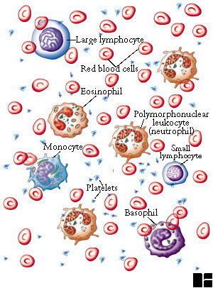
The physical and chemical properties of the blood
red color fluid with suspended blood cells
viscosity = 4,0-5,0 (water = 1)
рН = 7.35-7.45
temperature = 37^{о}С
blood contains liquid part (plasma) and blood cells
blood cells:
erythrocytes
leukocytes
thrombocytes

Slide 4
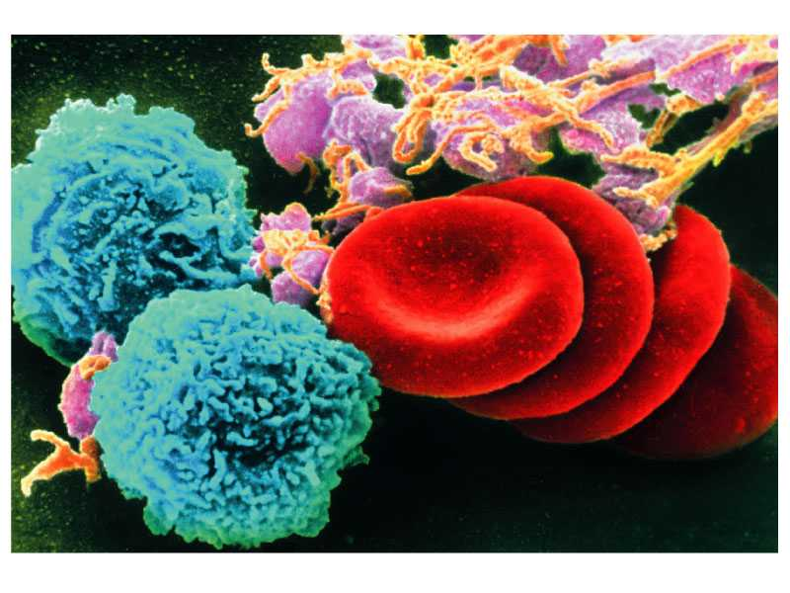
Functions of the blood
transport of gases, nutrients, and waste products
regulatory function – transported hormones perform control on functions of all cells of the organism
homeostatic function – the blood participates in maintenance of constant body temperature, рН, volume and pressure of extracellular fluid
defensive function – against infections and blood loss

Slide 5
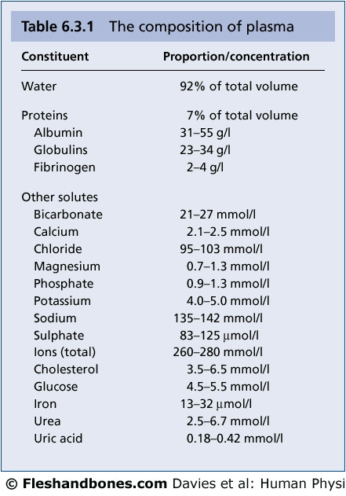
60- 80 g/l
CОP 28 mmHg
(25-30)
Posm ~ 290 mOsm/kg
(285-295)

Slide 6
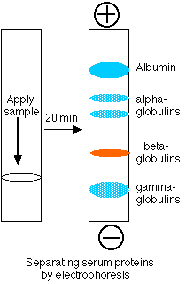
Plasma proteins
Plasma proteins are divided into 3 groups:
Albumins- 58-60%
globulins - 35-38%
fibrinogen- 2-4%
α (α₁,α₂)
ß (ß₁,ß₂)
γ
the different groups differ each other to molecular weight and the number of electrical charge. This allows their separation on fractions under рН 8.6, using electrophoresis.
albumins have the lowest molecular weight and are strongly charged
γ globulins have the highest molecular weight and are weakly charged. The most of them are antibodies.
all albumins, fibrinogen and 50-80% of globulins are formed into the liver. The other globulins are formed in the lymphatic system.

Slide 7
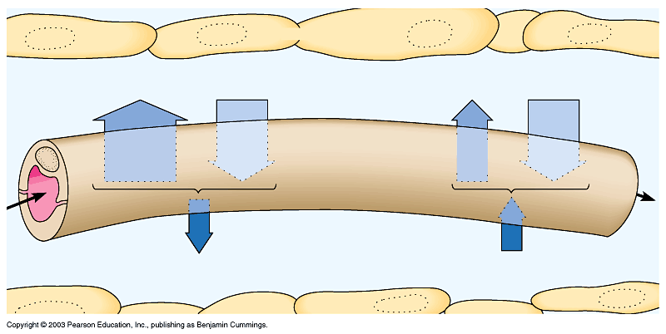
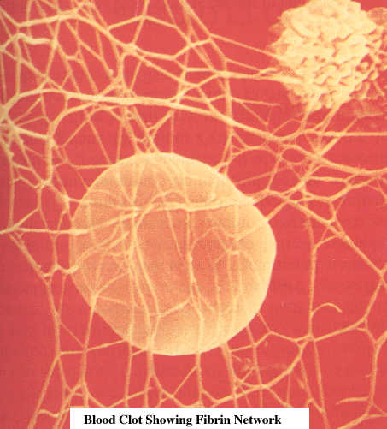
Functions of plasma proteins
Albumins = 32-52 g/l:
Colloid Osmotic
pressure
Colloid Osmotic
pressure
They determine at high degree (80%) colloid-osmotic (oncotic) pressure of the plasma, on which transport of water across capillary walls depends.
Blood
pressure
Blood
pressure
NET PRESSURE
OUT
NET PRESSURE
IN
transport of hormones , bilirubin,FFA, drugs
storage of AA that may use during starvation
they are buffer system of the blood
Globulins - 23-35 g/l heterogenic group with different functions:
α, ß – for transport of Fe, Cu, hormones, vitamins (А, D, Е, К), lipids
γ – antibodies against foreign antigens,
they perform humoral immunity
Fibrinogen – participates in hemocoagulation

Slide 8
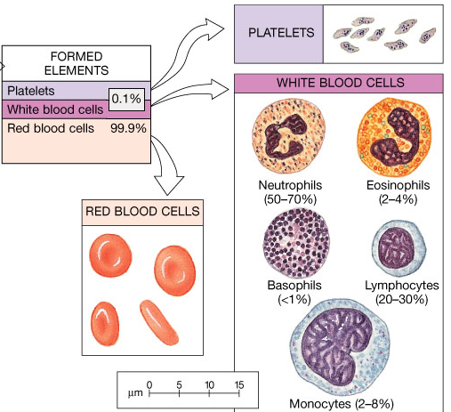
Blood cells
erythrocytes
leukocytes
thrombocytes (platelets)

Slide 9
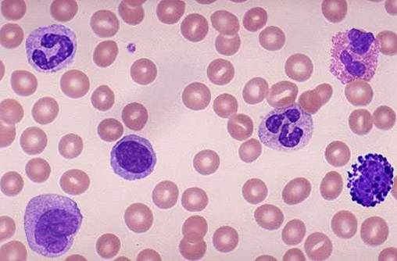
Tests for blood cells determination
determination of number of blood cells – electronic or chamber
blood cells counting
determination of the type of blood cells – preparation and watch
of blood smear
Thrombocyte
Eosinophil
Lymphocyte
Neutrophil
Monocyte
Еозинофил
Basophil
Erythrocyte

Slide 10
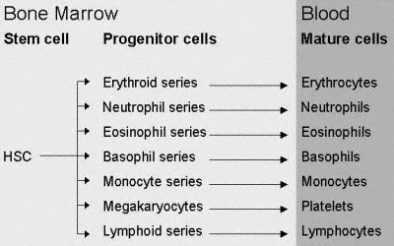
Hemopoiesis is the process of Production of Blood Cells.
There are 2 types of hemopoiesis:
constitutional:
Constant creation of blood cells with the rate maintaining their normal number in the blood ~ 10¹³ blood cells per day.
induceble:
Acceleration of hemopoiesis because pathological decrease of number of blood cells. It is specific – only increased production of type of blood cells that is lower than normal occurs.

Slide 11
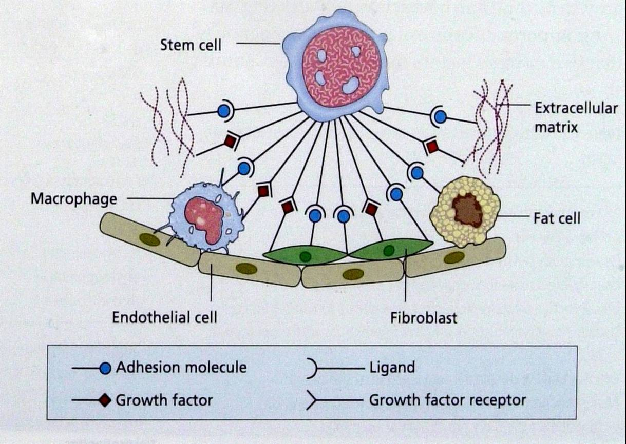
Hemopoiesis in bone marrow
Stroma of bone marrow contains the cells (fibroblasts, macrophages, fat cells) and extracellular matrix (fibronectin, laminin, colagene) to which are bound adhesion molecules and growth factors.
Stem cells have specialized receptors for them.
Interaction between stem cells and stroma is important for normal hemopoiesis.

Slide 12
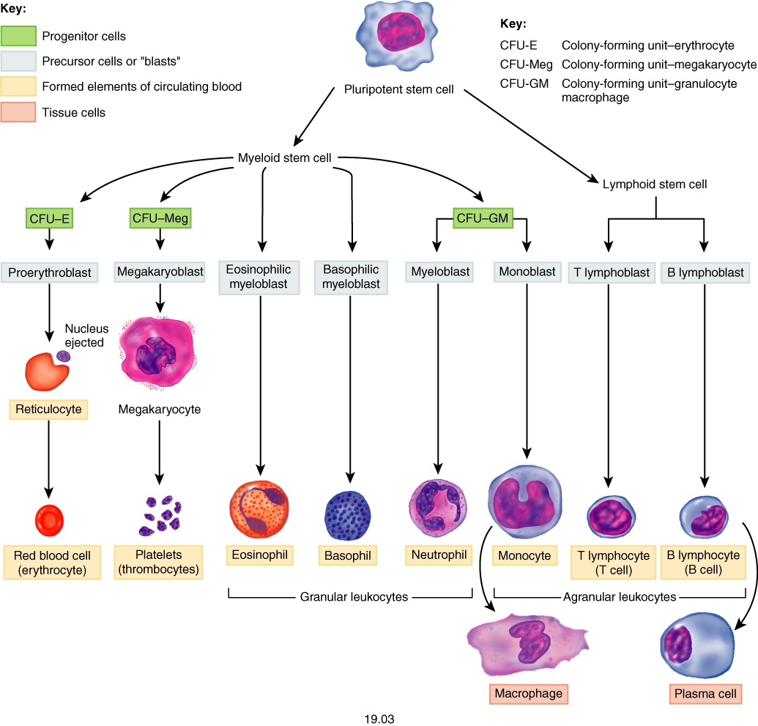
Hemopoiesis
CFU-Eo
CFU-Ba
CFU-G
CFU-Mo

Slide 13
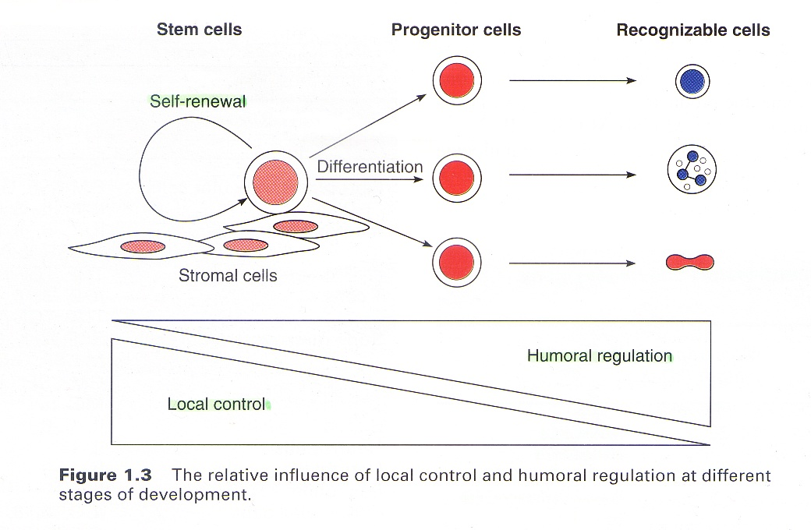
Control of hemopoiesis
Control of hemopoiesis ensures
exact balance between the rate of cell
production and the rate of controlled
cell death.
Controlled cell
production
Controlled cell
death
Control uses local and humoral mechanisms.
The local mechanisms include interaction between hemopoietic cells and stroma
of bone marrow, and are important in early phases of hemopoesis.

Slide 14
Humoral mechanisms of control are performed by hemopoetic growth factors that are secreted by the cells of bone marrow, kidney and liver.
Hemopoietic growth factors are glycoproteins from family of citokines.
Colonia-stimulating factors: SCF (stem cell factor) LIF (leucocyte inhibitory factor) GM-CSF (granulocyte /macrophage), MEG-CSF
trombopoietine
erythropoietine
interleukins (IL-1, IL-3, IL-4, IL-5, IL-6, IL-7, IL-11)

Slide 15
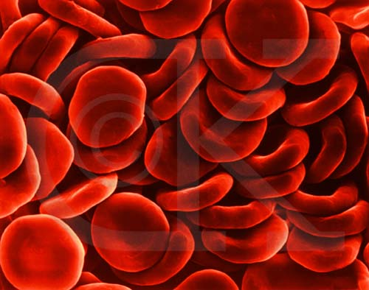
Red Blood Cells (Erythrocytes)
Functions of RBC:
¤ The major function of red blood cells, also known as erythrocytes, is to transport hemoglobin, which in turn carries oxygen from the lungs to the tissues.
¤ They contain a large quantity of carbonic anhydrase, an enzyme that catalyzes the reversible reaction between carbon dioxide (CO₂) and water
to form carbonic acid (H₂ CO₃), increasing the rate of this reaction several thousand fold. The rapidity of this reaction makes it possible for the water of the blood to transport enormous quantities of CO₂ in the form of bicarbonate ion (HCO₃⁻) from the tissues to the lungs, where it is reconverted to CO₂ and expelled into the atmosphere as a body waste product.
¤ The hemoglobin in the cells is an
excellent acid-base buffer (as is true of
most proteins), so that the red blood cells
are responsible for most of the acid-base
buffering power of whole blood.

Slide 16
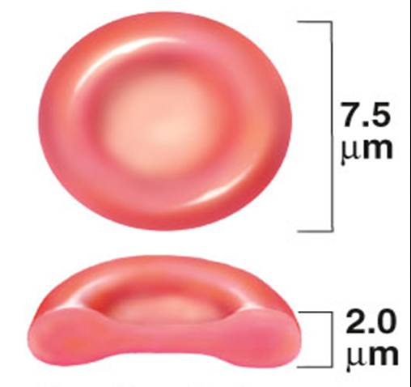
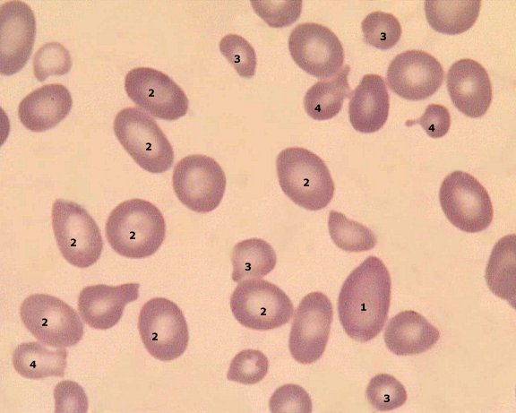
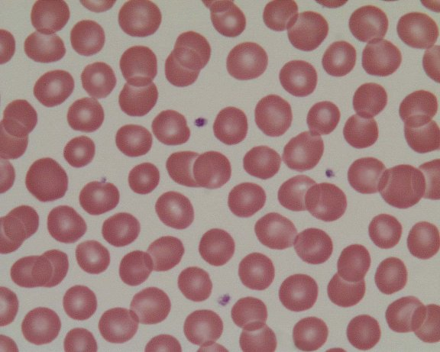
Shape and Size of Red Blood Cells
number of RBC - 4.5 - 5.9.10¹²/l ♂ and 4.2 - 5.2.10¹²/l ♀
Shape - Normal red blood cells are biconcave discs having a mean diameter of about 7.8 μm and a thickness of 2.5 μm at the thickest point and 1 μm or less in the center. This shape ensures well diffusion of gases. The shapes of red blood cells can change remarkably as the cells squeeze through capillaries.
90-95% of dry substance is due to Hb;
MCH=29±2,5pg
MCHC = 320 – 360 g/l erythrocytes
MCV~90 (82-98) fl
MCV> 100 fl - macrocytes
MCV< 80 fl - microcytes
нормоцити
1. megalocyte 2. macrocyte 3. microcyte 4. schistocyte

Slide 17
Characteristics of RBC morphology and metabolism:
they have not nuclei and ribosomes, have not synthesis of proteins
their life lasts av. 120 days
they have not mitochondria; the sours of energy is anaerobic glycolysis
glycolysis has important role for :
formation of 2,3-diphosphoglycerate (2,3-DPG) that decreases affinity of Hb to О₂ and increases its removal to the tissues

Slide 18
Characteristics of RBC morphology and metabolism:
Formation of reductors as - NADРН, NADН, reduced glutathione, that are important for reduction of Hb
They maintain osmotic pressure with low usage of energy (Na-K ATРase), because low permeability of their membrane for Na⁺ and К⁺ ions
RBC membrane has high permeability for water and anions (Cl⁻ and HCO₃⁻)
They exchange rapidly СО₂ and serve as its transporter from the tissues to the lungs

Slide 19
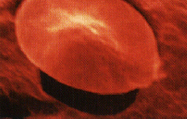
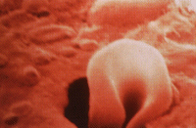
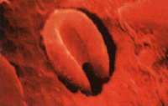
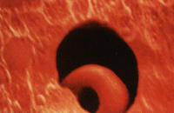
Deformation of RBC membrane
They can change the shape passing through thin capillaries
the possibility of deformation depends on:
cellular geometry- shape and ratio surface: volume
the structure of membrane and cytoskeleton and interaction between them
the content of АТP

Slide 20
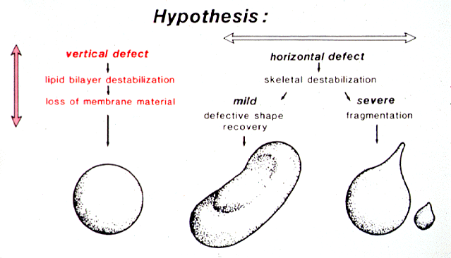
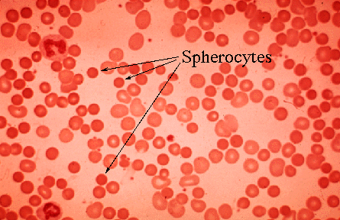
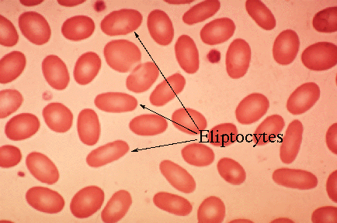
Hemolytic diseases, connected with the abnormal RBC shape
the causes for these diseases are:
altered interaction between membrane and cytosckeleton, loss of lipids from membrane and decreased ratio surface:volume
spherocytes
disturbance during formation of cytoskeleton (eliptocytosis)
eliptocytes

Slide 21
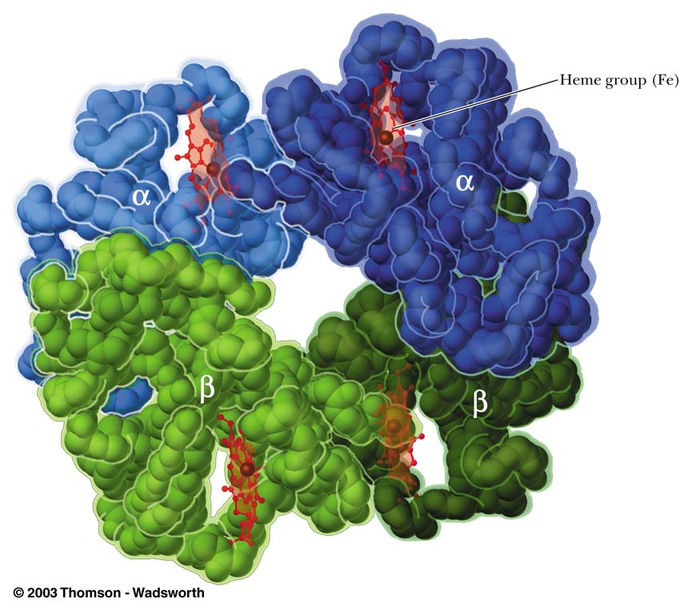
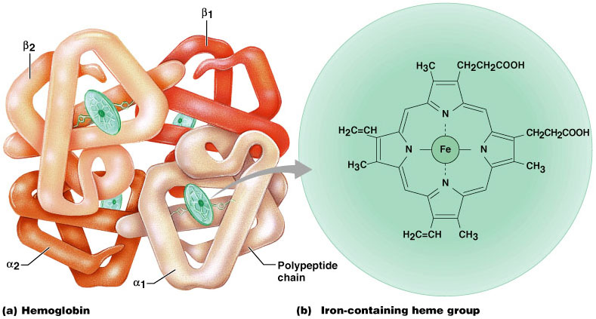
Hemoglobin
О₂
2+
heme

Slide 22
Hemoglobin
functions:
transport of О₂ from the lungs to the tissues
transport of СО₂ from the tissues to the lungs
the most powerful buffer system of the blood
normal concentration:
160±20 g/l (m) ; 140±20 g/l (f)
Hemoglobin is globular chromoprotein (mw ~64000),
Hemoglobin molecule contains 4 subunits
each subunit contains:
Heme – tetrapyrolic ring bound with Fe²⁺
Fe²⁺ reversely bound О₂ -> оxyhemoglobin
1 heme - 1 mol О₂; 4 hemes - 4 mol О₂
globin- polypeptide chain that bound heme and СО₂
molecule of Hb has 2 sparing polypeptide chains:
Hb А has 2 α and 2 β chains

Slide 23
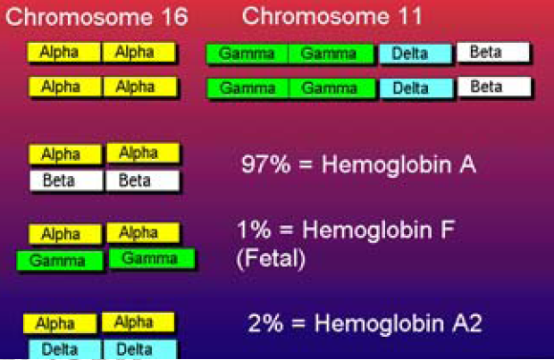
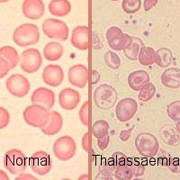
Hemoglobin
chain– chromosome 16;
β, δ, γ chains – chromosome 11
adults
Hb A (95 - 97 %) – α₂, β₂
normal
Hb A₂ (1 – 3 %) – α₂, δ₂
HB F ( ~ 1 %) – α₂, γ₂
Hb S – α₂, β₂^{S} – glutamat is replaced by valine
abnormal
Hemoglobin C – α₂, β₂^{C} - glutamat is replaced by lisine
Hemoglobin H (β₄): α-thalassemia

Slide 24
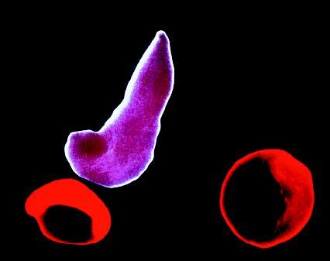
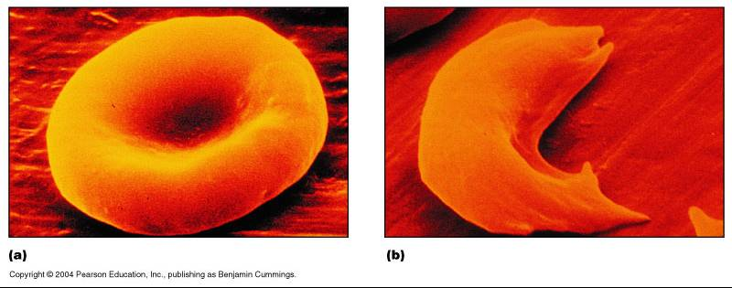
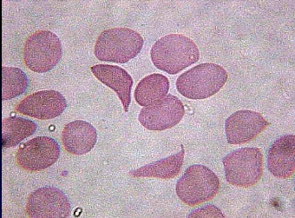
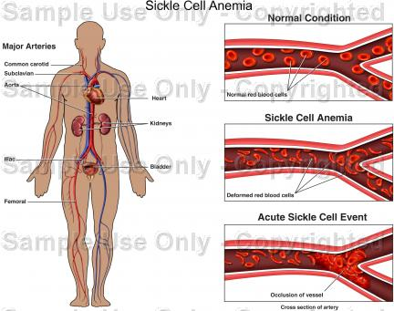
Sickle cell anemia
under low рО₂ β chains of hemoglobin S bound each other and make the big polymers that change the chap of erythrocytes
deformed erythrocytes make aggregats that close the vessels and cause the hemolysis
hemolytic anemia occurs with hypoxia,because of disturbansed microcirculation

Slide 25
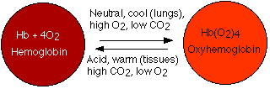
The compounds of hemoglobin
Oxyhemoglobin – combination of Hb with О₂, the iron is Fe²⁺
oxyhemoglobin removes О₂ to the tissues, because of their lower pО₂.
the removal of О₂ is facilitated by:
pСО₂, 2,3-DPG, H⁺, Tº

Slide 26
The compounds of hemoglobin
Carbaminohemoglobin (carbhemoglobin) – combination of Hb with СО_{2.} СО₂ is bound to globin - transport form of СО₂ from the tissues to the lungs
Methemoglobin – oxidased form of Hb, Fe²⁺ becomes Fe³⁺ and can not remove О₂.
Carboxihemoglobin – combination of Hb with СО. СО can bound to the heme with 200 fold higher affinity than this to О₂.

Slide 27
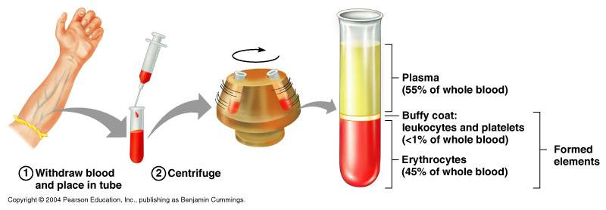
Haematocrit
Hct is the ratio between the volume of erythrocytes to the volume of whole blood.
normal value: male = 0,40-0,55 l/l ; female = 0,35-0,50 l/l
Hct is changed when:
the number of erythrocytes is changed
the volume of erythrocytes is changed
the volume of plasma is changed

Slide 28
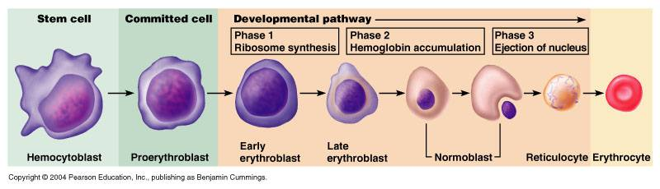
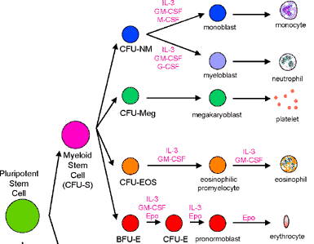
Production of Red Blood Cells
Erythropoiesis occurs in red bone marrow of the membranous bones, such as the vertebrae, sternum, ribs, and ilia.
erythrocytes are formed from pluripotential hematopoietic stem cell:
BFU-E (burst forming unit-erythroid) or proerythroblast
CFU-E (colony forming unit-erythroid) or early erythroblast
late erythroblast
normoblast
reticulocyte
erythrocyte
Hematopoietic growth and differentiation inducers influence the different phases.
IL-3
IL-6
GM-CSF
Epo

Slide 29
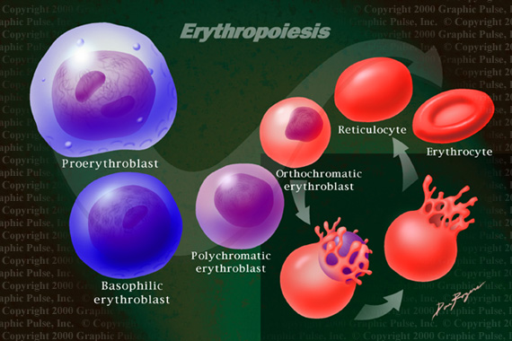
reticulocytes are av. 0.5 – 2.5 % of erythrocytes in peripheral blood
they have ribosomes, rough ЕR and can synthesize hemoglobin
for 2 days life in the blood they become erythrocytes
their number increase during accelerated erythropoesis

Slide 30
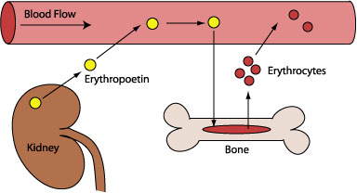
Control of erythropoiesis
  the main regulator of erythropoiesis is erythropoietin
it is glycoprotein (mw ~30 кDа)
it is synthesized mainly by the peritubular intersthicial cells in the renal cortex and outside medulla and small quantity (10-15%) by the liver

Slide 31
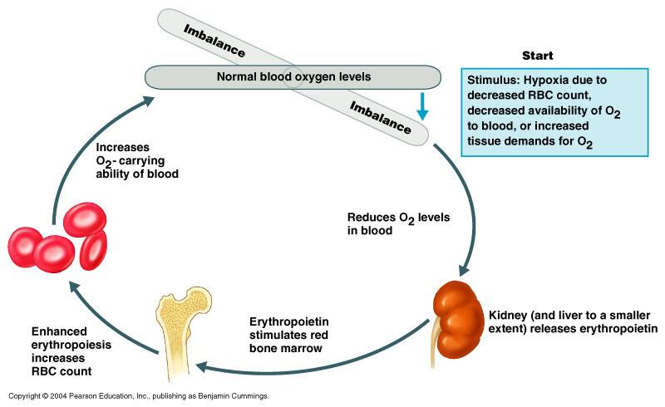
Control of secretion of erythropoietin
  the main stimulating factor is hypoxia
  negative feedback loop that participates in maintenance of normal pО₂ in the blood
synthesis of erythropoietin is stimulated and by the hormones
as - testosterone, growth hormone, thyroxin and cateholamines

Slide 32
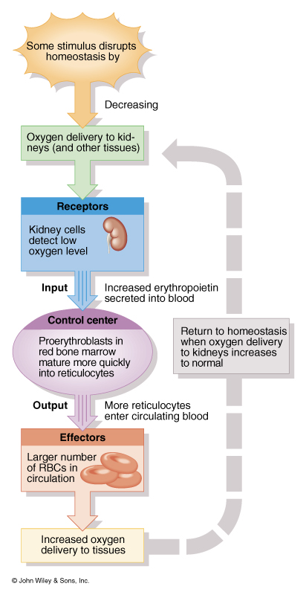
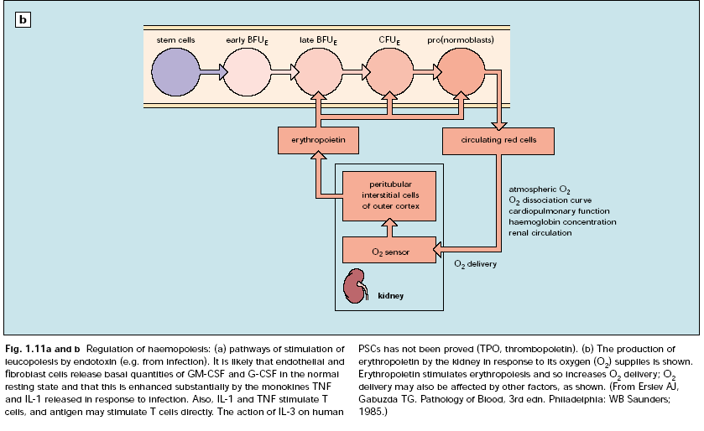
Effects of erythropoietin on bone marrow
stimulation of proliferation of early committed progenitor cells (BFU-E, CFU-E )

Slide 33
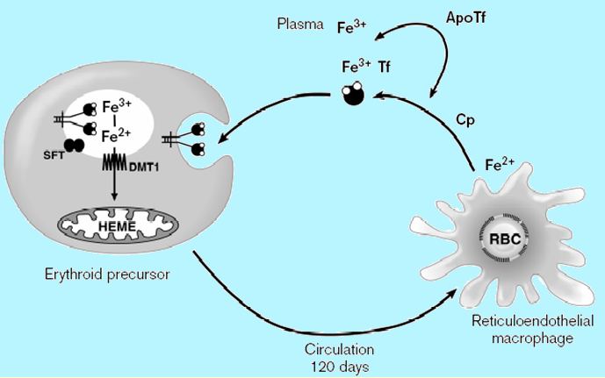
Fe²⁺, vit B₁₂, folic acid, АA are important for normal erythropoiesis except erythropoietin
Missing of iron leads to microcytic anemia
Vitamin В₁₂ and folic acid are important for synthesis of DNA. When they miss –> megaloblastic anemia

Slide 34
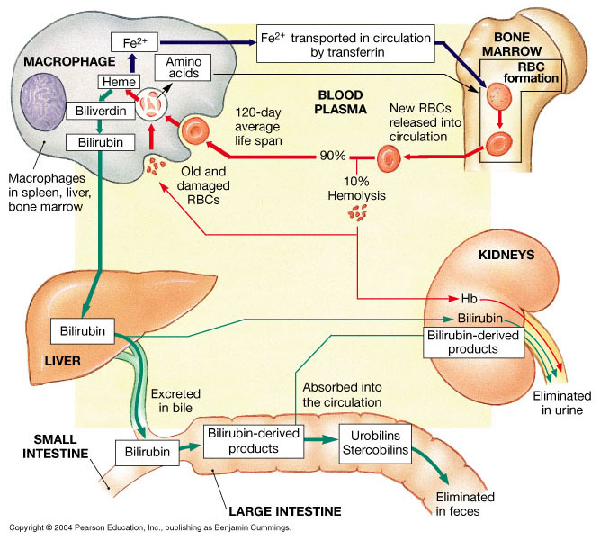
Destruction of erythrocytes

Slide 35
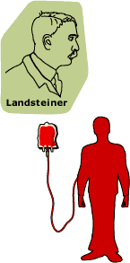
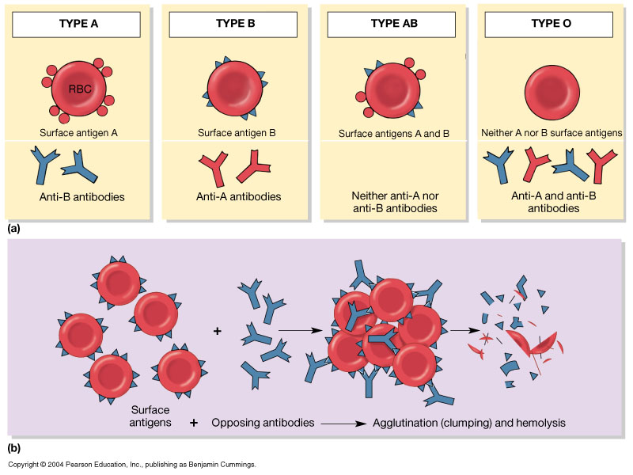
Blood groups
At least 30 commonly occurring antigens and hundreds of other rare antigens, each of them can at times cause antigen-antibody reactions, have been found in human on the surfaces of the cell membranes of RBC.
Two particular types of antigens are much more likely than the others to cause blood transfusion reactions. They are the O-A-B system of antigens and the Rh system.
ABO System
2 types agglutinogens- А and В
2 types agglutinins – anti-А (α) and anti-В (β)
group А is divided into А₁ and А₂

Slide 36
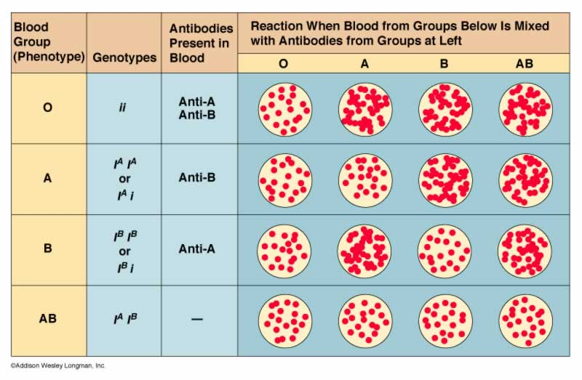
ABO system
Inheritance of blood groups
Father's group |  | Mother's group
 |  | O | A | B | AB
 | O | O | O, A | O, B | A, B
 | A | O, A | O, A | O, A, B, AB | A, B, AB
 | B | O, B | O, A, B, AB | O, B | A, B, AB
 | AB | A, B | A, B, AB | A, B, AB | A, B, AB
Blood typing

Slide 37
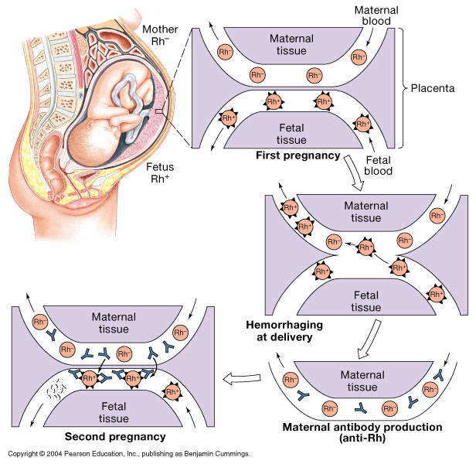
Rh system
It is determined by the presence of antigens С, D and Е.
Antigen D has the highest immunogenity, when it is present the human is Rh(+) , when it is absent - Rh(- ).
85% of white people are Rh(+)
Rh(-) people have not anti-D antibodies, but they can produce them when:
Rh(- ) humane receives Rh(+) blood
Rh(- ) mother has Rh(+) fetus
During the first pregnancy no danger for the fetus, but after delivery mother may produce anti-D antibodies and the second pegnancy with Rh(+) fetus causes developpment of erythroblastosis fetalis.
To prevent this reaction after the birth of Rh(+) fetus must inject anti-D immuno-globuline to this Rh(-) woman to activate В Ly and formation of cells of ummunological memory.

Slide 38
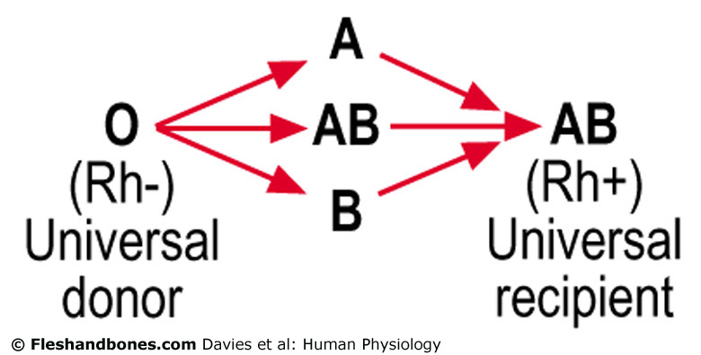
The rules for hemotransfusion
The erythrocytes of the donor must not be agglutinated by the serum of the recipient.
Group О (α,β) is universal donor, group АВ (-) is universal recipient
Autologouse blood may transfuse in unlimited volume, but heterologouse compatible blood no more than 300 ml.
Before hemotransfusion must determine Rh group, Rh (-) patients must receive Rh(-) blood.
> If donor blood of one blood type is transfused into a recipient who has another blood type, a transfusion reaction is likely to occur in which the red blood cells of the donor blood are agglutinated. Hemolysis of RBC occurs and this leads to death.

