Slide 1
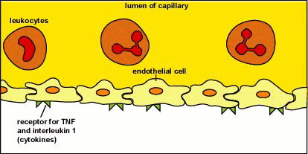
Leukocytes. Resistance of the body to infections. Hemostasis and blood coagulation
MEDICAL UNIVERSITY – PLEVEN
FACULTY OF MEDICINE
DISTANCE LEARNING CENTER
Lecture № 11
Assoc. prof. Boryana Ruseva, MD, PhD
Department of Physiology
Medical university
Pleven

Slide 2
Resistance of the Body to Infection
Our bodies are exposed continually to bacteria, viruses, fungi, and parasites, all of which occur normally and to varying degrees in the skin, the mouth, the respiratory passageways, the intestinal tract, the lining membranes of the eyes, and even the urinary tract.
Many of these infectious agents are capable of causing serious abnormal physiologic function or even death if they invade the deeper tissues.

Slide 3
Resistance of the Body to Infection
Our bodies have a special system for combating the different infectious and toxic agents. This is comprised of blood leukocytes (white blood cells) and tissue cells derived from leukocytes.
These cells work together in two ways to prevent disease: (1) by actually destroying invading bacteria or viruses by phagocytosis, and (2) by forming antibodies and sensitized lymphocytes, one or both of which may destroy or inactivate the invader.

Slide 4
Leukocytes (White Blood Cells)
Six types of white blood cells are normally present in the blood. They are polymorphonuclear neutrophils, polymorphonuclear eosinophils, polymorphonuclear basophils, monocytes, lymphocytes, and, occasionally, plasma cells.
The granulocytes and monocytes protect the body against invading organisms mainly by ingesting them - that is, by phagocytosis.
The lymphocytes and plasma cells function mainly in connection with the immune system.

Slide 5
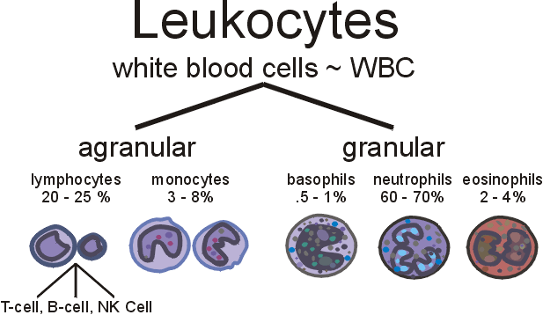
Leukocytes in perriferal blood
Number of WBC: 4.10⁹ - 11.10⁹/l
Differential WBC count
in adults
at rest
40%
50% -
2

Slide 6
Genesis of the WBC
The granulocytes and monocytes are formed only in the bone marrow.
Lymphocytes and plasma cells are produced mainly in the various lymphogenous tissues - especially the lymph glands, spleen, thymus, tonsils, and various pockets of lymphoid tissue elsewhere in the body, such as in the bone marrow and in so-called Peyer’s patches underneath the epithelium in the gut wall.
The white blood cells formed in the bone marrow are stored within the marrow until they are needed in the circulatory system. Then, when the need arises, various factors cause them to be released.

Slide 7
Genesis of the WBC

Slide 8
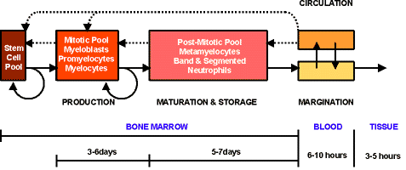
Genesis of the WBC

Slide 9
Life Span of the White Blood Cells
The life of the granulocytes after being released from the bone marrow is normally 4 to 8 hours circulating in the blood and another 4 to 5 days in tissues where they are needed.
In times of serious tissue infection, this total life span is often shortened to only a few hours because the granulocytes proceed even more rapidly to the infected area, perform their functions, and, in the process, are themselves destroyed.
The monocytes also have a short transit time, 10 to 20 hours in the blood, before wandering through the capillary membranes into the tissues. Once in the tissues, they swell to much larger sizes to become tissue macrophages, and, in this form, can live for months unless destroyed while performing phagocytic functions.
These tissue macrophages are the basis of the tissue macrophage system, discussed in greater detail later, which provides continuing defense against infection.

Slide 10
Life Span of the White Blood Cells
Lymphocytes enter the circulatory system continually, along with drainage of lymph from the lymph nodes and other lymphoid tissue. After a few hours, they pass out of the blood back into the tissues by diapedesis.
Then, still later, they re-enter the lymph and return to the blood again and again; thus, there is continual circulation of lymphocytes through the body.
The lymphocytes have life spans of weeks or months; this life span depends on the body’s need for these cells.

Slide 11
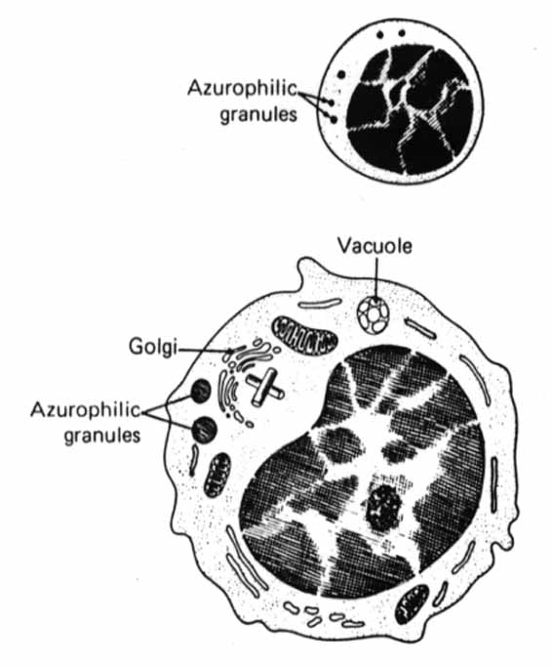
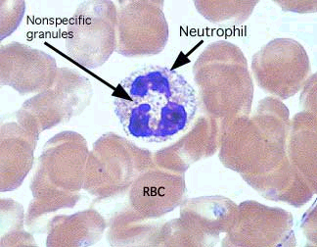
Neutrophils morphology

Slide 12
Neutrophils functions Neutrophils and Macrophages Defend Against Infections. Both Neutrophils and Macrophages Can Kill Bacteria

Slide 13
WBC Enter the Tissue Spaces by Diapedesis.
Neutrophils and monocytes can squeeze through the pores of the blood capillaries by diapedesis.
Trans endothelial migration
Diapedesis

Slide 14
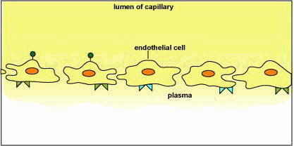
White Blood Cells Move Through Tissue Spaces by Ameboid Motion
White Blood Cells Are Attracted to Inflamed Tissue Areas by Chemotaxis.

Slide 15
Phagocytosis – cellular ingestion of the offending agent
A single neutrophil can usually phagocytize 3 to 20 bacteria before the neutrophil itself becomes inactivated and dies.

Slide 16
1
2

Slide 17
The receptors of neutrophils

Slide 18
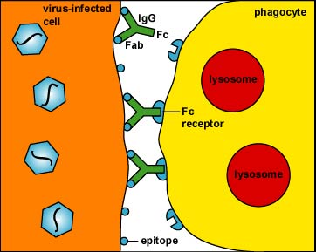
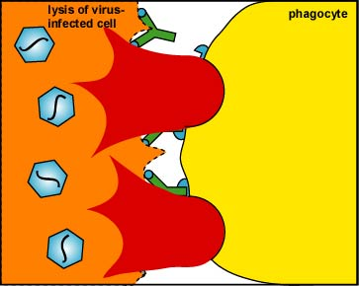
The importance of neutrophils during virus infections

Slide 19
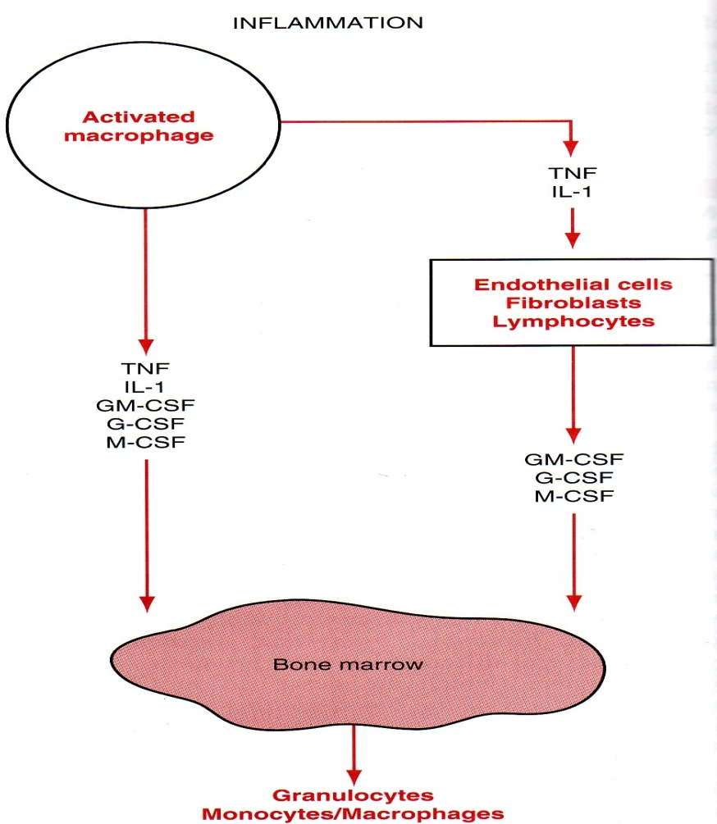
Control of neutrophils function
the main regulators: cytokines, secreted by Mo/macrophages, Ly, endothelial cells, fibroblasts, and by Ne
cytokines, stimulating activity of Ne
Interleukines(IL-1, IL-6, IL-8), TNF-α, interferons (IFN-γ), hemopoietic factors (GM-CSF, G-CSF)
the most of these cytokines stimulate granulocytopoiesis in bone marrow
cytokines, inhibiting activity of Ne:
IL-4 и IL-10-they have anti-inflammatory action
the other factors that influence activity of Ne:
eukosanoids (leukotrienes, prostaglandins, lipoxines),
hormones (growth hormone, prolactine, glucocorticoides)

Slide 20
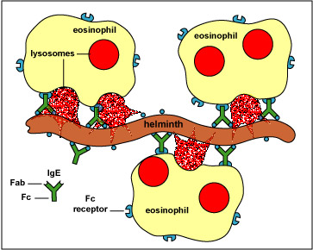
Eosinophils
Eosinophils are weak phagocytes, and they exhibit chemotaxis, but in comparison with the neutrophils, it is doubtful that the eosinophils are significant in protecting against the usual types of infection. Eosinophils, however, are often produced in large numbers in people with parasitic infections, and they migrate in large numbers into tissues diseased by parasites. Although most parasites are too large to be phagocytized by eosinophils or any other phagocytic cells, eosinophils attach themselves to the parasites by way of special surface molecules and release substances that kill many of the parasites.
Eosinophils also have a special propensity to collect in tissues in which allergic reactions occur.
The mast cells and basophils release an eosinophil chemotactic factor that causes eosinophils to migrate toward the inflamed allergic tissue.

Slide 21
Basophils
The basophils in the circulating blood are similar to the large tissue mast cells located immediately outside many of the capillaries in the body. Both mast cells and basophils liberate heparin into the blood, a substance that can prevent blood coagulation.
The mast cells and basophils also release histamine, as well as smaller quantities of bradykinin and serotonin. Indeed, it is mainly the mast cells in inflamed tissues that release these substances during inflammation. The mast cells and basophils play an exceedingly important role in some types of allergic reactions because the type of antibody that causes allergic reactions, the immunoglobulin E (IgE) type has a special propensity to become attached to mast cells and basophils.

Slide 22
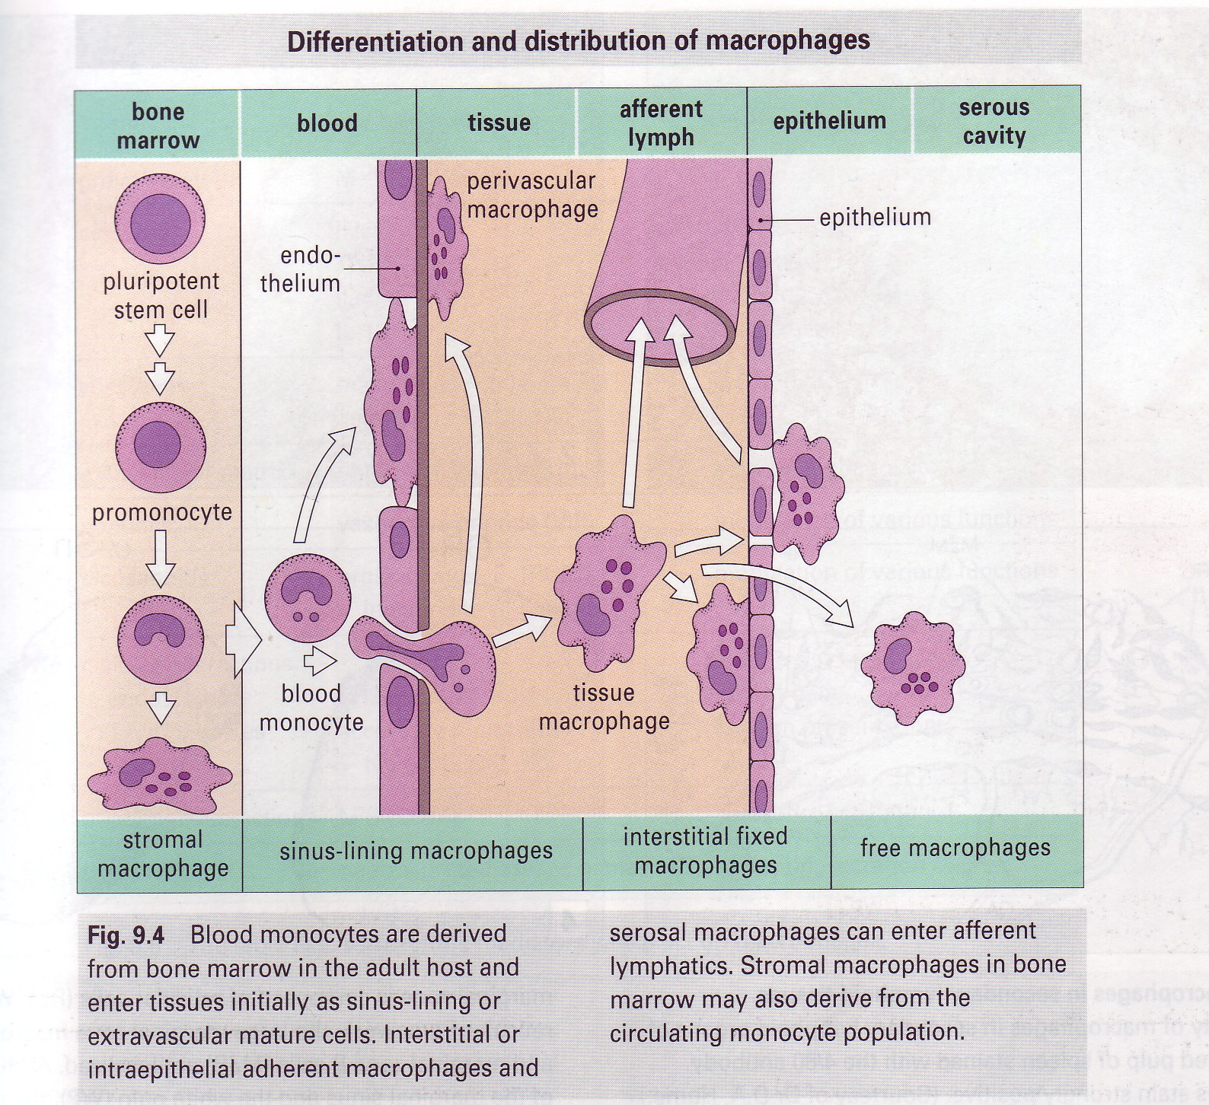
Monocytes
Macrophages are the end stage product of monocytes that enter the tissues from the blood.
They are much more powerful phagocytes than neutrophils, often capable of phagocytizing as many as 100 bacteria.

Slide 23
Macrophage and Neutrophil Responses During Inflammation
Tissue Macrophage Is a First Line of Defense Against Infection.
Neutrophil Invasion of the Inflamed Area Is a Second Line of Defense.
¤ Acute Increase in Number of Neutrophils in the Blood - “Neutrophilia.”
Second Macrophage Invasion into the Inflamed Tissue Is a Third Line of Defense.
Increased Production of Granulocytes and Monocytes by the Bone Marrow Is a Fourth Line of Defense.

Slide 24
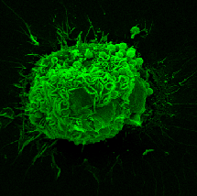
Functions of macrophages
Phagosytosis of pathological microorganisms and own changed cells
Processing and introducing of antigens to lymphocytes
Secretion of cytokines that cause inflammation and activation of Ly
Macrophages perform relationship between acquired and innate immunity
Microbe
IFN-γ
Cytokines
TNF-α (vascular permeability)
IL-1β (lymphocyte activation)
IL-6 (liver: acute phase protein)
IL-8 (leukocyte chemotaxis)
IL-12,15,18 (NK cell activation)
lipid metabolites
PAF
TXA₂
PGE₂
reduced oxygen species
superoxide anion
OH radical
nitric oxide
Balanced
Dysregulated
Physiological
host immunity
adjuvant effect
Pathological
circulatory collapse
multiple organ failure
shock/death

Slide 25
Immunity and Allergy
The human body has the ability to resist almost all types of organisms or toxins that tend to damage the tissues and organs. This capability is called immunity.
Much of immunity is acquired immunity that does not develop until after the body is first attacked by a bacterium, virus, or toxin, often requiring weeks or months to develop the immunity.
An additional portion of immunity results from general processes, rather than from processes directed at specific disease organisms. This is called innate immunity. It includes the following:
1. Phagocytosis of bacteria and other invaders by white blood cells and cells of the tissue macrophage system.
2. Destruction of swallowed organisms by the acid secretions of the stomach and the digestive enzymes.

Slide 26
Immunity and Allergy
3. Resistance of the skin to invasion by organisms.
4. Presence in the blood of certain chemical compounds that attach to foreign organisms or toxins and destroy them. Some of these compounds are (1) lysozyme, a mucolytic polysaccharide that attacks bacteria and causes them to dissolute; (2) basic polypeptides, which react with and inactivate certain types of gram-positive bacteria; (3) the complement complex, a system of about 20 proteins that can be activated in various ways to destroy bacteria; and (4) natural killer lymphocytes that can recognize and destroy foreign cells, tumor cells, and even some infected cells.
This innate immunity makes the human body resistant to such diseases as some paralytic viral infections of animals, hog cholera, cattle plague, and distemper - a viral disease that kills a large percentage of dogs that become afflicted with it.
Conversely, many lower animals are resistant or even immune to many human diseases, such as poliomyelitis, mumps, human cholera, measles, and syphilis, which are very damaging or even lethal to human beings.

Slide 27
Acquired (Adaptive) Immunity
In addition to its generalized innate immunity, the human body has the ability to develop extremely powerful specific immunity against individual invading agents such as lethal bacteria, viruses, toxins, and even foreign tissues from other animals. This is called acquired or adaptive immunity.
Acquired immunity is caused by a special immune system that forms antibodies and/or activated lymphocytes that attack and destroy the specific invading organism or toxin.
Acquired immunity can often bestow extreme protection. For instance, certain toxins, such as the paralytic botulinum toxin or the tetanizing toxin of tetanus, can be protected against in doses as high as 100,000 times the amount that would be lethal without immunity.
This is the reason the treatment process known as immunization is so important in protecting human beings against disease and against toxins.

Slide 28
Basic Types of Acquired Immunity
Two basic but closely allied types of acquired immunity occur in the body. In one of these the body develops circulating antibodies, which are globulin molecules in the blood plasma that are capable of attacking the invading agent. This type of immunity is called humoral immunity or B-cell immunity (because B lymphocytes produce the antibodies).
The second type of acquired immunity is achieved through the formation of large numbers of activated T lymphocytes that are specifically crafted in the lymph nodes to destroy the foreign agent. This type of immunity is called cell-mediated immunity or T-cell immunity (because the activated lymphocytes are T lymphocytes).

Slide 29
Lymphocytes
size - 5 - 12 μm
nucleus – big, round shaped
cytoplasm - scanty, looks like ring around the nucleus
life span – long to 20 years
main function – participation in acquired immunity for defense
against foreign antigens and changed own cells
there are 3 types of Ly into the blood:
В-10-15%, Т-80% and natural killer cells (NK)
В Ly during the meeting of specific for them antigen differentiate in :
plasma cells – they secret antibodies against antigens and perform humoral immunity
Memory B cells – they ensure rapid and powerful immune response during the next meeting with them

Slide 30
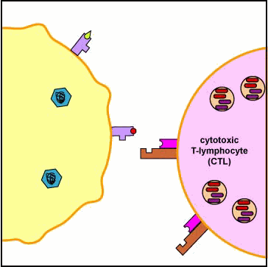
Т Ly are 4 types:
T cytotoxic (CD8+) – direct destruction of infected by the viruses or bacteria cells or changed cells (tumor or transplanted cells) -> cellular immune response
T helpers (CD4+) -> secrete cytokines that
activate cells, participating in innate (granulocytes, macrophages, NK) and acquired cell – mediated (cytotoxic Т-Ly) and humoral (B-Ly) immune
responses
T suppressors – prevent development of extremely powerful immune responses, inhibiting the activity of cells of immune system
Memory T cells – during second meeting with the same antigen, they rapidly differentiate in T - helpers or T – cytotoxic.
natural killer cells are big granulated Ly that destroy all abnormal cells in the organism (infected and tumor cells) by secretion of perforins like cytotoxic T Ly.

Slide 31
T Ly and B-Ly Antibodies React Highly Specifically Against Specific Antigens - Role of Lymphocyte Clones
Millions of different types of preformed B lymphocytes and preformed T lymphocytes that are capable of forming highly specific types of antibodies or T cells have been stored in the lymph tissue.
Each of these preformed lymphocytes is capable of forming only one type of antibody or one type of T cell with a single type of specificity.
All the different lymphocytes that are capable of forming one specificity of antibody or T cell are called a clone of lymphocytes.
Each clone of lymphocytes is responsive to only a single type of antigen (or to several similar antigens that have almost exactly the same stereochemical characteristics).

Slide 32
Role of Macrophages in the Activation Process
Most invading organisms are first phagocytized and partially digested by the macrophages, and the antigenic products are liberated into the macrophage cytosol.
The macrophages then pass these antigens by cell-to-cell contact directly to the lymphocytes, thus leading to activation of the specified lymphocytic clones.
The macrophages, in addition, secrete a special activating substance that promotes still further growth and reproduction of the specific lymphocytes. This substance is called interleukin-1.

Slide 33
Role of the T Cells in Activation of the B Lymphocytes.
Some of the T cells that are formed, called helper cells, secrete specific substances (collectively called lymphokines) that activate the specific B lymphocytes. Indeed, without the aid of these helper T cells, the quantity of antibodies formed by the B lymphocytes is usually slight.
The antibodies are gamma globulins called immunoglobulins. There are five general classes of antibodies, respectively named IgM, IgG, IgA, IgD, and IgE.
Antibodies act mainly in two ways to protect the body against invading agents: (1) by direct attack on the invader and (2) by activation of the “complement system” that then has multiple means of its own for destroying the invader.

Slide 34
Complement System for Antibody Action
“Complement” is a collective term that describes a system of about 20 proteins, many of which are enzyme precursors. The principal actors in this system are 11 proteins designated C1 through C9, B, and D. All these are present normally among the plasma proteins in the blood as well as among the proteins that leak out of the capillaries into the tissue spaces. The enzyme precursors are normally inactive, but they can be activated mainly by the so-called classic pathway.

Slide 35
Classic Pathway
It is initiated by an antigen-antibody reaction. That is, when an antibody binds with an antigen, a specific reactive site on the “constant” portion of the antibody becomes uncovered, or “activated,” and this in turn binds directly with the C1 molecule of the complement system, setting into motion a “cascade” of sequential reactions.
1. Opsonization and phagocytosis
2. Lysis
3. Agglutination
4. Neutralization of viruses
5. Chemotaxis
6. Activation of mast cells and basophils
7. Inflammatory effects

Slide 36
Complement System for Antibody Action

Slide 37
The antibodies can inactivate the invading agent in one of several ways, as follows:
1. Agglutination, in which multiple large particles with antigens on their surfaces, such as bacteria or red cells, are bound together into a clump
2. Precipitation, in which the molecular complex of soluble antigen (such as tetanus toxin) and antibody becomes so large that it is rendered insoluble and precipitates
3. Neutralization, in which the antibodies cover the toxic sites of the antigenic agent
4. Lysis, in which some potent antibodies are occasionally capable of directly attacking membranes of cellular agents and thereby cause rupture of the agent

Slide 38
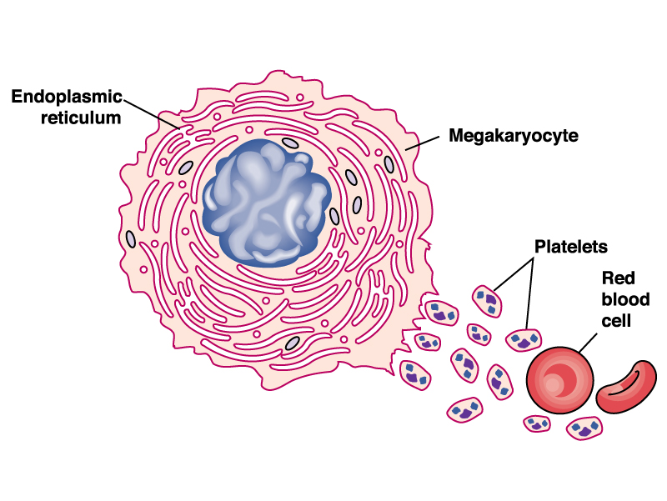
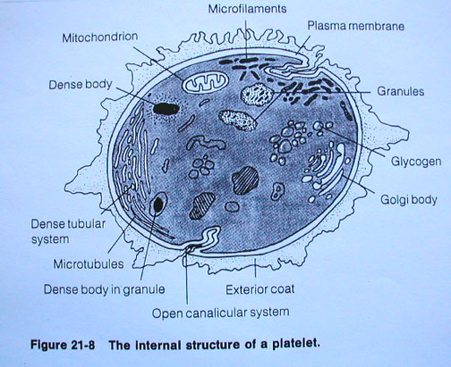
Тромбоцити
Thrombocytes are cytoplasmic fragments from megakaryocytes
number=150-350.10⁹/l
size – 2-4μm
shape of disc
enucleated
well developed cytoskeleton maintaining the shape (actin filaments and microtubular system)
Canalicular system, contained Са²⁺ and СОХ
granules – 2 types:
α granules (light) – contain polypeptides, participating in coagulation(factor V, VІІІ, vWF, fibrinogen), in adhesion (selectin, fibronectin, thrombospondin)in fibrinolysis (plasminogen), antifibrinolysis (α₂-antiplasmin, PAI-1), in growth (PDGF, TGF-β)
δ granules(dense) – contain low molecular substances: Са²⁺, ADP, ATP, serotonin,

Slide 39
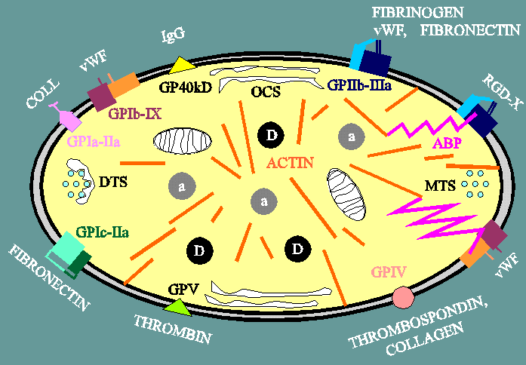
Receptors on the surface of the cellular membrane of thrombocytes
Functions of thrombocytes
participation in hemostasis
Secretion of substances, important for regeneration and normal functioning of endothelium
participation in inflammatory reactions

Slide 40
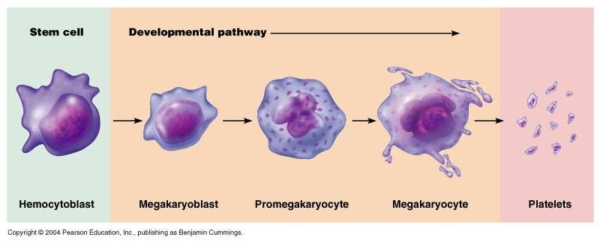
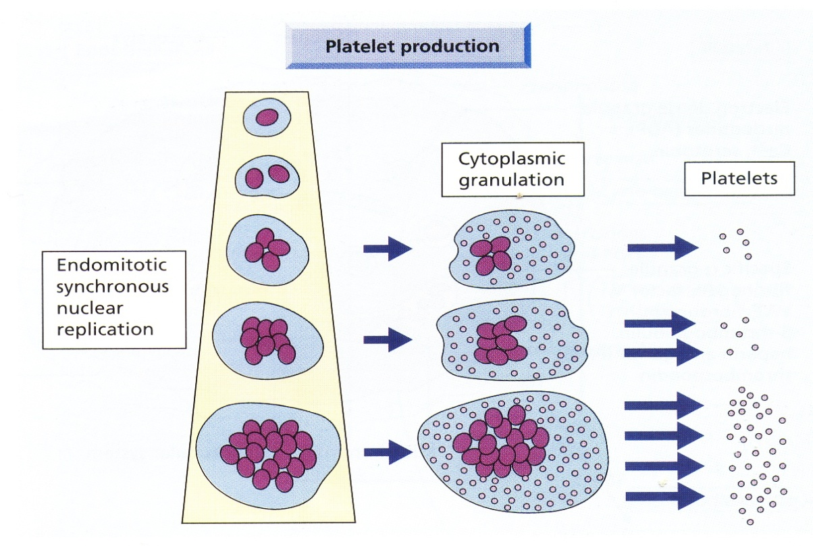
Genesis of thrombocytes
Control of thrombopoiesis
the main regulator is thrombopoietine, synthesized by
the liver

Slide 41
Events in Hemostasis
The term hemostasis means prevention of blood loss.
Whenever a vessel is severed or ruptured,
hemostasis is achieved by several mechanisms:
(1)vascular constriction,
(2) formation of a platelet plug,
(3) formation of a blood clot as a result of blood coagulation, and eventual growth of fibrous tissue into the blood clot to close the hole in the vessel permanently,
(4) recanalisation of the vessel.

Slide 42
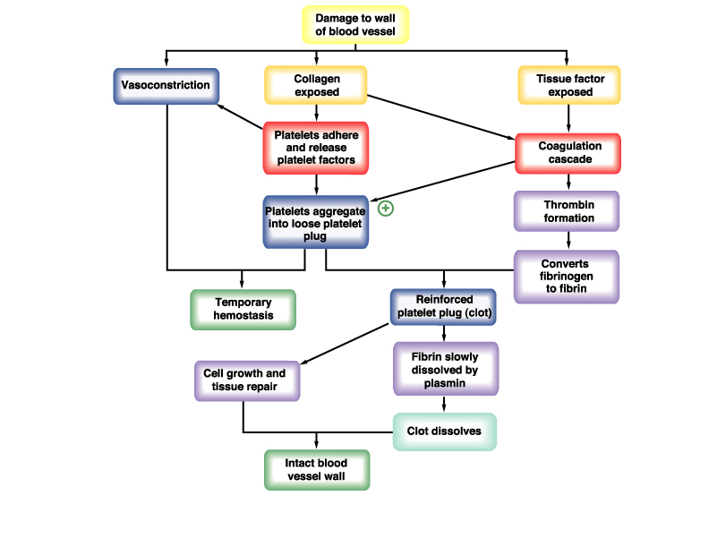
1
2
3
4

Slide 43
1
2

Slide 44
Hemocoagulation
3

Slide 45
Clotting Factors in Blood and Their Synonyms
Fibrinogen Factor I
Prothrombin Factor II
Tissue factor Factor III; tissue thromboplastin
Calcium Factor IV
Factor V Proaccelerin
Factor VII Serum prothrombin conversion accelerator (SPCA); proconvertin;
Factor VIII Antihemophilic factor (AHF); antihemophilic factor A
Factor IX Plasma thromboplastin component, Christmas factor; antihemophilic factor B
Factor X Stuart factor; Stuart-Prower factor
Factor XI Plasma thromboplastin antecedent; antihemophilic factor C
Factor XII Hageman factor
Factor XIII Fibrin-stabilizing factor
Prekallikrein Fletcher factor
High-molecular-weight Fitzgerald factor; HMWK kininogen
Platelets

Slide 46
3
4

Slide 47
The role of vitamin K for hemocoagulation

Slide 48
The role of Ca ions

Slide 49
Fibrinolysis

Slide 50
Scheme of the coagulation-anticoagulation system Activation of the coagulation system culminates in generation of thrombin, which cleaves fibrinogen to form fibrin clots with platelets on the site of vascular injury. The coagulation system is negatively regulated by tissue factor pathway inhibitor (TFPI), antithrombin (AT), and activated protein C (APC). Fibrinolytic system also regulates coagulation by generation of plasmin, which dissolves fibrin clots. Fibrinolytic system is negatively regulated by plasminogen activator inhibitor 1 (PAI-1). A delicate balance between coagulation and anticoagulation is necessary to prevent pathophysiological conditions such as excessive bleeding or thrombosis.

