Slide 1
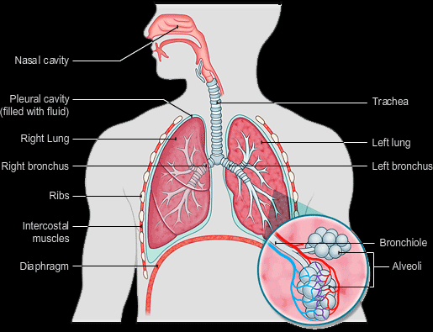
Respiration. Pulmonary and alveolar ventilation. Lung capacities. Gas exchange through respiratory membrane. Gas transport between the lungs and tissues
MEDICAL UNIVERSITY – PLEVEN
FACULTY OF MEDICINE
DISTANCE LEARNING CENTER
Lecture № 12
Assoc. Prof. Boryana Ruseva, MD, PhD
Department of Physiology
Medical University
Pleven

Slide 2
The goals of respiration are to provide oxygen to the tissues and to remove carbon dioxide.
To achieve these goals, respiration can be divided into four major functions:
(1) pulmonary ventilation, which means the inflow and outflow of air between the atmosphere and the lung alveoli;
(2) diffusion of oxygen and carbon dioxide between the alveoli and the blood;
(3) transport of oxygen and carbon dioxide in the blood and body fluids to and from the body’s tissue cells; and
(4) regulation of ventilation and other facets of respiration.

Slide 3
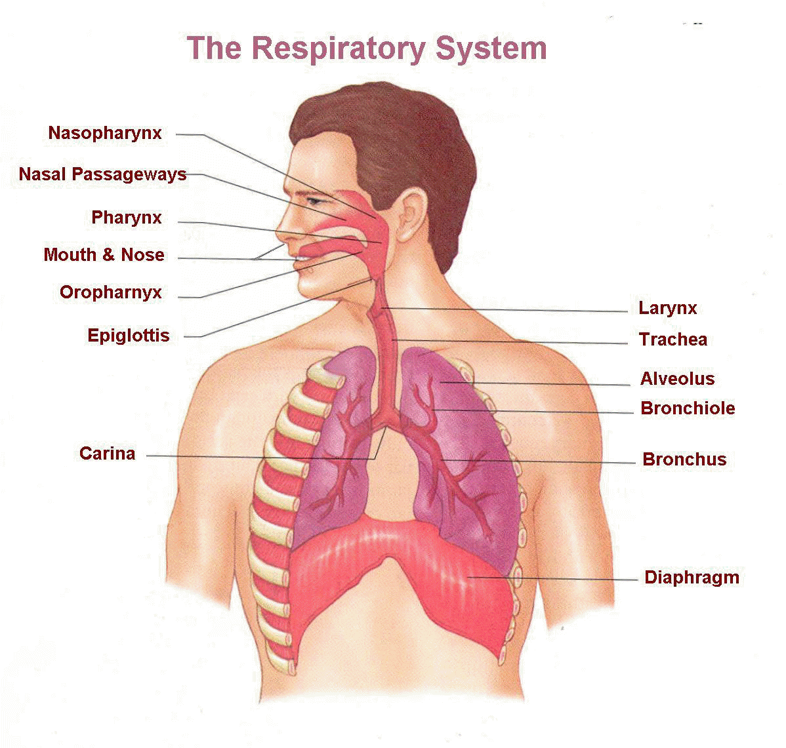

Slide 4
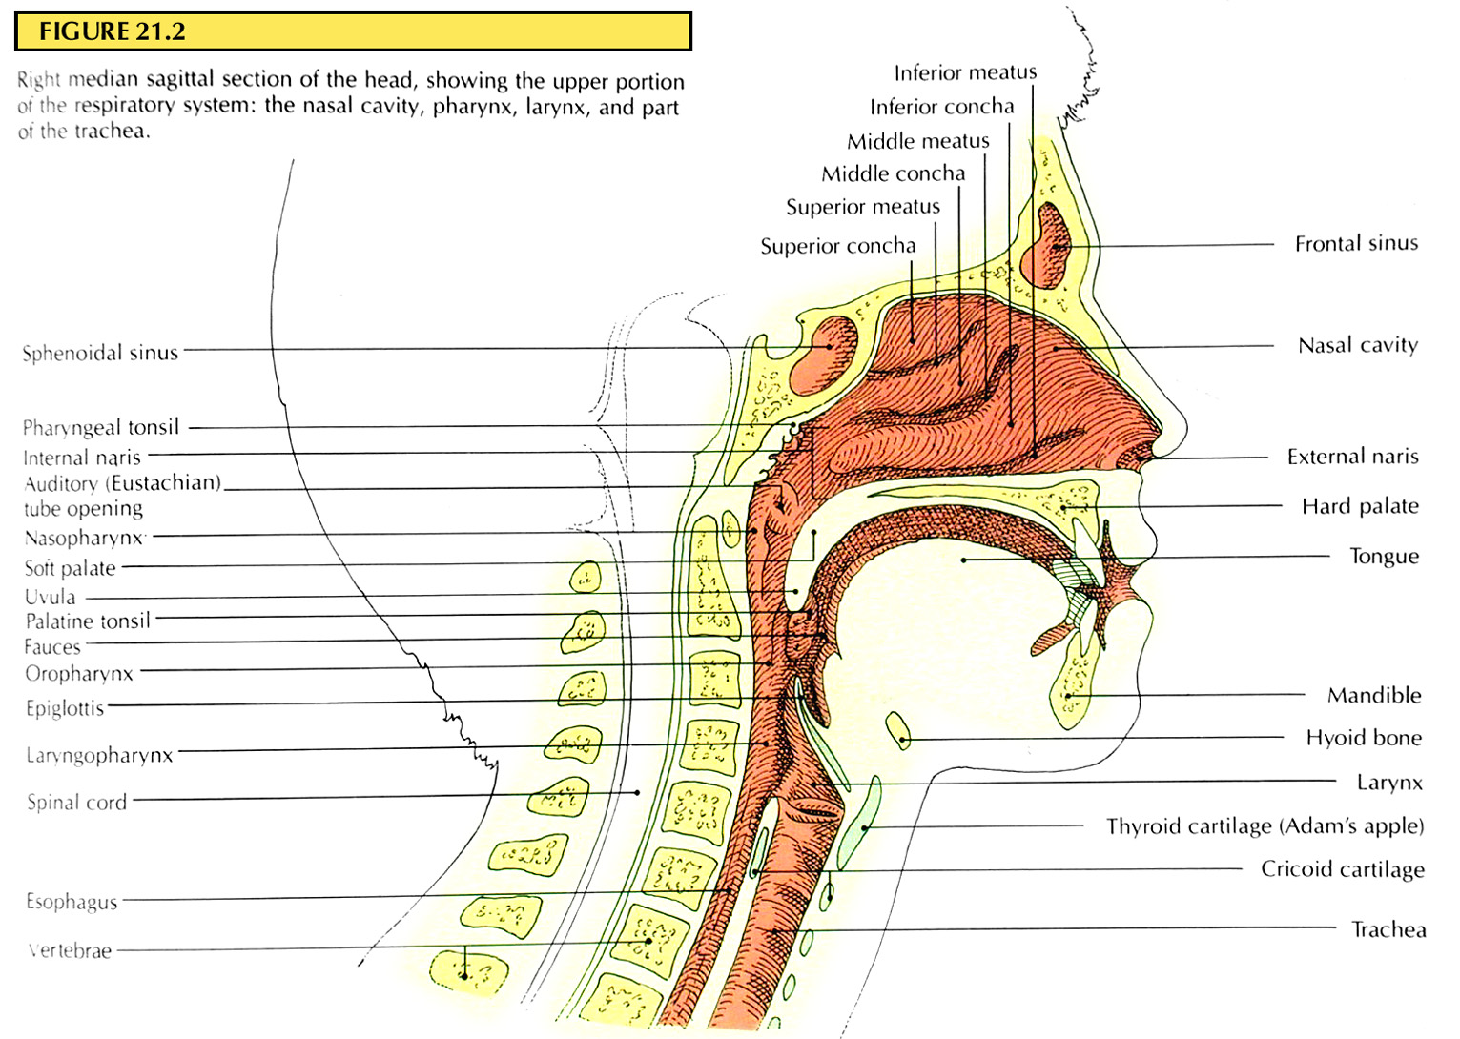
Upper portion of the respiratory system
As air passes through the nose, three distinct normal respiratory functions are performed by the nasal cavities:
(1) the air is warmed by the extensive surfaces of the conchae and septum, a total area of about 160 square cm
(2) the air is almost completely humidified even before it passes beyond the nose; and
(3) the air is partially filtered.
These functions together are called the air conditioning function of the upper respiratory passageways.
Ordinarily, the temperature of the inspired air rises to within 1°F of body temperature and to within 2 to 3 % of full saturation with water vapor before it reaches the trachea.
(A temperature interval of 1 °F is equal to an interval of ⁵⁄₉ degrees Celsius)

Slide 5
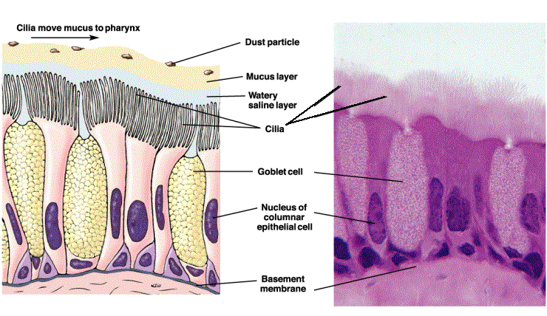
Respiratory epithelium

Slide 6
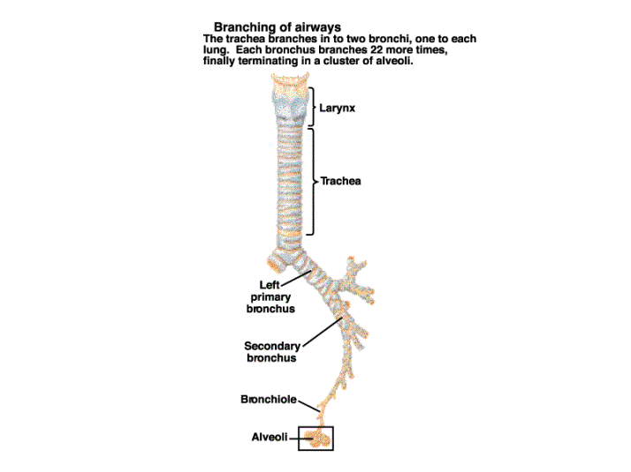

Slide 7
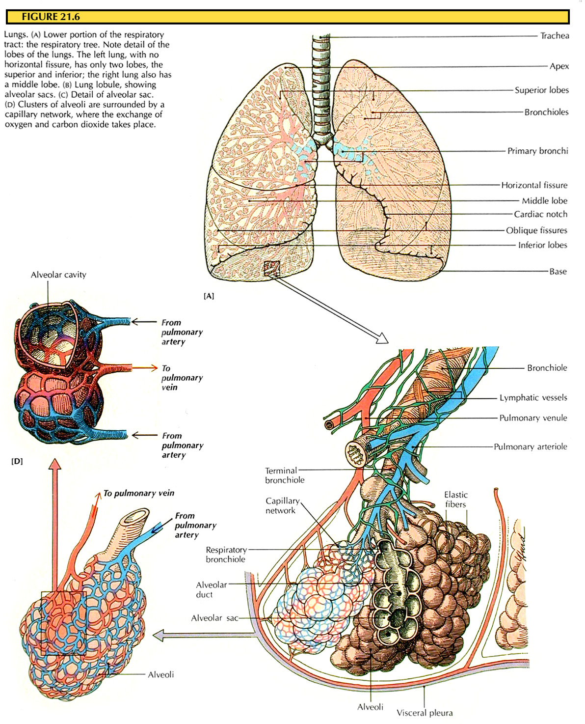
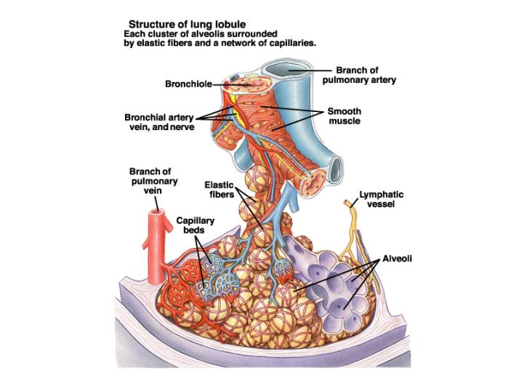
Lower portion of respiratory system
Cluster of alveoli

Slide 8
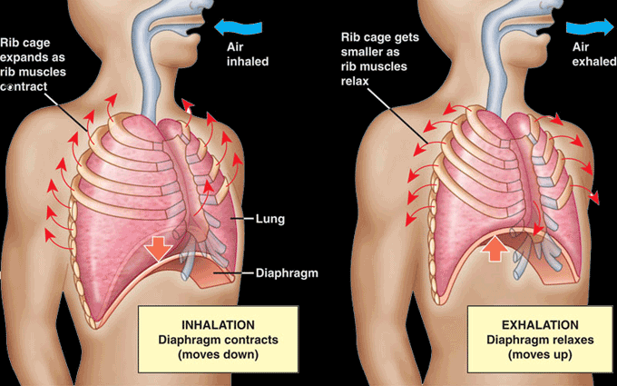
The phases of breathing

Slide 9
Mechanics of Pulmonary Ventilation
The lungs can be expanded and contracted in two ways:
(1) by downward and upward movement of the diaphragm to lengthen or shorten the chest cavity, and
(2) by elevation and depression of the ribs to increase and decrease the anterior-posterior diameter of the chest cavity.

Slide 10
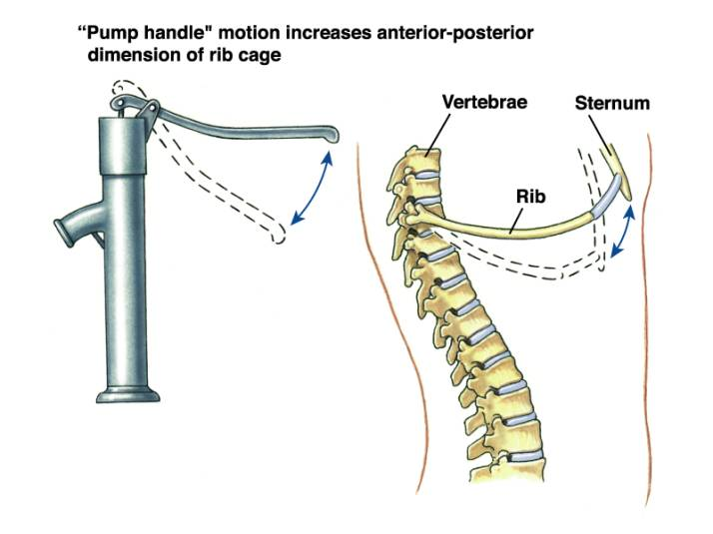
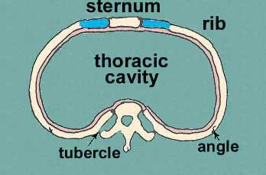
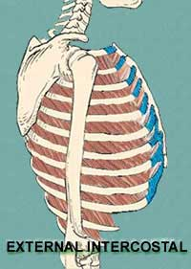
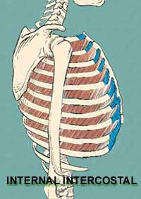
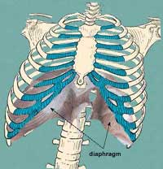
Mechanics of Pulmonary Ventilation

Slide 11
Respiratory muscles
The most important muscles that raise the rib cage are the external intercostals, but others that help are the (1) sternocleidomastoid muscles, which lift upward on the sternum; (2) anterior serrati, which lift many of the ribs; and (3) scaleni, which lift the first two ribs.
The muscles that pull the rib cage downward during expiration are mainly the (1) abdominal recti, which have the powerful effect of pulling downward on the lower ribs at the same time that they and other abdominal muscles also compress the abdominal contents upward against the diaphragm, and (2) internal intercostals.

Slide 12
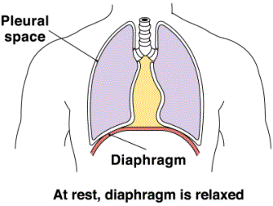
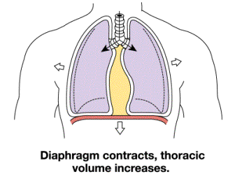
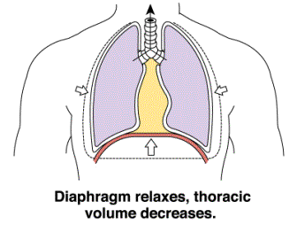

Slide 13
Effect of the Thoracic Cage on Lung Expansibility
The thoracic cage has its own elastic and viscous characteristics, similar to those of the lungs; even if the lungs were not present in the thorax, muscular effort would still be required to expand the thoracic cage.
The compliance of the entire pulmonary system (the lungs and thoracic cage together) is measured while expanding the lungs of a totally relaxed or paralyzed person.
To do this, air is forced into the lungs a little at a time while recording lung pressures and volumes.
To inflate this total pulmonary system, almost twice as much pressure is needed as to inflate the same lungs after removal from the chest cage.

Slide 14
Therefore, the compliance of the combined lung-thorax system is almost exactly one half that of the lungs alone =110 ml of volume per cm of water pressure for the combined system, compared with 200 ml/cm water pressure for the lungs alone.
The characteristics of the compliance diagram are determined by the elastic forces of the lungs.
These can be divided into two parts: (1) elastic forces of the lung tissue itself and (2) elastic forces caused by surface tension of the fluid that lines the inside walls of the alveoli and other lung air spaces.

Slide 15
Movement of Air In and Out of the Lungs and the Pressures That Cause the Movement
The lung is an elastic structure that collapses like a balloon and expels all its air through the trachea whenever there is no force to keep it inflated.
Also, there are no attachments between the lung and the walls of the chest cage, except where it is suspended at its hilum from the mediastinum.
Instead, the lung “floats” in the thoracic cavity, surrounded by a thin layer of pleural fluid that lubricates movement of the lungs within the cavity.
Further, continual suction of excess fluid into lymphatic channels maintains a slight suction between the visceral surface of the lung pleura and the parietal pleural surface of the thoracic cavity.
Therefore, the lungs are held to the thoracic wall as if glued there, except that they are well lubricated and can slide freely as the chest expands and contracts.

Slide 16
Pleural pressure is the pressure of the fluid in the thin space between the lung pleura and the chest wall pleura.
This is normally a slight suction, which means a slightly negative pressure.
The normal pleural pressure at the beginning of inspiration is about –5 cm of water, which is the amount suction required to hold the lungs open to their resting level.
Then, during normal inspiration, expansion of the chest cage pulls outward on the lungs with greater force and creates more negative pressure, to an av. of about –7.5 cm of water.

Slide 17
Alveolar pressure is the pressure of the air inside the lung alveoli.
When the glottis is open and no air is flowing into or out of the lungs, the pressures in all parts of the respiratory tree, all the way to the alveoli, are equal to atmospheric pressure, which is considered to be zero reference pressure in the airways - that is, 0 cm water pressure.
To cause inward flow of air into the alveoli during inspiration, the pressure in the alveoli must fall to a value slightly below atmospheric pressure (below 0).

Slide 18
Transpulmonary Pressure
The difference between the alveolar pressure and the pleural pressure is called the transpulmonary pressure.
It is the pressure difference between that in the alveoli and that on the outer surfaces of the lungs, and
it is a measure of the elastic forces in the lungs that tend to collapse the lungs at each instant of respiration, called the recoil pressure.

Slide 20
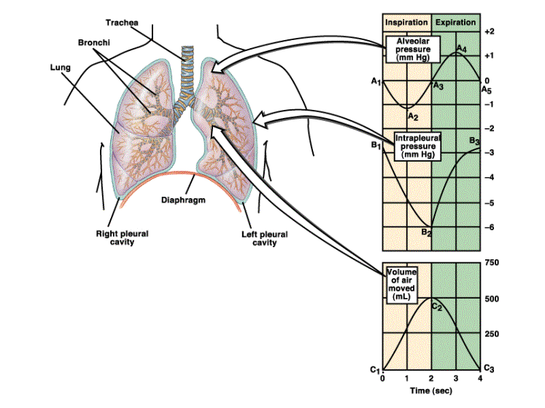

Slide 21
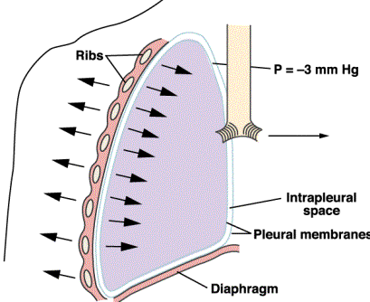
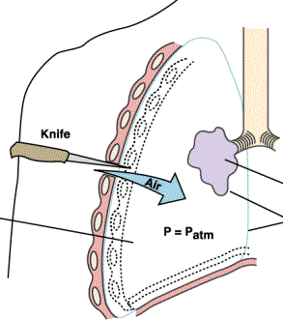
Collapse of the lung, when
atmospheric pressure = pleural pressure

Slide 22
Surfactant, Surface Tension, and Collapse of the Alveoli
When water forms a surface with air, the water molecules on the surface of the water have an especially strong attraction for one another. As a result, the water surface is always attempting to contract.
This results in an attempt to force the air out of the alveoli through the bronchi and, in doing so, causes the alveoli to try to collapse.
The net effect is to cause an elastic contractile force of the entire lungs, which is called the surface tension elastic force.

Slide 23
Surfactant and Its Effect on Surface Tension.
Surfactant is a surface active agent in water, which means that it greatly reduces the surface tension of water.
It is secreted by special surfactant-secreting epithelial cells called type II alveolar epithelial cells, which constitute about 10 % of the surface area of the alveoli.
These cells are granular, containing lipid inclusions that are secreted in the surfactant into the alveoli.
Surfactant is a complex mixture of several phospholipids, proteins, and ions.
The most important components are the phospholipid dipalmitoylphosphatidylcholine, surfactant apoproteins, and calcium ions.

Slide 24
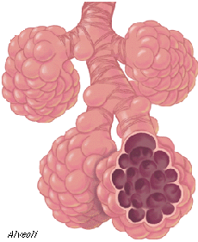
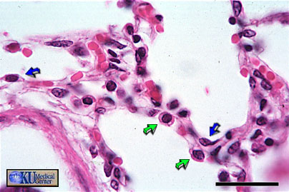
alveoli
Lung cells that produce surfactant

Slide 25
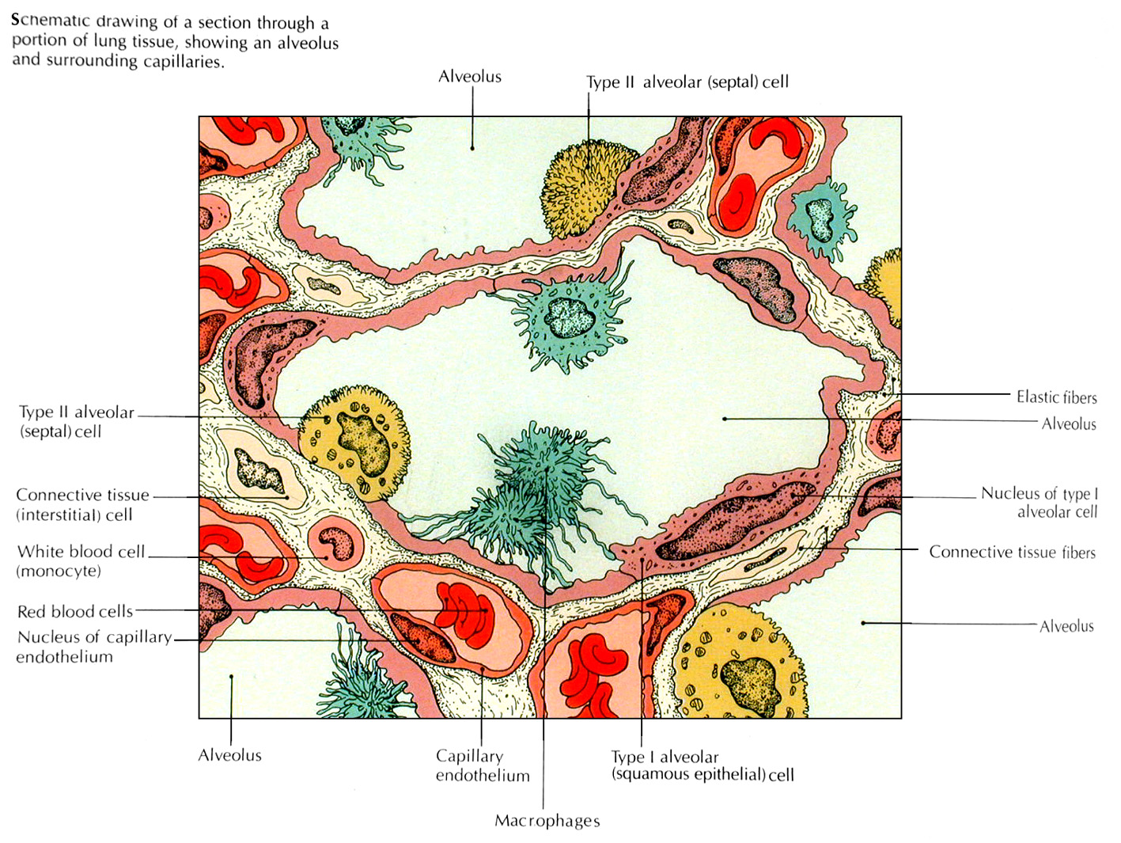

Slide 26
Pressure in Occluded Alveoli Caused by Surface Tension
If the air passages leading from the alveoli of the lungs are blocked, the surface tension in the alveoli tends to collapse the alveoli. This creates positive pressure in the alveoli, attempting to push the air out.
The amount of pressure generated in this way in an alveolus can be calculated from the following formula:
Pressure=2 x Surface tension/Radius of alveolus
For the average-sized alveolus with a radius of about 100 μm and lined with normal surfactant, this calculates to be about 4 cm of water pressure (3 mm Hg). If the alveoli were lined with pure water without any surfactant, the pressure would calculate to be about 18 cm of water pressure, 4.5 times as great. Thus, one sees how important surfactant is in reducing alveolar surface tension and therefore also reducing the effort required by the respiratory muscles to expand the lungs.
Many premature babies have little or no surfactant in the alveoli when they are born, and their lungs have an extreme tendency to collapse, sometimes as great as 6 to 8 times that in a normal adult person. This causes the condition called respiratory distress syndrome of the newborn.

Slide 27
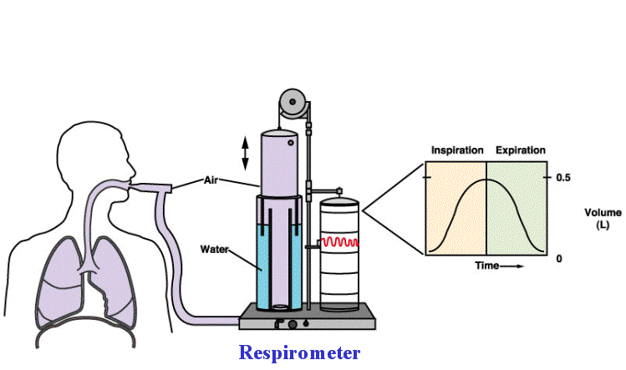
spirometry

Slide 28
Pulmonary Volumes
1. The tidal volume is the volume of air inspired or expired with each normal breath; it amounts to about 500 ml in the adult male.
2. The inspiratory reserve volume is the extra volume of air that can be inspired over and above the normal tidal volume when the person inspires with full force; it is usually equal to about 3000 ml.
3. The expiratory reserve volume is the maximum extra volume of air that can be expired by forceful expiration after the end of a normal tidal expiration; this normally amounts to about 1100 ml.
4. The residual volume is the volume of air remaining in the lungs after the most forceful expiration; this volume averages about 1200 ml.

Slide 29
Pulmonary Capacities
1. The inspiratory capacity equals the tidal volume plus the inspiratory reserve volume. This is the amount of air (about 3500 ml) a person can breathe in, beginning at the normal expiratory level and distending the lungs to the maximum amount.
2. The functional residual capacity equals the expiratory reserve volume plus the residual volume. This is the amount of air that remains in the lungs at the end of normal expiration (about 2300 ml).
3. The vital capacity equals the inspiratory reserve volume plus the tidal volume plus the expiratory reserve volume. This is the maximum amount of air a person can expel from the lungs after first filling the lungs to their maximum extent and then expiring to the maximum extent (av. 4600 ml).
4. The total lung capacity is the maximum volume to which the lungs can be expanded with the greatest possible effort (about 5800 ml); it is equal to the vital capacity plus the residual volume.
All pulmonary volumes and capacities are about 20 to 25 % less in women than in men, and they are greater in large and athletic people than in small and asthenic people.

Slide 30
Pulmonary ventilation
The minute respiratory volume is the total amount of new air moved into the respiratory passages each minute; this is equal to the tidal volume times the respiratory rate per minute. The normal tidal volume is about 500 milliliters, and the normal respiratory rate is about 12 breaths per minute. Therefore, the minute respiratory volume averages about 6 L/min.
Alveolar ventilation per minute is the total volume of new air entering the alveoli and adjacent gas exchange areas each minute. It is equal to the respiratory rate times the amount of new air that enters these areas with each breath.
A V=RR•(TV –DV)
where AV is the volume of alveolar ventilation per minute, RR is the frequency of respiration per minute, TV is the tidal volume, and DV is the physiologic dead space volume.
Thus, with a normal tidal volume of 500 ml, a normal dead space of 150 ml, and a respiratory rate of 12 breaths per minute, alveolar ventilation equals 4,2 L/min.

Slide 31
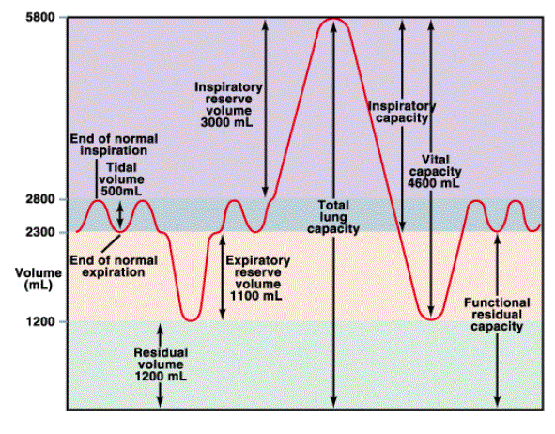
Pulmonary volumes and capacities

Slide 32
Physics of Gas Diffusion and Gas
Partial Pressures
Gas Pressures in a Mixture of Gases - “Partial Pressures” of Individual Gases
Pressure is caused by multiple impacts of moving molecules against a surface.
The pressure of a gas acting on the surfaces of the respiratory passages and alveoli is proportional to the summated force of impact of all the molecules of that gas striking the surface at any given instant.
This means that the pressure is directly proportional to the concentration of the gas molecules.
In respiratory physiology, one deals with mixtures of gases, mainly of oxygen, nitrogen, and carbon dioxide.
The rate of diffusion of each of these gases is directly proportional to the pressure caused by that gas alone, which is called the partial pressure of that gas.

Slide 33
Consider air, which has an approximate composition
Of 79 % nitrogen and 21 % oxygen and 0,04% of carbon dioxide and inert gases.
The total pressure of this mixture at sea level averages760 mm Hg.
It is clear from the preceding description of the molecular basis of pressure that each gas contributes to the total pressure in direct proportion to its concentration.
Therefore, 79 % of the 760 mm Hg is caused by nitrogen (600 mm Hg) and 21 % by oxygen (160 mm Hg).
Thus, the “partial pressure” of nitrogen in the mixture is 600 mm Hg, and the “partial pressure” of oxygen is 160 mm Hg; the total pressure is 760 mm Hg, the sum of the individual partial pressures.
The partial pressures of individual gases in a mixture are designated by the symbols pO₂, pCO₂, pN₂.

Slide 34
Factors That Determine the Partial Pressure of a Gas Dissolved in a Fluid
The partial pressure of a gas in a solution is determined not only by its concentration but also by the solubility coefficient of the gas.
These relations are expressed by the following formula, which is Henry’s law:
Partial pressure = Concentration of dissolved gas / Solubility coefficient
Carbon dioxide is more than 20 times as soluble as oxygen.
Therefore, the partial pressure of carbon dioxide (for a given concentration) is less than one twentieth that exerted by oxygen.

Slide 35
Diffusion of Gases Between the Gas Phase in the Alveoli and the Dissolved Phase in the Pulmonary Blood
The partial pressure of each gas in the alveolar respiratory gas mixture tends to force molecules of that gas into solution in the blood of the alveolar capillaries.
Conversely, the molecules of the same gas that are already dissolved in the blood are bouncing randomly in the fluid of the blood, and some of these bouncing molecules escape back into the alveoli.
The rate at which they escape is directly proportional to their partial pressure in the blood.
But in which direction will net diffusion of the gas occur? The answer is that net diffusion is determined by the difference between the two partial pressures.

Slide 36
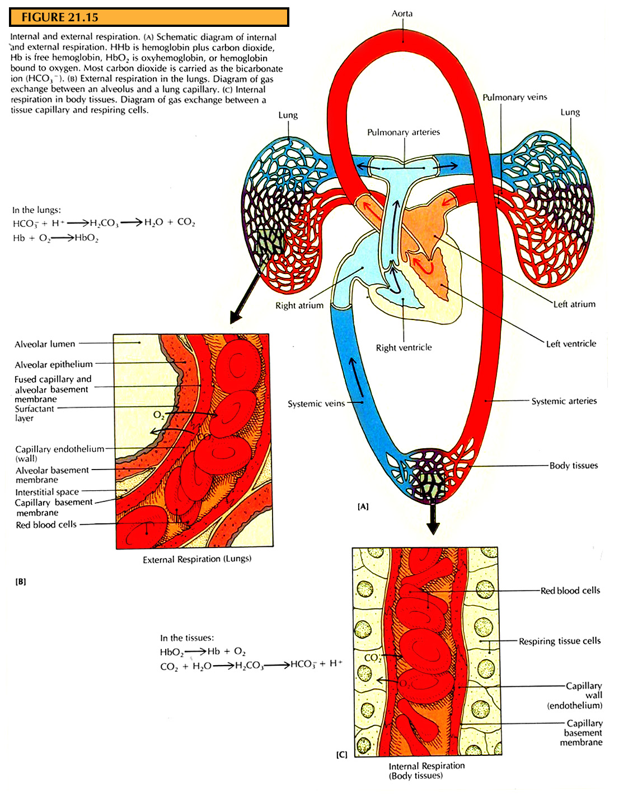

Slide 37
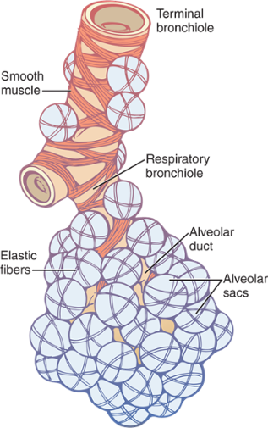
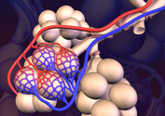
Diffusion of Gases Through the Respiratory Membrane
Respiratory Unit, which is composed of a respiratory bronchiole, alveolar ducts, atria, and alveoli.
The alveolar walls are extremely thin, and between the alveoli is an almost solid network of interconnecting capillaries.

Slide 38
Respiratory Membrane
Layers of the respiratory membrane:
1. A layer of fluid lining the alveolus and containing surfactant that reduces the surface tension of the alveolar fluid
2. The alveolar epithelium composed of thin epithelial cells
3. An epithelial basement membrane
4. A thin interstitial space between the alveolar epithelium and the capillary membrane
5. A capillary basement membrane that in many places fuses with the alveolar epithelial basement membrane
6. The capillary endothelial membrane

Slide 39
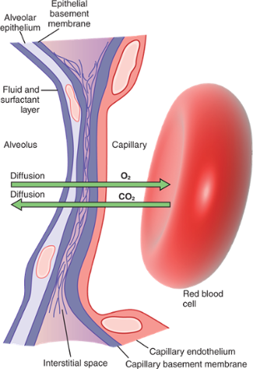
Ultra structure of the alveolar respiratory membrane, shown in cross section

Slide 40
Factors That Affect the Rate of Gas Diffusion Through the Respiratory Membrane:
(1) the thickness of the membrane,
(2) the surface area of the membrane,
(3) the diffusion coefficient of the gas in the substance of the membrane, and
(4) the partial pressure difference of the gas between the two sides of the membrane.

Slide 41
Diffusing Capacity of the Respiratory Membrane
Diffusing Capacity for Oxygen
Diffusing capacity for oxygen under resting conditions averages 21 ml/min/mm Hg
The mean oxygen pressure difference across the respiratory membrane during normal, quiet breathing is about 11 mm Hg. Multiplication of this pressure by the diffusing capacity gives a total of about 230 ml of oxygen diffusing through the respiratory membrane each minute; this is equal to the rate at which the resting body uses oxygen.
Diffusing Capacity for Carbon Dioxide
Expected diffusing capacity for carbon dioxide under resting conditions av. 400 to 450 ml/min/ mm Hg
Carbon dioxide diffuses through the respiratory membrane so rapidly that the average pCO₂ in the pulmonary blood is not far different from the pCO₂ in the alveoli - the average difference is less than 1 mm Hg — and with the available techniques, this difference is too small to be measured.

Slide 42
Gas Exchange and Alveolar Partial Pressures When Ventilation/perfusion ratio is normal
When there is both normal alveolar ventilation and normal alveolar capillary blood flow (normal alveolar perfusion), exchange of oxygen and carbon dioxide through the respiratory membrane is nearly optimal,
and alveolar pO₂ is normally at a level of 104 mm Hg, which lies between that of the inspired air (149 mm Hg) and that of venous blood (40 mm Hg).
Likewise, alveolar pCO₂ lies between two extremes; it is normally 40 mm Hg, in contrast to 45 mm Hg in venous blood and 0 mm Hg in inspired air.
Thus, under normal conditions, the alveolar air pO₂ averages 104 mm Hg and the pCO₂ averages 40 mm Hg.

Slide 43
respiratory quotient (RQ)
The cells of the body consume an average 250 ml of oxygen per minute and produce about 200 ml of carbon dioxide per minute.
The ratio of the carbon dioxide produced over the oxygen consumed is called the respiratory quotient.
Hence, the av. respiratory quotient is 0.8.

Slide 44
We will discuss:
Diffusion of Oxygen from the Alveoli to the Pulmonary Capillary Blood
the initial pressure difference that causes oxygen to diffuse into the pulmonary capillary is 104 – 40, or 64 mm Hg
Diffusion of Oxygen from the Peripheral Capillaries to the Tissue Cells
the normal intracellular pO₂ ranges from as low as 5 mm Hg to as high as 40 mm Hg
Diffusion of Carbon Dioxide from the Peripheral Tissue Cells into the Capillaries and from the Pulmonary Capillaries into the Alveoli

Slide 45
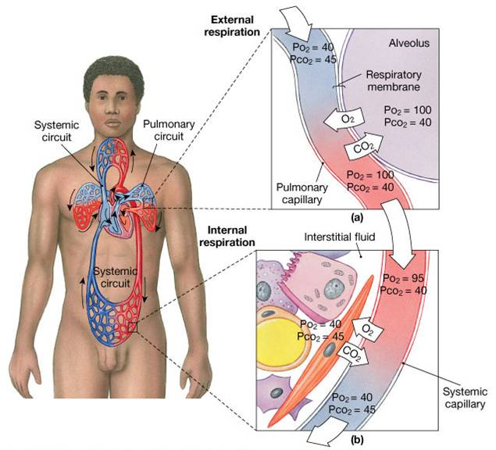
Gas exchange

Slide 46
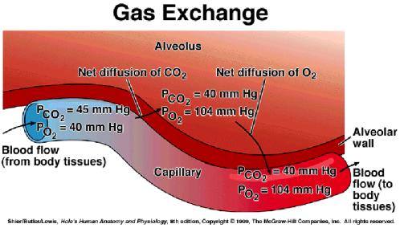
When blood first arrives at the pulmonary capillary at its arteriole end, the partial pressures of carbon dioxide and oxygen are: pCO₂= 45 mm Hg, pO₂ = 40 mm Hg.

Slide 47
Transport of Oxygen from the Lungs to the Body Tissues
Once oxygen has diffused from the alveoli into the pulmonary blood, it is transported to the peripheral tissue capillaries almost entirely in combination with hemoglobin.
The presence of hemoglobin in the red blood cells allows the blood to transport 30 to 100 times as much oxygen as could be transported in the form of dissolved oxygen in the water of the blood.
Normally, about 97 % of the oxygen transported from the lungs to the tissues is carried in chemical combination with hemoglobin in the red blood cells.
The remaining 3 % is transported in the dissolved state in the water of the plasma and blood cells.

Slide 48
Oxygen-Hemoglobin Dissociation Curve
The oxygen-hemoglobin dissociation curve, which demonstrates a progressive increase in the percentage of hemoglobin bound with oxygen as blood pO₂ increases, which is called the per cent saturation of hemoglobin.
Because the blood leaving the lungs and entering the systemic arteries usually has a pO₂ of about 95 mm Hg, one can see from the dissociation curve that the usual oxygen saturation of systemic arterial blood averages 97 %.
Conversely, in normal venous blood returning from the peripheral tissues, the pO₂ is about 40 mm Hg, and the saturation of hemoglobin averages 75 %.

Slide 49
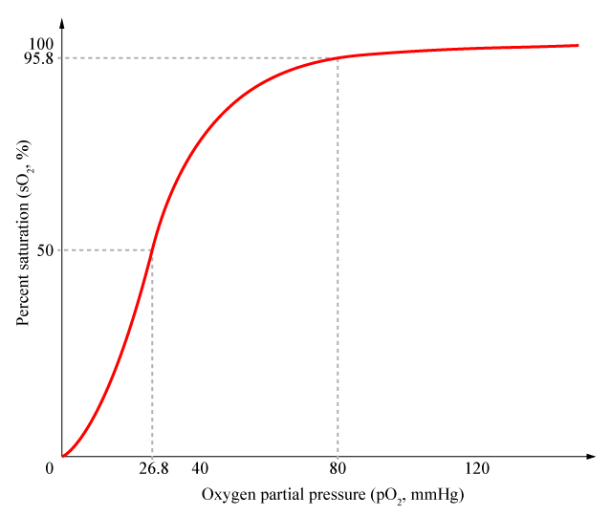
oxygen-hemoglobin dissociation curve

Slide 50
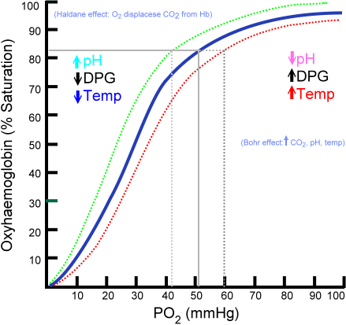
Factors That Shift the Oxygen-Hemoglobin Dissociation Curve:

Slide 51
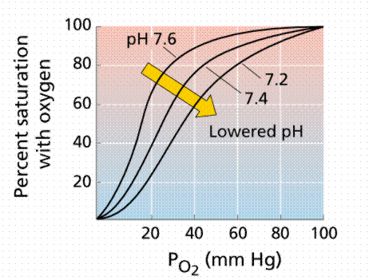

Slide 52
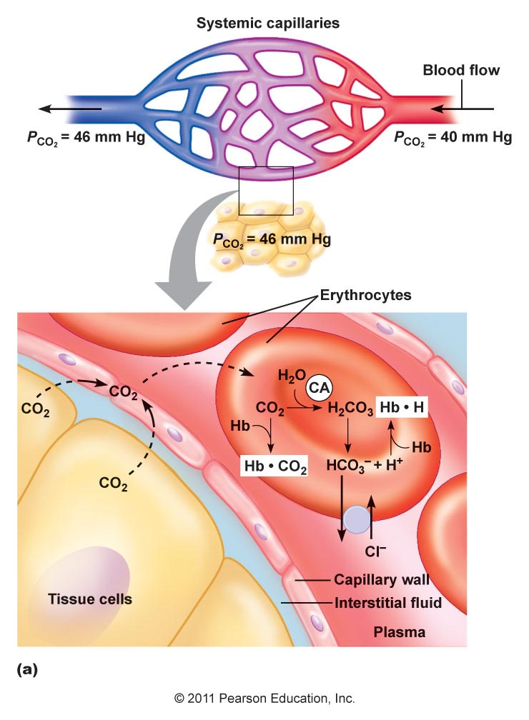
Diffusion of carbon dioxide in the tissues

Slide 53
Chemical Forms in Which Carbon Dioxide Is Transported
Transport of Carbon Dioxide in the Form of Bicarbonate Ion – 70%
Transport of Carbon Dioxide in Combination with Hemoglobin (Carbaminohemoglobin) - 23%
Transport of Carbon Dioxide in the Dissolved State - 7%

Slide 54
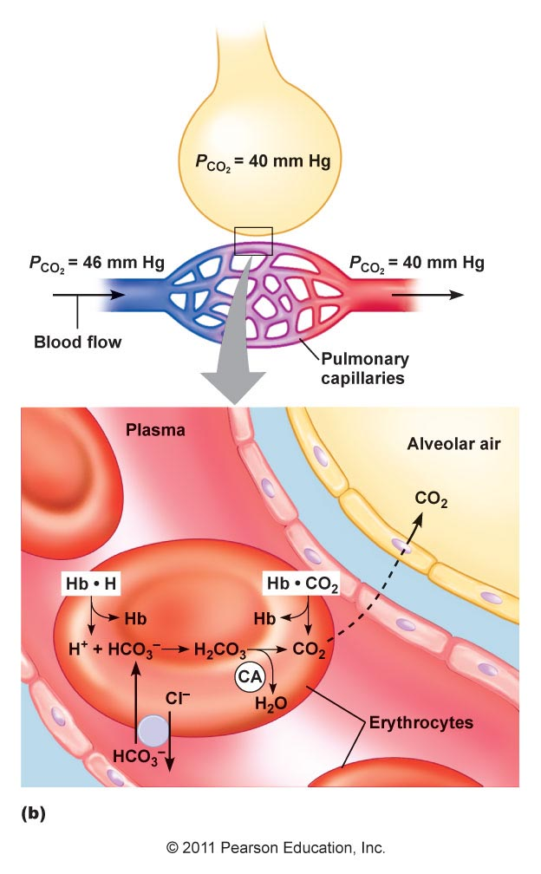
Diffusion of carbon dioxide in the alveolus

Slide 55
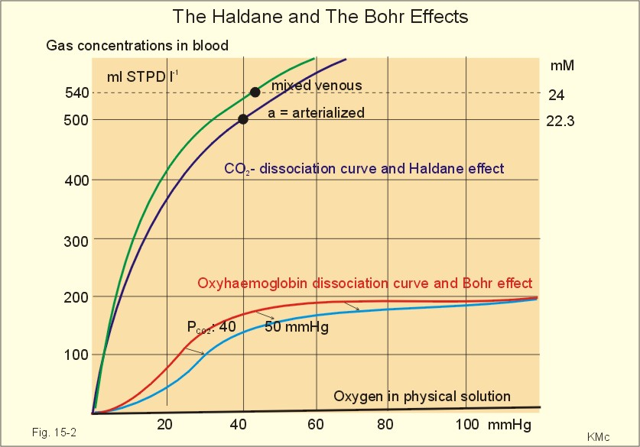

Slide 56

Тhanks for your attention!

