Slide 1

The body fluid compartments: extracellular and intracellular fluids. Regulation of the fluid volume and osmolarity.
Acid - base balance regulation
MEDICAL UNIVERSITY – PLEVEN
FACULTY OF MEDICINE
DISTANCE LEARNING CENTER
Lecture № 19
Assoc. Prof. Boryana Ruseva, MD, PhD
Department of Physiology
Medical University-Pleven

Slide 2
The maintenance of a relatively constant volume and a stable composition of the body fluids is essential for homeostasis.
In the average 70-kg adult human, the total body water is about 60 % of the body weight, or about 42 liters.
This percentage can change, depending
on age, gender, and degree of obesity.

Slide 3
Daily Intake of Water
(1) it is ingested in the form of liquids or water in the food, which together normally add about 2300 ml/day to the body fluids, and
(2) it is synthesized in the body as a result of oxidation of carbohydrates, adding about 200 ml/day.
This provides a total water intake of about 2500 ml/day
Intake of water, however, is highly variable among different people and even within the same person on different days, depending on climate, habits, and level of physical activity.

Slide 4
Daily Loss of Body Water
Water Loss by the Kidneys –from 0,5 l to 1,5 l/day
Water Loss in Feces - Only a small amount of water (100 ml/day) normally is lost in the feces.
Fluid Loss in Sweat - The amount of water lost by sweating is highly variable, depending on physical activity and environmental temperature. The volume of sweat normally is about 100 ml/day, but in very hot weather or during heavy exercise, water loss in sweat occasionally increases to 1 to 2 l/hour.
Insensible Water Loss - a continuous loss of water by evaporation from the respiratory tract and diffusion through the skin, which together account for about 700 ml/day of water loss under normal conditions.

Slide 5
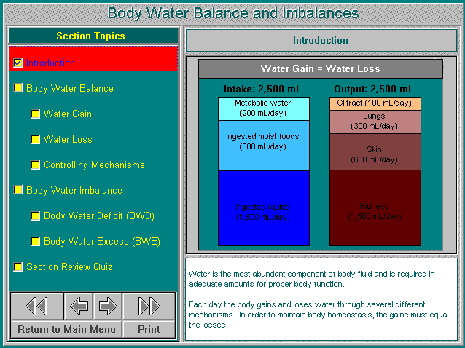

Slide 6
Body Fluid Compartments
The total body fluid is distributed mainly between two compartments:
I. the intracellular fluid (40%) and
II. the extracellular fluid (20%):
Interstitial fluid - (14%)
Intravasal fluid (blood plasma) - (5%)
Transcellular fluid - (1%)

Slide 7
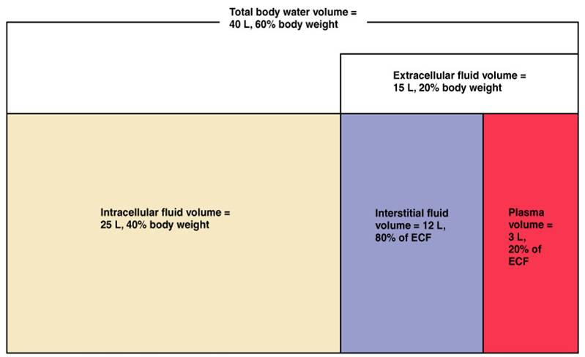
Body fluid compartments

Slide 8
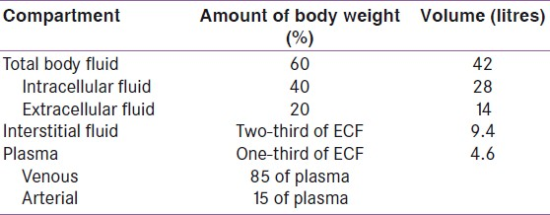
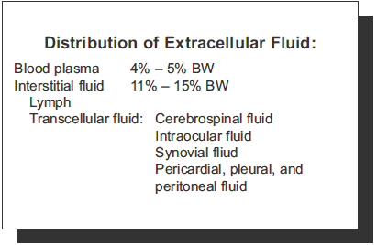

Slide 9
Constituents of Extracellular and Intracellular Fluids
Because the plasma and interstitial fluid are separated only by highly permeable capillary membranes, their ionic composition is similar.
The most important difference between these two compartments is the higher concentration of protein in the plasma; because the capillaries have a low permeability to the plasma proteins, only small amounts of proteins are leaked into the interstitial spaces in most tissues.

Slide 10
The extracellular fluid, including the plasma and the interstitial fluid, contains large amounts of sodium and chloride ions, reasonably large amounts of bicarbonate ions, but only small quantities of potassium, calcium, magnesium, phosphate, and organic acid ions.
The composition of extracellular fluid is carefully regulated by various mechanisms, but especially by the kidneys.
This allows the cells to remain continually bathed in a fluid that contains the proper concentration of electrolytes and nutrients for optimal cell function.

Slide 11
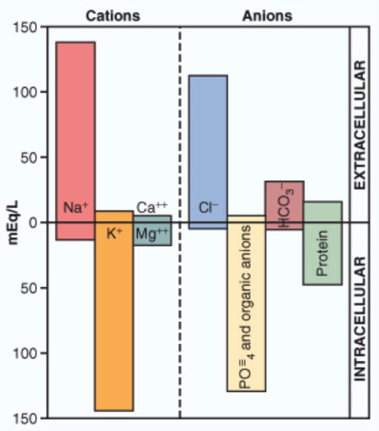
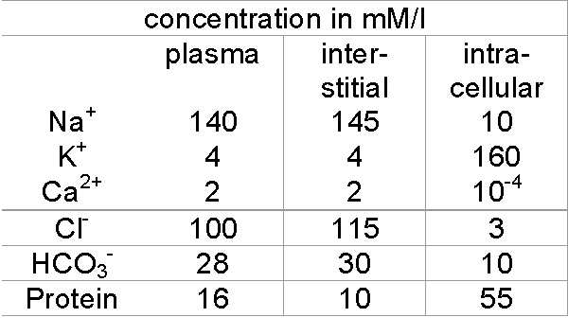

Slide 12
Regulation of Fluid Exchange and Osmotic Equilibrium
Between Intracellular and
Extracellular Fluid
A frequent problem in treating seriously ill patients is maintaining adequate fluids in one or both of the intracellular and extracellular compartments.
The relative amounts of extracellular fluid distributed between the plasma and interstitial spaces are determined mainly by the balance of hydrostatic and colloid osmotic forces across the capillary membranes.

Slide 13
Osmosis is the net diffusion of water across a selectively permeable membrane from a region of high water concentration to one that has a lower water concentration.
When a solute is added to pure water, this reduces the concentration of water in the mixture. Thus, the higher the solute concentration in a solution, the lower the water concentration.
Further, water diffuses from a region of low solute concentration (high water concentration) to one with a high solute concentration (low water concentration).
The term osmole refers to the number of osmotically active particles in a solution rather than to the molar concentration.
The term milliosmole (mOsm), which equals 1/1000 osmole, is commonly used.

Slide 14
Osmosis of water molecules across a selectively permeable membrane can be opposed by applying a pressure in the direction opposite that of the osmosis.
The precise amount of pressure required to prevent the osmosis is called the osmotic pressure.
The distribution of fluid between intracellular and extracellular compartments, in contrast, is determined mainly by the osmotic effect of the smaller solutes - especially sodium, chloride, and other electrolytes - acting across the cell membrane.
The reason for this is that the cell membranes are highly permeable to water but relatively impermeable to even small ions such as sodium and chloride.
Therefore, water moves across the cell membrane rapidly, so that the intracellular fluid remains isotonic with the extracellular fluid.

Slide 15
Isosmotic, Hyperosmotic, and Hypo-osmotic Fluids
The terms isotonic, hypotonic, and hypertonic refer to whether solutions will cause a change in cell volume.
The tonicity of solutions depends on the concentration of impermeant solutes. Some solutes, however, can permeate the cell membrane.
Solutions with an osmolarity the same as the cell are called isosmotic, regardless of whether the solute can penetrate the cell membrane. Osmolality of blood plasma averages about 290 mOsm/kg H2O. For humans 0,9% solution of sodium chloride is isosmotic.
The terms hyperosmotic and hypo-osmotic refer to solutions that have a higher or lower osmolarity, respectively, compared with the normal extracellular fluid, without regard for whether the solute permeates the cell membrane.

Slide 16
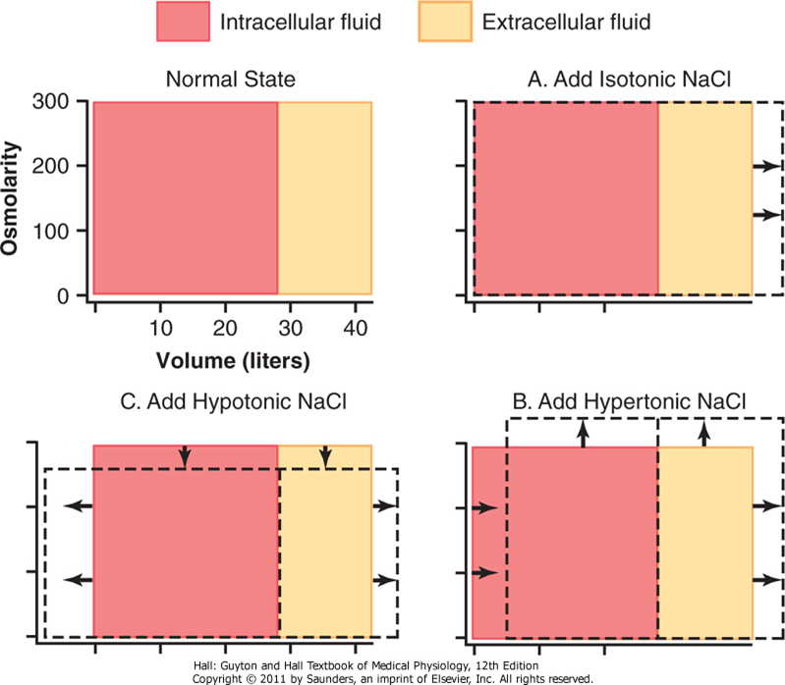
Effect of adding isotonic, hypertonic, and hypotonic solutions to the extracellular fluid after osmotic equilibrium.
The normal state is indicated by the solid lines, and the shifts from normal are shown by the shaded areas.
The volumes of intracellular and extracellular fluid compartments are shown in the abscissa of each diagram, and the osmolarities of these compartments are shown on the ordinates.

Slide 17
The concentration of positively charged ions (cations) is slightly greater (about 2 %) in the plasma than in the interstitial fluid.
The plasma proteins have a net negative charge and, therefore, tend to bind cations, such as sodium and potassium ions, thus holding extra amounts of these cations in the plasma along with the plasma proteins.
Conversely, negatively charged ions (anions) tend to have a slightly higher concentration in the interstitial fluid compared with the plasma, because the negative charges of the plasma proteins repel the negatively charged anions.

Slide 18
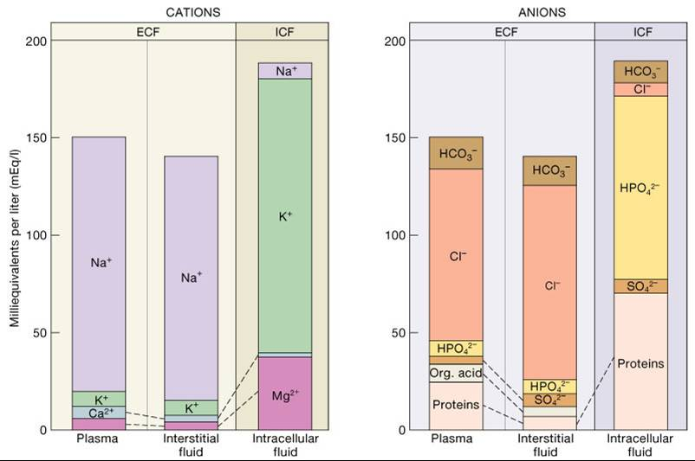
Ions composition of body fluids

Slide 19
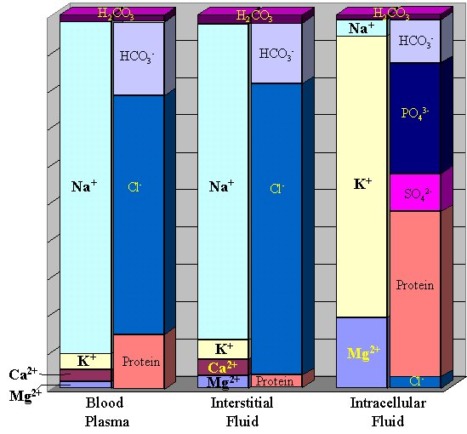
Ions composition of body fluids

Slide 20
Regulation of Extracellular Fluid Osmolarity and Sodium Concentration
For the cells of the body to function properly, they must be bathed in extracellular fluid with a relatively constant concentration of electrolytes and other solutes. The total concentration of solutes in the extracellular fluid - and therefore the osmolarity - is determined by the amount of solute divided by the volume of the extracellular fluid.
Thus, to a large extent, extracellular fluid sodium concentration and osmolarity are regulated by the amount of extracellular water.
The body water in turn is controlled by:
(1) fluid intake, which is regulated by factors that determine thirst, and
(2) renal excretion of water, which is controlled by multiple factors that influence glomerular filtration and tubular reabsorption.

Slide 21
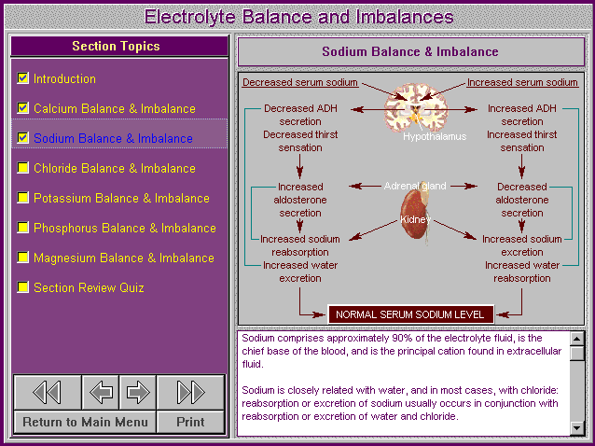

Slide 22
Abnormalities of Body Fluid Volume Regulation: Hyponatremia and Hypernatremia
Hypo-osmotic dehydration - Adrenal insufficiency; overuse of diuretics
Hypo-osmotic overhydration - Excess ADH; bronchogenic tumor
Hyper-osmotic dehydration - Diabetes insipidus; excessive sweating
Hyper-osmotic overhydration - Cushing’s disease; primary aldosteronism

Slide 23
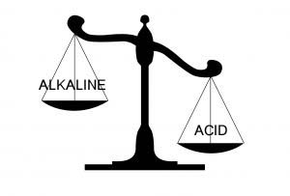
Regulation of Acid-Base Balance
Regulation of hydrogen ion (H⁺) balance is similar in some ways to the regulation of other ions in the body.
Precise hydrogen ion regulation is essential because the activities of almost all enzyme systems in the body are influenced by hydrogen ion concentration [H⁺]. Therefore, changes in hydrogen concentration alter virtually all cell and body functions.

Slide 24
Molecules containing hydrogen atoms that can release hydrogen ions in solutions are referred to as acids.
Daily production of acid is the basic challenge:
1. 13000 - 20000 mmol of CO₂ / day are produced by metabolism. CO₂ is in equilibrium with H₂CO₃. Both are considered volatile acids.
2. nonvolatile or fixed acids - 40 - 60 mmol / day (H₂SO₄; H₂ PO₄; organic acids - from metabolism of phospholipids, carbohydrates and fats).
Because H⁺ concentration normally is low and because these small numbers are cumbersome, it is customary to express H⁺ concentration on a logarithm scale, using pH units.
The pH of a solution is defined as the negative logarithm of the H⁺ concentration.
pH= - log [ H⁺]

Slide 25
The normal pH of arterial blood is 7.4 ± 0.05
(from 7.35 to 7.45).
The pH of venous blood and interstitial fluids is about 7.35 because of the extra amount of CO₂ released from the tissues to form H₂CO₃ in these fluids.
The lower limit of pH of arterial blood at which a person can live more then of a few hours is about 6.8, and the upper limit is about 8.0.
Intracellular pH is slightly lower than plasma pH.
When the pH falls below 7.35, a person is considered to have acidosis and to have alkalosis when the pH rises above 7.45.

Slide 26
There are three primary systems that regulate the hydrogen ion concentration in the body fluids to prevent acidosis or alkalosis:
1. the chemical acid - base buffer systems of the body fluids, which immediately combine with acid or base to prevent excessive changes in H⁺ concentration
2. the respiratory center, which regulates the removal of CO₂ (and therefore H₂CO₃) from the extracellular fluid
3. the kidneys, which can excrete either acid urine, or alkaline urine thereby readjusting the extracellular fluid hydrogen ion concentration toward normal during acidosis or alkalosis.

Slide 27
Buffering of hydrogen ions in the body fluids
When there is a change in H⁺ concentration the buffer systems of the body fluids react within a fraction of a second to minimize these changes. Buffer systems do not eliminate H⁺ from the body or add them to the body but only keep them tied up until balance can be re-established.
Buffer: weak acid, weak base, or salt of an acid or base which helps to resist large pH changes in blood.

Slide 28
Isohydric principle: All buffers in a common solution are in equilibrium with the same hydrogen ion concentration.
Blood buffers: 4 buffers exist in blood that prevent large alterations of pH
1. bicarbonate pair NaHCO₃ / H₂ CO₃ *** the most important***
2. hemoglobin pair K⁺Hb / H⁺Hb *** the most powerful***
3. phosphate pair Na₂HPO₄ / NaH₂PO₄
4. protein pair Na⁺protein / H⁺protein

Slide 29
“Buffer power“ is determined by :
1. absolute concentration of the buffers
2. pH of the fluids
The buffer system is the most effective for 1.0 pH unit on either side of its pK = -log K (dissociation constant of the acid) .

Slide 30
The Bicarbonate buffer system
The bicarbonate buffer system consists of a water solution that contains two ingredients: 1. H₂CO_{3 and} 2. bicarbonate salt NaHCO₃ .
H₂CO₃ is formed in the body by the reaction:
CO₂ + H₂O ← ^{carbonicanhydrase} → H₂CO₃
This reaction is slow, and exceedingly small amounts of H₂CO₃ are formed unless the enzyme carbonicanhydrase is present. This enzyme is especially abundant in the walls of the lung alveoli and it is also present in the epithelial cells of the renal tubules.
H₂CO₃ ionizes weakly to form small amounts of H⁺ and HCO₃ ⁻ :
H₂CO₃ ===> H⁺ + HCO₃ ⁻
The second component of the system, bicarbonate salt, occurs predominantly as NaHCO₃ in the extracellular fluid. NaHCO₃ ionizes almost completely to form bicarbonate ions and sodium ions as follows:
NaHCO₃ ===> Na⁺ + HCO₃ ⁻

Slide 31
When a strong acid is added to the bicarbonate buffer solution, the increased H⁺ ions released from the acid are buffered by HCO₃ ⁻ . As a result, more H₂CO₃ is formed, causing increased CO₂ and H₂O production. The excess CO₂ greatly stimulates respiration, which eliminates the CO₂ from the extracellular fluid.
The opposite reaction takes place when a strong base is added to the bicarbonate buffer solution. In this case, the hydroxyl ion (OH⁻) from the base combines with H₂CO₃ to form additional HCO₃ ⁻ . The rise in blood HCO₃ ⁻ that occurs is compensated for by increased renal excretion of HCO₃ ⁻ .

Slide 32
Quantitative dynamics of the Bicarbonate buffer system
For any acid, the concentration of the acid relative to its dissociated ions is defined by the dissociation constant K.
K = [H⁺ ] . [ HCO₃⁻ ] / H₂ CO₃
[ H⁺ ] = K . H₂CO₃ / [ HCO₃⁻ ]
- log [ H⁺ ] = - log K + log [ HCO₃⁻ ] / [H₂CO₃]
As discussed above, it is customary to express H⁺ concentration in pH units.
pH = pK + log [HCO₃⁻ ] / [H₂CO₃ ]
pK = - log K

Slide 33
Quantitative dynamics of the Bicarbonate buffer system
However the most clinical laboratories measure the blood CO₂ tension (pCO₂). Under physiological conditions, the solubility coefficient for CO₂ is 0.03 millimole / mm Hg at the body temperature. This means that 0.03 mmol of H₂CO₃ is present in the blood for each mm of Hg pCO₂ measured. Therefore equation of pH can be rewritten as:
pH= pK + log [ HCO₃⁻ ] / 0.03 . pCO₂
This equation is known as Henderson - Hassel Balch equation.
For the bicarbonate buffer system the pK is 6.1.
pH = 6.1 + log [ HCO₃⁻ ] / 0.03 . pCO₂
Normal pCO₂ of arterial blood is 40 mm Hg. Normal [HCO₃⁻] is 24mmol / l. Thus:
pH = 6.1 + log 24 / 1.2 =6.1 +1.3 = 7.4

Slide 34
We can see that, from equation of Henderson - Hassel Balch, pH of the arterial blood is determined by the ratio of bicarbonate concentration to carbonic acid. Normally this ratio is 20 /1.
The bicarbonate buffer system is the most important extracellular buffer.
This is due to the fact that two elements of the buffer system (HCO₃⁻ and CO₂) are regulated respectively by the kidneys and the lungs. The bicarbonate buffer system is the most powerful extracellular buffer in the body.

Slide 35
The Phosphate buffer system
The main elements of the Phosphate buffer system are H₂PO₄⁻ and HPO₄⁼. When a strong acid is added to a mixture of these two substances, the H⁺ is accepted by the base HPO₄⁼ and converted to H₂PO₄⁻ (weak acid) and the decrease of pH is minimized. When a strong base such as, NaOH, is added to the buffer system, the OH⁻ is buffered by the H₂PO₄⁼ to form additional amounts of HPO₄⁼ + H₂O, causing only a slight increase in the pH.
The phosphate buffer system has a pK of 6.8, which is not far from the normal pH of 7.4 in the body fluids.
The Henderson - Hassel Balch equation for the Phosphate buffer system is:
pH = 6.8 + log [HPO₄⁼ ] / [H₂PO₄⁻ ]
The total buffering power of the phosphate system in the extracellular fluid is much less than of the bicarbonate buffering system, because its concentration in the extracellular fluid is low, only about 8% of the concentration of the bicarbonate buffer.

Slide 36
Proteins are important intracellular buffers
Proteins are among the most plentiful buffers in the body because of their high concentrations, especially within the cells.
The pH of the cells, although slightly lower than in extracellular fluid, nevertheless changes approximately in proportion to extracellular fluid pH changes.
There is a slight amount of diffusion of H⁺ and HCO₃⁻ ions throughout the cell membrane, although these ions require several hours to come to equilibrium with the extracellular fluid, except for rapid equilibrium that occurs in the red blood cells.

Slide 37
In the red blood cells, hemoglobin is an important buffer as follows:
H⁺ + Hb <---- > H Hb
Experimental studies have shown that 60 to 70 % of the total chemical buffering of the body fluids is inside the cells, and most of this results from the intracellular proteins.
Another factor besides the high concentration of proteins in the cells that contributes to their buffering power is the fact that the pK of many of these protein systems are fairly close to 7.4.

Slide 38
Respiratory regulation of acid - base balance
The second line of defense against acid-base disturbances is control of extracellular fluid CO₂ concentration by the lungs. In discussing the Henderson-Hassel Balch equation, we noted that an increase in pco₂ of extracellular fluid decreases the pH, whereas a decrease in pco₂ raises the pH.
Therefore, by adjusting the pco₂ either up or down, the lungs can effectively regulate the hydrogen ion concentration of the extracellular fluid.
An increase in ventilation eliminates CO₂ from extracellular fluid, which, by mass action, reduces the hydrogen ion concentration.
Conversely, decreased ventilation increases CO₂, thus also increasing hydrogen ion concentration in the extracellular fluid.

Slide 39
Respiratory regulation of acid - base balance
Respiratory control can not return the hydrogen ion concentration all the way back to normal when some disturbance outside the respiratory system has altered pH.
If the hydrogen ion concentration is suddenly increased by adding acid to extracellular fluid and pH falls from 7.4 to 7.0, the respiratory system can return the pH to a value of about 7.2 to 7.3. This response occurs within 3 to 12 minutes.
The overall buffering power of the respiratory system is one to two times as great as the buffering power of all other chemical buffers in the extracellular fluid combined.
Respiratory regulation of acid-base balance is a physiological type of buffer system because it acts rapidly and keeps the hydrogen ion concentration from changing too much until the much more slowly responding kidneys can eliminate the imbalance.

Slide 40
RENAL CONTROL OF ACID-BASE BALANCE
The kidneys regulate extracellular fluid hydrogen ion concentration through three mechanisms:
secretion of hydrogen ions,
reabsorption of filtered bicarbonate ions, and
production of new bicarbonate ions.
Renal correction of acidosis -> increased excretion of hydrogen ions and increased addition of bicarbonate ions to the extracellular fluid.
Renal correction of alkalosis -> decreased tubular secretion of hydrogen ions and increased excretion of bicarbonate ions.

Slide 41
RENAL CONTROL OF ACID-BASE BALANCE
Hydrogen Ions Are Secreted by Secondary Active Transport in the Early Tubular Segments
Primary Active Secretion of Hydrogen Ions in the Intercalated Cells of Late Distal and Collecting Tubules
Filtered Bicarbonate Ions Are Reabsorbed by Interaction with Hydrogen Ions in the Tubules

Slide 42
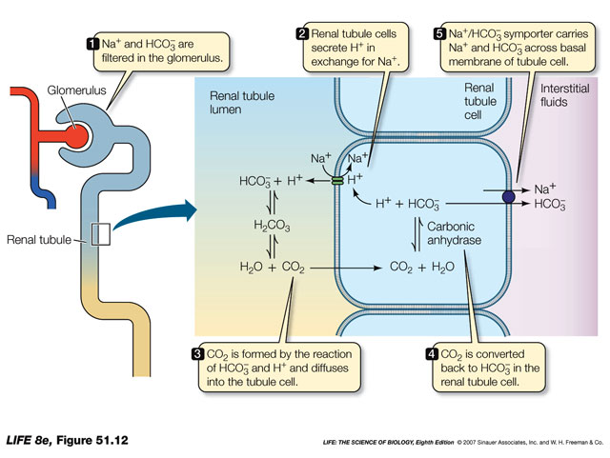
Bicarbonate buffer system of the kidney

Slide 43
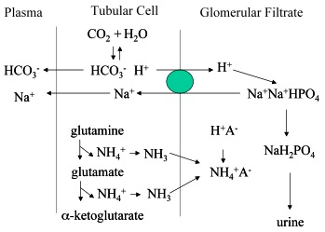
Combination of Excess Hydrogen Ions with Phosphate and Ammonia Buffers in the Tubule - A Mechanism for Generating “New” Bicarbonate Ions

Slide 44
Determination of acid - base status
Indicators :
Actual pH - pH of anaerobically taken arterial or arterialized capillary blood at the body temperature 37⁰ C.
Normal pH of arterial blood is 7.4 (7.35 - 7.45)
Actual pCO₂ - pCO₂ of anaerobically taken arterial blood at the body temperature 37⁰.
Normal value - pCO₂= 40 mm Hg (35 - 45 mm Hg)
Actual [ HCO₃⁻ ] in the blood plasma of anaerobically taken arterial blood at the body temperature 37⁰.
Normal value of actual bicarbonate concentration = 24 mmol/l
Standard [ HCO₃-] - concentration of bicarbonate in blood plasma at the T=37⁰C , which is equilibrated with a gas, that has pCO₂ = 40 mm Hg and pO₂, ensuring maximal Hb saturation.
Normal value of standard bicarbonate concentration = 24 mmol/l
Total buffer bases (TBB) - the amount of all buffer bases of the blood: HCO₃⁻, Hb, proteins.
Normal value = 48 mmol/l (44 - 50 mmol/l)
Normal buffer bases (NBB) - the amount of all buffer bases of the blood, when pH=7.38 and pCO₂=40 mm Hg.
Base excess ( BE ) - the difference between actual TBB and NBB
The BE is (+) in alkalosis; The BE is (-) in acidosis
Normal value of BE = ±2.5 mmol/l

Slide 45
Classification of acid - base disorders
Respiratory acidosis
1) primary defect is decreased elimination of CO₂: can be due to increased production of CO₂, or ventilation/perfusion mismatch
2) causes:
a. depression of respiratory center in CNS
b. interference with gas exchange across alveolar membrane
c. reduction in amount of blood pumped to lungs
3) laboratory findings:
* pH < 7.35
* H₂CO₃ is increased
* pCO₂ > 45 mm Hg
* pO₂ decreased unless on respiratory support
* HCO₃⁻ / H₂CO₃ < 20
* [K⁺] is increased
4) buffering: Hb and bicarbonate pair ; K⁺ / H⁺ exchange
5) compensation - kidney:
* retains HCO₃⁻
* produces new HCO₃⁻
* excretes H⁺
6) results of compensation: increased buffering capacity and an increase in pH towards normal

Slide 46
Classification of acid - base disorders
Respiratory alkalosis
1) primary defect: CO₂ deficit
2) causes:
* overstimulation of respiratory center
* hyperventilation
3) lab findings:
* pH > 7.45
* HCO₃⁻ / H₂CO₃ > 20
* pCO₂ < 35 mm Hg
* [K⁺] decreased with pO₂ slightly higher
* H₂CO₃ decreased
4) buffering : Hb, lactate excreted from intracellular fluid ---> K⁺ / H⁺ exchange
5) compensation - kidney : reabsorbs less HCO₃⁻
6) results of compensation: decreased buffering capacity, less base, which decreases the pH towards normal

Slide 47
Classification of acid - base disorders
Metabolic acidosis
1) primary defect: decrease in HCO₃⁻ or increase in fixed acids from a metabolic problem ( disorder )
2) causes:
* excessive production of organic acids
* reduce excretion of acids
* excessive loss of HCO₃⁻
* toxicity
3) lab findings
* pH < 7.35
* pCO₂ - decreased
* HCO₃⁻ < 24 mmol/l
* HCO₃⁻ / H₂CO₃ <20
4) buffering: Hb, plasma proteins, bicarbonate pair
5) compensation:
* fast : respiratory - increased ventilation
* slow : renal - increased excretion of acid, increased production of new HCO₃⁻
6) results of compensation : increased buffering capacity, increased production of base, excretion of acid leads to increasing pH towards normal

Slide 48
Classification of acid - base disorders
Metabolic alkalosis
1) primary defect: excess bicarbonate, or decreased fixed acid
2) causes:
* over administration of NaHCO₃ or citrate
* excessive loss of HCl
* diseases causing hypokalemia
3) lab findings:
* pH > 7.45
* pCO₂ increased
* HCO₃⁻ >24 mmol/l
* HCO₃⁻ / H₂CO₃ >20
4) buffering: Hb, bicarbonate pair, lactate from intracellular fluid
5) compensation :
fast respiratory : depression of respiratory center
slow renal : decreased reabsorption of HCO₃⁻ , decreased Na⁺ / H⁺ exchange on tubular cells
6) results of compensation: decreased buffering capacity, decreasing base concentration, return of pH back towards normal

Slide 49
Treatment of acidosis and alkalosis
The formula of Melemgaard - Astrup is used to calculate the deficit of bases in acidosis or of acids in alkalosis.
Deficit ml (mol/l) = 0,3 . bw (kg) . BE
To neutralize excess acid the molar concentration solution of sodium bicarbonate or sodium lactate can be infused intravenously with physiological solution at the ratio 1 : 3.
mol/l solution of NaHCO₃ = 8,4 % solution of NaHCO₃
For the treatment of alkalosis ammonium chloride can be administered.
mol/l solution of NH₄Cl = 5,3 % solution of NH₄Cl

Slide 50

Thanks for your attention!

