Slide 1
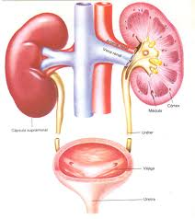
Urine formation by the kidneys. Glomerular filtration. Tubular reabsorption and secretion. Urine concentration and dilution. Micturition
MEDICAL UNIVERSITY – PLEVEN
FACULTY OF MEDICINE
DISTANCE LEARNING CENTER
Lecture № 18
Assoc. Prof. Boryana Ruseva, MD, PhD
Department of Physiology
Medical University
Pleven

Slide 2
Multiple Functions of the Kidneys in Homeostasis
Excretion of metabolic waste products and foreign chemicals
Regulation of water and electrolyte balances
Regulation of body fluid osmolality and electrolyte concentrations
Regulation of arterial pressure
Regulation of acid-base balance
Secretion, metabolism, and excretion of hormones
Gluconeogenesis

Slide 3
General Organization of the Kidneys and Urinary Tract

Slide 4
Anatomy of the kidney

Slide 5
The Nephron Is the Functional Unit of the Kidney

Slide 6
Blood supply

Slide 7
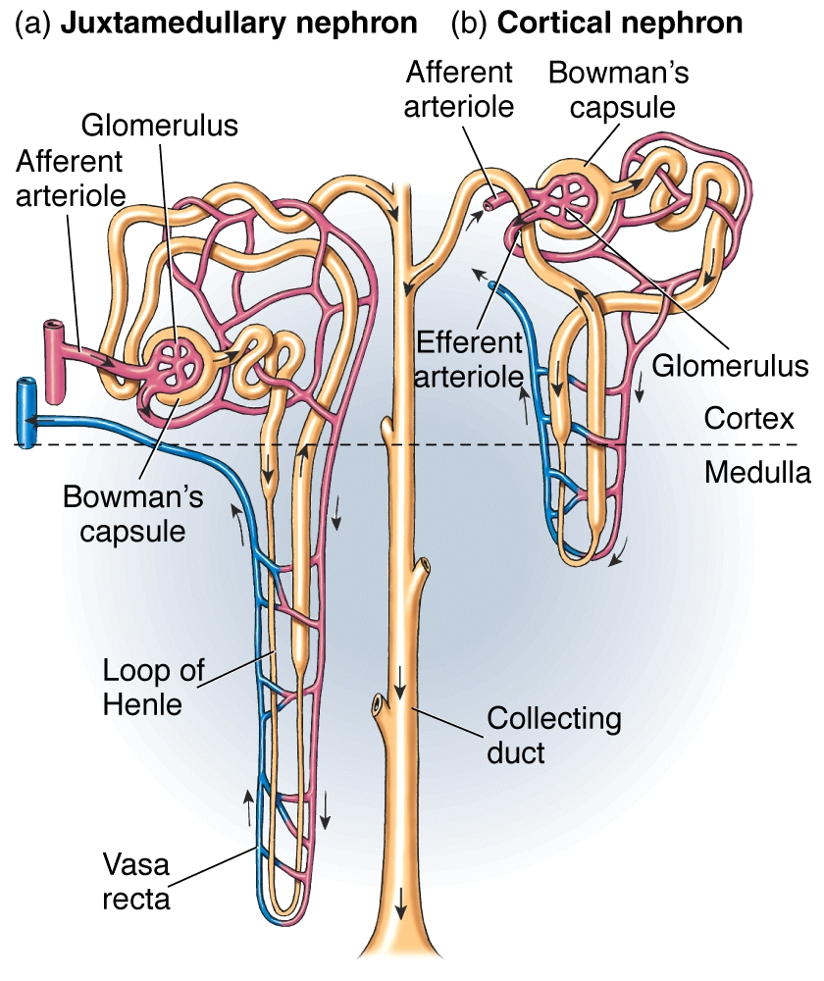
Regional Differences in Nephron Structure: Cortical and Juxtamedullary Nephrons

Slide 8
glomerulus

Slide 9
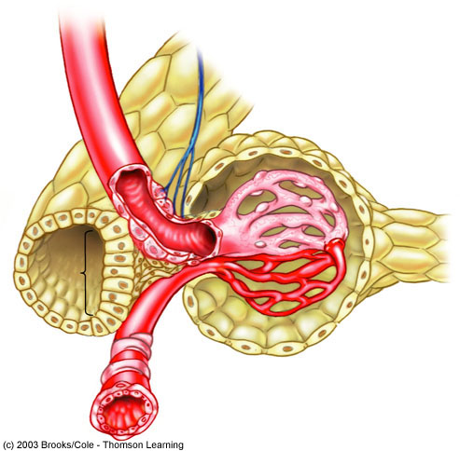
Juxtaglomerular apparatus
It is formed at the place where distal tubule contacts with afferent arteriole
It consists of:
granular (juxtaglomerular) cells – JG cells are modified smooth muscle cells located in the walls of the afferent arterioles immediately proximal to the glomeruli, that synthesize renin
Macula densa – high dense cells of the distal tubule
extraglomerular mesangeal cells
Afferent
arteriole
Renal
nerves
Granular cells
(renin)
Urinary space
Distal
tubule
Bowman’s
capsule
Proximal
tubule
Macula
densa
Glomerular
capillaries
Efferent
arteriole

Slide 10
Juxtaglomerular apparatus

Slide 11
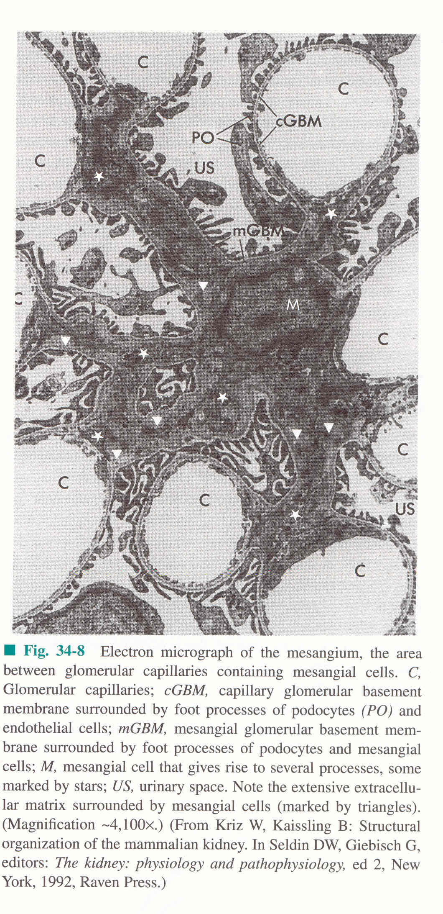
The functions of mesangial cells:
supporting
secretory --> prostaglandins, cytokines
defensive --> phagocytosis
regulatory – their contraction controls blood flow and filtration area

Slide 12
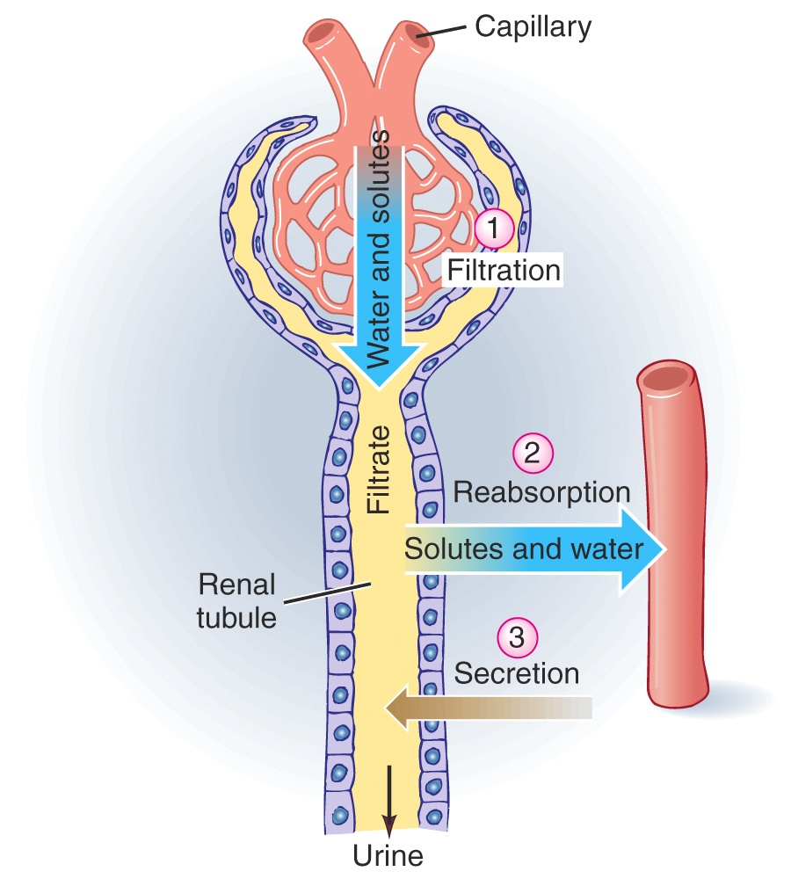
Urine Formation Results from:
Glomerular Filtration,
Tubular Reabsorption, and
Tubular Secretion

Slide 13
Glomerular Filtration

Slide 14
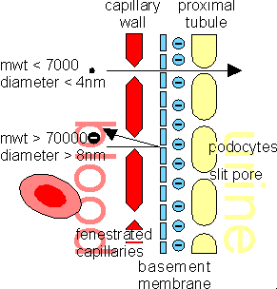
Glomerular filtration membrane

Slide 15
Determinants of the glomerular filtration rate (GFR)
The GFR is determined by
(1) the sum of the hydrostatic and colloid osmotic forces across the glomerular membrane, which gives the net filtration pressure, and
(2) the glomerular capillary filtration coefficient, Kf.
Expressed mathematically, the GFR equals the product of Kf and the net filtration pressure:
GFR = Kf x Net filtration pressure

Slide 16
The net filtration pressure represents the sum of the hydrostatic and colloid osmotic forces that either favor or oppose filtration across the glomerular capillaries. These forces include:
(1) hydrostatic pressure inside the glomerular capillaries (glomerular hydrostatic pressure, PG), which promotes filtration;
(2) the hydrostatic pressure in Bowman’s capsule (PB) outside the capillaries, which opposes filtration;
(3) the colloid osmotic pressure of the glomerular capillary plasma proteins (πG), which opposes filtration; and
(4) the colloid osmotic pressure of the proteins in Bowman’s capsule (πB), which promotes filtration. (Under normal conditions, the concentration of protein in the glomerular filtrate is so low that the colloid osmotic pressure of the Bowman’s capsule fluid is considered to be zero.)

Slide 17
The Glomerular filtration rate can be expressed as GFR = Kf x (PG – PB – πG + πB)

Slide 18
Factors on which GFR depends : 1. increased glomerular capillary filtration coefficient increases GFR 2. increased glomerular capillary hydrostatic pressure increases GFR 3. increased glomerular capillary colloid osmotic pressure decreases GFR 4. increased Bowman’s capsule hydrostatic pressure decreases GFR

Slide 19
Glomerular filtration rate

Slide 20
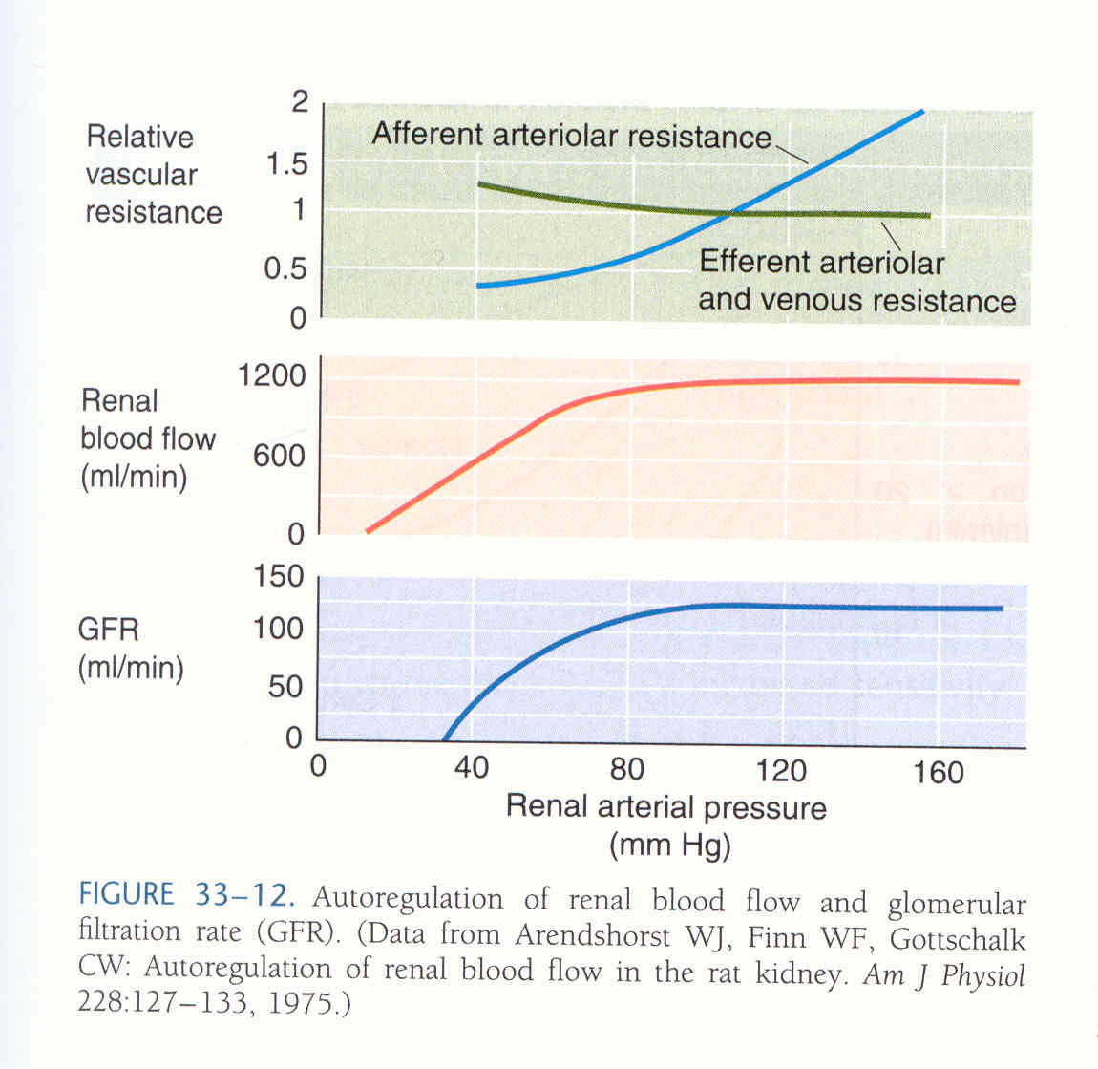
Autoregulation of GFR and Renal Blood Flow
Renal autoregulation prevents large changes in GFR that would otherwise occur when the AP is changed between 80 – 180 mm Hg, using 2 mechanisms:
(1) Myogenic Autoregulation of Renal Blood Flow and GFR, and
(2) a phenomenon referred to as Glomerulotubular balance - adaptive mechanisms in the renal tubules that allow them to increase their reabsorption rate when GFR rises.

Slide 21
Role of Tubuloglomerular Feedback in Autoregulation of GFR
To perform the function of autoregulation, the kidneys have a feedback mechanism that links changes in sodium chloride concentration at the macula densa with the control of renal arteriolar resistance. This feedback helps ensure a relatively constant delivery of
sodium chloride to the distal tubule and helps prevent spurious fluctuations in renal excretion that would
otherwise occur.

Slide 22
Hormones and Autacoids That Influence Glomerular Filtration Rate (GFR)
Norepinephrine
Epinephrine
Endothelin
Angiotensin II (prevents )
Endothelial-derived nitric oxide
Prostaglandins
Bradykinin

Slide 23
hormonal control of GFR

Slide 24
Nervous control of GFR

Slide 25
Epithelium of the tubular system

Slide 26
reabsorption

Slide 27
reabsorption of sodium ions
Net reabsorption of sodium ions from the tubular lumen back into the blood involves at least three steps:
1. Sodium diffuses across the luminal membrane (also called the apical membrane) into the cell down an electrochemical gradient established by the sodium-potassium ATP-ase pump on the basolateral side of the membrane.
2. Sodium is transported across the basolateral membrane against an electrochemical gradient by the sodium-potassium ATP-ase pump.

Slide 28
reabsorption of sodium ions
3. Sodium, water, and other substances are reabsorbed from the interstitial fluid into the peritubular capillaries by ultrafiltration, a passive process driven by the hydrostatic and colloid osmotic pressure gradients.
In the more distal parts of the nephron, the epithelial cells have much tighter junctions and transport much smaller amounts of sodium. In these segments, sodium reabsorption exhibits a transport maximum similar to that for other actively transported substances.
Furthermore, this transport maximum can be increased in response to certain hormones, such as aldosterone.

Slide 29
secondary active transport of glucose and amino acids in the proximal tubule
In both instances, a specific carrier protein in the brush border combines with a sodium ion and an amino acid or a glucose molecule at the same time. These transport mechanisms are so efficient that they remove virtually all the glucose and amino acids from the tubular lumen.
After entry into the cell, glucose and amino acids exit across the basolateral membranes by facilitated diffusion, driven by the high glucose and amino acid concentrations in the cell.

Slide 30
secondary active transport of glucose and amino acids in the proximal tubule
Although transport of glucose against a chemical gradient does not directly use ATP, the reabsorption of glucose depends on energy expended by the primary active sodium-potassium ATPase pump in the basolateral membrane. Because of the activity of this pump, an electrochemical gradient for facilitated diffusion of sodium across the luminal membrane is maintained, and it is this downhill diffusion of sodium to the interior of the cell that provides the energy for the simultaneous uphill transport of glucose across the luminal membrane.
Thus, this reabsorption of glucose is referred to as “secondary active transport” because glucose itself is reabsorbed uphill against a chemical gradient, but it is “secondary” to primary active transport of sodium.

Slide 31
Reabsorption and secretion
Passive Water Reabsorption by Osmosis Is Coupled Mainly to Sodium Reabsorption
Reabsorption of Chloride, Urea, and Other Solutes by Passive Diffusion
Reabsorption of potasium by active transport
Reabsorption of calcium by active transport
> Reabsorption of water in the collecting tubules is controlled by ADH
> Reabsorption of sodium and secretion of potasium ions in the distal and collecting tubules is controlled by aldosteron
> Reabsorption of calcium ions in the collecting tubules is controlled by parathormone
> Secretion of hydrogen ions along whole tubular system

Slide 32
Reabsorption and secretion

Slide 33
Regulation of Tubular Reabsorption
Glomerulotubular Balance - The Ability of the Tubules to Increase Reabsorption Rate in Response to Increased Tubular Load
Peritubular Capillary and Renal Interstitial Fluid Physical Forces
Effect of Arterial Pressure on Urine Output - The Pressure-Natriuresis and Pressure-Diuresis Mechanisms
Hormonal Control of Tubular Reabsorption (ADH, Aldosterone, Angiotensin II, Parathyroid hormone, Atrial natriuretic peptide)
Sympathetic Nervous System Activation Increases Sodium Reabsorption

Slide 34
Use of Clearance Methods to Quantify Kidney Function
The renal clearance of a substance is the volume of plasma that is completely cleared of the substance by the kidneys per unit time.
This is somewhat of an abstract concept because there is no single volume of plasma that is completely cleared of a substance.
The concept of renal clearance is based on the principle of mass balance. The renal artery is the single input to the kidney, whereas the renal vein and ureter constitute the two output routes.

Slide 35
renal clearance
Maintaining mass balance the following relationship can be derived:
P_{ax} . RPF_{a} = ( P_{vx} . RPF_{v}) + ( U_{x} . V )
where
P_{ax} and P_{vx} = concentration of substance x in the renal artery and renal vein plasma
RPF_{a} and RPF_{v} = renal plasma flow rates in the artery and vein
U_{x} = concentration of x in the urine
V = urine flow rate per minute

Slide 36
The principle of renal clearance (C_{x}) emphasizes the excretory function of the kidney; it considers only the rate at which a substance is excreted into the urine and not the rate at which it is returned to the systemic circulation in the renal vein. Therefore in terms of mass balance, the urinary excretion rate of x (U_{x} . V) is proportional to the plasma concentration of x (P_{ax}).
To equate the urinary excretion rate of x to its renal arterial plasma concentration one must determine the rate at which x is removed from the plasma by the kidneys. This removal rate is the clearance (C_{x}).
P_{ax} . C_{x} = U_{x} . V
C_{x} = U_{x} . V / P_{x}
C_{x} = ml / min and P_{x} = mg / ml
V = ml / min and U_{x} = mg / ml

Slide 37
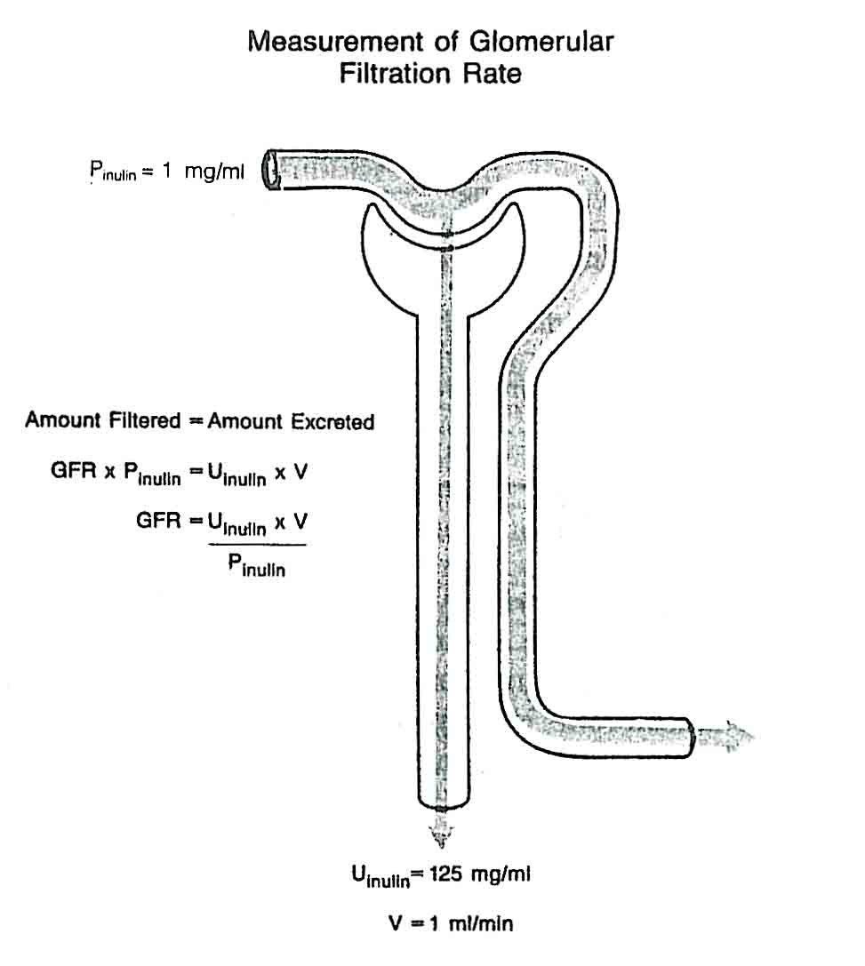
Glomerular filtration rate (GFR) and Clearance of Inulin (C_{in})
Inulin is a polyfructose molecule (m.w. = 5000) that can be used to measure the GFR. It is not produced endogenously by the body and therefore must be administered intravenously. Inulin is freely filtered at the glomerulus and neither reabsorbed, secreted nor metabolized by the cells of the nephron. The amount of inulin excreted in the urine per minute equals the amount of inulin filtered at the glomerulus each minute:
amount filtered = amount excreted
GFR . P_{in} = U_{in} . V
GFR = U_{in} . V / P_{in}

Slide 38
Any substance that meets the following criteria will serve as an appropriate marker for the measurement of GFR:
1. The substance must be nontoxic.
2. The substance must not bind on plasma proteins.
3. The substance must be freely filtered by the glomerulus.
4. The substance must not be reabsorbed or secreted by the nephron.
5. The substance must not be metabolized or produced by the kidney.
6. The substance must not alter GFR.

Slide 39
The fact that inulin must be infused intravenously limits its use in clinical settings. Consequently Creatinine is used to estimate the GFR. It is a by-product of skeletal muscle creatine metabolism. However creatinine is not a perfect substance to measure GFR, because it is secreted in the proximal tubule when its plasma concentration is greater than 0.02 mg / ml. The creatinine is present in the plasma at a relatively constant concentration and for this reason C_{cr} is the most widely used method of estimating GFR clinically.
GFR is proportional to body surface area and the clearance of each substance must multiply by coefficient K = 1.73 / BSA .
1.73 m² = standard body surface area of 25 years old human
BSA = m² body surface area of the patient
Normal value of GFR for standard body surface area:
C_{in} = 100 - 150 ml /min ; av. C_{in} = 125 ml /min
C_{cr} = 80 - 180 ml /min

Slide 40
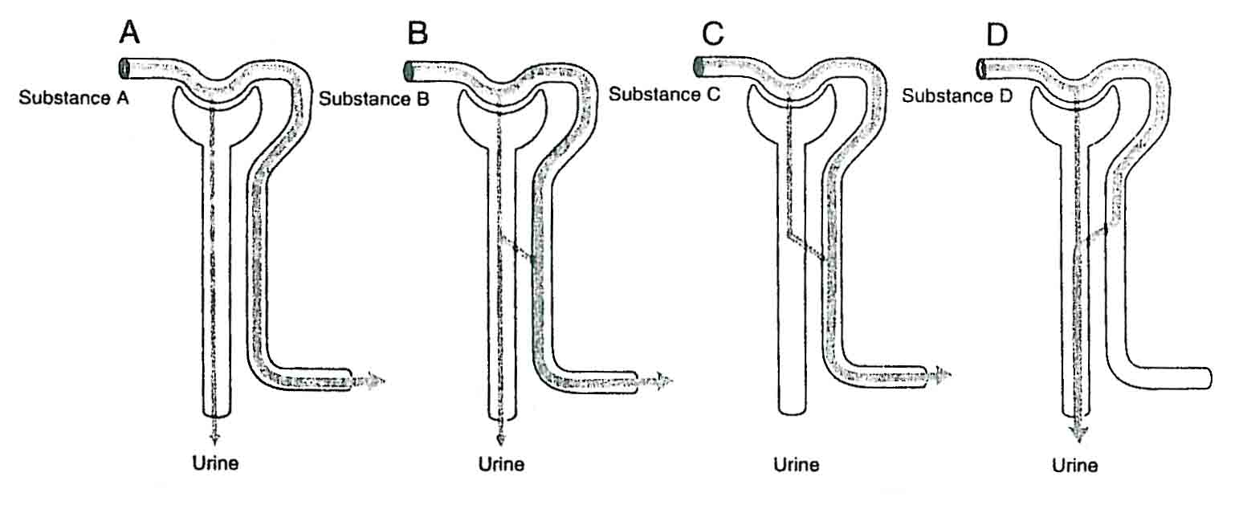
Most substances are filtered and either reabsorbed or secreted
1. If its clearance is less than that of Cin, the substance is reabsorbed by the nephron.
2. If its clearance is greater than that Cin, the substance is secreted.
3. If its clearance equals that Cin, the substance is only filtered.

Slide 41
Urinary excretion = Glomerular filtration – Tubular reabsorption + Tubular secretion

Slide 42
PAH Clearance
p-Aminohippuric acid (PAH) is an organic anion excreted into the urine by the processes of glomerular filtration and tubular secretion. As inulin, PAH is not produced in the body and therefore must be infused.
C _{pah} = U _{pah} . V / P _{pah}
Normal value of C _{pah} for standard body surface area:
C _{pah} = 500 - 800 ml / min ;
C _{pah} = av. 650 ml / min

Slide 43
Transport Maximum for Substances That Are Actively Reabsorbed
T_{max gl} = C_{in} . P_{gl} - U _{gl} . V
We can use clearance method for determining T_{max gl} and S_{max PAH}. For most substances that are actively reabsorbed or secreted, there is a limit to the rate at which the solute can be transported. It is due to saturation of the specific transport systems. The glucose transport system in the proximal tubule is a good example.
The T_{max gl} varies from individual to individual and normally in adult human averages about 320 mg / min (300 - 375 mg / min). When P_{gl} is normal C_{gl} = 0, because whole filtered glucose is reabsorbed. The plasma glucose concentration at which glucose first appears in the urine is called the plasma threshold (P_{gl} = 10 mmol/l). Beyond this point the excretion rate increases linearly and parallels the filtered load.

Slide 44
Transport Maximums for Substances That Are Actively Secreted
S_{max} _{pah} = U _{pah} . V - C_{in} . P _{pah}
S_{max} _{pah} - normal average value of 80 mg / min
At a constant GFR the filtered load of PAH increases linearly whit the increase in plasma PAH concentration. The secretion process becomes saturated between P _{pah} of 0,1 and 0,2 mg / ml. Below the S_{max} _{pah} virtually all of the PAH that enters the kidney is excreted, thus clearance of PAH can be used to measure the renal plasma flow (RPF). Approximately 90 % of plasma does in fact flow through peritubular capillaries that surround the proximal tubules (effective renal plasma flow - ERPF). However 10 % perfuse some of the medullary structures, the renal capsule and part of the renal hilum. Thus the PAH in this plasma can not be secreted and this portion of PAH is returned to the systemic circulation in the renal vein plasma

Slide 45
ERPF = C_{pah}
ERPF - 90% T RPF= ERPF . 100 / 90
TRPF - 100% T RPF= ERPF / 0.9
The C _{pah} also can be used to estimate the renal blood flow (RBF). Whole blood consists of a cellular fraction (Hematocrit) and a plasma fraction (1- Hct ). Once the Hct is known, TRBF can be calculated as
TRBF = TRPF / 1 - Hct
RBF normal av. value = 1200 ml / min

Slide 46
Filtration fraction (FF) - The portion of plasma that is filtered passing trough the nefrons
FF = GFR .100 / ERPF FF = C_{in} . 100 / C _{pah} normal av. value of FF = 20%

Slide 47
Concentration and dilution of urine

Slide 50
Micturition
Micturition is the process by which the urinary bladder empties when it becomes filled.
This involves two main steps:
First, the bladder fills progressively until the tension in its walls rises above a threshold level; this elicits
the second step, which is a nervous reflex called the micturition reflex that empties the bladder or, if this fails, at least causes a conscious desire to urinate.
Although the micturition reflex is an autonomic spinal
cord reflex, it can also be inhibited or facilitated by centers in the cerebral cortex or brain stem.

Slide 51
Micturition Reflex
It is stretch reflex initiated by sensory stretch receptors in the bladder wall, especially by the receptors in the posterior urethra when this area begins to fill with urine at the higher bladder pressures.
Sensory signals from the bladder stretch receptors are conducted to the sacral segments of the cord through the pelvic nerves and then reflexively back again to the bladder through the parasympathetic nerve fibers by way of these same nerves.
The micturition reflex is a completely autonomic spinal cord reflex, but it can be inhibited or facilitated by centers in the brain. These centers include
(1) strong facilitative and inhibitory centers in the brain stem, located mainly in the pons, and
(2) several centers located in the cerebral cortex that are mainly inhibitory but can become excitatory.

Slide 52
Micturition reflex

