Slide 1
Cardiac cycle. Function of the valves. Work output of the heart. Heard sounds. Intrinsic and extrinsic regulation of myocardial performance
MEDICAL UNIVERSITY – PLEVEN
FACULTY OF MEDICINE
DISTANCE LEARNING CENTER
Lecture № 7
Assoc. prof. Boryana Ruseva, MD, PhD
Department of Physiology
Medical university
Pleven

Slide 2
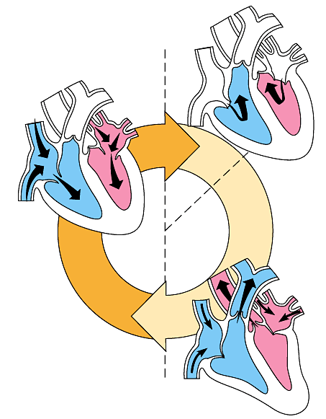
The heart contracts and relaxes rhythmically.
1
2
The heart is relaxed. AV valves are opened.
Atria contract.
Cardiac cycle is the time
for performing of one systole
and one diastole.
HR=75/min; CC=0,8s
Vs=0,3s
As=0,1s
Vd=0,5s
Ad=0,7s
0.1 sec
systole
3
0.3 sec
0.4 sec
The ventricles contract. Semilunar valves are opened.
diastole
1 systole + 1 diastole = cardiac cycle

Slide 3
Contraction of ventricles
ventricles have circular and spiral muscle fiber layers
contraction of spiral layer causes shortening of their length
contraction of circular layer causes shortening of their diameter
contraction of both ventricles begins from the apex and goes to the basis that ensures movement of the blood to semilunar valves
relaxation occurs from the basis to the apex of ventricles ensuring rapid blood flow entering from atria
Right ventricle
Left ventricle

Slide 4
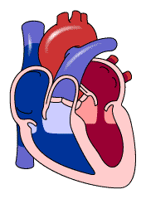
The pump function of the heart
the heart consists of two successively connected pumps
right ventricle pumps venous blood into the lungs
left ventricle pumps oxygenated blood into systemic circulation

Slide 5
The valves of the heart
the function of the valves is to ensure one way successive blood flow
they open or close under influence of the pressure on the both side
atrio-ventricular valves:
mitral (bicuspid)
tricuspid
semilunar valves:
aortic
pulmonal

Slide 6
The valves during the diastole
The valves during the systole
Function of papillary muscles and hordae tendineae
muscles contracted, hordes extended
muscles and hordes relaxed

Slide 7
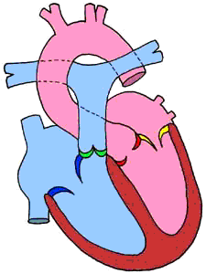
Papillary muscles and hordae tendineae prevent turn of cusps of А-V valves to atria during ventricular systole.

Slide 8
Phases of cardiac cycle
phase 1. diastole: Atria and ventricles are relaxed. The blood from big veins flows into the
ventricles through atria and fills them. The pressure and the volume of the ventricles increase.
phase 2. atrial contraction: the ventricles are additionally filed with blood (20-30%) and
their volume riches maximal value.
phase 1
phase 2
During these 2 phases of ventricular filling:
P_{v} < P_{a} - АV valves are opened
P_{v} < P_{art} – semilunar valves are closed.

Slide 9
Phase 3. isovolumetric contraction of ventricles
It begins with closer of АV valves - Р_{v} > P_{a}
Semilunar valves also are closed, because P_{v} < P_{art} and the volume of ventricles remains the same independently of the pressure change.
It lasts to the moment when Р_{v}>Р_{art} and semilunar valves open.

Slide 10
Phase4. ventricular ejection
Two sub phases:
rapid ejection– Р_{v} > Р_{art} and the blood enters arteries with high velocity. The pressure of ventricles and large arteries increases, reaching the maximal value to the end of this period. The volume of the ventricles suddenly decreases.
slow ejection– the pressure of ventricles and arteries begins to decrease and Р_{art}>Р_{v}, but the blood flows under inertion.
During this phase: P_{v} > P_{a} – АV valves are closed
P_{v} > P_{art} – semilunar valves are opened, but at the end gradient turns

Slide 11
Phase 5. Isovolumetric relaxation
the ventricular pressure suddenly decreases, because of relaxation of the walls Р_{v}<Р_{art} -> closer of semilunar valves
AV valves also are closed and the volume of ventricles remains constant
P_{V} > P_{A} - AV valves are closed
P_{V} < P_{ART} - semilunar valves also are closed

Slide 12
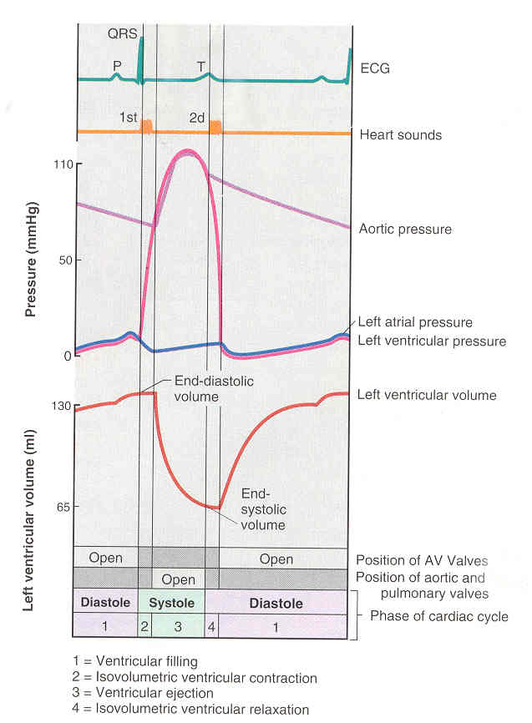
Phase 1.Ventricular filling
Two sub phases:
rapid filling– begins with opening of АV, whenР_{v}<Р_{a} . The volume of the ventricles increases rapidly, but their pressure lasts to drop, because of lasting relaxation of the muscles
slow filling– the pressure of the ventricles increases, because of decreased compliance with increase of the volume

Slide 13
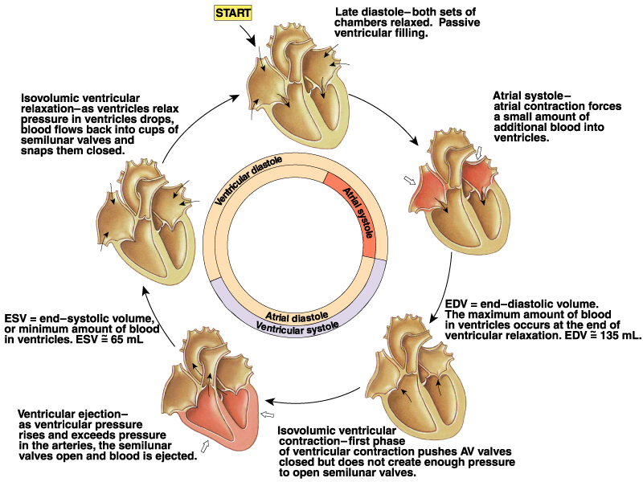
Сърдечен цикъл
Cardiac cycle
1
2
5
4
3

Slide 15
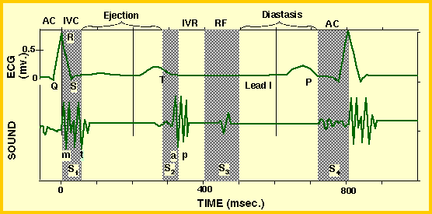
Heart sounds
We can hear always 2 heart sounds.
First (S1) – systolic
Second (S2) – diastolic
We may register S3 or S4 heart sounds.

Slide 16
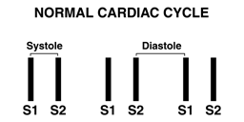
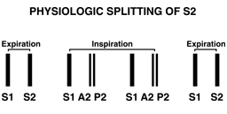
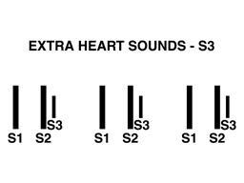
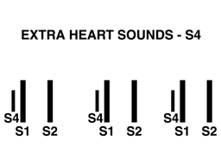
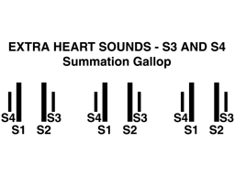
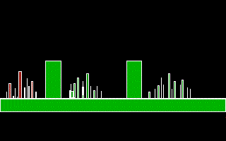
lub dub lub dub lub dub
Pulse of carotid artery
S₁ S₂

Slide 17
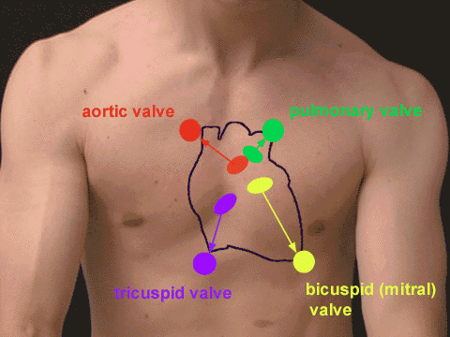
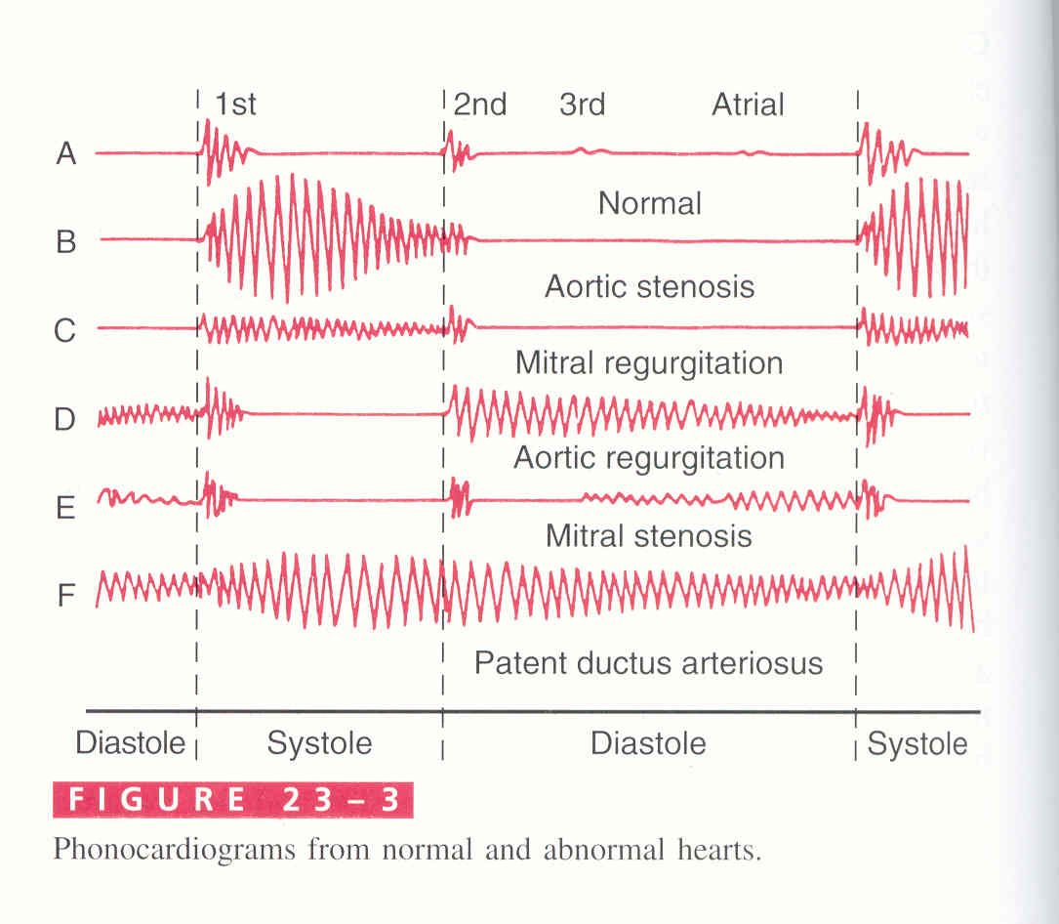
Auscultatory sites of the heart valves

Slide 18
Heart volumes
end diastolic volume = 120-140 ml
end systolic volume = 50-65 ml
stroke volume = 70 ml
cardiac output = 4-6 l/min; av. 5,25 l/min
The stroke volume of both ventricles must equal!!!

Slide 19
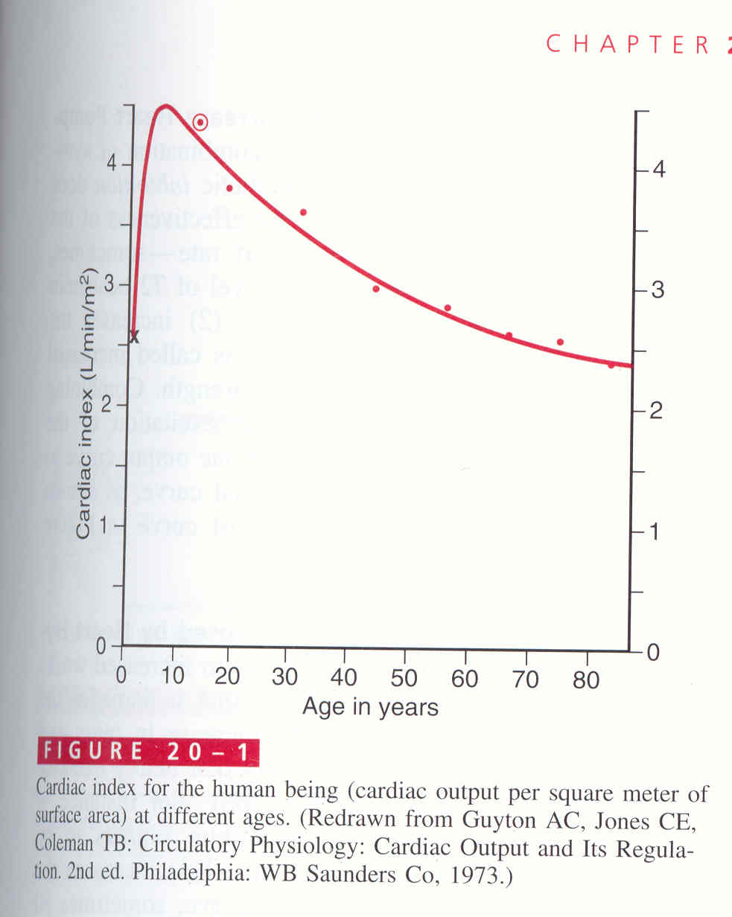
Cardiac output depends on:
age
sex
body surface area
physical activity
cardiac index = СO : BSA ~ 3 l /min / m²
CI decreases with aging after 10 years of age.

Slide 20
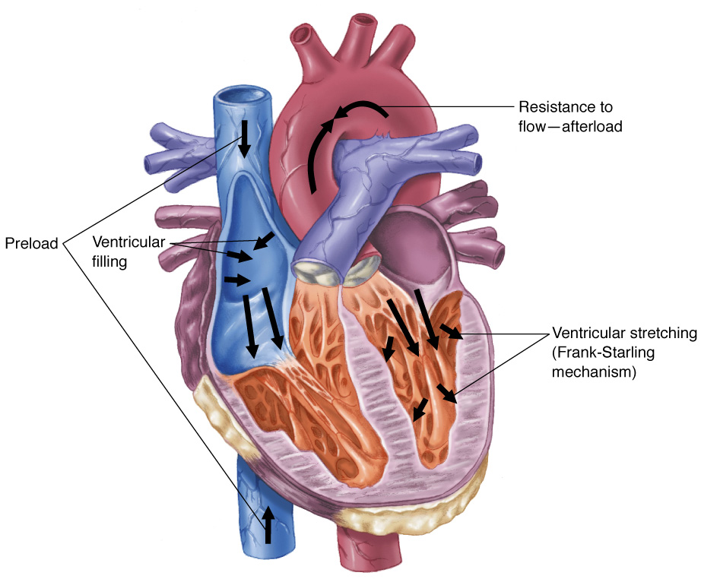
Factors on which stroke volume depends :
preload – ventricular filling
afterload – resistance of big vessels
ventricular contractility

Slide 21
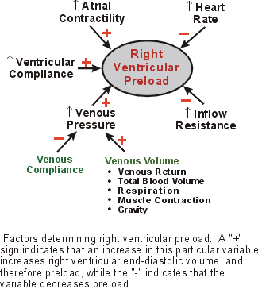
Preload depends on:
150
Stroke Volume
Maximum Capacity
To Produce SV
70
Normal Range:
SV increases with EDV
130
300
End-Diastolic Volume

Slide 22
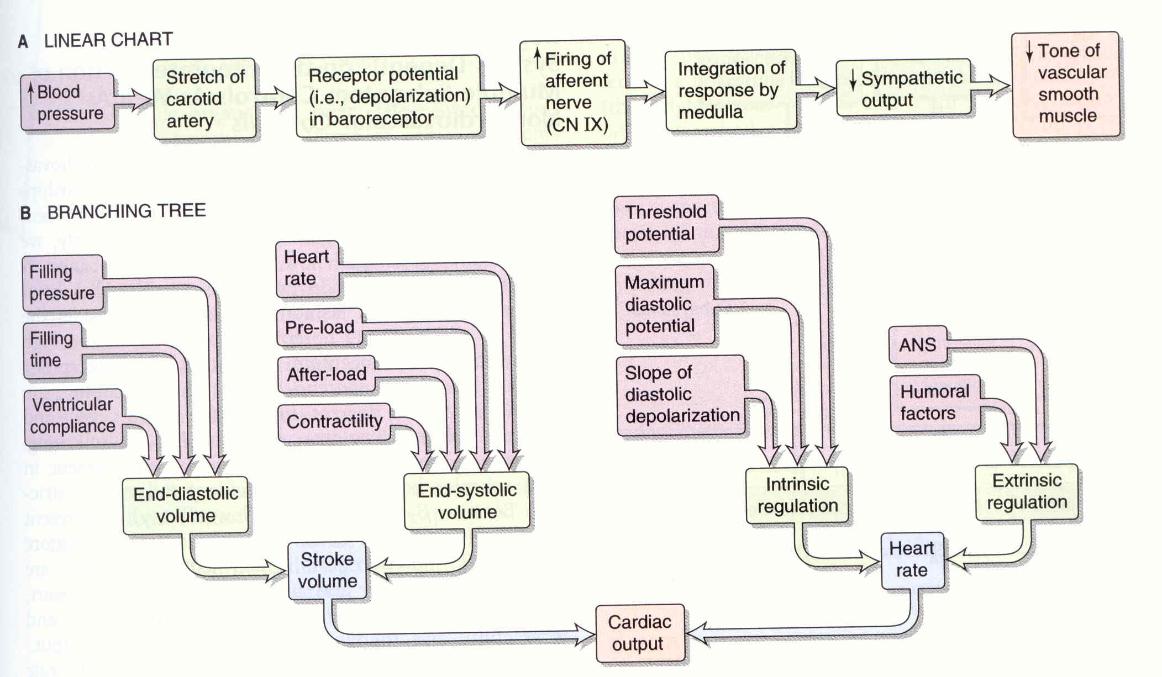
Factors on which cardiac output depends
Pre-load

Slide 23
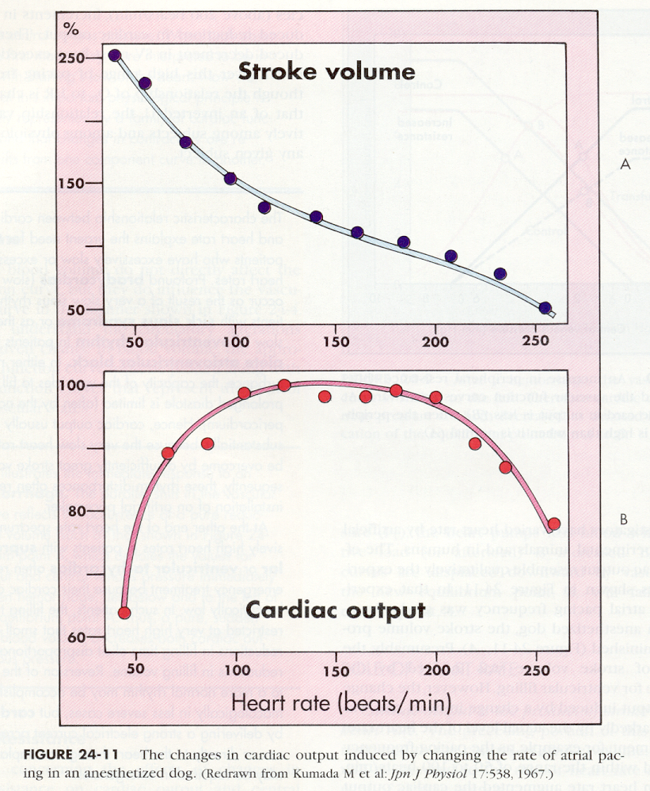
Cardiac output
Stroke volume
Heart rate
=
х
Stroke volume decreases during increased heart rate.
Cardiac output increases during increase of heart rate from 50 to 100 b/min.
After that remains relatively constant and decreases when HR is higher than
200 b/min.

Slide 24
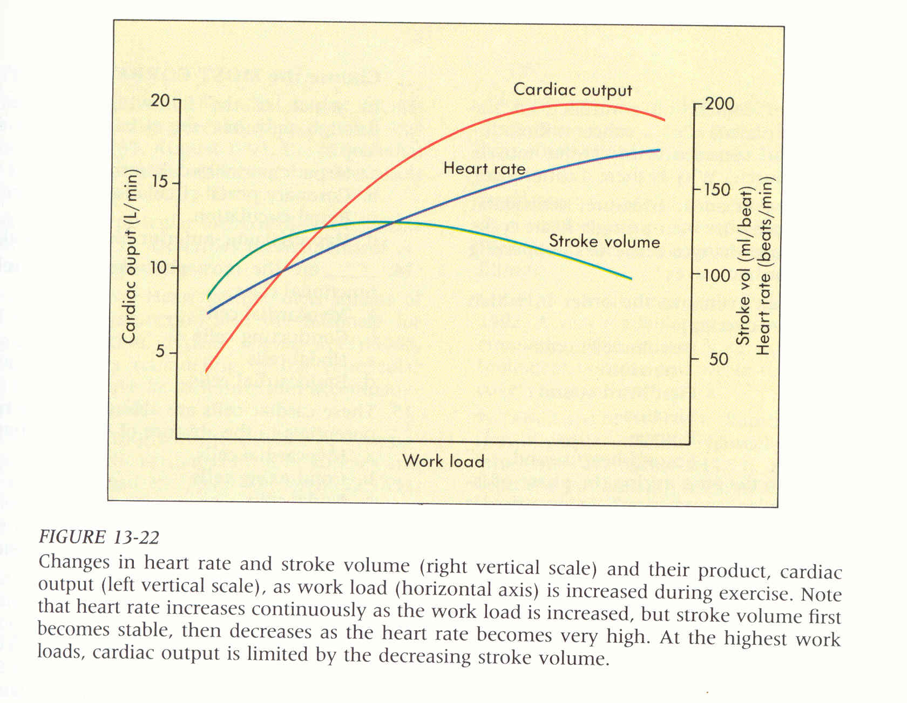
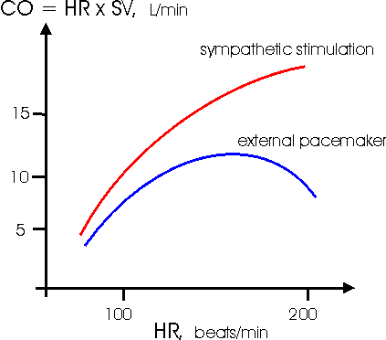
During exercises cardiac output increases 5 (7) times:
HR ; max HR= 220 – age
contractility

Slide 25
Functional curves of the heart
They connect pump function of the heart with the peripheral factors determining the return of the blood to the heart.
The venous return is the main factor that determines EDV!!!
Atrial
Pressure
(Preload)
Ventricular Output
Cardiac
Output
Atrial Input
Right or Left Heart

Slide 26
The heart work
The heart performs external work to eject stroke volume into the two rings of circulation and to give acceleration of blood to flow:
ejection of the stroke volume against the pressure (Ws)
Ws = P.V
Kinetic work(Wk)
E = P.V + ½ mv² + k.T. ∆t
k.T. ∆t –the heat during isovolumic contraction
Wk = ½ mV²
W_{total} = P. V + ½ mV²

Slide 27
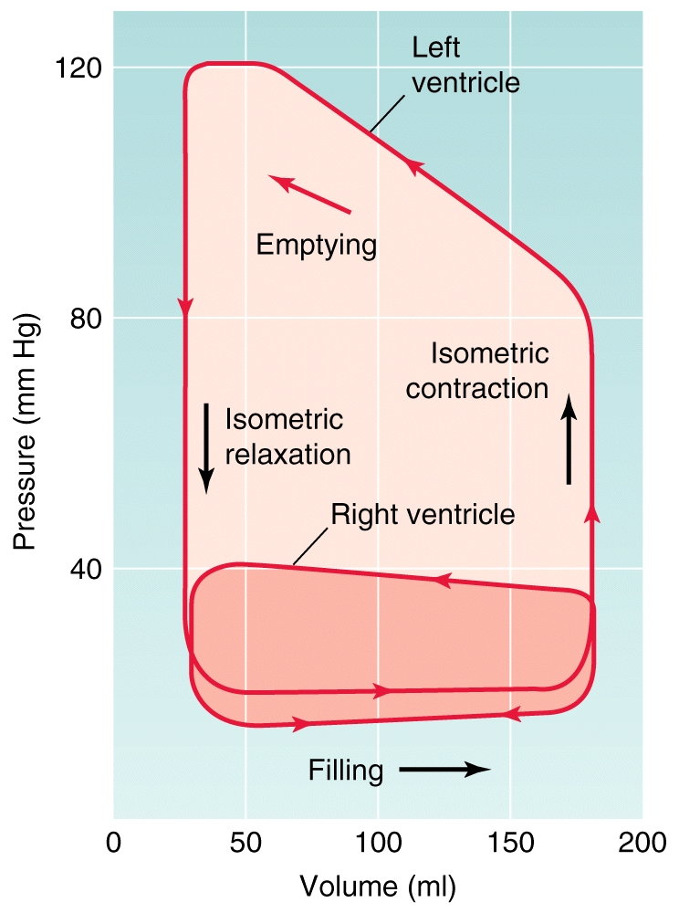
The external work of left ventricle is 5 times greater than this of right ventricle, because 5 time greater is its tension during the systole.

Slide 28
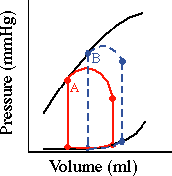
During one the same external work the heart uses much energy when works at the condition of increased afterload (B), than the situation of increased preload (A).

Slide 29
Myocardial metabolism
oxidative phosphorilation of:
fatty acids 60%
glucose, lactic acid - 35-40%
the heart has high oxygen consumption(OC)
Cardiac State
MVO₂ (ml O₂/min per 100g)
Organ
O₂ Consumption (ml O₂/min per 100g)
Brain
3
Arrested heart
2
Kidney
5
Resting heart rate
8
Skin
0.2
Resting muscle
1
Heavy exercise
70
Contracting muscle
50

Slide 30
Autoregulation
It ensures adaptation of the heart to the changes of hemodynamic conditions without participation of extracardial factors.
2 mechanisms:
heterometric (law of Frank – Starling)
It triggers when the length of myocytes is changed before start of contraction ( EDV)
It ensures stronger than normally contraction to decrease EDV.
homeometric
It triggers without change of the length of myocytes:
change of HR- effect of Bowditch
increased afterload effect ofAnrep
It ensures stronger than normally contraction during increased HR and arterial pressure

Slide 31
Heterometric autoregulation
Increased EDV lengthens the cardiomyocytes and this leads to:
increased sensitivity of troponin С to Са²⁺ and increased rate of formation and splitting of cross bridges between myosin and actin.

Slide 32
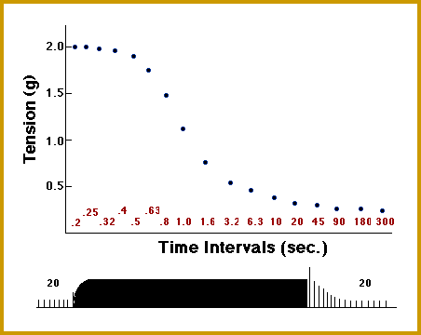
Homeometric autoregulation
effect of Bowditch
Myocardium develops higher tension with shortening of interval between stimuli.
it is due to increase of [Ca²⁺]_{i}
effect of Anrep
Sudden increase of aortic pressure causes:
decrease of SV, ESV and EDV increase.
Mechanism of Frank and Starling makes improvement of SV.

Slide 33
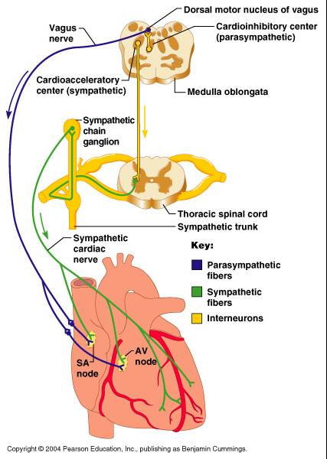
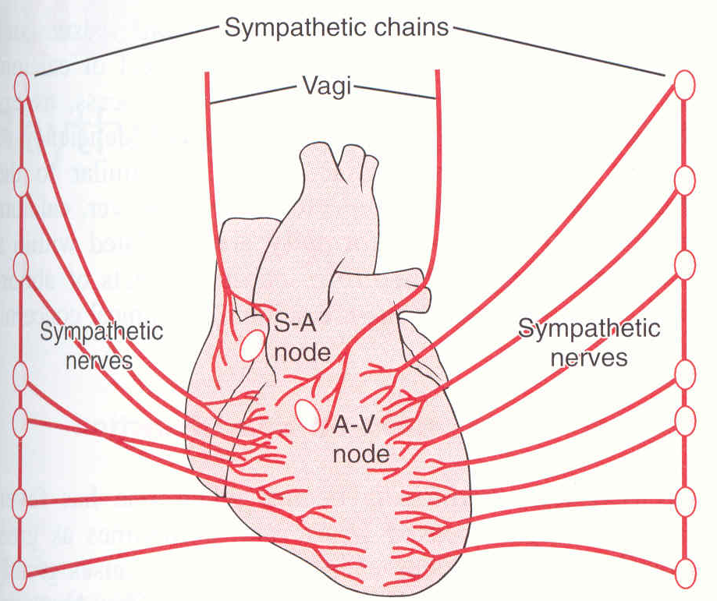
Extracardial control on heart performance
It is nervous and humoral.
Nervous regulation
Parasympathicus –n.vagus
right n.vagus –> SA node
left n.vagus – AV node
atria are innervated by the n. vagus, but ventricles are not
sympathicus – from upper thoracic segments of spinal cord
sympathicus innervates whole heart

Slide 34
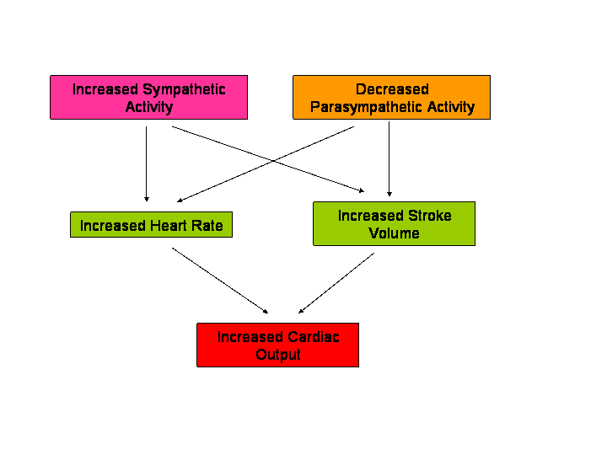
Effects of parasympathicus
Effects of sympathicus
rapid slow
Short time lasting long time lasting
Chronotropic effect
Negative positive
Dromotropic effect
Negative positive
Inotropic
Negative : on the atria
positive: on the atria and venticules
Lusitropic
Negative positive

Slide 35
Cyclic changes of the tone of the nerves of autonomic nervous system during respiration cause respiratory arrhythmia.
The tone of vagus decreases during inspiration and sympathicus tone increases.
HR increases during inspiration
and decreases during expiration.

Slide 36
Mechanism of action of Acetylcholine on SA node
Acetylcholine binds to М₂ choline receptors.
М₂ receptors are connected with G protein, its βγ-subunits open К channels (GIRK).
K⁺
ACh
Out
M₂
βγ
Gαi
βγ
GIRK
In
Hyperpolarization of cell membrane slows down diastolic depolarization.

Slide 37
Mechanism of action of Acetylcholine on SA node
М₂ receptors through Gα_{i} inhibit adenylate cyclase -> cAMP -> activity of non selective cation channels, responsible for I_{f.}
Adenylate cyclase
ACh
Out
M₂
βγ
-
Gαi
cAMP
In
Pacemaker Channel
ATP
cAMP
(HCN4)
This slows down depolarization and decreases HR
Strong vagus stimulation can completely stop generation of AP by SA node!!!

Slide 38
Chronotropic effect of Sympathicus
NА and А bound with β₁ adrenoreceptors of SA node
β agonist
Adenylate cyclase
Out
Gαs
βγ
+
In
cAMP
β-Receptor
Na
Pacemaker Channel
ATP
cAMP
(HCN4)
activation of G protein stimulates adenylate cyclase
cAMP activates non selective cation channels responsible for If
cAMP activates РКА -> phosphorilation of Са channels, participating in generation of AP
this accelerates depolarization and HR increases

Slide 39
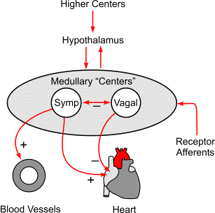
The tone of autonomic nervous system nerves on the heart is changed under the influence of the other NC, situated at medulla oblongata, hypothalamus and brain cortex.

Slide 40
>Cardio-accelerator center – through sympathicus performs positive effects on heart performance
Into medulla oblongata are situated two centers, controlling the heart performance.
Cardio-inhibitor center - through vagus nerve performs negative effects on heart performance

Slide 41
Reflex control of heart performance by mechanoreceptors
The volume receptors excite by the increased volume.
These receptors are situated at:
V. cava superior and v. cava inferior
Pulmonary artery
atria
ventricles
into the atria are situated 2 types of receptors:
type А – they excite during atrial contraction
type В – they excite during atrial filling

Slide 42
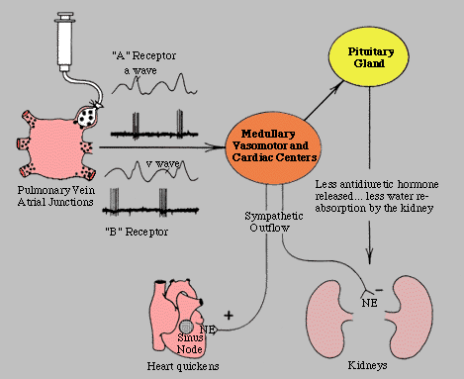
Increased blood volume stimulates atrial mechanoreceptors type В:
HR increases because increased tone of sympathicus and stimulation of SA node and decreased tone of vagus nerve – reflex of Bainbridge

Slide 43
Reflex control of heart performance by chemoreceptors

Slide 44
Humoral control of heart performance
substances with positive inotropic action
Epinephrine and Norepinephrine
Angiotensin II
Glucagon
Thyroid hormones
increased [Ca²⁺]_{о}
substances with negative inotropic action
increased [К⁺]_{о}
Intracellular acidosis
Adenosine
Acetylcholine

Slide 45
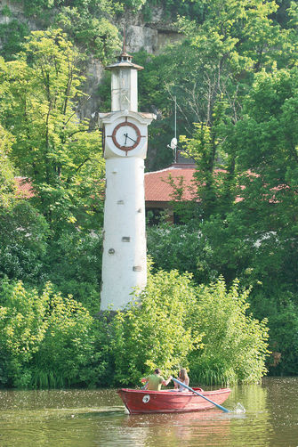
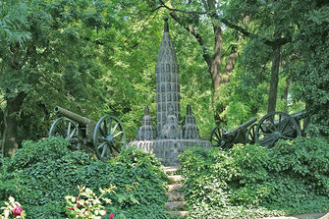
Тhanks for your attention!

