Slide 1
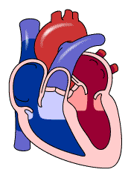
Rapid Control of Arterial Pressure. Dominant Role of the Kidney in Long-Term Regulation of Arterial Pressure
MEDICAL UNIVERSITY – PLEVEN
FACULTY OF MEDICINE
DISTANCE LEARNING CENTER
Lecture № 9
Assoc. prof. Boryana Ruseva, MD, PhD
Department of Physiology
Medical University-Pleven

Slide 2
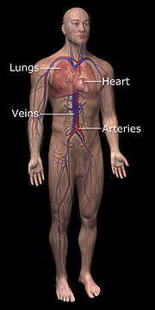
Physical characteristics of the circulation

Slide 3
Blood pressure
The blood pressure in the arteries supplying the body is a result of the interaction between
● the cardiac output (the volume of blood the heart is pumping per minute) and
● the vascular resistance, usually termed total peripheral resistance by physicians and researchers.
∆P = Q8lη / πr⁴

Slide 4
Blood pressure (BP)
Systolic BP normal value: 100-140mmHg
SBP depends on cardiac output (av. 5,25 l/min)
cardiac output = stroke volume x heart rate
Stroke volume depends on:
● venous return
● dystensibility of arterial vessels
● myocardial contractility
Heart rate depends on:
● the tone of sympathicus

Slide 5
Blood pressure (BP)
Diastolic BP normal value: 60-90 mmHg
Depends on: peripheral resistance
Pulse pressure = SBP – DBP
Mean BP = DBP + 1/3 PP

Slide 6
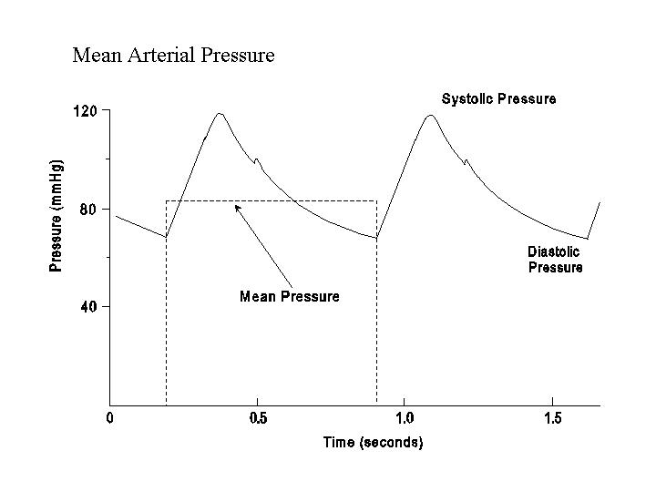

Slide 7
Pressures in the Various Portions of the Circulation
Because the heart pumps blood continually into the aorta, the mean pressure in the aorta is high, averaging about 100 mm Hg.
Also, because heart pumping is pulsatile, the arterial pressure alternates between a systolic pressure level of 120 mm Hg and a diastolic pressure level of 80 mm Hg.

Slide 8
Pressures in the Various Portions of the Circulation
As the blood flows through the systemic circulation,
its mean pressure falls progressively to about 0 mm Hg by the time it reaches the termination of the venae cavae where they empty into the right atrium of the heart.
The pressure in the systemic capillaries varies from as high as 35 mm Hg near the arteriolar ends to as low as 10 mm Hg near the venous ends.

Slide 9
Pressures in the Various Portions of the Circulation
In the pulmonary arteries, the pressure is pulsatile, just as in the aorta, but the pressure level is far less: pulmonary artery systolic pressure averages about 25 mm Hg and diastolic pressure 8 mm Hg, with a mean pulmonary arterial pressure of only 16 mm Hg.
The mean pulmonary capillary pressure averages only 7 mm Hg.

Slide 10
Rapid control of blood pressure
Regulated parameter is mean blood pressure
Negative feed-back loop
Reflex control

Slide 11
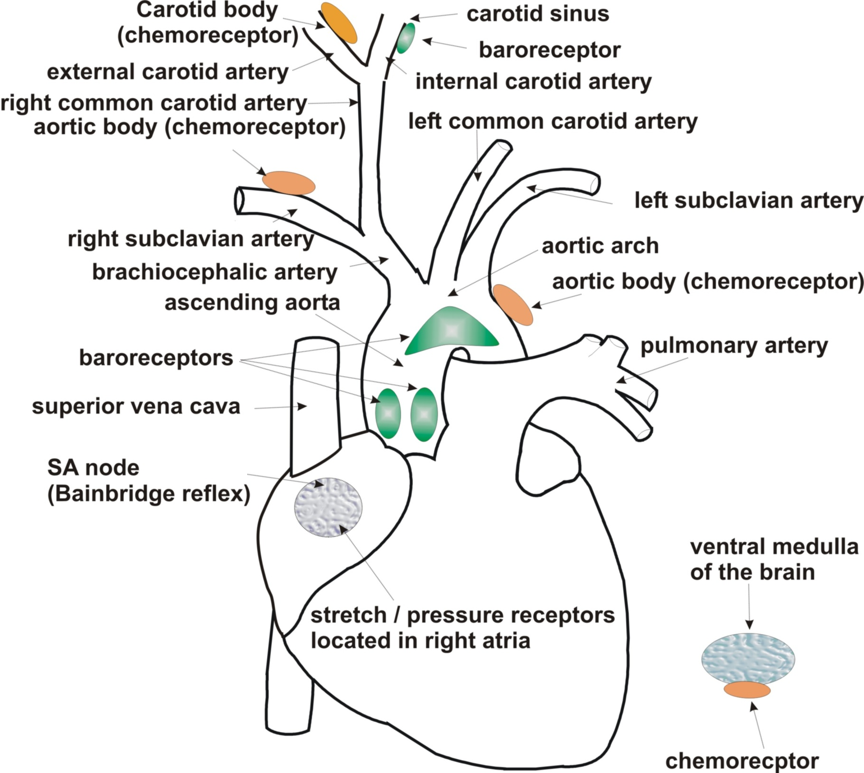

Slide 12
Vasomotor Center in the Brain and Its Control of the Vasoconstrictor System
Located bilaterally mainly in the reticular substance of the medulla and of the lower third of the pons, is an area called the vasomotor center. This center transmits parasympathetic impulses through the vagus nerves to the heart and transmits sympathetic impulses through the spinal cord and peripheral sympathetic nerves to virtually all arteries, arterioles, and veins of the body.
Although the total organization of the vasomotor center is still unclear, experiments have made it possible to identify certain important areas in this center, as follows:

Slide 13
Vasomotor Center in the Brain and Its Control of the Vasoconstrictor System
1. A vasoconstrictor area located bilaterally in the anterolateral portions of the upper medulla. The neurons originating in this area distribute their fibers to all levels of the spinal cord, where they excite preganglionic vasoconstrictor neurons of the sympathetic nervous system.
2. A vasodilator area located bilaterally in the anterolateral portions of the lower half of the medulla. The fibers from these neurons project upward to the vasoconstrictor area just described; they inhibit the vasoconstrictor activity of this area, thus causing vasodilation.

Slide 14
Vasomotor Center in the Brain and Its Control of the Vasoconstrictor System
3. A sensory area located bilaterally in the tractus solitarius in the posterolateral portions of the medulla and lower pons. The neurons of this area receive sensory nerve signals from the circulatory system mainly through the vagus and glossopharyngeal nerves, and output signals from this sensory area then help to control activities of both the vasoconstrictor and vasodilator areas of the vasomotor center, thus providing “reflex” control of many circulatory functions.

Slide 16
THE ARTERIAL BARORECEPTORS
In the systemic arterial system there are two sets of receptors which respond to changes in arterial pressure level. One set is the carotid baroreceptors located in the wall of the carotid sinus, which is situated at the origin of the internal carotid artery at the carotid bifurcation.
The other set is the aortic baroreceptors located in the wall of the arch of the aorta (see diagram on cardiovascular reflex pathway).
The afferent impulses from the carotid sinus travel in the glossopharyngeal (IXth cranial) nerve, whereas those from the aortic arch are conveyed by the vagus (Xth cranial) nerve.

Slide 17
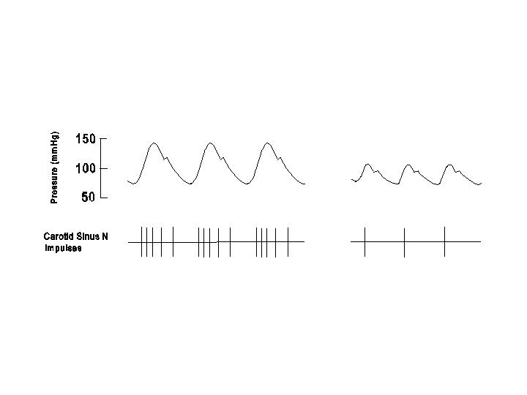
The baroreceptors are stretch receptors which are activated when the vessel wall is stretched by the arterial pressure.
These receptors are not only sensitive to the absolute pressure level, but also to the rate of change of arterial pressure. Thus, the frequency of afferent impulses increases when the pressure is rising during systole and decreases when the pressure is falling during diastole.
The baroreceptor impulses cease completely at pressure below 50 mmHg, rise progressively between 60 and 180 mmHg, and reach a maximum frequency at pressures higher than approximately 180 mmHg.

Slide 18
Baroreceptor control
baroreceptors are located in carotid sinus and aortic arch
they are stretch receptors, sensitive to increase of mean blood pressure
activity of baroreceptors increase during increase of blood pressure from 50
to 200 mm Hg
stimulation of cardio-inhibitor center
inhibition of cardio-stimulator center
HR and SV

Slide 19
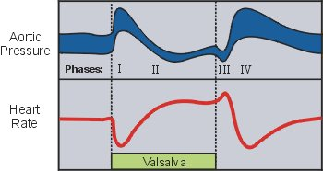
Baroreceptor reflex

Slide 20
THE ARTERIAL CHEMORECEPTORS
The arterial chemoreceptors are located in areas very close to the baroreceptors:
The carotid bodies are situated at the carotid bifurcation, and the aortic bodies are located near the aortic arch.
These chemoreceptors are connected to the main arterial tree by arterial branches which carry a very high rate of blood flow considering the small size of the chemoreceptors.
The afferent impulses from the carotid bodies travel in the glossopharyngeal (IXth cranial) nerve and those from the aortic bodies are conveyed by the vagus (Xth cranial) nerve.

Slide 21
THE ARTERIAL CHEMORECEPTORS
The chemoreceptors are sensitive to their local metabolic environment when altered. Thus, these receptors are stimulated by decreases in local pO₂ and pH and an increase in local pCO₂.
Because of the existence of a very high rate of blood flow per unit weight of chemoreceptors normally (approximately 2,000 ml/min/100 gm), these local metabolic factors are sensitive primarily to variations in the corresponding parameters in the arterial blood.
Thus, a decrease in arterial pO_{2,} an increase in arterial pCO_{2,} or a reduction in arterial pH, which are changes occurring after suppression of respiration, may cause stimulation of the chemoreceptors.

Slide 22
Control of blood pressure by chemoreceptors

Slide 23
The chemoreceptors can also be activated when there is a severe reduction in chemoreceptor blood flow, e.g., following a large volume of blood loss.
The primary effect of chemoreceptor impulses is to stimulate the respiratory center and increase ventilation, but they also cause excitation of the cardiovascular center.
The increase in sympathetic adrenergic activity resulting from chemoreceptor stimulation is mainly exerted on the resistance vessels to cause vasoconstriction.

Slide 24
When circulatory and respiratory functions are normal, the existence of a high chemoreceptor blood flow and normal values for blood gases and pH provides a local metabolic environment which gives rise to the normal chemoreceptor firing rate.
When the arterial pO₂ is reduced due to hypoventilation, the chemoreceptors become increasingly activated. The resulting chemoreceptor reflex causes a stimulation of respiratory movements to improve arterial pO₂ and a selective constriction of resistance vessels to provide the brain and the heart with sufficient blood flow and oxygen delivery.

Slide 25
OTHER CARDIOVASCULAR RECEPTORS
(1) Mechanoreceptors
There are receptors located in the atria and ventricles which are sensitive to mechanical stretch. The afferent fibers travel in the vagus nerves and in the sympathetic nerves.
There are several types of atrial receptors. The type that has the clearest physiological function is the receptors which fire upon atrial distention.
An expansion in blood volume would cause atrial distention. The impulses from these atrial receptors inhibit the medullary cardiovascular center to cause dilation of the resistance vessels and also inhibit the release of antidiuretic hormone by the hypothalamico-hypophyseal system. This latter effect would cause an increased urine flow, thus tending to reduce the blood volume toward normal.

Slide 26
OTHER CARDIOVASCULAR RECEPTORS
A reduction in blood volume would reduce the impulse discharge from these atrial receptors, thus causing sympathetic vasoconstriction and release of ADH.
Atrial distention can also directly cause release of atrial peptide from the atrial myocytes. The atrial peptide would cause vasodilation and renal sodium excretion.

Slide 27
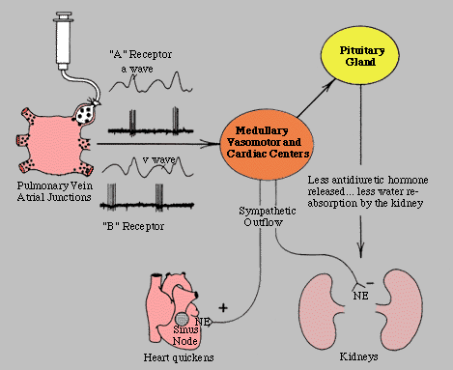
Increased blood volume stimulates atrial mechanoreceptors type В:
HR increases because increased tone of sympathicus and stimulation of SA node and decreased tone of vague nerve – reflex of Bainbridge

Slide 28
OTHER CARDIOVASCULAR RECEPTORS
The ventricular mechanoreceptors are located in the ventricular myocardium. These impulses cause reflex bradycardia and vasodilation, leading to a decrease in arterial pressure.
(2) Chemoreceptors.
Injection of several drugs (e.g., veratrum alkaloids and nicotine) into the coronary arteries of the dog causes reflex bradycardia and hypotension, together with some degree of respiratory inhibition. This is referred to as the Bezold-Jarish reflex, the significance of which is not known in man.

Slide 29
RECEPTORS IN THE SOMATIC SYSTEM
In addition to the above receptors which are found in the cardiovascular system, there are also receptors in the skin, periosteum, skeletal muscles and joints which send afferent impulses to modify the activity of the cardiovascular center.
(1) Thermoreceptors.
Upon exposure to cold, the receptors in the skin send afferent impulses to stimulate the cardiovascular center and enhance sympathetic adrenergic impulses. Therefore, the arterial pressure rises in a cold environment. This can be demonstrated by the cold pressor test in which an individual immerses his forearm in a bucket of cold water (e.g., 10°C) for several minutes. The vasoconstriction in the immersed hand is due to a combination of the direct effect of low temperature on the vascular smooth muscle and the reflex activation of the sympathetic adrenergic system. The vasoconstriction in the contralateral, un-immersed hand and other parts of the body is due to the reflex action alone.

Slide 30
RECEPTORS IN THE SOMATIC SYSTEM
The afferent impulses resulting from exposure to warmth causes an inhibition of the cardiovascular center.
(2) Pain receptors.
Superficial, sharp pain, e.g., that inflicted by a cut in the skin, is associated with afferent impulses which stimulate the cardiovascular center and sympathetic adrenergic nerves.
Deep, dull pain, e.g., that elicited by scraping of priosteum by an orthopedic surgeon, is associated with afferent impulses which inhibit the cardiovascular center. Therefore, this type of deep, dull pain is often accompanied by a precipitous fall in arterial pressure.
(3) Proprioceptors in muscle and joints.
During muscular exercise, the rhythmic activation of propiroceptors in the exercising limb leads to afferent impulses which are excitatory to the cardiovascular center and the respiratory center.

Slide 31
CEREBRAL ISCHEMIC RESPONSE
The cardiovascular center is stimulated by local accumulation of CO₂ and acid metabolites. This occurs when cerebral blood flow is reduced as the arterial pressure falls below 50 mmHg. The cerebral ischemic response involves intense sympathetic adrenergic discharge, leading to a marked rise of arterial pressure as a last line of attempt to defend against cerebral ischemia.

Slide 32
HIGHER CENTERS
The activity of the medullary cardiovascular center can be modified by descending impulses from the cerebral cortex and hypothalamus.
Emotional stimuli can activate these higher centers, which in turn excite the medullary cardiovascular center, giving rise to increases in heart rate and arterial pressure. These higher centers are also responsible for the activation of sympathetic system that occurs in anticipation of exercise.

Slide 34
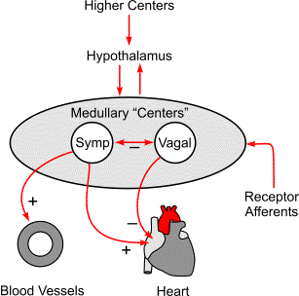
The tone of autonomic nervous system nerves on the heart and vessels is changed under the influence of the other NC, situated at medulla oblongata, hypothalamus and brain cortex.

Slide 35
Into medulla oblongata are situated two centers, controlling the heart performance and the vessels tone.

Slide 36
Long-term regulation of blood pressure
Control by hormones:
Vasopressin (ADH)
Renin –angiotensin - aldosterone system
Atrial natriuretic peptide
Effector organ is kidney -> change of reabsorption of water and sodium ions

Slide 37
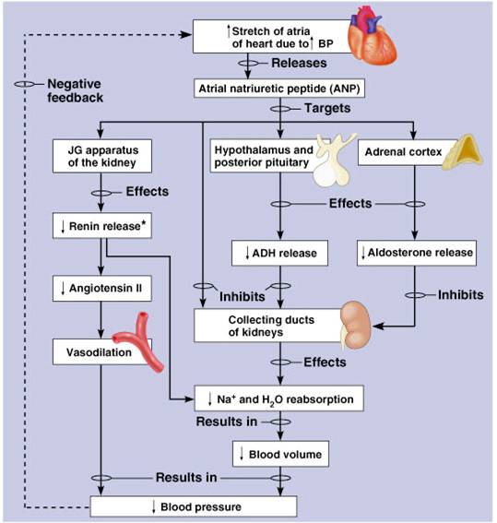
Control of blood pressure

Slide 38
Thanks for your attention!

