Slide 1
The basic concepts of allergies. Atopy. Genetic Mechanisms. Types of allergens
Assoc. Prof. Vanya Tsvetkova PhD
Head of Clinic of Allergology

Slide 2

INTRODUCTION
“Allergic diseases are increasing worldwide with unprecedented complexity and severity”
The precise causes of this increase are not fully understood
White Book on Allergy, 2011

Slide 3
GLOBAL ATLAS OF ALLERGY
Allergic disease affect more than one billion
2050 is expected to reach 4 billion
Significant effect on economy due to: health care cost, bad/low productivity, absenteeism

Slide 4

GLOBAL ATLAS OF ASTHMA
Asthma is a common chronic inflammatory disease
Patients of all ages are affected
In UK the prevalence of asthma reached 5% per year
Serious challenge to public health

Slide 5
GLOBAL ATLAS OF ALLERGIC RHINITIS AND
CHRONIC RHINOSINUSITIS
Allergic Rhinitis and Chronic Rhinosinusitis affect more than 30% of the population
More than 150 bln Euro in Europe for treatment

Slide 6

TARGET ORGANS
Allergic Rhinitis

Slide 7
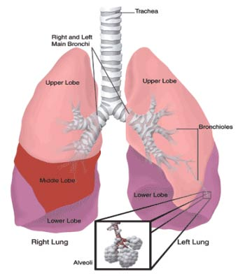
TARGET ORGANS
Bronchial Asthma

Slide 8
TARGET ORGANS
Allergic Rhinitis

Slide 9
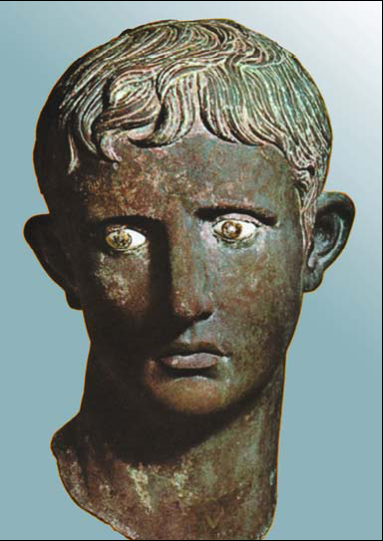
The Roman Emperor Augustus suffered from atopic syndrome (bronze sculpture, around 14 A.D., British Museum, London)

Slide 10
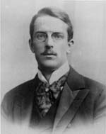
Australian pediatrician - Clemens von Pirquet (1874-1929), used the word allergy in 1906 for the first time.
“allo” – other; “ergon” - activity.

Slide 11
Australian pediatrician - Clemens von Pirquet (1874-1929), used the word allergy in 1906 for the first time.
“allo” – other; “ergon” - activity.

Slide 12
Paul Ehrlich (1854–1915)
Discovered eosinophils and mast cells

Slide 13
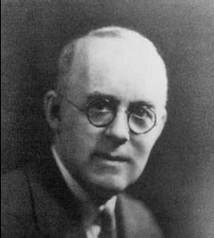
Arthur Fernandez Coca (1875–1959)
Introduced the term “atopy”

Slide 14
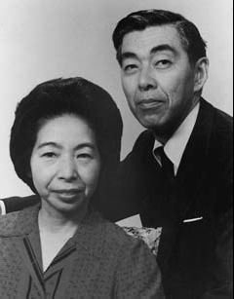
Teruko Ishizaka and Kimshige Ishizaka discovered IgE in 1967 year

Slide 15
DEFINITIONS
Abnormally immune mediated hypersensitivity reaction
Allergy is a hypersensitive inflammatory immune response to innocuous environmental antigens, mediated by immunoglobulin type E (IgE) antibodies
Allergens – antigens which cause allergy
Atopy- a personal and/or familial tendency, usually in childhood or adolescence, to become sensitized and produce IgE antibodies in response to ordinary exposure to allergens, usually proteins

Slide 16
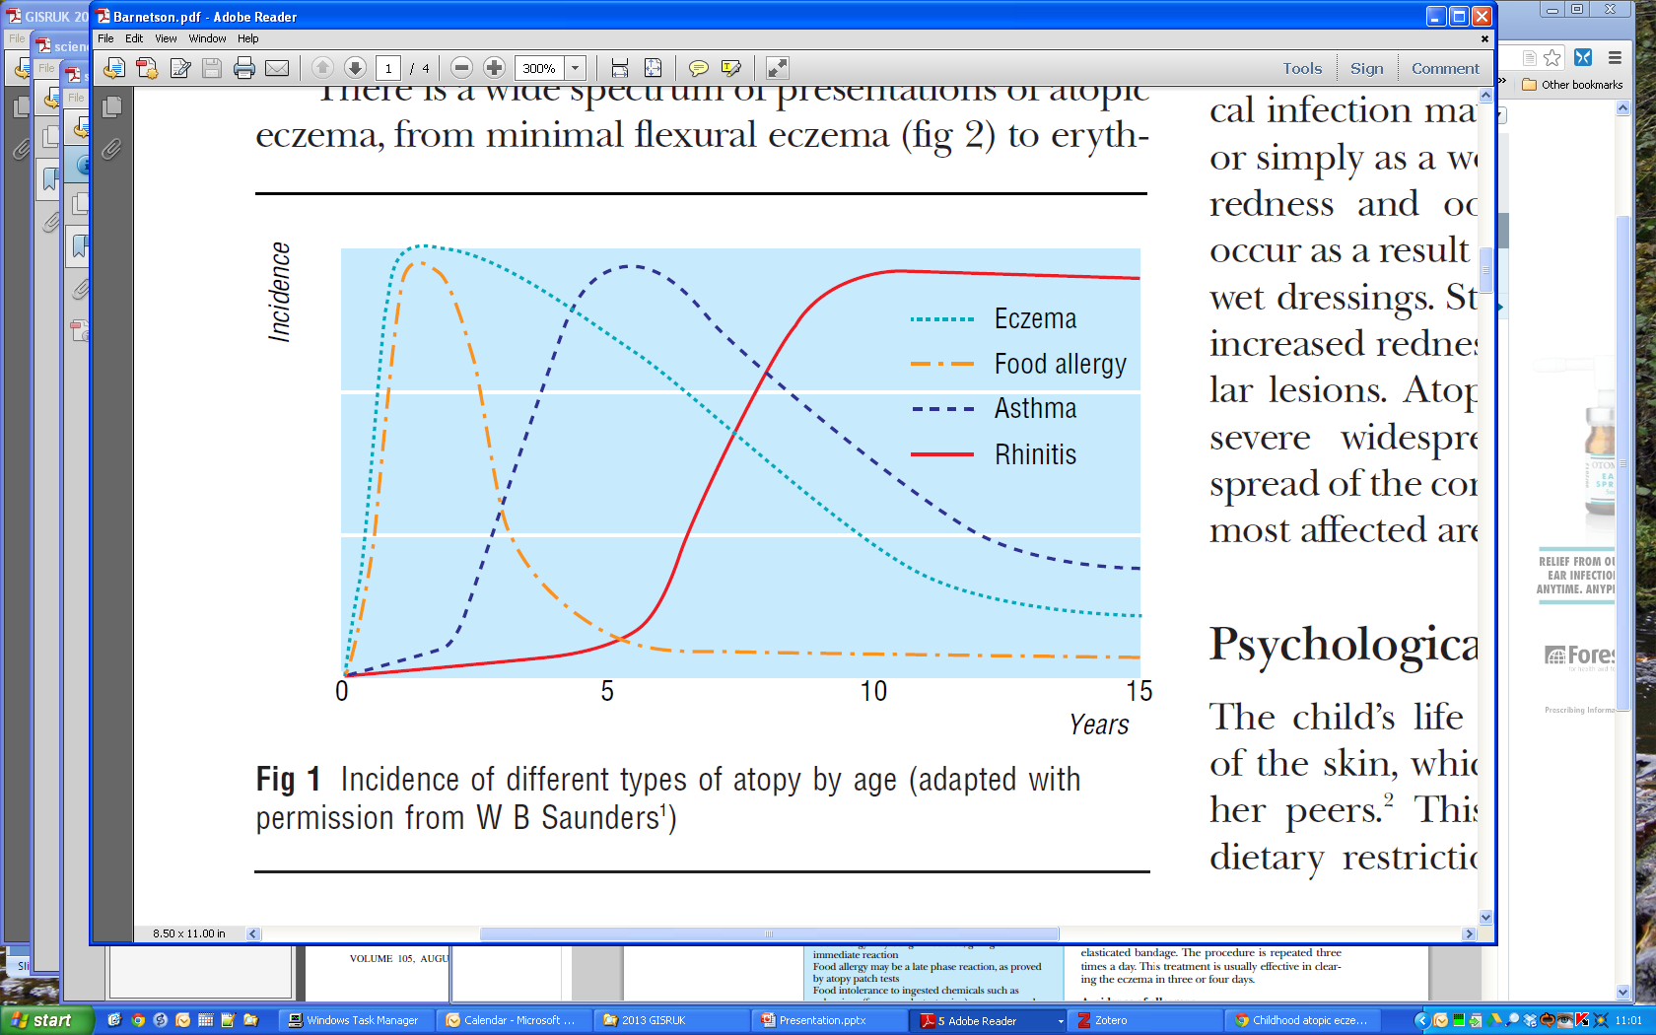
March of Atopy
The March of Atopy is a contested area
Studies show that
childhood eczema / allergies significantly increases the chance of asthma in later life
Barnetson (2002) Fig. 1
Notes:
March of Atopy is a contested concept.
16

Slide 17

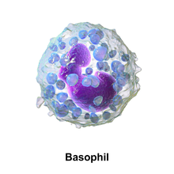
MAJOR CELLS
Myeloid precursor→ bone marrow→basophil→tissues→mast cell
Mast cells – basic in early allergic reaction
Mast cell

Slide 18
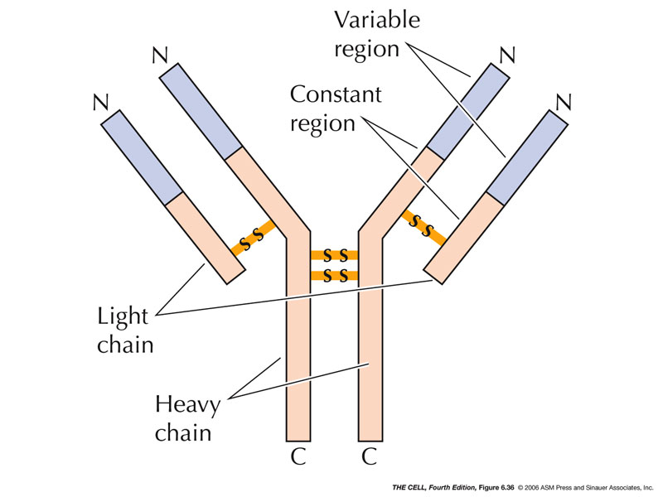
Immunoglobulin Е

Slide 19
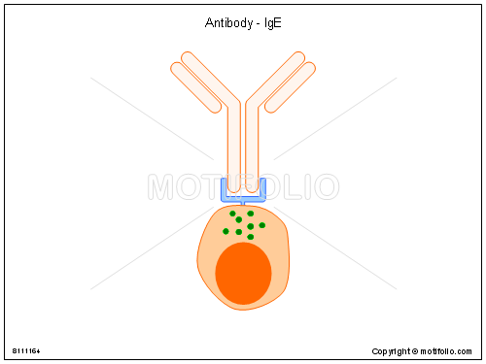
IgE
Atopic patients – Serum IgEs 5-10-fold higher
Fc defines the ability to bind to membrane receptors for IgE on mast cells and eosinophils
Notes:
An Fc receptor is a protein found on the surface of certain cells – including, among others, B lymphocytes, follicular dendritic cells, natural killer cells, macrophages, neutrophils, eosinophils, basophils, human platelets, and mast cells – that contribute to the protective functions of the immune system.

Slide 20
GENETIC MECHANISMS
Allergic diseases are complex and development involves both environmental and genetic factors
The existence of a genetic component for allergy was first described almost 100 years ago
Necessary of high technologies to investigate genetic variation in large numbers of subjects.
Genome-Wide Association Studies (GWAS), a hypothesis-free method of interrogating large numbers of common variants spanning the entire genome in disease and non-disease subjects
Notes:
The first GWAS for asthma was completed in 2007 by Moffatt and colleagues, a discovery cohort of 994 patients with childhood onset asthma and 1243 nonasthma controls identified significant association to a locus on chromosome 17q21

Slide 21
GENETIC MECHANISMS
Genetic predisposition for IgE synthesis is associated with 11 chromosome (11q13)
asthma
The 17q21 has been reproduced as a locus associated with asthma, severe asthma and asthma with severe exacerbations in subsequent multiple GWAS
allergic rhinitis
11q13 locus; C11orf30/LRRC32 – regulates gene expression , epithelial T-cell function.
atopic dermatitis
1q21 and 11q13 loci; FLG, LCE3A, OVOL1 - development and differentiation of epidermal/epithelial
tissues
Notes:
The first GWAS for asthma was completed in 2007 by Moffatt and colleagues, a discovery cohort of 994
patients with childhood onset asthma and 1243 non asthma controls identified significant association to a
locus on chromosome 17q21

Slide 22
Immune Recognition of Allergen
I stage
Т - cell independent immune response:
- The allergen is inhaled or digested in previously sensitized individual with genetically predisposition
- Processing of allergen by APC (antigen-presenting cells ) – macrophages, dendritic or B cells.
Presenting to T cells that bear receptors for specific antigens
II stage
В cell binding of allergen:
- Enzymatic treatment
- Proliferation and differentiation of B cells to IgE producing plasma cells
Notes:
The antigen-presenting cells then migrate to lymph nodes, where they prime naïve TH cells that bear receptors for the specific antigen.

Slide 23
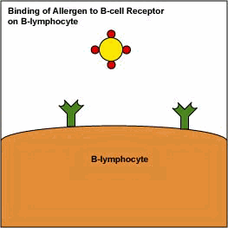

Slide 24
Mechanism of type І IGE mediated allergic reaction
Degranulation – releasing of preformed mediators: histamine, tryptase, proteoglycans, chemotactic factors
Newly formed mediators
– leukotrienes, prostaglandins, platelate-activating factor (PAF)
Histamine – vasodilation, contraction of smooth muscles, pruritus
Notes:
Histamine: This mediator acts on histamine 1 (H1) and histamine 2 (H2) receptors to cause contraction of smooth muscles of the airway and GI tract, increased vasopermeability and vasodilation, enhanced mucus production, pruritus, cutaneous vasodilation, and gastric acid secretion. Tryptase is found in all human mast cells but in few other cells and thus is a good marker of mast cell activation.

Slide 25
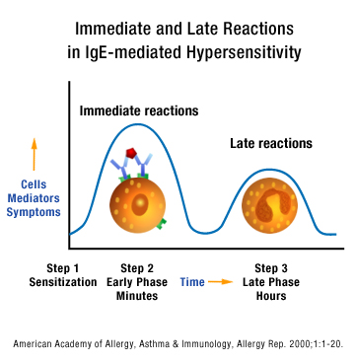
Mechanism of type І IgE mediated allergic reaction

Slide 26
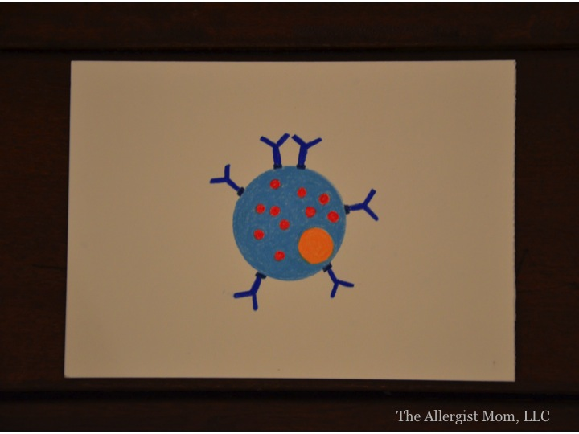
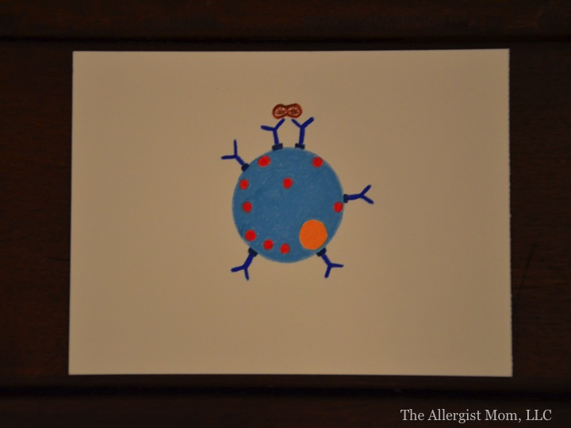
Mechanism of type І IgE mediated allergic reaction

Slide 27
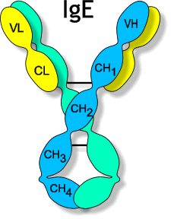
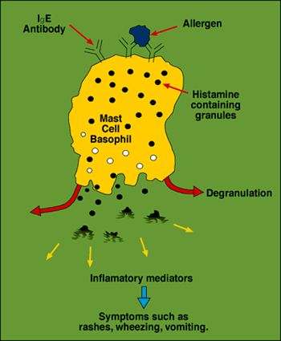

Slide 28
Mechanism of type І IgE mediated allergic reaction
Leukotrienes: LTC4, LTD4, LTE4 – spasmogenic cysteinyl LTs
LTB4 – serves as a potent chemoattractant for neutrophils and eosinophils
PAF – Platelet activating factor
Histamine and leukotrienes in early allergic reactions: asthma attack, sneezing, rhinorrhea, acute urticaria
PAF, LTB4, eosinophils in late allergic response: chronic asthma and rhinitis. Regulatory role of Th2 lymphocytes

Slide 29


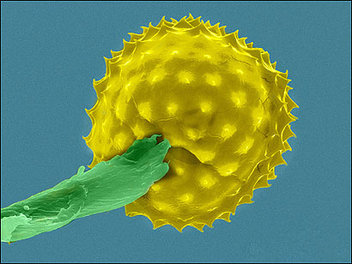
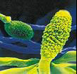
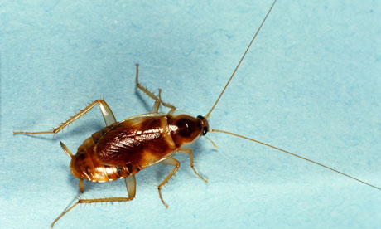
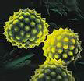

Slide 30
Th1 and Th2 Response
T lymphocytes are major “players” in the immune system
These cells bear antigen specific receptors on their cell surface to allow recognition of foreign substances: pathogens, allergens
Two main subsets of T lymphocytes, distinguished by the presence of cell surface molecules known as CD4 and CD8
T lymphocytes expressing CD4 are also known as helper T cells- Th1, Th2
Notes:
They can also recognise normal tissue during episodes of autoimmune diseases. This subset can be further subdivided into Th1 and Th2,

Slide 31
Th1 cause phagocyte-dependent inflammation and the proinflammatory responses responsible for killing intracellular parasites and viruses
Th2 cells evoke IgE antibody response and eosinophil accumulation
Allergen-specific Th2 responses are responsible for atopic disorders in genetically susceptible individuals.
Notes:
Further, Th1-dominated responses are involved in the pathogenesis of organ-specific autoimmune disorders, Crohn's disease, sarcoidosis, acute kidney allograft rejection, and some unexplained recurrent abortions.

Slide 32
Polarization between Th1 and Th2 led to the Th1/Th2 paradigm
Th1 and Th2 responses are determined by the cytokines the T cells secrete
Th1 cytokines: IFN-g, IL-2, TNF
Th2 cytokines: IL-4, IL-5, IL-6, IL-10, IL-13

Slide 33



Important questions in allergy
The main topics of concern
Food safety
(allergenicity of food:
composite and genetically
modified foods)
Biological factors
(safety of vaccination)
Chemical factors
(products highly aggressive
for the skin, self-imposed
medication )

Slide 34
Classification of Allergens
By way of submission
inhalant ingestent
contact trough skin
By origin
plants animal
microorganisms household
professional auto allergens

Slide 35
Classification of Allergens
Indoor
house dust dust mites
Indoor molds cockroaches
animal feather pet allergens
Outdoor
grass pollen tree pollen
weeds
molds bacterial allergens
food allergens insect sting allergens
drug allergens industrial allergens
Notes:
people are not allergic to an animal’s hair, but to an allergen found in the saliva, dander (dead skin flakes) or urine of an animal with fur.

Slide 36
House Dust Mites
Major source for indoor allergens и
Widespread worldwide
One of the major reason for bronchial asthma
Global atlas of allergy,2015

Slide 37
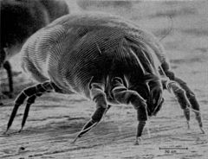
Do not occur in dry climate areas, high altitude or cold weather
Main representatives
Dermatophagodes pteronyssinus
Dermatophagodes farinae
Notes:
Акарите живеят практически във всички дюшеци, матраци, килими и спално бельо.

Slide 38

Allergens from pets
Isolated allergens:
8 from cat - felis domesticus
6 from dog – canis familiaris
4 from horse – equus caballus
и др.
Sensitization to pets is a risk factor for severe asthma

Slide 39

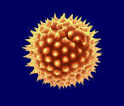
Tree pollen allergens
Pollen grains: microspore of a seed plant containing male gametophyte
They have a hard coat – sporopollenin
Common trees: birch, beech, olive, cypress, walnut

Slide 40
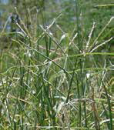
Grass allergens
Grass pollen allergy is a global problem
Sensitization levels in the general population is between 1 and 30%
Grass allergens – major factors for seasonal allergic rhinitis and asthma
Global atlas of allergy,2015
Notes:
Снимки на различни тревни видове и техните полени.

Slide 41
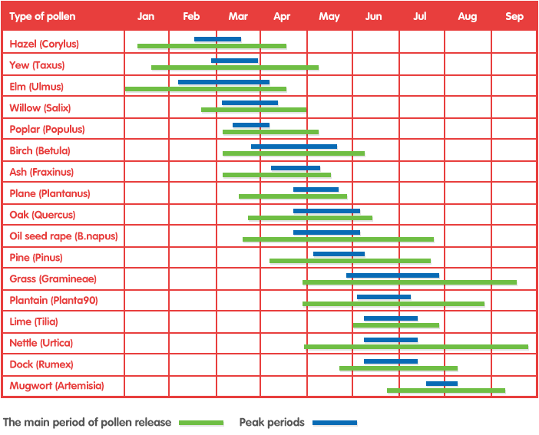
Pollen Calendar
Severity of pollen seasons differ from year to year
Pollen Calendar depends on: weather and geographical location
Notes:
Поленовият календар дава информация за продължителността и интензитета на цъфтеж на най-важните алергизиращи растителни видове в България: сем. Брезови, сем. Житни, плевели и други. Поленовият календар дава ориентировъчна информация. Цветовете означават различната степен на въздушна концентрация на полени.

Slide 42
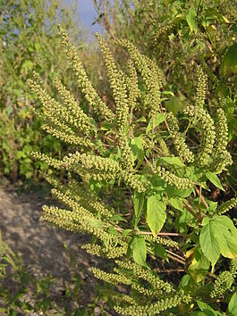
Weed Allergens
Usually from august to November weeds bloom and release pollens
In many areas pollen levels are highest in mid-September
Typical:
Artemisia; Parietaria; Ambrosia

Slide 43

Food Allergens
Prevalence in USA - over 15 million
Oral Allergy Syndrome

Slide 44
Structural Biology of Allergens
Most inhalant allergens are 10-60 kDa proteins or glycoproteins
Hundreds of different proteins have been found to be allergens
IgE responses to proteins depend on immunologic, environmental, host factors
Allergic patients have high levels of IgE antibodies to allergens to which they are exposed in the peripheral blood and in the skin
Notes:
Structural and molecular studies have revealed that allergens are a diverse group of proteins with different structures and biological functions. Most common allergens have been cloned, sequenced and manufactured as recombinant proteins in high-level expression systems

Slide 45
An allergic patient will not produce a single IgE antibody to a single allergen molecule, but will typically react to several allergens from the allergenic source
Usually, allergens are classified as ‘major’ or ‘minor’ based on the prevalence of IgE sensitization in a selected population of allergic patients
Notes:
Some allergens are more important than others. Usually > 50% prevalence defines a major allergens and < 20% is minor. The current definition of major allergen is based on the prevalence of IgE or skin reactivity in subjects that are sensitized (usually very strongly) to the total extract.

Slide 46
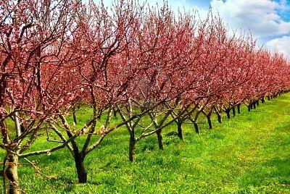

POLLENS
Early spring
Notes:
Pollens are tiny grains needed to fertilize many kinds of plants. Each plant has a period of pollination that does not vary much from year to year. However, the weather can affect the amount of pollen in the air at any time

Slide 47



May-June
Notes:
grass pollens and garden flowers

Slide 48
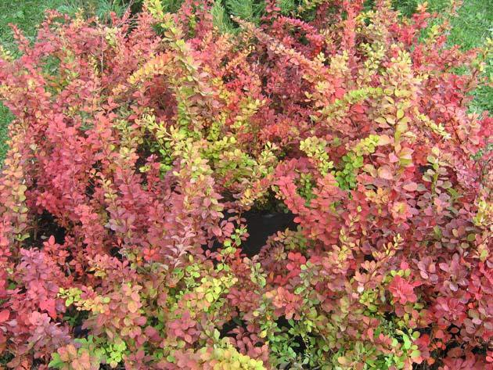
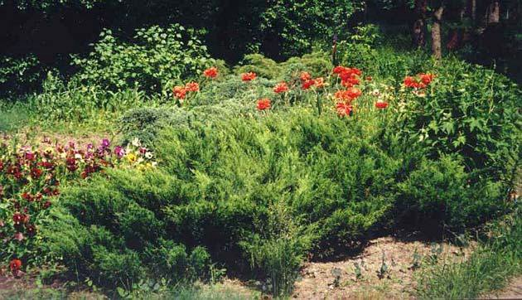
August-October
Notes:
Bushes

Slide 49
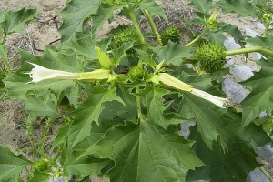
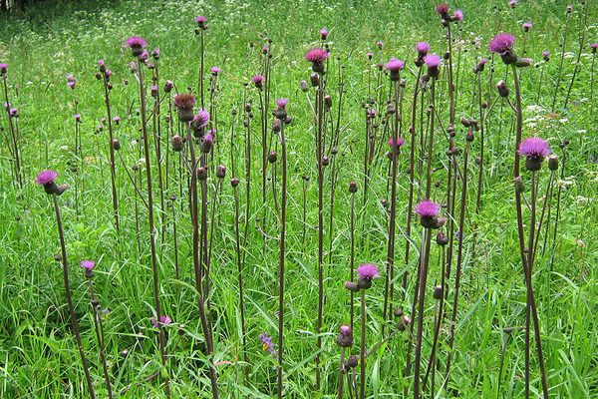
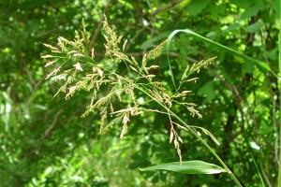

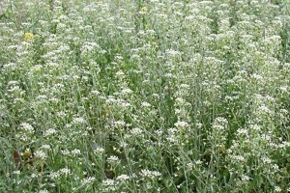
Late autumn
Notes:
Weeds

Slide 50
ALLERGY TESTING
The most important ancillary test to confirm the diagnosis of allergy is the skin test, which is the gold standard.
Allergy testing helps the physician to determine if a patient’s problem is indeed caused by allergy and to identify the specific problem allergens.

Slide 51
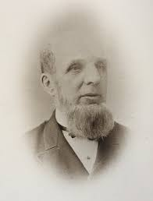
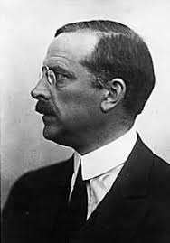
Skin Testing
Although Blackley first documented the diagnostic potential of skin testing by placement of an allergen on abraded skin, the introduction of the cutaneous test for tuberculosis by von Pirquet became the chief impetus for subsequent allergy skin testing

Slide 52
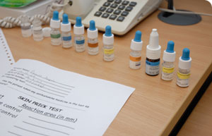

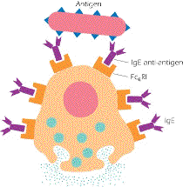
Skin tests
In vitro serum IgE specific antibody testing (RAST).
Notes:
The two major types of tests for IgE-mediated type I hypersensitivity reactions are :

Slide 53
Skin prick test kit comprising four allergens and positive control solution (histamine 10 mg/ml) and negative control (allergen diluent)
Lancet for skin prick testing

Slide 54
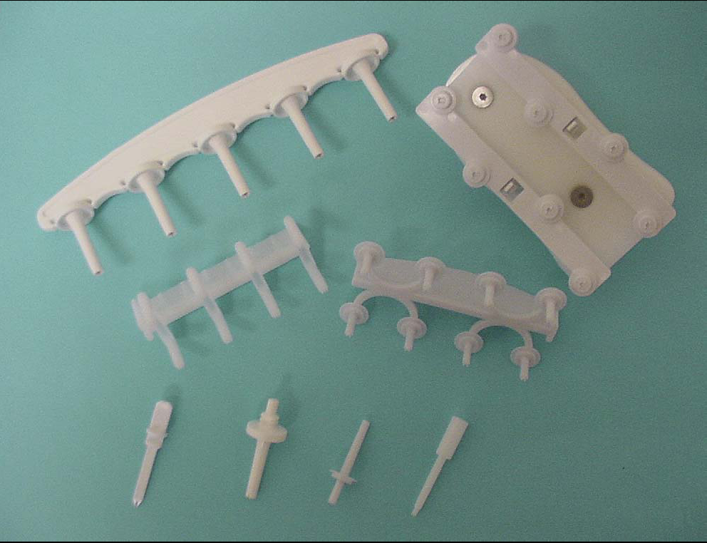
Skin test devices

Slide 55
Prick test

Slide 56
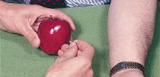
Prick-Prick test

Slide 57
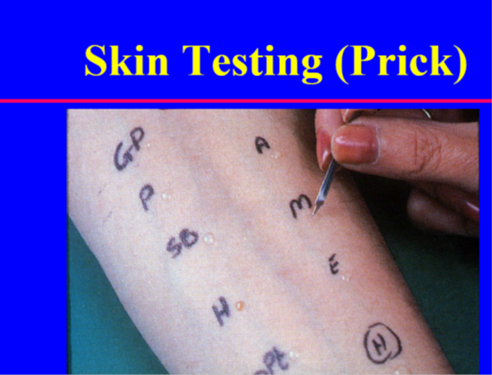
Skin Prick -Technique
In performing the skin prick test, a drop of allergen extract is placed on the skin, then pierced through by the instrument at a 45–60° angle to the skin, creating a small break in the epidermis, which allows the allergen solution to penetrate.

Slide 58
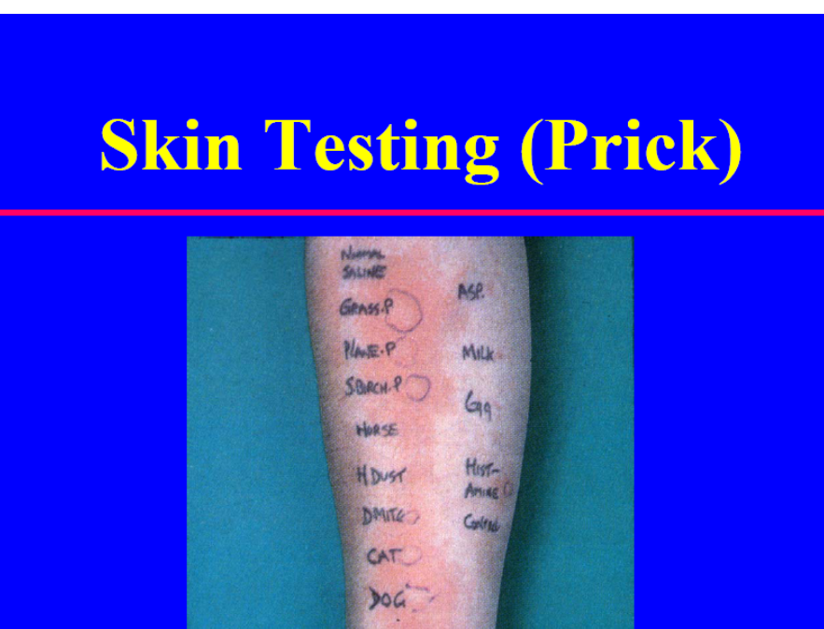
Skin prick tests - on the upper back or volar surface of the forearm
Notes:
can be performed

Slide 59
Skin Prick -Technique
The mediators (primarily histamine) released at the site cause the formation of localized erythema, edema, and widespread flare, which peak at 15–20 minutes
The size of the wheal and the surrounding erythema are then recorded

Slide 60
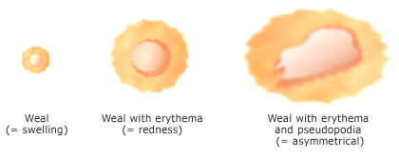
The central wheal of the skin response is principally a result of histamine-induced vasopermeability and secondary edema

Slide 61
Evaluation at 15 minutes of skin prick test results (weal sizes in mm)

Slide 62
Drugs that suppress skin prick and intradermal tests
Generic name
No. of days medication should be discontinued before skin testing
Antihistamine, first generation
Chlorpheniramine 3
Diphenhydramine 2
Hydroxyzine 5
Antihistamine, second generation
Cetirizine 4
Fexofenadine 4
Loratadine 6
Tricyclic antidepressants
Desipramine 3
Imipramine 10
Doxepin 7
H 2 Antihistamines
Ranitidine 1
a Leukotriene antagonists and topical antihistamines azelastine (nose), levocabastine
(eye), and topical nasal corticosteroids do not affect skin prick and
intradermal tests

Slide 63
Which test?
Skin testing is most useful in evaluating type I (immediate) hypersensitivity
  Most frequently used in evaluating adverse reactions to penicillin, local anesthetics, insulin, and vaccines
Radioallergosorbent (RAST) tests have 20% false-negative rate in penicillin type I allergy and therefore RAST must be followed by skin testing
  RAST test cannot replace skin testing?

Slide 64
Intradermal test

Slide 65
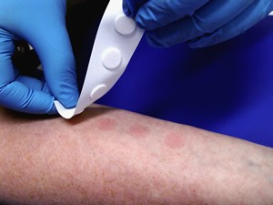
Patch test

Slide 66
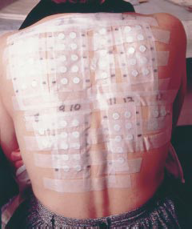
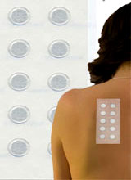
Patch testing for diagnosing causal sensitiser in allergic contact eczema
Patch testing with Finn chambers

Slide 67
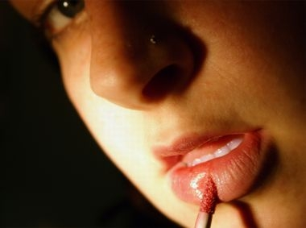
Keep your skin healthy by conducting a patch test before using new cosmetics

Slide 68
How Many Drug Tests?
Intradermal Tests (IDT)
IDT are performed only when prick tests show negative results 20 min after testing with the suspected drug
As they could re-induce the adverse drug reactions, IDT are not performed in patients with Stevens-Johnson syndrome, Lyell’s syndrome or leukocytoclastic vasculitis on histological examination and have to be considered
with caution in drug reactions with eosinophilia and systemic symptoms (DRESS)

Slide 69

A good allergist has to be like Sherlock Holmes – nothing is unimportant!

Slide 70

Thank You for your attention

