Slide 1
HEALTH SYSTEM AS A SOCIAL SYSTEM
MEDICAL UNIVERSITY – PLEVEN
FACULTY OF PUBLIC HEALTH
DEPARTMENT OF PUBLIC HEALTH SCIENCES
DAY 4 INTERNSHIP
Prepared by:
Prof. Dr. Silviya Aleksandrova-Yankulovska, MD, PhD, MAS
Assoc. Prof. Dr. Stela Georgieva, MD, PhD

Slide 2
Outline of the lecture
Definitions of main terms:
  Health system
  Healthcare
  Medical care
Health systems:
  Objectives and functions
  Evolution
  Reforms
  Assessment of overall performance
Health care:
  Levels
  Characteristics
Health services evaluation

Slide 3
Relation between terms

Slide 4
All organizations, institutions and resources, that are devoted to performing health activities
Health system
Health care
Medical care
A multitude of services provided to individuals, families or communities by agents of the health services or professions, for the purpose of promoting, maintaining, monitoring or restoring health.
Therapeutic action by or under the supervision of a physician.
Those personal services that are provided directly by physicians or as a result of physician’s instruction.

Slide 5
Definitions of main terms (1)
Health systems:
The economic, fiscal, and political management method that nations use to run the national health services (Last 2007)
All organizations, institutions and resources, that are devoted to performing health activities (WHR-2000).
All means and activities whose primary purpose is to improve or maintain health (Murray and Frenk 2000).

Slide 6
HEALTH SYSTEMS
Formal health services, including the professional delivery of personal medical attention, are clearly within these boundaries.
So are actions by traditional healers, and all use of medication, whether prescribed by a provider or not.
So is home care of the sick, which is how somewhere between 70% and 90% of all sickness is managed.
Such traditional public health activities as health promotion and disease prevention, and other healthenhancing interventions like road and environmental safety improvement, are also part of the health system.

Slide 7
HEALTH SYSTEMS
Beyond the boundaries of this definition are:
Those activities whose primary purpose is something other than health – education, for example – even if these activities have a secondary, health-enhancing benefit. Hence, the general education system is outside the boundaries, but specifically health-related education is included.
So are actions intended chiefly to improve health indirectly by influencing how non-health systems function – for example, actions to increase girls’ school enrolment or change the curriculum to make students better future caregivers and consumers of health care.

Slide 8
Definitions of main terms (2)
Health care:
A multitude of services provided to individuals, families or communities by agents of the health services or professions, for the purpose of promoting, maintaining, monitoring or restoring health.

Slide 9
Definitions of main terms (3)
Medical care:
Therapeutic action by or under the supervision of a physician.
Those personal services that are provided directly by physicians or as a result of physician’s instruction.

Slide 10
HEALTH SYSTEMS - objectives
According to WHR-2000 the objectives of any good health system are:
To achieve the best attainable average level of health – goodness of the health system;
To reduce health inequalities and differences between individuals and groups – fairness of the health system.

Slide 11
HEALTH SYSTEMS - objectives
According to WHR-2000 the objectives of any good health system are:
To satisfy people’s expectations with quality and timeliness of health services;
To provide financial risk protection, protection against excessive expenditure in case of illness

Slide 12
HEALTH SYSTEMS - functions
Progress towards these goals depends on four vital functions:
  Service provision
  Resource generation
  Financing
  Stewardship – oversight of all other functions

Slide 13
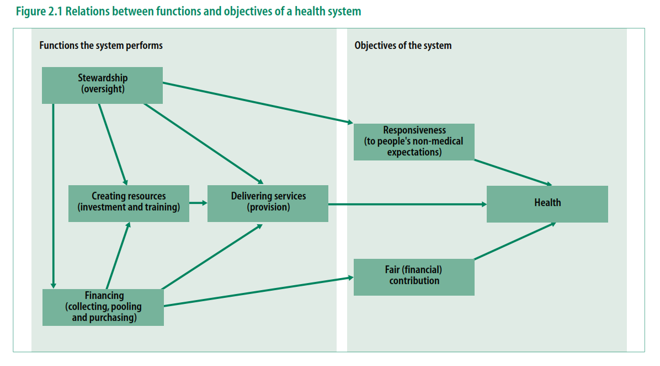

Slide 14
HEALTH SYSTEMS - factors
Medical factors
Non-medical factors
Level and tendencies of public health
Development of medical education
Development of a science of medicine
Medical traditions
Economic development of the country
Social policy
Climate and geographic peculiarities
National traditions

Slide 15
HEALTH SYSTEMS - evolution
Traditional practices based on herbal cures integrated with spiritual counselling > nowadays coexist with modern medicines.
  Example: Chinese medicine can be traced back more than 3000 years, and still plays a huge role in the Chinese health system.

Slide 16
HEALTH SYSTEMS - evolution
2. Organized health systems in the modern sense - a century ago.
  Hospitals have longer history but few people visited them. Until the 19th century they were mostly run by charitable organizations, and often were refuges for the orphaned or the insane.
  There was nothing like the modern practice of referrals from one level of the system to another, and little protection from financial risk.

Slide 17
HEALTH SYSTEMS - evolution
3. Industrial revolution > recognition of the huge toll of death, illness and disability among workforces > great losses in productivity > company owners began providing medical services to their workers.
  Bismarck, Chancellor of Germany, in 1883, Germany enacted a law requiring employer contributions to health coverage for low-wage workers in certain occupations - first example of a STATEMANDATED SOCIAL INSURANCE MODEL.
  Adoption of similar legislation in Belgium in 1894 and Norway in 1909.
  In 1922, Japan added health benefits to the other benefits for which workers were eligible.
  In 1924, Chile brought all workers under the umbrella of a Ministry of Labour scheme.
  By 1935, 90% of Denmark’s population was covered by work-related health insurance.
  In the Netherlands social insurance was introduced during the Second World War.

Slide 18
HEALTH SYSTEMS - reforms
The first generation of reforms - the founding of national health care systems, and the extension of social insurance systems, mostly in the 1940s and 1950s in richer countries and later in poorer countries.
  health services still were used mostly by the better-off, and efforts to reach the poor were often incomplete.
  need for radical change that would make systems more cost-efficient, equitable, and accessible.

Slide 19
HEALTH SYSTEMS - reforms
The second generation of reforms - the promotion of primary health care as a route to achieving affordable universal coverage.
  Experience with disease control in the 1940s in countries such as South Africa, China, Cuba, Guatemala, Indonesia, Niger, the United Republic of Tanzania, and Maharashtra State in India, Costa Rica and Sri Lanka - very good health outcomes at relatively little cost, adding 15 to 20 years to life expectancy at birth in two decades.

Slide 20
HEALTH SYSTEMS - reforms
Primary health care as the strategy for achieving the goal of “Health for All” at the International Conference on Primary Health Care (Alma-Ata, 1978).
  Minimum level for all of health services, food and education, adequate supply of safe water and basic sanitation.
  Public health measures, prevention, essential drugs, and education of the public by community health workers.

Slide 21
HEALTH SYSTEMS - reforms
“New universalism” - delivery to all of high-quality essential care, defined mostly by criteria of effectiveness, cost and social acceptability.
It implies explicit choice of priorities among interventions, respecting the ethical principle that it may be necessary and efficient to ration services, but that it is inadmissible to exclude whole groups of the population.

Slide 22
HEALTH SYSTEMS - reforms
Transformation from centrally planned to market-oriented economies, reduced state intervention in national economies, fewer government controls, and more decentralization.
Greater emphasis on individual choice and responsibility.
Limited promises and expectations about what governments should do.

Slide 23
HEALTH SYSTEMS - reforms
This is the third generation of reforms - characterized by an increasing interest to respond more to people’s demand, with greater emphasis on individual choice and responsibility, and greatly increased interest in explicit insurance mechanisms, including privately financed insurance.

Slide 24
HEALTH SYSTEMS
Assessment of overall performance
Level of health
Distribution of health
Level of responsiveness – how the system performs relative to non-health aspects, meeting or non-meeting a population’s expectations of how it should be treated. Elements:
Distribution of responsiveness.
Fairness of financial contribution.
I. Respect for persons: - Respect for the dignity of the person - Confidentiality - Autonomy | II. Client orientation: - Prompt attention - Amenities (cleanness, space, hospital food) - Access to social support networks - Choice of provider

Slide 25
HEALTH SYSTEMS
Assessment of overall performance
The composite is constructed on a scale from 0 to 100.
The weights on the five components are:
Level of health – 25%
Distribution of health – 25%
Level of responsiveness – 12.5%
Distribution of responsiveness – 12.5%
Fairness of financial contribution – 25%

Slide 26
Definitions of main terms (2)
Health care:
A multitude of services provided to individuals, families or communities by agents of the health services or professions, for the purpose of promoting, maintaining, monitoring or restoring health.

Slide 27
HEALTH CARE - characteristics
According to WHO health care has many characteristics, the most important among them are five A’s:
appropriateness (relevance), i.e. whether the service is needed at all in relation to essential human needs, priorities and policies;
adequacy, i.e., if the service is proportionate to requirement;

Slide 28
HEALTH CARE - characteristics
availability, i.e., the ratio between the population of an administrative unit and the health facility (e.g. population per centre; doctor-population ratio);
accessibility, i.e., geographic, economic or cultural accessibility;
affordability, i.e., the cost of health care should be within the means of the individual and the state;

Slide 29
HEALTH CARE - characteristics
Among the other characteristics it is worth to mention:
comprehensiveness, i.e. whether there is an optimum mix of preventive, curative and promotional services;
feasibility, i.e., operational efficiency of certain procedures, logistic support, manpower and material resources.

Slide 30
HEALTH CARE - levels
Health services are usually organized at three levels, each level supported by a higher level to which the patient is referred:
PRIMARY HEALTH CARE
SECONDARY HEALTH CARE
TERTIARY HEALTH CARE

Slide 31
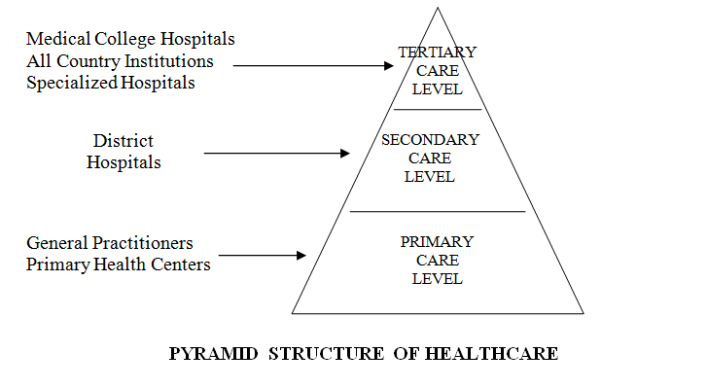
HEALTH CARE - levels

Slide 32
PRIMARY HEALTH CARE
HEALTH CARE - levels
This is the first level of contact between the individual and the health system where “essential” health care is provided.
A majority of prevailing health complaints and problems can be satisfactory dealt with at this level. This level of care is closest to the people.

Slide 33
SECONDARY HEALTH CARE
HEALTH CARE - levels
At this level, more complex problems are dealt with. This care comprises essentially curative services and is provided by district hospitals and community health centers. This level serves as the first referral level in the health system.

Slide 34
TERTIARY HEALTH CARE
HEALTH CARE - levels
This level offers super specialized care provided by regional/central level institutions. These institutions provide also planning and managerial skills and teaching for specialized staff.

Slide 35
HEALTH CARE - levels
The infrastructure of the health system:
health care providers
health care administrative and financing authorities

Slide 36
HEALTH CARE - levels
These two groups closely relate to each other and to the population of health care consumers (users).
The professionals and health institutions orient the consumers through the institutions and prescribe different diagnostic tests and therapeutic means; they are at the same time in relationship with the authorities charged with the administration and financing.

Slide 37


Slide 38
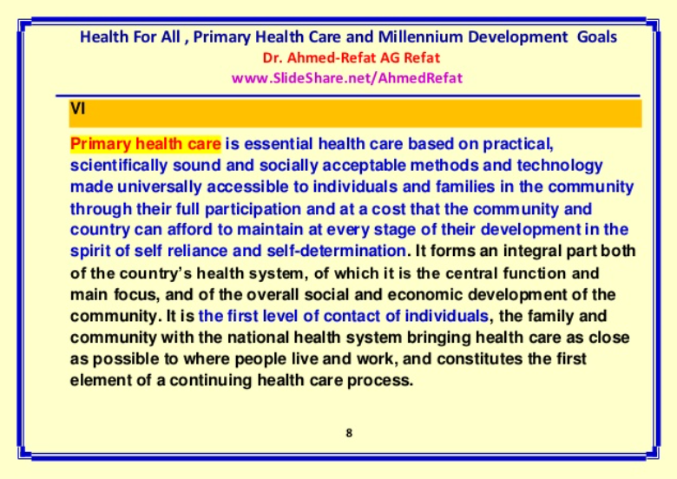

Slide 39
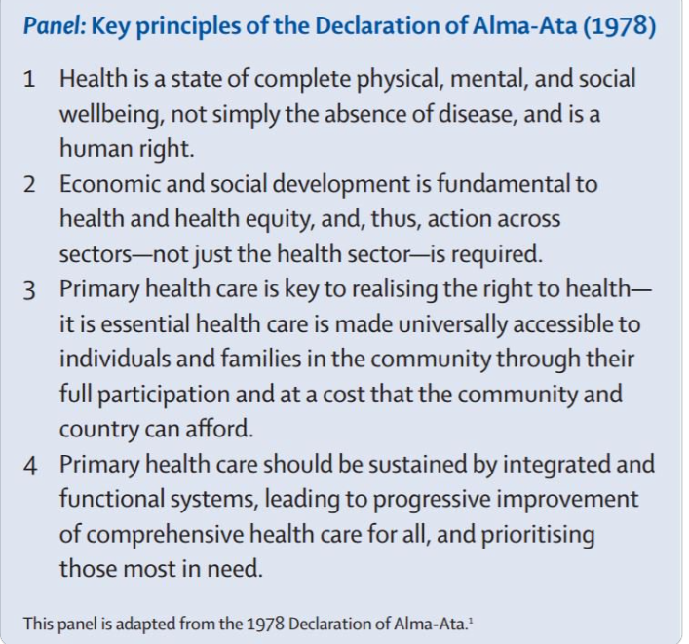

Slide 40
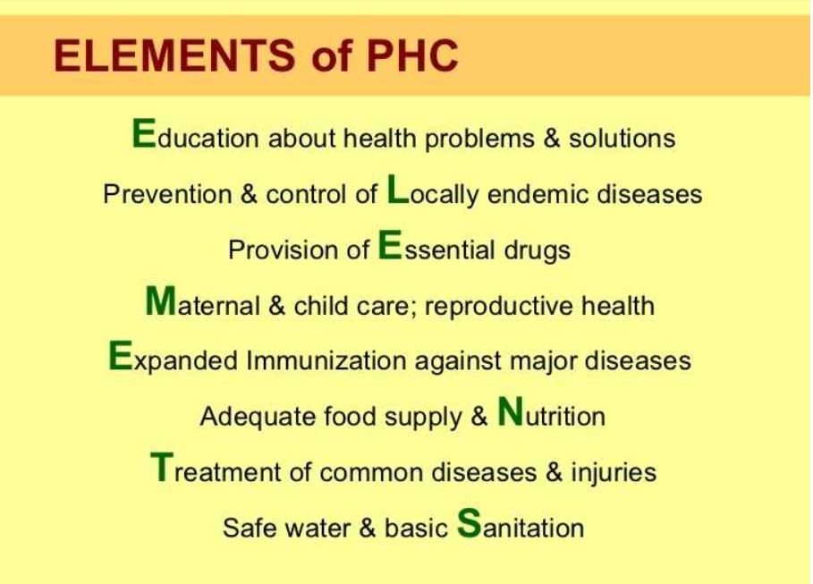

Slide 41
TYPOLOGY OF HEATH SYSTEMS AND PRIORITIES OF HEALTH POLICY IN THE DEVELOPED WORLD

Slide 42
TYPES OF HEALTH SYSTEMS
Why a typology?
A typology is an useful tool in understanding the key framework of a country’s health care system.

Slide 43
TYPES OF HEALTH SYSTEMS
The earliest attempt to develop a typology was made by Mark Field in 1973, who classified four categories of health care systems into:
pluralistic,
insurance,
health service, and
socialized types.
Criteria:
Extend of public control over health resources:
  funding,
  personnel,
  knowledge, and
  legitimacy.
2. Professional autonomy

Slide 44
The contemporary typology of health systems have been driven by the understanding of industrialised country health systems.
The common typology reflecting an ideal set of macro-institutional characteristics should be based on variations in:
the funding of health care and
corresponding differences in the organization of health care provision, e.g. the role of the Government and local authorities in the health care organization, the type of meeting the basic health needs, etc.

Slide 45
In general, three well-known types of health care system exist:
NATIONAL HEALTH SERVICE (NHS) =STATE MONOPOLY,
SOCIAL HEALTH INSURANCE (SHI), AND
PRIVATE HEALTH INSURANCE (PHI) = LIBERAL PLURALISM

Slide 46
Criteria for analysis of Health systems are:
The role of the Government in ownership of resources and organization of health services
Sources and management of resources
Orientation of health services – supply or demand oriented
Type of financing
Other criteria

Slide 47


Slide 48
STATE MONOPOLY
or the National Health Service (NHS) model is characterized by:
Universal coverage;
Funding out of general taxation;
Public provision of health services.
The predominant role of the Government in health care organization;
The Government is the owner of all health care resources (except health professionals);
The administration of the system is highly centralized;

Slide 49
STATE MONOPOLY
The system is appropriate when there is a need for strict coordination of health care activities as in cases of emergency and limited resources.
The system is exposed to a risk of bureaucratization and going away from the health needs of the population.
Such health systems were typical for all former socialist countries.
Good examples of such systems in UK, Sweden, etc.

Slide 50
NATIONAL HEALTH SERVICE UK
When state monopoly system is functioning in the context of market economy it may be successful. For example, in UK within the health care reform starting in 1990 there is a strong division between health care providers (heath trusts, hospitals, general practitioners, etc.) and purchasers of health care (health authorities, health commissions, etc.) that contracted health care for their population.
There is also a strong managed competition between different health providers to assure high quality health care for the population.

Slide 51
NATIONAL HEALTH SERVICE UK
Changes since April 2013
These changes have an effect on who makes decisions about NHS services, how these services are commissioned and the way money is spent.
Abolition of primary care trusts (PCTs) and strategic health authorities (SHAs), and the introduction of clinical commissioning groups (CCGs) and Healthwatch England.
Competition between providers that meet NHS standards on price, quality and safety, with a new regulator (Monitor).
Local authorities have taken on a bigger role, assuming responsibility for budgets for public health. Local authorities are expected to work more closely with other health and care providers, community groups and agencies, using their knowledge of local communities to tackle challenges such as smoking, alcohol and drug misuse and obesity.
Changes DO NOT AFFECT access to NHS – GP appointments, prescriptions, referrals to specialists.
51

Slide 52


Slide 53
HEALTH INSURANCE SYSTEM
The Social Health Insurance (SHI) model is typical for most western countries (Germany, France, etc.) and it is characterized by:
the availability of insurance system presented by powerful insurance funds, independent from the state, and covering more often compulsory the whole population;
the insurance funds come from three partners: the Government, the employers and the employees;
the public and private provision of health care.

Slide 54
HEALTH INSURANCE SYSTEM
There are many different schemes of insurance funds:
the Government may have a predominant role as in some Nordic countries;
the employers and the employees may have a greater proportion than the Government (as in the most of western countries);
the employers and the employees may have the same proportion in insurance.

Slide 55
HEALTH INSURANCE SYSTEM
The system is based on the principles of:
- SOCIAL RIGHTNESS - the monthly payment is proportionate to the income (the better-off pay more than the poorer);
- SOCIAL SOLIDARITY - all the participants will get the care they need without referring to the amount of money they had paid.

Slide 56
HEALTH INSURANCE SYSTEM
Health care resources are both public and private.
The system is highly decentralized. The role of the Government is to provide with a strong legislative package and the local authorities have a predominant role in the self-administration of health care.

Slide 57


Slide 58
LIBERAL PLURALIZM
In private health insurance (PHI) model, health care is funded by the individual and employer premiums and health delivery relies predominantly on private ownership.
The prototype of health care system model is the United States.
The system is based on the economic liberalism and pluralistic ownership of the resources.
The role of the Government is strong to assure a healthy environment and lifestyle factors but it is very restricted in health care organization and provision of health services.

Slide 59
LIBERAL PLURALIZM
The entire Social Health Protection System in USA is made up of four types of institutions:
Medicare,
Medicaid,
Private insurance companies – more than 1500, and
Health maintenance organizations (HMOs).
Some part of the population is not covered by any of these organizations and their health needs must be met by charity hospitals, which are decreasing in number. Some hospitals managed by municipalities (city hospitals) provide for the uninsured.

Slide 60
LIBERAL PLURALIZM
MEDICARE is the nation’s largest health insurance program, which covers more than 37 million Americans. It was enacted in 1965 under Title XVIII of the Social Security Act.
MEDICARE provides insurance to:
people who are 65 years old;
people who are disabled;
people with permanent kidney failure.

Slide 61
LIBERAL PLURALIZM
MEDICARE has two parts:
Medicare Part A: provides coverage of inpatient hospital services, skilled nursing facilities, home health services and hospital care.
Medicare Part B: helps pay for the cost of physician services, outpatient hospital services, medical equipment and supplies and other health services and supplies.

Slide 62
LIBERAL PLURALIZM
MEDICAID is a jointly-funded, Federal-State health insurance program for certain low-income and needy people. It covers approximately 36 million individuals including children, the aged, blind and/or disabled, and people who are eligible to receive federally assisted income maintenance payments.

Slide 63
LIBERAL PLURALIZM
MEDICAID became law in 1965 under Title XIX of the Social Security Act as a jointly funded cooperative venture between the Federal and State governments to assist States in the provision of adequate medical care to eligible needy persons.

Slide 64
LIBERAL PLURALIZM
MEDICAID is the largest program providing medical and health-related services to America’s poorest people. Within broad national guidelines which the Federal government provides, each of the States:
establishes its own eligibility standards;
determine the type, amount, duration, and scope of services;
sets the rate of payment for services; and administers its own program.

Slide 65
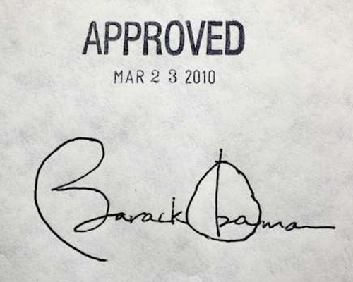
Health care reform in USA - Obama Care
Patient Protection and Affordable Care Act – signed 23 March 2010
Amended through Health care and Education Reconciliation Act
Motivation:
  USA spends more than similarly-developed nations but has lower public health indicators
  Significant underinsurance (the individual have health insurance but it does not offer complete financial protection)
  Significant impending unfunded liabilities from its aging demographic

Slide 66
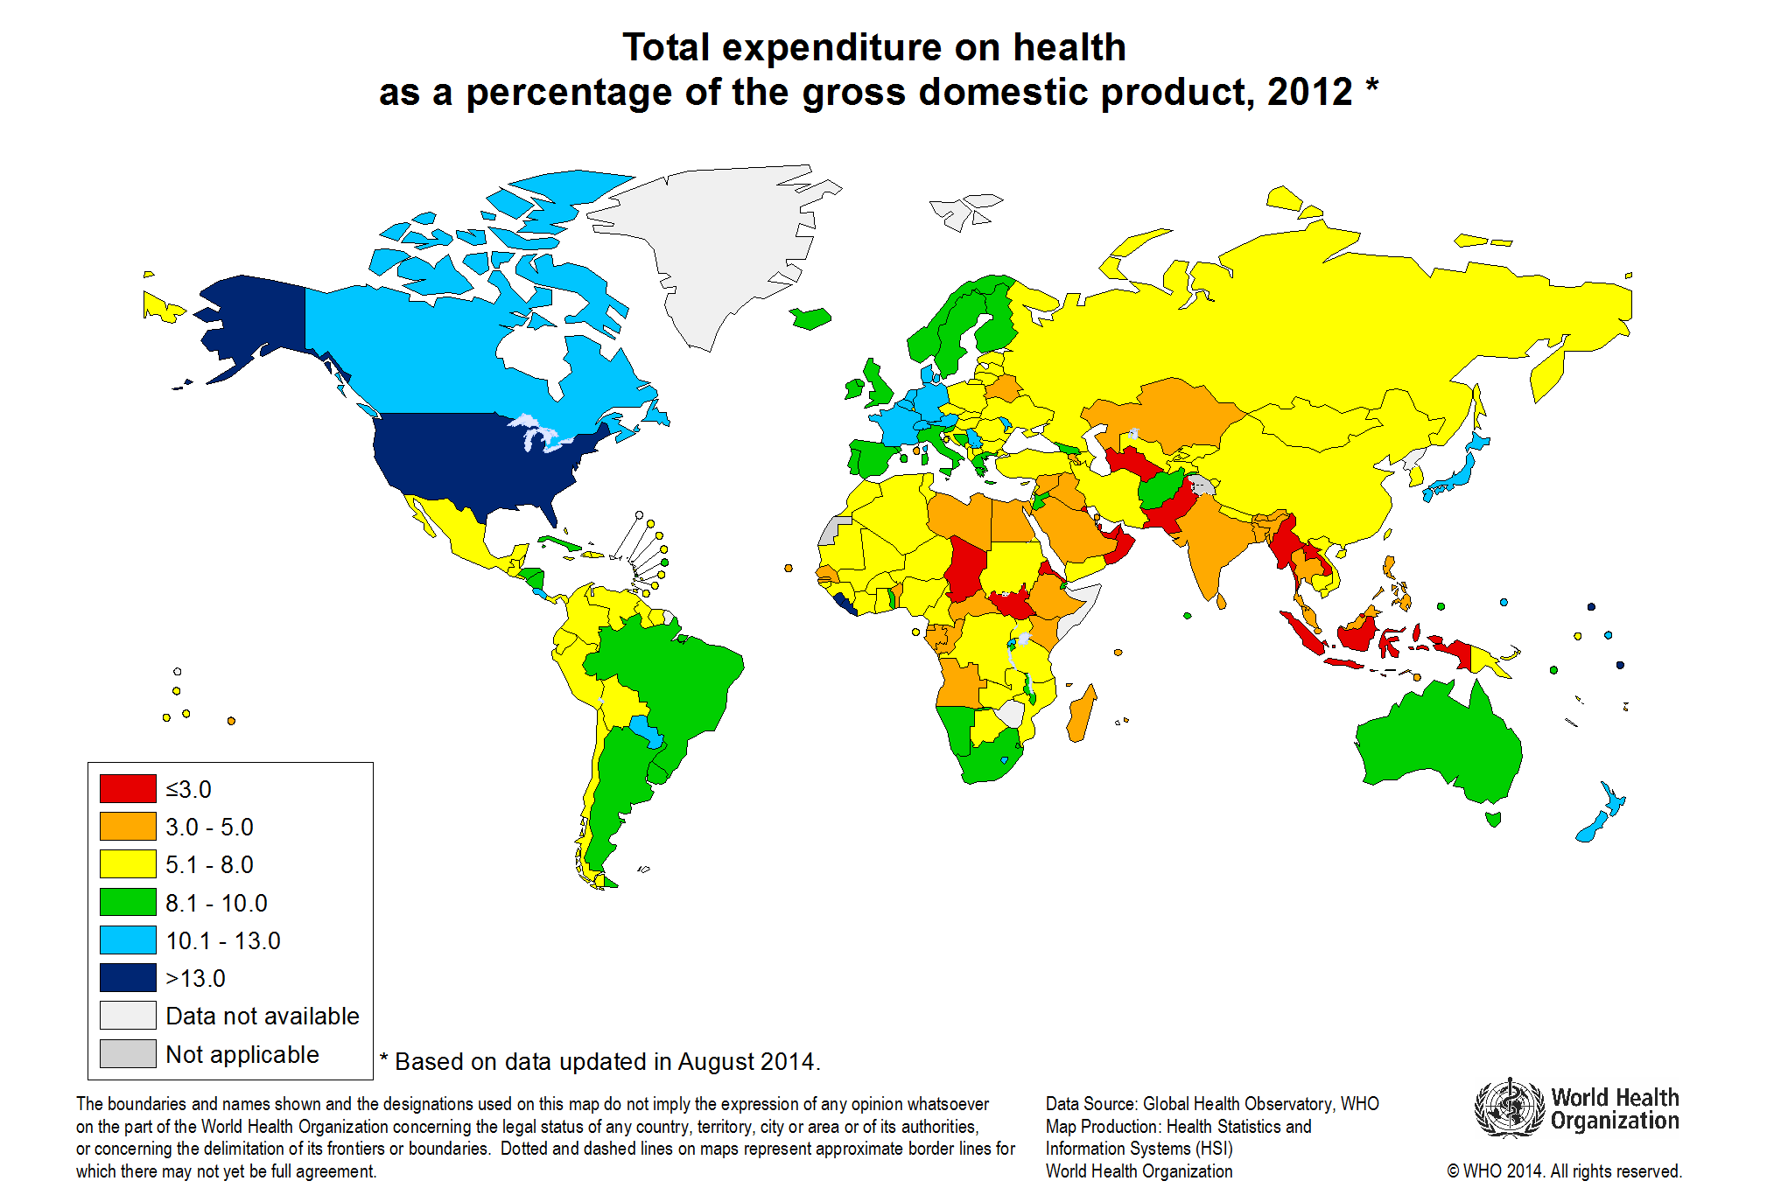

Slide 67
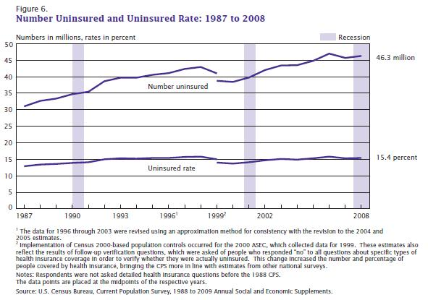

Slide 68
Health care reform in USA - Obama Care
Additional motivation:
Decline in the number of employers who offer health insurance
Even for employed health insurance vary a lot in its coverage
20-30% of health spending under Medicare and Medicaid services is waste:
  Overtreatment of patients
  Failure to coordinate care
  Administrative complexity
  Burdensome rules
  Fraud (3-10% of all health expenditures)
Public opinion: majority of the public support various levels of governmental involvement in health care

Slide 69
Health care reform in USA - Obama Care
Goal: To give more Americans access to affordable, quality health insurance, and to reduce the growth in health care spending.
Regulates health insurance not health care!
Companies can no longer charge members based on gender, burdening men with the health care costs of women.
Allowance for dependents to remain on their plan until 26.
Stop insurance companies from dropping people when they are sick.
Stop insurance companies from making unjustified rate hikes.
Mandate that insurers fully cover certain preventative services – early check-ups, immunizations, counseling and screening.
69

Slide 70
Health care reform in USA - Obama Care
High-risk pools for uninsured.
Tax credits for businesses to provide insurance to employees.
Allowed the FDA to approve generic biologic drugs and specifically allows for 12 years of exclusive use for newly developed biologic drugs.
Creation of Patient-Centered Outcomes Research Institute as government-sponsored organization investigating the relative effectiveness of various medical treatments by evaluating existing studies and conducting its own. Medicare may consider the Institute’s research in the determining what sorts of therapies it will cover.
The law also requires for reduced Medicare reimbursements for hospitals with excess readmissions and eventually ties physician Medicare reimbursements to quality of care metrics.
70
70

Slide 71
PRIORITIES OF HEALTH POLICY IN THE DEVELOPED COUNTRIES

Slide 72
Health policy is a statement based on human aspirations, set of values, commitments, assessment of health situation and an image of a desired future situation.
A national health policy is an expression of goals for improving the health situation, the priorities among those goals, and the main directions for attaining them.

Slide 73
Health policy is often defined at a national level.
Each country will have to develop a health policy for its own aimed and defined goals, for improving the people’s health, in the light of its own problems, particular circumstances, social and economic structures, and political and administrative mechanisms.

Slide 74
Among the crucial factors affecting realization of these goals are:
- a political commitment,
- financial implications,
- administrative reforms,
- community participation and basic legislation.

Slide 75
Developed countries have many common features in their health situation and health policy goals.
Among these priorities the most important are:

Slide 76
1. Shift from hospital care to primary health care.
2. New approaches to prevention: greater emphasis on primary prevention and within it - to population strategy of primary prevention instead of high-risk strategy.

Slide 77
3. Health promotion as a central part in combined efforts to improve people’s health.
4. Quality control and evaluation of health care activities.

Slide 78
5. Market orientation of health care.
6. New preventive, diagnostic and curative technologies.
7. Improvement of health legislation, development of health management and promotion of managerial culture in the health systems.

Slide 79
8. Highly developed information technologies.
9. Decentralization and involvement of local authorities in the health system regulation.
10. Integral approach to the management and functioning of health systems.

