Slide 1
INSECT ALLERGY
Vanya Tsvetkova PhD

Slide 2
Definition
An immunological reaction occurring in contact with insects
IgE mediated reaction after insect bite
Respiratory and contact allergies to insects
Allergy to the bites of blood-sucking insects

Slide 3
Prevalence
Adults 2-20%
Medical history for anaphylactic reactions – 1-5%
In the general population, 3% of adults and less than 1% of children have systemic reactions
Wasp stings are more common in males than in females, likely because of increased occupational and recreational exposure in men
Notes:
This is probably because adults are more likely to have developed sensitization from a prior wasp sting.

Slide 4
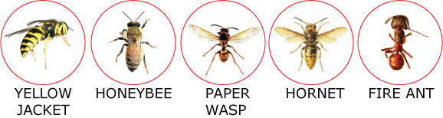
Etiology
Severe and life-treatening allergic reactions are caused by insects from Hymenoptera: honeybee (Apis mellifera); Axes (Polistes, Wasps), Hornet (Vespula)
In USA: Yellow jacket, Fire ants

Slide 5
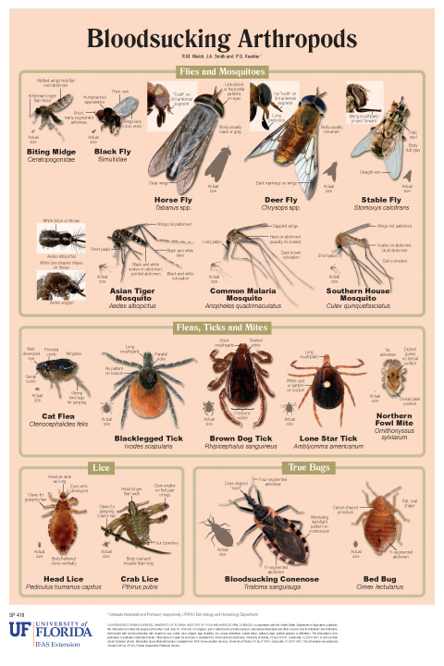
Etiology
Allergy to bites of blood-sucking insects
Ticks, mosquitoes, fleas, blood-sucking flies

Slide 6
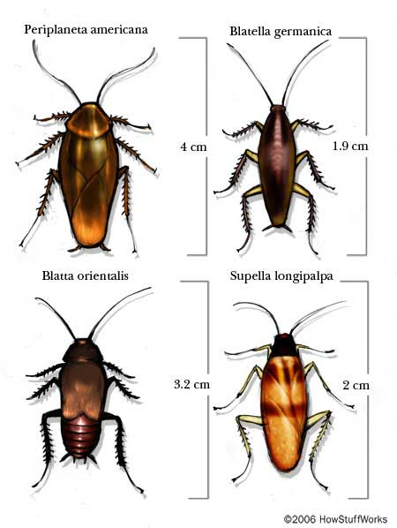
Respiratory and Contact Allergies to Insects
Moths
Bees
Cockroaches

Slide 7
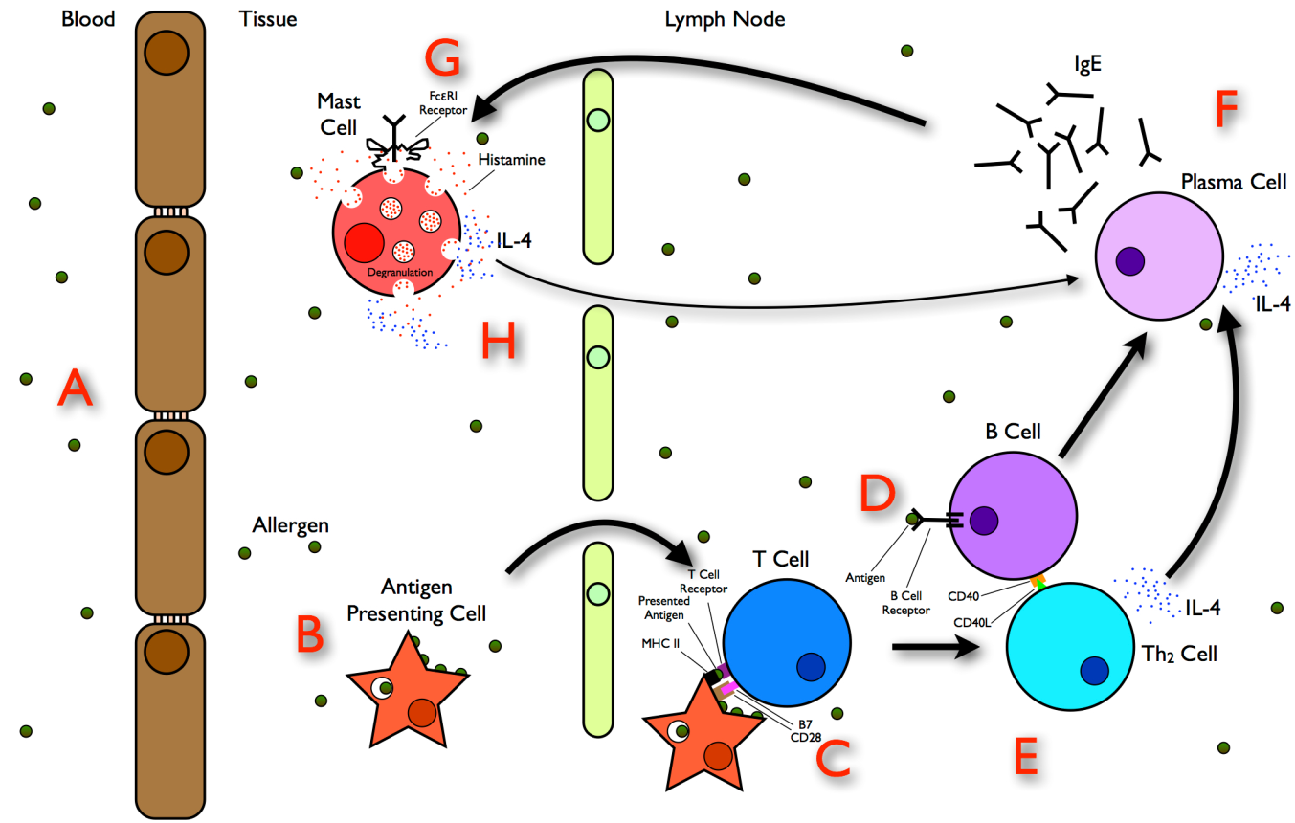
Pathophysiology
Hypersensitivity of І-st type – IgE mediated

Slide 8
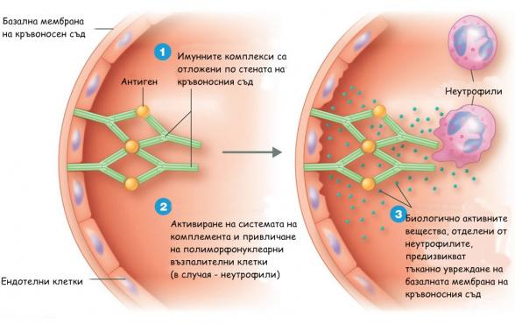
Pathophysiology
Hypersensitivity of ІІІ type
Atypical clinical manifestations may occur – arthritis, encephalitis, vasculitis

Slide 9
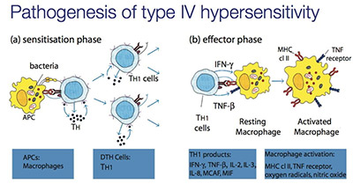
Pathophysiology
Hypersensitivity of ІV type- cell mediated
Clinical Manifestation- Dermatitis Contacta

Slide 10
Pharmacological Agents and Allergens
Bee venom
Proteins (enzymes)
Phospholipase A2
Hyaluronidase
Phospholipase B
Phosphatase
a - Glucosidase
Peptides
Melittin
Apamine
Biogenic amines
Histamine
Dopamine
Noradrenalin
Phospholipids
Amino acids
Volatiles (pheromones)
Sugars and Minerals
Notes:
Bee venom is a complex mixture of proteins, peptides and low molecular components. Nowadays its components have been characterised. The main components are proteins and peptides. The composition of fresh and dried BV differs mainly in regards to the volatile components; the overall biological activity is similar. The enzymes are proteins catalyzing specific reactions. There are 5 enzymes in BV. Polypeptides are smaller in molecular weight than enzymes, made of 2 or more amino acids. BV has numerous polypeptides the main one being melittin, which is also the main component of BV.
Melittin has a MW of 2840 daltons but it can reach 12 500 daltons because it can be also in a tetrameric form.

Slide 11
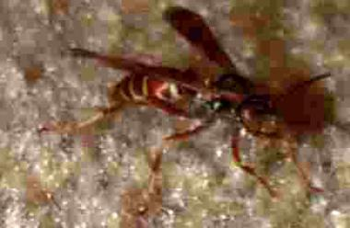
Wasp venom
Phospholipase A2
Serotonin
Hyaluronidase
Acetylcholine
Phospholipase B
Notes:
More than 25,000 species of wasps exist worldwide. They include yellow jackets, which are members of the genus Vespula and are large and aggressive

Slide 12
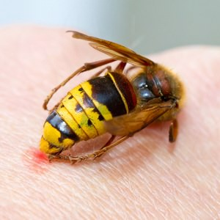
Phospholipase A1
Dopamine
Histamine
Serotonin
Hyaluronidase

Slide 13
Clinical Manifestation
Normal reaction
IgE mediated
Local reaction
Systemic reaction
Severe systemic or anaphylactic reaction
Non- IgE mediated (immunocomplex)
Vasculitis
Arthritis
Encephalitis
Notes:
Normal reaction-erythema, oedema and pain at the sting place.Several hours and resolves spontaneously without treatment

Slide 14
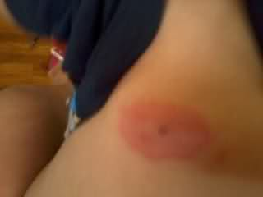
Heavy Local Reaction
After a sting the redness does not remain local, but expands over the extremities. The swellings can be very painful and can persist for a longer period of time (24-48 hours) even a week.

Slide 15
Systemic Reaction
The first symptoms arise a few minutes after the sting
The main symptoms are redness, swelling and itching
They can be accompanied by strong swelling of the face
Shivering, vomiting, nausea, shortage of breath
life endangering collapse of blood circulation can occur – the anaphylactic shock.

Slide 16
Unusual Reactions
Vasculitis
Arthritis
Encephalitis
Guillian-Barre syndrome
Immunotherapy is not recommended!!!!

Slide 17
Diagnosis
Medical history
Type of insect
Physical signs
- Local reaction
Generalized urticarial reaction
Angioedema
Anaphylaxis

Slide 18
Laboratory Tests
Skin prick test
Specific IgE test
Patients with negative SPT 6 weeks after the sting and history for systemic reaction should be tested again for specific IgE (SPT or in vitro test or both)

Slide 19
Laboratory Tests
CBC count, electrolytes, BUN and creatinine, glucose, and liver function studies
Patients may have mild leukocytosis related to demargination from catecholamine release
Arterial blood gas values
Chest radiography in patients who present with dyspnea or chest tightness or who have an anaphylactic episode after a sting

Slide 20
Laboratory Tests
ECG on patients who experience palpitations, chest tightness, dyspnea, or lightheadedness after a sting
A baseline peak flow measurement in patients who present with wheezing, dyspnea, or prolongation of the expiratory phase of respiration after a sting
Flexible fiberoptic visualization of the larynx and vocal chords to exclude laryngeal edema or spasm

Slide 21
Treatment
Prehospital care
Removal of sting
Cooling
Аdrenaline s.c. or autoinjector with 300 µcg, 150 µcg (Anapen, Epipen)
Oral H1 blocker
Notes:
When a human is stung by a bee, the sting with the sting apparatus remains stuck in the
skin. First the stung should be removed as soon as possible, for that purpose in should be pushed away from
the side with the finger nail. Be aware that pressing the sting with both fingers will cause emptying of the bee venom into the tissue. Cold compress with acid water (1 part of vinegar and 2 parts of water) , ice cubes, cold spray or alcohol. Anti-allergic gel if available.

Slide 22
Airway Management
Check the airway
Assess the level of consciousness and obtain blood pressure, pulse, and oximetry values
Place the patient in the supine position with legs elevated, and begin supplemental oxygen
Cricothyrotomy

Slide 23
Hospital Care
Systemic reaction
Epinephrine: 0.3-0.5 mL subcutaneously in a 1:1000 solution. The procedure should be repeated several times in 15 min.
Dose for children: 0,01 ml/kg
Epinephrine – i.m. or i.v.
Fluid resuscitation with Isotonic crystalloid solutions (ie, normal saline, Ringer lactate)
Hospitalization for 24 hours (risk of biphasic anaphylaxis)

Slide 24
Antihistamines - much slower onset of action than epinephrine. Мinimal effect on blood pressure, and they should not be administered alone
Corticosteroids - no immediate effect on anaphylaxis. Administer them early to try to prevent a potential late-phase reaction (biphasic anaphylaxis).
Notes:
Antihistamine therapy thus is considered adjunctive to epinephrine.

Slide 25
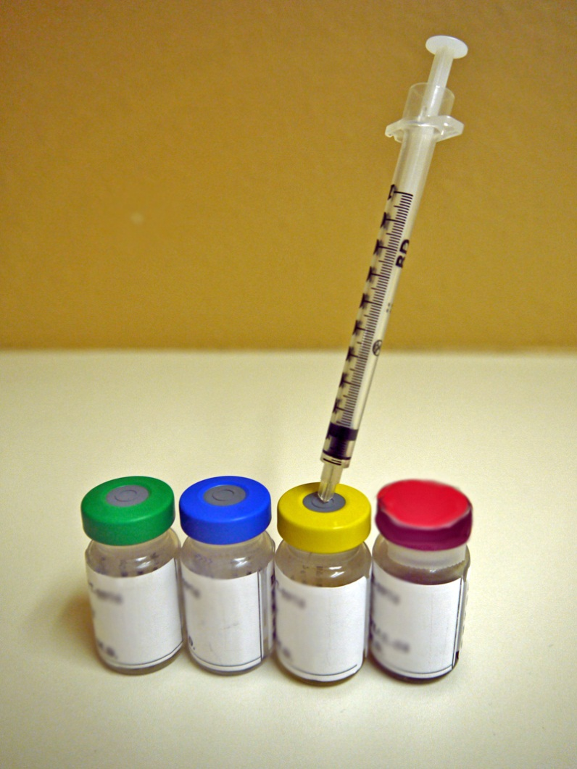
Desensitisation
Desensitisation is absolutely recommended from three to five years
Success of the desensitisation against bee venom is about 80 %
Success against wasp venom allergy is approx. 95 %

Slide 26

Prophylaxis
Avoid contact with insects
Education about behavior in case of insect sting
Always with auto-injector
Avoidance of bright colored clothes, strong perfumes
Recommended color clothes: khaki, tobacco, green, white
Bracelet, necklace indicating allergy

Slide 27


