Slide 1
The kidney and UTI – common diseases
Prof. Maria Tzekova, MD,PhD, DSc

Slide 2
Acute kidney injury (AKI)
(AKI) is a syndrome characterised by :
a rapid (hours to days) deterioration of kidney function.
It is often diagnosed in the context of other acute illnesses
and is particularly common in critically ill patients.

Slide 3
Acute kidney injury (AKI)
The clinical consequences of AKI include:
the accumulation of waste products,
electrolytes,
and fluid,
but also less obvious effects, including:
reduced immunity
and dysfunction of non-renal organs (organ cross-talk)

Slide 4
Diagnosis of AKI
a rise in serum creatinine and/or fall in urine output.
short- and long-term risk of death
or renal replacement therapy (RRT)
were greatest when patients met both criteria for AKI and when these abnormalities persisted for longer than 3 days.

Slide 5
KDIGO definition and classification of AKI
Diagnostic criteria for AKI:
AKI is defined as any of the following:
• Increase in serum creatinine by ≥0.3 mg/dl (≥26.5 μmol/l) within 48 h; or • Increase in serum creatinine to ≥1.5 times baseline, which is known or presumed to have occurred within the prior 7 days; or • Urine volume <0.5 ml/kg/h for 6 h.
AKI staging system:

Slide 6
AKI stage - stage I and stage II
AKI stage | Serum creatinine criteria | Urine output criteria
AKI stage I | Increase of serum creatinine by ≥0.3 mg/dl (≥26.4 μmol/L) | Urine output <0.5 ml/kg/h for 6–12 h
 | or
 | increase to 1.5–1.9 times from baseline
AKI stage II | Increase of serum creatinine to 2.0–2.9 times from baseline | Urine output <0.5 ml/kg/h for ≥12 h

Slide 7
AKI stage - stage III
Increase of serum creatinine ≥3.0 times from baseline
Urine output <0.3 ml/kg/h for ≥24 h
or
serum creatinine ≥4.0 mg/dl (≥354 μmol/L)
anuria for ≥12 h
or
in patients <18 years, decrease in estimated GFR to <35 ml/min per 1.73 m²

Slide 8
Glomerulonephritis
Glomerular disease includes:
glomerulonephritis, i.e. inflammation of the glomeruli
and
glomerulopathies when there is no evidence of inflammation.

Slide 9
Acute Glomerulonephritis
Inflammation of the glomeruli which causes the kidneys to malfunction
also called Acute Nephritis, Glomerulonephritis and Post-Streptococcal Glomerulonephritis
Predominantly affects children from ages 2 to 12
Incubation period is 2 to 3 weeks

Slide 10
Glomerulonephritis
Glomerulonephritis is a subset of glomerulopathies
Nephrotic syndrome.
Acute glomerulonephritis (acute nephritic syndrome).
Rapidly progressive glomerulonephritis.
Asymptomatic urinary abnormality (haematuria, proteinuria or both).

Slide 11
Acute Glomerulonephritis
Incidental discovery of occult proteinuria or HTN
Usually presents as chronic renal failure or occult proteinuria
Glomerulus has scar tissue
Diabetes most common cause
most common cause of renal failure
glycoproteins deposit in basement membrane
Vascular disease
atherosclerosis
HTN
vascultitis

Slide 12
Acute Glomerulonephritis
Heavy proteinuria
Proteinuria & haematuria
Predominant haematuria Minimal
Change Lupus nephritis
Acute post streptococcus
Focal sclerosis Membranous
Diabetes Mellitus
Amyloidosis Membrano- proliferative Endocarditis
Henoch-Schonlein purpura Crescentic (RPGN)
Haemolytic uraemic syndrome

Slide 13
Acute Glomerulonephritis - symptoms
Fever
Headache
Malaise
Anorexia
Nausea and vomiting
High blood pressure
Pallor due to edema and/or anemia
Confusion
Lethargy
Loss of muscle tissue
Enlargement of the liver

Slide 14
Acute Glomerulonephritis - symptoms
Hematuria: dark brown or smoky urine
Oliguria: urine output is < 400 ml/day
Edema: starts in the eye lids and face then the lower and upper limbs then becomes generalized; may be migratory
Hypertension: usually mild to moderate

Slide 15
Acute Glomerulonephritis - syndromes
urinary (haematuria, proteinuria),
nephritic (edemas, hypertension, gross haematuria, proteinuria),
nephrotic (edemas, proteinuria, hypoproteinemia, hypercholesterolemia),
mixed.

Slide 16
Acute Glomerulonephritis
Abrupt onset of:
glomerular haematuria (RBC casts or dysmorphic RBC).
non-nephrotic range proteinuria (<2 g in 24 hrs).
oedema (periorbital, sacral).
hypertension.
transient renal impairment (oliguria, uraemia).

Slide 17
Acute Glomerulonephritis
Base line measurements: -
↑ Urea
↑ Creatinine
Urinalysis (MSU):
a) Urine microscopy (red cell cast)
b) proteinuria

Slide 18
Acute Glomerulonephritis
COMPLICATION :
Hypertensive encephalopathy,
heart failure and acute pulmonary edema may occur in severe cases
Acute renal necrosis due to injury of capillary or capillary thrombosis

Slide 19
Acute Glomerulonephritis
Is characterized by irreversible and progressive glomerular and tubulointerstitial fibrosis.
ultimately leading to a reduction in the glomerular filtration rate (GFR) and retention of uremic toxins.
If disease progression is not halted with therapy, the net result is chronic kidney disease (CKD), end-stage renal disease (ESRD), and cardiovascular disease

Slide 20
Acute Glomerulonephritis
Nearly all forms of acute glomerulonephritis have a tendency to progress to chronic glomerulonephritis.
The progression from acute glomerulonephritis to chronic glomerulonephritis is variable.
Whereas complete recovery of renal function is the rule for patients with poststreptococcal glomerulonephritis, several other glomerulonephritides, such as immunoglobulin A (IgA) nephropathy, often have a relatively benign course and many do not progress to ESRD.

Slide 21
Glomerulonephritis
Primary – confined to the kidney
Secondary – due to a systemic disease

Slide 22
Glomerulonephritis -syndromes
Proteinuria – asymptomatic
Haematuria – asymptomatic
Hypertension
Nephrotic syndrome
Acute renal failure
Rapidly progressive renal failure
End stage renal failure

Slide 23
CHRONIC GLOMERULONEPHRITIS
Can result from just about ANY of acute ones:
  THIN CORTEX
  HYALINIZED (fibrotic) GLOMERULI
  OFTEN SEEN IN DIALYSIS PATIENTS
Notes:
Once again, as in “chronic” pancreatitis, the main features of “chronic” are more a fibrosis (hyalinization), rather than lymph and macrophage infiltrates.

Slide 24
Chronic Glomerulonephritis
Presence of glomerular disease as opposed to tubulointersititial or vascular disease is suspected from history :
Haematuria (especially dysmorphic red cells)
Red cell casts
Lipiduria (glomerular permeability must be increased to allow the filtration of large lipoproteins)
Proteinuria (may be in nephrotic range of >3.5 g/24hours)

Slide 25
Chronic Glomerulonephritis
Immune complex disease.
Named according to:
etiology ,
microscopic findings ,
clinical syndrome
Most common clinical presentations :
acute nephritic syndrome ,
nephrotic syndrome.
Most common cause is autoimmune.

Slide 26
Chronic Glomerulonephritis
Autoimmune injury initiated by beta-hemolytic streptococcus
acute proliferative glomerulonephritis
Presents as acute nephritic syndrome
Hematuria
HT
increased urea & creatinine
low urine output
edema
Antibodies produced by strep throat deposit in glomerulus
Most fully recover but about 10% evolve into rapidly progressive glomerulonephritis

Slide 27
Chronic Glomerulonephritis
Unknown causes or secondary to poststreptococcal glomerulonephritis
Autoimmune
Some present as acute nephritic syndrome , others as renal failure
Caused by deposition of An-Ab complexes
All but a few progress to renal failure

Slide 28
Chronic Glomerulonephritis
Autoimmune - Most common cause of nephrotic syndrome in adults
About 10% proceed to renal failure within 10 yrs,
25% recover completely,
most progress slowly with:
proteinuria,
HTN,
loss of renal function

Slide 29
Urine Microscopy :
Cells Casts Crystals.
Cells - epithelial, inflammatory, malignant.
Casts – Protein cast of nephron –
  Suggest Kidney pathology – not URT.
  Protein, lipid, cells or mixed.
Crystals suggest high concentration or altered solubility.

Slide 30
TUBULOINTERSTITIAL DISEASE
Most tubular diseases involve the interstitium
2 distinct types of diseases
a) inflammatory diseases
i) “tubulointerstitial nephritis”
b) ischemic or toxic tubular injury →
i) ATN
ii) acute renal failure

Slide 31
Tubulointerstitial Nephritis (TIN)
Inflammatory disease of Interstitium/tubules
Glomerulus not involved at all or only late in
disease
Infections induced TIN – “pyelonephritis”
Non infection – interstitial nephritis
a) Caused by:
i) drugs
ii) metabolic disorders (hypokalemia)
iii radiation injury
iv) immune reactions

Slide 32
TIN divided into 2 categories, regardless of etiology:
a) – acute
b) - chronic

Slide 33
Pyelonephritis Definition:
Inflammation of the parenchyma
and lining of renal pelvis of kidney

Slide 34
Pyelonephritis Epidemiology and Risk Fctors:
Host factor:
Female :Shorter urethra
Male : uncircumcised infant → bacterial colonization inside prepuce and urethra
Catherization ◦ DIRECT: Bacteria carried directly into bladder during insertion ◦ INDIRECT:Facilitation of bacterial access via lumen of catheter . Tracking up between outside catheter and urethral wall

Slide 35
Types of pyelonephritis
Pyelonephritis, according to clinical course rate of onset, may be:
acute
or
chronic

Slide 36
Acute PYELONEPHRITIS
Acute Pyelonephritis is suppurative (purulent) inflammation involving:
the renal tubules ,
interstitial tissue,
calyices,
and pelvis of the kidney.
One or both kidney may be involved in the disease.

Slide 37
Routes of infection in acute pyelonephritis
1- ascending pyelonephritis
2- Hematogenous source of the infection

Slide 38
Acute Pyelonephritis
2 routes bacteria can reach kidney
a) blood stream (not very common)
b) lower urinary tract (ascending infections)
i) – catheterization
ii) - cystoscopy

Slide 39
Acute Pyelonephritis
Kidney/renal pelvis (distal to collecting ducts)
Caused by bacterial infections
  (lower UTI) – cystitis, urethritis and prostatitis
  upper UTI – (pyelonephritis)
  both tracts
Principle causative bacteria are gram - rods
a) E. coli (most common), Proteus, enterobacter, Klebsiella

Slide 40
Routes of infection in acute pyelonephritis
1- ascending pyelonephritis represent more than 85% of all cases with acute pyelonephritis ,the causative organisms are Escherichia coli, Proteus, Enterobacter
It result from Ascending of the infection from Purulent cystitis helped by:
A-chronic obstructive diseases of urinary tract
B-vesicoureteral and intrarenal reflux

Slide 41
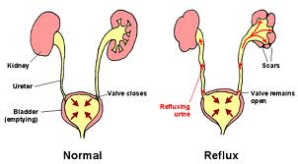
FACTORS
OBSTRUCTION: Congenital or Acquired
INSTRUMENTATION
VESICOURETERAL REFLUX
PREGNANCY
AGE, SEX, why sex? F>>>M
PREVIOUS LESIONS
IMMUNOSUPPRESION or IMMUNODEFICIENCY
Notes:
What are the 3 parts of the ureter which are most subject to obstruction or stones for anatomic reasons alone?
UPJ, pelvic brim, bladder inlet

Slide 42
Routes of infection in acute pyelonephritis
2- Hematogenous source of the infection caused by :
Staphylococcus,
-streptococcus
usually produce multiple payemic abscesses.

Slide 43
Acute Pyelonephritis
Most commonly affect females (in absence of instrumentation)
a) close proximity to rectum
b) shorter urethra
Urine sterile, flushing keeps bladder sterile
Obstruction increased incidence of UTI:
i) prostate hypertrophy
ii) uterine prolapse
iii) UT obstructions

Slide 44
Host factor:
Normal urine flow disruption ( obstruction );
Incomplete bladder emptying ;
> 2-3ml residual urine;
infection ;
ascent of infection;
Pregnancy ;
Prostatic hypertrophy ;

Slide 45
Host factor:
Renal calculi ;
Tumor ;
Stricture ;
Loss of neurological control of bladder and sphincter( spina bifida , paraplegia, multiple sclerosis) ;
Vesicourethral reflux ( urine reflux from bladder to ureter, renal pelvis and parenchyma) ;
Diabetes Mellitus ; diabetic neuropathy; interfere with bladder
Impaired cytokine secretion

Slide 46
Host factor:
genetic background of the host;
familial disposition to pyelonephritis;
women with recurrent UTI .
Have had their first UTI before the age of 15 years
persistent vaginal colonization
Mutations in host response genes(those coding forToll- like receptors and the interleukin 8 receptor)

Slide 47
Host factor:
Factors independently associated with pyelonephritis in young healthy women include:
Frequent sexual intercourse
New sexual partner，
UTI in the previous 1 2 months，
Maternal history of UTI，
Diabetes
Incontinence.
spermicide use
And Factors independently associated with pyelonephritis in postmenopausal women: cystoceles ,incontinence and residual urine

Slide 48
Etiology
The uropathogens causing Pyelonephritis vary by clinical syndrome but are usually enteric gram-negative rods that have migrated to the urinary tract.
-Gram negative organism : E.coli (common); Proteus mirabilis, Citrobacter, klebsiella, enterobacter, proteus pseudomonas aeruginosa .
Gram positive organism : Staph.saprophyticus, Staph. Epidermidis enterococcus, Corynebacteria and lactobacilli

Slide 49
Etiology
Virus Parasite Rare
Virus Human polymaviruses
Cytomegalovirus and rubella
Korean hemorrhagic fever virus
Mumps and HIV
Recovered in urine in absence of UTI
Fungi : candida spp and histoplasma capsulatum
Protozoa : trichomonas vaginalis
Helminth: schistosoma haematobium

Slide 50
Pathogenesis:
The urinary tract can be viewed as an anatomic unit united by a continuous column of urine extending from the urethra to the kidneys.
In the majority of UTIs bacteria establish infection by ascending from the urethra to the bladder.
Continuing ascent up the ureter to the kidney is the pathway for most renal parenchymal infections.

Slide 51
Clinical picture of pyelonephritis
Fever
Flank pain
Nausea ,vomiting
Turbid urine due to Presence of pus
Cystitis manifestations may be present (urgency,frequency,dysuria)

Slide 52
Signs and Symptoms:
a) hypertension
b) seen following normal physical exam
c) slowly progressive → late in disease
d) can cause loss of concentrating mechanisms (if bilateral and progressive)
i) - polyuria
ii) - nocturia

Slide 53
Clinical Features
Mild pyelonephritis:
low-grade fever
with or without lower-back or costovertebral-angle pain .
Severe pyelonephritis:
High fever “picket-fence” 72hr
Nausea
Vomiting
flank and/or loin pain

Slide 54
ACUTE PYELONEPHRITIS
Leukocyte infiltration
within interstitial tissue of the kidney
with neutrophils predominance

Slide 55
COMPLICATIONS of ACUTE PYELONEPHRITIS
1- papillary necrosis due to inflammatory thrombosis of the blood vessels supplying the renal papilla
2 –pyonephrosis which mean filling of the dilated calyces and pelvis by pus due to obstruction at pelviureteric junction
3 -perinephric abscess due to spread of the inflammation to the perinephric fat.
4 - Transformation to chronic pyelonephritis

Slide 56
CHRONIC PYELONEPHRITIS
Chronic pyelonephritis is termed chronic tubular and interstitial inflammatory disease
with asymmetric irregular sclerosis(fibrosis)
and deformation of calyices and adjacent parenchyma .

Slide 57
Causes of CHRONIC PYELONEPHRITIS
1 – infection (viral, fungal ,bacteria )
2- calcular pyelonephritis caused by obstructing stone and back reflux of urine.
3 - toxins
4 - metabolic diseases
5 - physical factors
6 - tumors
7 - immunologic reaction
8 - vascular diseases
9- Xanthogranulomatous chronic pyelonephritis

Slide 58
Microscopic picture of CHRONIC PYELONEPHRITIS
- Stroma is infiltrated by lymphocytes, plasma cells and macrophages.
- tubules may be filled with colloid protein
Casts so the Enlarged tubules are like thyroid follicle a Phenomenon is termed thyroidisation(i.e renal tubules containing colloid casts simulate thyroid follicles containing colloid inside it).
- Periglomerular fibrosis may end with complete glomerular fibrosis and hyalinosis.

Slide 59
Laboratory Diagnosis
Rapid diagnostic test:
Appearance of WBC in urine;
test for nitrite & leukocyte esterase ;
Urinalysis:
WBC in Cast shape due to of pyelonephritis

Slide 60
Urine Culture:
Method of Sampling: Clean Catch: Straight Catheterization: foley cathatere: Suprapubic Aspiration:
Urine culture interpretation:
- It is positve with colony count equal or more than 10 power 2 In women with dysuria & pyuria
- It is positve with colony count > 10 power 3 In Men

Slide 61
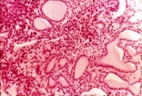
CHRONIC PYELONEPHRITIS: Stroma is infiltrated by lymphocytes,plasma cells and macrophages, with thyroidisation of the tubules

Slide 62
Pyelonephritis
Emphysematous pyelonephritis: exclusively in diabetic patients production of gas in renal and perinephric tissues bilateral papillary necrosis rise in the serum creatinine level ;
Xanthogranulomatous pyelonephritis chronic urinary obstruction (often by staghorn calculi) , chronic infection , Suppurative destruction of renal tissue

Slide 63
Xanthogranulomatous chronic pyelonephritis
Etiologic agent is Proteus
There are a lot of macrophages with pale pink foamy cytoplasm filled with:
lipid,
-plasma cells,
lymphocytes,
and
granulocytes

Slide 64
Pyelonephritis
Pyelonephritis can also be complicated by intraparenchymal abscess formation;
this situation should be suspected when a patient has:
continued fever
and/or bacteremia despite antibacterial therapy.

Slide 65
Complication of CHRONIC PYELONEPHRITIS
nephrosclerosis involving
Stroma, calyces, pelvis, then vascular and periglomerular sclerosis
secondary contracted kidneys due to fibrosis
chronic renal failure

Slide 66
Differential diagnosis for pyelonephritis
cystitis which is inflammation of the urinary bladder characterized by: urgency,frequency,dysuria.
While pyelonephritis characterized by inflammation of the kidney characterized by:
flank pain ,
tenderness,
fever,
Chills
and increase WBCs.

Slide 67
Chronic pyelonephritis and reflux nephropathy
Interstitial inflammation with scarring of renal parenchyma
Important cause of chronic renal failure
Two forms:
a) - Chronic obstructive pyelonephritis
b) - Chronic reflux-associated pyelonephritis

Slide 68
Chronic obstructive pyelonephritis
Can be bilateral (congenital disease)
Obstruction predisposes kidney to infection
recurrent infections on obstructive foci causes
scarring – chronic pyelonephritis

Slide 69
chronic reflux-associated pyelonephritis (reflux nephropathy)
More common form of chronic pyelonephritis

Slide 70
reflux nephropathy
Occurs from superimposed of a UTI on vesiculouretheral and intrarenal reflux
a) reflux may be bi- or unilateral
i) unilateral causes atrophy
ii) bilateral can cause chronic renal insufficiency
iii) diffuse or patchy
- Unclear if sterile vesiculouretheral disease causes renal damage

Slide 71
reflux nephropathy
Hallmark is scarring involving pelvis/calyces, leading to papillary blunting and deformities
Renal papillae – area of kidney where opening
from collecting ducts enters renal pelvis
Kidneys are asymmetrically contracted

Slide 72
Drug-induced interstitial nephritis
Acute TIN – seen with synthetic penicillins,
diuretics (thiazides), NSAID
a) disease begins ~15 days (2-40 range)
i) fever
ii) rash (25% cases)
  iii) renal findings: hematuria, leukouria
  iv) increased serum creatinine or acute renal failure with oliguria (50% of cases)

Slide 73
Drug-induced interstitial nephritis
Immune mechanism is indicated (suggested)
a) IgE increased (hypersensitivity – Type I)
Injury produced by IgE and cell-mediated immune reactions

Slide 74
Analgesic Nephropathy
Patients who consume large quantities of
analgesics may develop chronic interstitial
nephritis, often associated with renal papillary
necrosis
Usually result from consumption of a mixture for
long periods of time:
a) - aspirin
b) - caffeine
c) - acetaminophen
d) - codeine
e) - phenacetin

Slide 75
Primary pathogenesis is
a) papillary necrosis followed by
b) interstitial nephritis is secondary
c) acetaminophen – oxidative damage
d) aspirin inhibits prostaglandins – vasoconstriction
e) all the above leads to papillary ischemia
Chronic renal failure, hypertension and anemia
Complications may be incidence of “transitional
cell carcinoma” of renal pelvis or bladder.

Slide 76
ATN (Clinical entity)
Destruction of tubular epithelial cells
Acute suppression of renal function
Most common cause of acute renal failure(ARF):
Acute suppression of renal function , oliguria ( 400 ml/day)

Slide 77
Other causes of ARF
b) severe glomerular disease (RPGN
c) diffuse vascular disease (Polyarteritis nodosa)
d) diffuse cortical necrosis
e) interstitial nephritis (acute drug- induced)
f) acute papillary necrosis

Slide 78
Diseases of Blood Vessels
Nearly all diseases of kidney involve blood
vessels.
Kidneys involved in pathogenesis of essential
and secondary hypertension
Systemic vascular disease (i.e. arteritis) also
involve kidney

Slide 79
Benign nephrosclerosis
Renal changes associated with benign
hypertension
a) always associated with hyaline arteriosclerosis
Kidneys are atrophic
Many renal diseases cause hypertension which
in turn may lead to benign nephrosclerosis.
Therefore this disease seen simultaneously. with other diseases of kidney

Slide 80
This disease by itself usually does not cause
severe damage
a) mild oliguria
b) loss (slight) of concentrating mechanism
c) decreases GFR
d) mild degree of proteinuria is a constant finding
These patients usually die from hypertensive
heart disease or cerebrovascular disease rather
than from renal disease

Slide 81
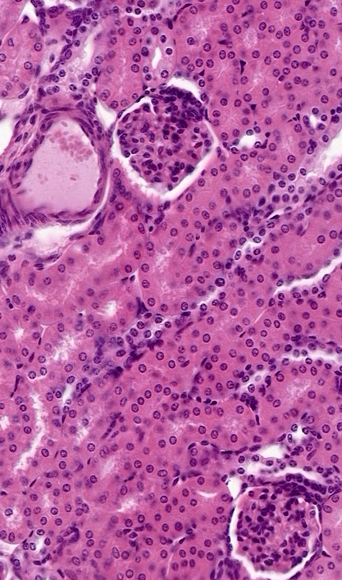
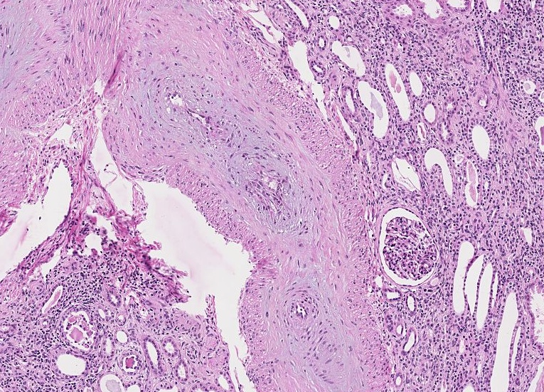
BENIGN NEPHROSCLEROSIS
Sclerosis, i.e., “hyalinization” of arterioles and small arteries, i.e., arterio-, arteriolo-
Is this part of “routine” atherosclerosis????
VERY VERY VERY common

Slide 82
Renal stone disease
Nephrolithiasis refers to renal stone disease;
Urolithiasis refers to the presence of stones in the urinary system.
Stones, or calculi, are formed in the urinary tract from the kidney to bladder by the crystallization of substances excreted in the urine•

Slide 83
Risk Factors
Prevalence: 2-3% in the U.S., geographic variations
Gender: Male/Female ratio 4:1
Life-time risk: Males: 12 % Females: 7 %, incident is rising
Peak age 20-50 years
Family History
Genetic factors
  Medullary sponge kidney
  CaSR or FGF 23 polymorphism
Caucasians more than blacks or hispanics
Recurrence 30%- 40% at 5 years, 50%- 60% at 10 years

Slide 84
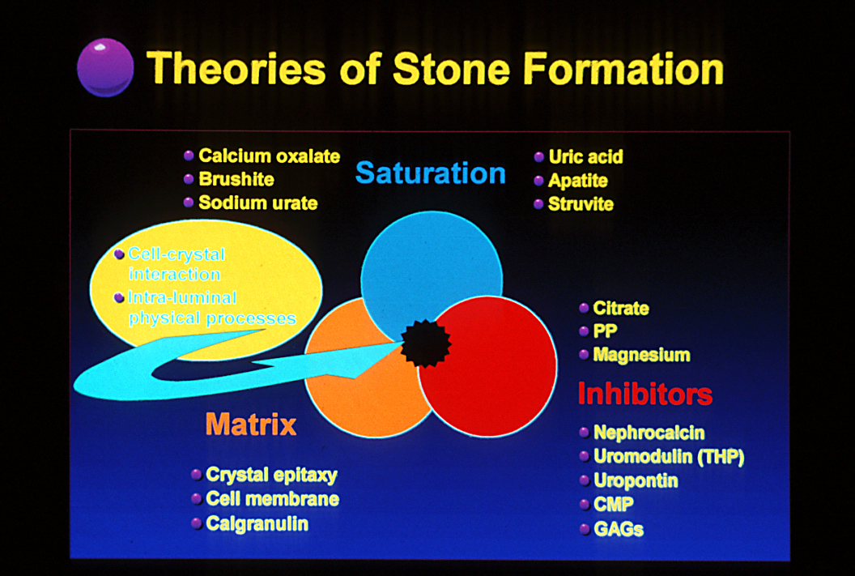
Infection?

Slide 85
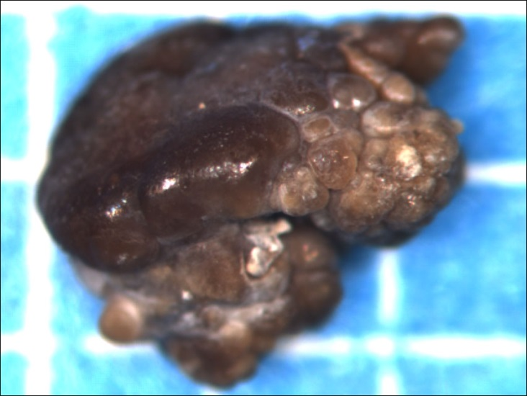
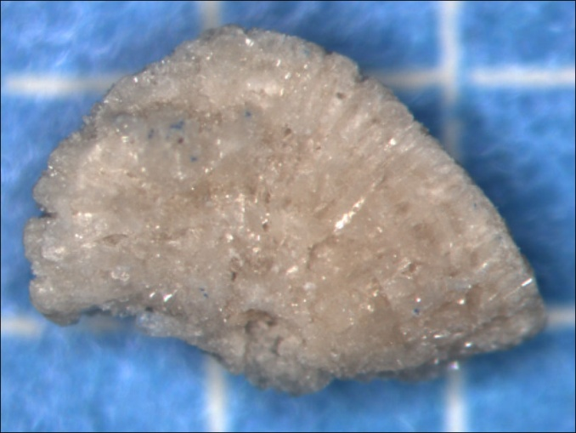
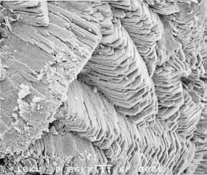
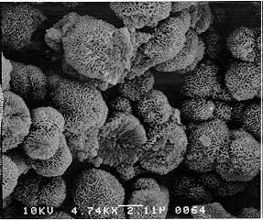
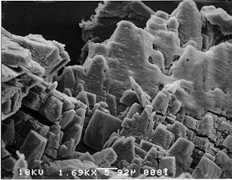
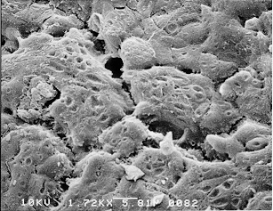
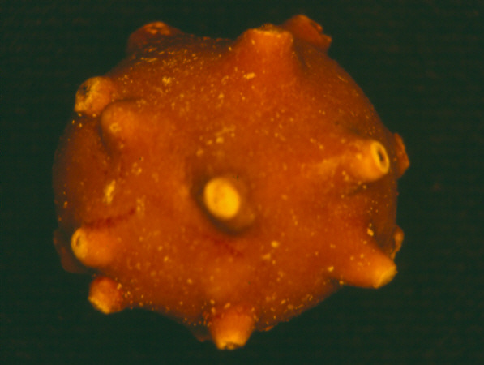
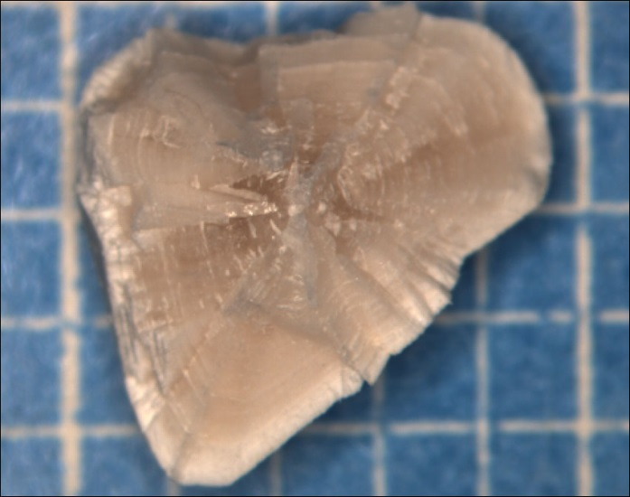
Stone types
Calcium Oxalate
Calcium Phosphate
(60-70%)
Uric Acid (10-15%)
Struvite (10-15%)

Slide 86
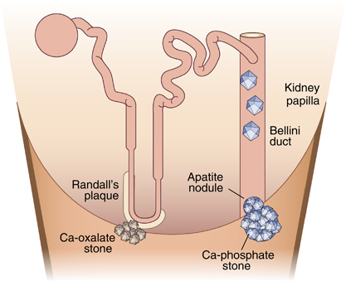
Site of stone formation

Slide 87
Stones, also known as renal calculus or nephrolith, are small, hard deposits of mineral and acid salts on the inner surfaces of the kidneys.
If stones grow to sufficient size they can cause blockage of the ureter.
There is seasonal variation with stone occurring more often in the summer months suspecting the role of dehydration in this process.

Slide 88
INCIDENCE
Urinary calculi are more common in men than in women.
Incidence of urinary calculi peaks between the 3rd and 5th decades of life.
80% of stones under 2mm in size
90% of stones pass through the urinary system spontaneously

Slide 89
STONE FORMATION
Highly concentrated urine constituents crystallize and harden to form calculi.
Kidney stones form when urine contains more crystal- forming substances — such as calcium, oxalate and uric acid.
At the same time, our urine may lack substances that prevent crystals from sticking together, creating an ideal environment for kidney stones to form.

Slide 90
STONE FORMATION
The crystals get deposited on the nucleus and continue to grow.
These can some times adhere to the renal papillae.
TYPES OF KIDNEY STONES:
Calcium oxalate
Calcium phosphate
Struvite
Uric acid
Cystine

Slide 91
Renal stones
Calcium stones: Most kidney stones are calcium stones, usually in the form of calcium oxalate and calcium phosphate.
Oxalate is a naturally occurring substance found in food. Some fruits and vegetables, as well as nuts and chocolate, have high oxalate levels. Our liver also produces oxalate.
IN ALKALINE URINE →  ENLARGES RAPIDLY → TAKE SHAPE OF CALYCES →  STAGHORN →CALCIUM PHOSPHATE

Slide 92
Renal stones
Uric Acid: This type of kidney stone is more common in men than in women.
They can occur in people with gout or those going through chemotherapy.
Struvite: This type of stone is found mostly in women with urinary tract infection. These stones can be quite large and cause urinary obstruction.
Cystine: Cystine stones are rare. They occur in both men and women who have the genetic disorder cystinuria.
Other: Other, rarer types of kidney stones also can occur. Such as XANTHINE STONES, DIHYDROXY ADENINE STONE, SILICATE STONES etc.

Slide 93
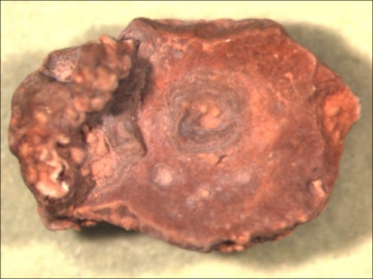
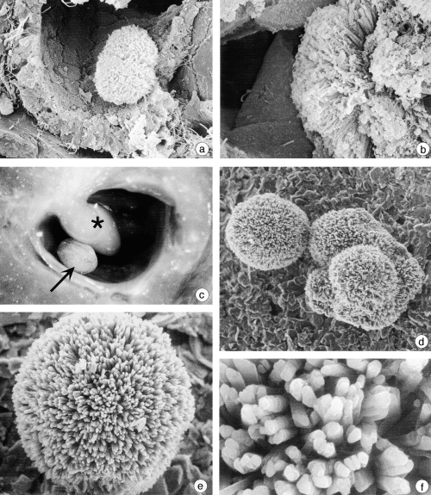
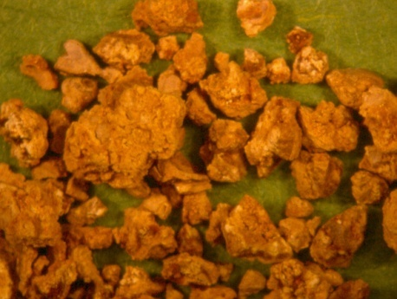
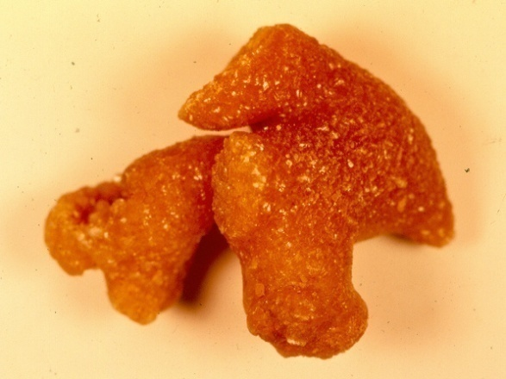
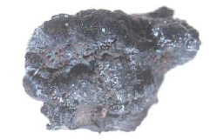
Hereditary Disorders
Xanthine
Polycystic kidney Disease
Medullary Sponge Kidney
Horseshoe kidney
2,8-dihydroxyadenine
adenine phosphoribosyltransferase (APRT)
Alcaptonuria
homogentisate 1,2-dioxygenase
Cystine (1%)
dibasic AA transporter

Slide 94
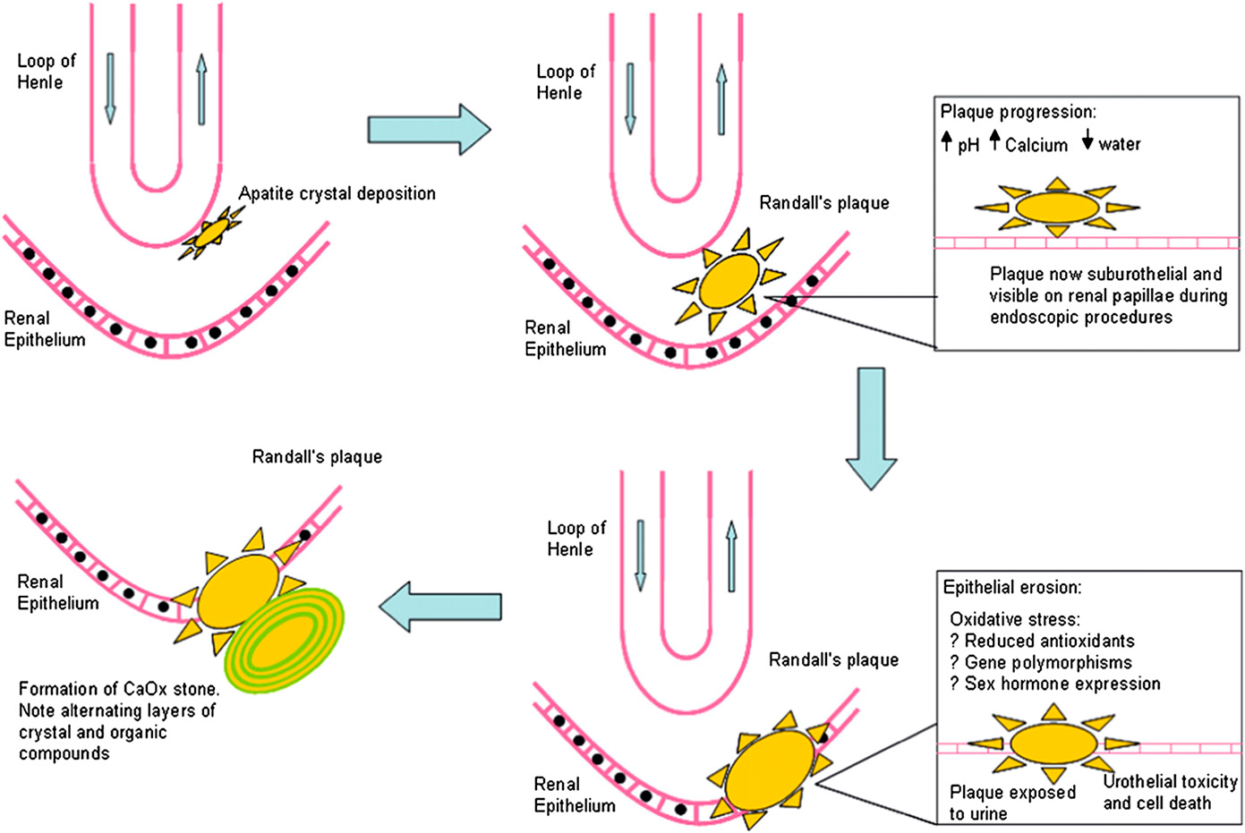
Pathobiology of stone formation

Slide 95
CAUSES
Supersaturation of urine is the key to stone formation
Imbalance of pH in urine
Gout
Hyperparathyroidism
Inflammatory Bowel Disease
UTI (Urinary Tract Infections)
Dehydration
Crystal aggregation

Slide 96
Hyperuricosuria:
20-40% of stone formers.
Elevated RBC urate transport.
Uric acid may interact with glutamic acid
and act as a promoter.
Reduces inhibitory activity of urinary
macromolecular inhibitors.
“Salting out” phenomenon.
Solubility enhanced by urine pH > 6.5.
Dietary purine intake is the major source.

Slide 97
RISK FACTORS
HIGH MINERAL CONTENT IN DRINKING WATER
DEHYDRATION
FAMILY OR PERSONAL HISTORY DIETARY INTAKE BEING OBESE

Slide 98
PATHOPHYSIOLOGY
Slow urine flow, resulting in super saturation of the urine.
Damage to the lining of the urinary tract
Decreased inhibitor substances in the urine that would otherwise prevent super saturation and crystalline aggregation.

Slide 99
CLINICAL MANIFESTATION
Severe flank pain
Abdominal pain
Nausea and vomiting
Fatigue
Elevated temperature, BP, and respirations
Steady Pain
Pain on urination;
Pink, red or brown urine
Oliguria and anuria in obstruction →Hematuria → Renal colic→Hydronephrosis

Slide 100
Metabolic abnormalities: Urinary excretion values
Hypercalciuria
Hyperoxaluria
Hyperuricosuria
Hypocitrituria
Hypomagnesuria
> 4 mg/kg/d or > 140 mg/gm Cr
> 40 mg/d
800 mg/d (M), 750 mg/d (F) or 300 mg/L
< 320 mg/d
< 60 mg/d

Slide 101
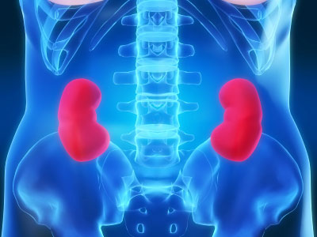
Chronic Kidney Disease
Chronic Kidney Disease is defined as a slow lose of renal function over time. This leads to a decreased ability to remove waste products from the body and perform homeostatic functions.

Slide 102
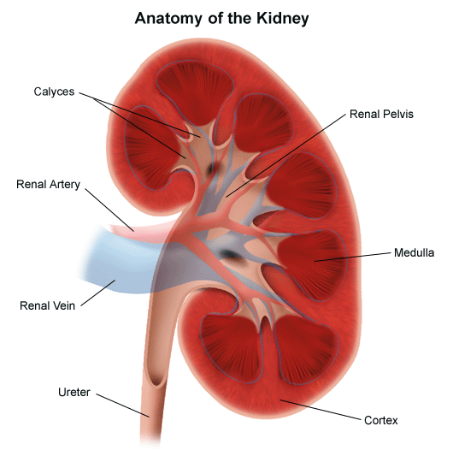
Clinical Definition
GFR of less than 60 ml/minute per 1.73m² per body surface area (normal is 125ml/min) .
  GFR Calculator: http://www.kidney.org/professionals/kdoqi/gfr_calculator.cfm
Presence of kidney damage, regardless of the cause, for three or more months
Notes:
Things that cause kidney disease:
-Glomerulonephritis, a group of diseases that cause inflammation and damage to the kidney's filtering units. These disorders are the third most common type of kidney disease.
-Inherited diseases, such as polycystic kidney disease, which causes large cysts to form in the kidneys and damage the surrounding tissue.
-Malformations that occur as a baby develops in its mother's womb. For example, a narrowing may occur that prevents normal outflow of urine and causes urine to flow back up to the kidney. This causes infections and may damage the kidneys.
-Lupus and other diseases that affect the body's immune system.
-Obstructions caused by problems like kidney stones, tumors or an enlarged prostate gland in men.
-Repeated urinary infections.

Slide 103
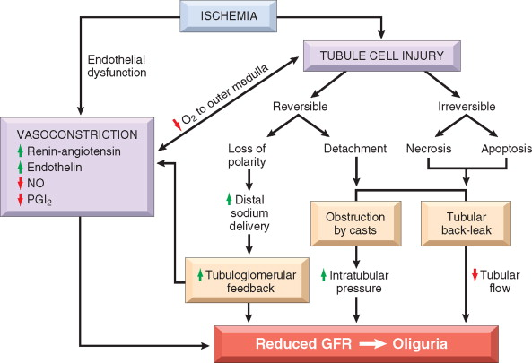
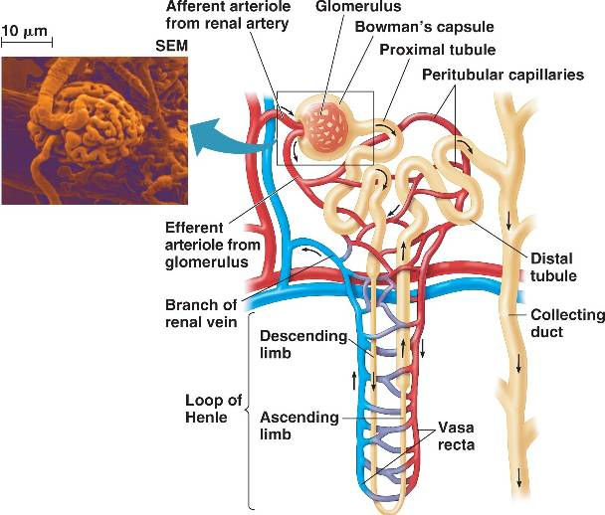
Pathophysiology
Repeated injury to kidney
Notes:
The causes of acute or chronic kidney disease are traditionally classified by that portion of the renal anatomy most affected by the disorder
The two major causes of reduced renal perfusion are volume depletion and/or relative hypotension. This may result from true hypoperfusion due to bleeding, gastrointestinal, urinary, or cutaneous losses, or to effective volume depletion in heart failure, shock, or cirrhosis
Various vascular diseases can also lead to kidney disease.
Direct etiologies from kidney: Tubular and interstitial disease, Glomerular disease, Obstructive uropathy
Acute tubular necrosis — 45 percent
Prerenal — 21 percent
Acute or chronic kidney disease — 13 percent (mostly due to acute tubular necrosis and prerenal disease)
Urinary tract obstruction — 10 percent (most often older men with prostatic disease)
Glomerulonephritis or vasculitis — 4 percent
Acute interstitial nephritis — 2 percent
Atheroemboli — 1 percent

Slide 104
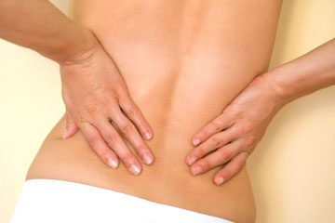
Symptoms
Hematuria
Flank pain
Edema
Hypertension
Signs of uremia
Lethargy and fatigue
Loss of appetite
If asymptomatic may have elevated serum creatinine concentration or an abnormal urinalysis

Slide 105
Risk Factors
Age of more than 60 years
Hypertension and Diabetes
  Responsible for 2/3 of cases
Cardiovascular disease
Family history of the disease.
Race and ethnicity
    Highest incidence is for African Americans
    Hispanics have higher incidence rates of ESRD than non-Hispanics.
Notes:
_followed by American Indians and Alaska Natives, then Asian Americans and native Hawaiians and other Pacific Islanders, and finally Caucasians.

Slide 106
Convergence of Genetic Factors
Genes for heart and vascular disease
Genes that maintain ionic balance
Genes for glomerulonephritis
Genes for diabetes
Genes that may be involved in inherited renal diseases

Slide 107
Prevention
  Keep diabetes and blood pressure controlled
  If at risk perform screening tests
  Reduce exposure to nephrotoxic drugs
  Eat right and exercise
  Know your family history
    If you have a positive family history ask doctor to perform common screening tests for kidney function.

