Slide 1
STRESS AND HEALTH
Lecture:4
Stress – definitions and terms. Physical responses to stress. Stress and the immune system. Life events and stress. Stress as a person-environment interaction. Stress and health. Stress in medicine. Managing stress.
Assoc. Prof. Petranka Chumpalova,
Dept. of Psychiatry and Medical psychology, Pleven Medical University
chumpalova@abv.bg

Slide 2
AGENDA
What is stress: definitions, theories etc.
Stress and health
Stress in medicine
Managing stress

Slide 3
Introduction and definitions
Originating from mechanics, the word stress has become widely used to express:
  Unfavorable/negative situation
  A feeling of pressure/tension
  Negative emotion
Current psychological concepts consider stress as occurring when demands are appraised as exceeding a person’s resources to cope.
Stress has many components but the most important distinction is between:
  Stressor
  Stress responses

Slide 4
Introduction and definitions
Stressor: event that triggers a stress response.
  Based on their origin stressors are subdivided to:
    External (e.g. feeling stressed while studying for an exam)
    Internal (e.g. conflicting desires - to study for exam or to help a good friend who needs you at the same time)
  Based on their type and duration stressors are sub- classified to:
    Acute (e.g. death of a close friend)
    Chronic (e.g. caring for a sick relative)
    Daily hassles (e.g. problems during work)
    Traumatic stressors (e.g. an assault)
    Role strain (e.g. balancing home and work roles)

Slide 5
Introduction and definitions
Stress responses: the various ways to respond to a stressor. They are subdivided into:
  Cognitive
  Affective
  Behavioral
  Physiological
The association between these responses is not obligatory. It is possible for a person to have a strong physiological response with little or no emotional one (the so called repressive coping style seen in some people*).
Furnham, A. et al. (2003) Repressive coping style and positive self-presentation, British Journal of Heath Psychology, 8: 223-249
Notes:
People having the so called repressive coping style when put under stress will report little or no emotional distress but show strong physiological responses.

Slide 6
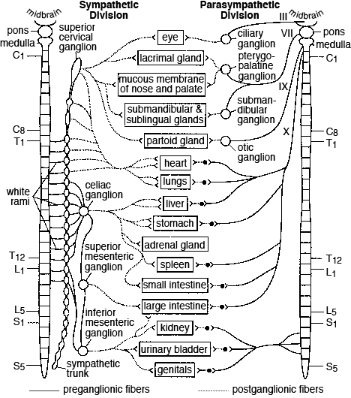
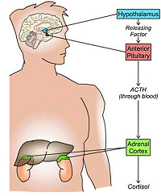
Physiological responses to stress
They are critical in explaining the link between stress and disease. Initial research (1950s) focused on fight-flight response which involves:
  the sympathetic branch of the autonomic nervous system as a fast, first wave response.
  the endocrine pathways of the hypothalamic-pituitary-adrenal (HPA) axis as a slower, second wave response.
Epinephrine
Norepinephrine
The adrenal medulla produces stress hormones such as adrenaline (epinephrine) and noradrenaline (norepinephrine). They cause stimulation of the heart and lungs and the diversion of energy away from unnecessary functions such as saliva production, digestion and reproduction.

Slide 7
Physiological responses to stress
Upon HPA activation, cortisol secretion starts from the adrenal cortex. Cortisol is a critical stress hormone with physiological activities such as:
  Increase in blood sugar levels and metabolic rate
  Influencing regulation of blood pressure
  Influencing immune system and inflammatory response
The HPA axis works as a negative feedback loop so the presence of cortisol in the blood stream triggers the hypothalamus to stop producing CRF and its levels in blood return to normal in 40-60 min.
In prolonged periods of stress the HPA axis can become dysregulated resulting in chronically elevated levels of cortisol. In the long term this will have negative effect such as accumulation of abdominal fat and wasting of bone and muscle tissue.

Slide 8
Physiological responses to stress
H. Selye (1956) proposed that physical responses to stress can be understood as a general adaptation syndrome with three stages:
  Alarm: an immediate physical response to stress that prepares us for fight-flight.
  Resistance: our body attempts to resolve the stress and return to normal, but if the stressor continues, we will remain in a physiologically active state.
  Exhaustion: if the stressor continues indefinitely, the physical strain on our body will lead to exhaustion, illness, or death.
Research supports to some extent the general adaptation syndrome but our understanding of the physiological responses to stress has developed substantially since the time of Selye.
Selye, H. (1956) The Stress of Life. New York: McGraw-Hill

Slide 9
Physiological responses to stress
We now know that physiological responses to stress will vary according the characteristics of the situation such as:
  If it is new: stronger physiological stress responses will occur in situations that are novel*
  If it is predictable: unpredictable events can lead to greater physiological stress**
  If it is controllable: lack of control is associated with greater stress and a more negative impact on health***
The latter has lead to the view that it is important to empower patients and encourage them to have as much control as possible. Though this is usually true, in situations which are essentially incontrollable encouraging someone to strive for control might result in more strain on the person.
*Schedlowski, M. & Tewes, U. (1992) Physiological arousal and perception of bodily state during parachute jumping, Psychophysiology, 29: 95-103
Evans, G.W. et al. (2002) The morning rush hour: Predictability and commuter stress, Environment and Behavior, 34: 521-530
Walker, J. (2001) Control and the psychology of health. Buckingham: Open University Press
Notes:
It has important implications for uncontrollable situations in healthcare, such as births that involve obstetric complications women cannot predict or control

Slide 10
Physiological responses to stress
Individual stress response variations exist and some individuals will be more physiologically responsive than others. According to twin studies, stress responsivity may be at least partly genetically determined*
Individuals also vary in their pattern of physical responses to stress. One person may have high blood pressure responses to stress and another person may show a stronger inflammatory response.
*Hewitt, J.K & Turner, J.R. (1995) Behavior genetic studies of cardiovascular responses to stress, in J.R. Turner et al.(eds) Behavior Genetic Approaches in Behavioral Medicine. New York: Plenum. pp 87-103

Slide 11
Physical responses to stress
Babies of mothers with high levels of stress and anxiety during pregnancy are more responsive to stress, show more anxiety and fearfulness and are more likely to have cognitive and attentional problems.*
The environment is also important in shaping responses to stress. Animal studies show that offspring of more nurturing mothers have reduced HPA axis responses through less CRF and enhanced negative feedback.**
Thus, individual differences in stress responsivity is determined by nature and nurture.
*Talge, N.M. et al. (2007) Antenatal maternal stress and long-term effects on child neurodevelopment: How and why?, Journal of Child Psychology and Psychiatry, 48: 245-261
**Champagne, F & Meaney, M.J. (2001) Like mother, like daughter: Evidence for non-genomic transmission of parental behavior and stress responsivity, Progress in Brain Research, 133: 287-302

Slide 12
Physiological responses to stress
Emerging evidence suggests that the fight-flight response may be more relevant to males, while females may be more likely to show tend-befriend responses, where they will turn to the group for safety and to protect their young.* Data from studies show that the biological mechanism involved in this difference might be hormonal - oxytocin.
In summary physiological responses to stress will differ according to:
  Circumstances
  Individual differences
  The group involved
Taylor, S.E. et al. (2000) Behavioral responses to stress in females: tend-and-befriend, not fight or flight, Psychological Review, 107: 411-429
Notes:
If male animals are injected with oxytocin and then put in a stressful situation they are more likely to nurture any young animals present (Taylor et al. 2000)

Slide 13
Stress and the immune system
Stress will have various effects on the immune system, depending on the demands of the situation.
The sympathetic nervous system increases immune system activity, particularly large granular lymphocyte activity such as NK-cells (natural killers cells).
However, the HPA axis suppresses some immune activity through the production of cortisol, which has an anti-inflammatory effect and reduces both the number of white blood cells (WBC) and the release of cytokines.

Slide 14
Stress and the immune system
Different type of stressful events invoke different immune responses. Short stressors lead to an acute immune response such as the one described above to provide an immediate defense against injuries and the broad risk of infection. This response is rapid and the immune system will quickly return to baseline levels.
Stressors lasting several days lead to increase in cytokine production and thus the body is more able to co-ordinate responses against infections.*
Chronically stressful events will have a negative impact on almost all aspects of immune functioning, with poorer immune function overall. This makes a person more likely to get ill, particularly if they are already vulnerable (e.g. older people) or have a pre-existing disease.
Notes:
This might explain why students often get sick after exams – because during the stressful revision period they have increased immunity against infections which largely disappears when exams are over.

Slide 15
The role of life events
Life events are usually measured with a checklist of different types of stressful events (e.g. divorce, bereavement, marriage, or financial problems). Advantages of this approach are:
  Distinguishes the stressor from the stress
  Provides an objective measure of stress response.
Disadvantages:
  Fails to account for individual differences in events that are perceived as stressful - for example a muscle injury will potentially be much more stressful for a professional athlete than for an office worker.
  Measurement of stress by checklists is likely to be affected by recall biases - people who are ill are much more likely to search for a cause of their illness and attribute it to stress in comparison to those that are healthy.
Notes:
*.
**. Therefore, they are more likely to recall stressful events than people who are healthy.

Slide 16
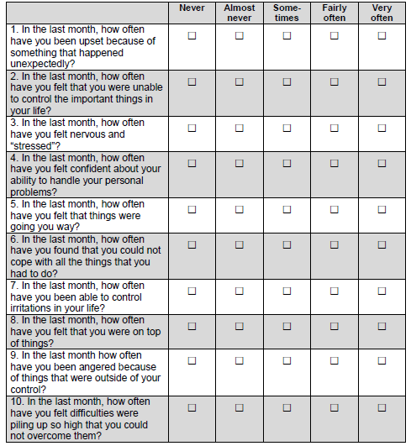
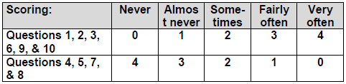
The role of life events
Alternative measures of stress such as PERCEIVED STRESS SCALE* focus on appraisal and stress responses. This approach detects significant life events more accurately but mixes together stressors, stress responses, and coping responses
There is plenty of evidence to show that more life events are associated with various illnesses and even death**
*Cohen, S. et al. (1983) A global measure of perceived stress. Journal of Health and Social Behavior, 24: 385-396
**Subramanian, S.W. et al. (2008) Widowhood and mortality among the elderly: the modifying role of neighborhood concentration of widowed individuals. Social Science and Medicine, 66: 873-884

Slide 17
Stress as a person-environment interaction
Interactional explanations of stress posit that the response to stress depends on the interaction between a person and his/her environment - stress occurs when a person appraises the demands of a situation as being greater than their ability to cope with them.*
Appraisal processes are central and explain the great variation in how people respond to stressful circumstances. Those who apprise an event as challenging will have smaller cortisol responses than those who apprise it as stressful.
Three processes of appraisal are outlined:
  Primary appraisal: the demands of the situation are evaluated as benign, challenging, or stressful/threatening.
  Secondary appraisal: a person evaluates their resources and the ability to cope.
  Reappraisal: a person reconsiders the situation once they have tried to cope with it. It may be seen as less or more stressful than originally thought, depending on the effect of their coping responses.
*Lazarus, R.S & Folkman, S (1984) Stress, Appraisal and Coping. New York: Springer

Slide 18
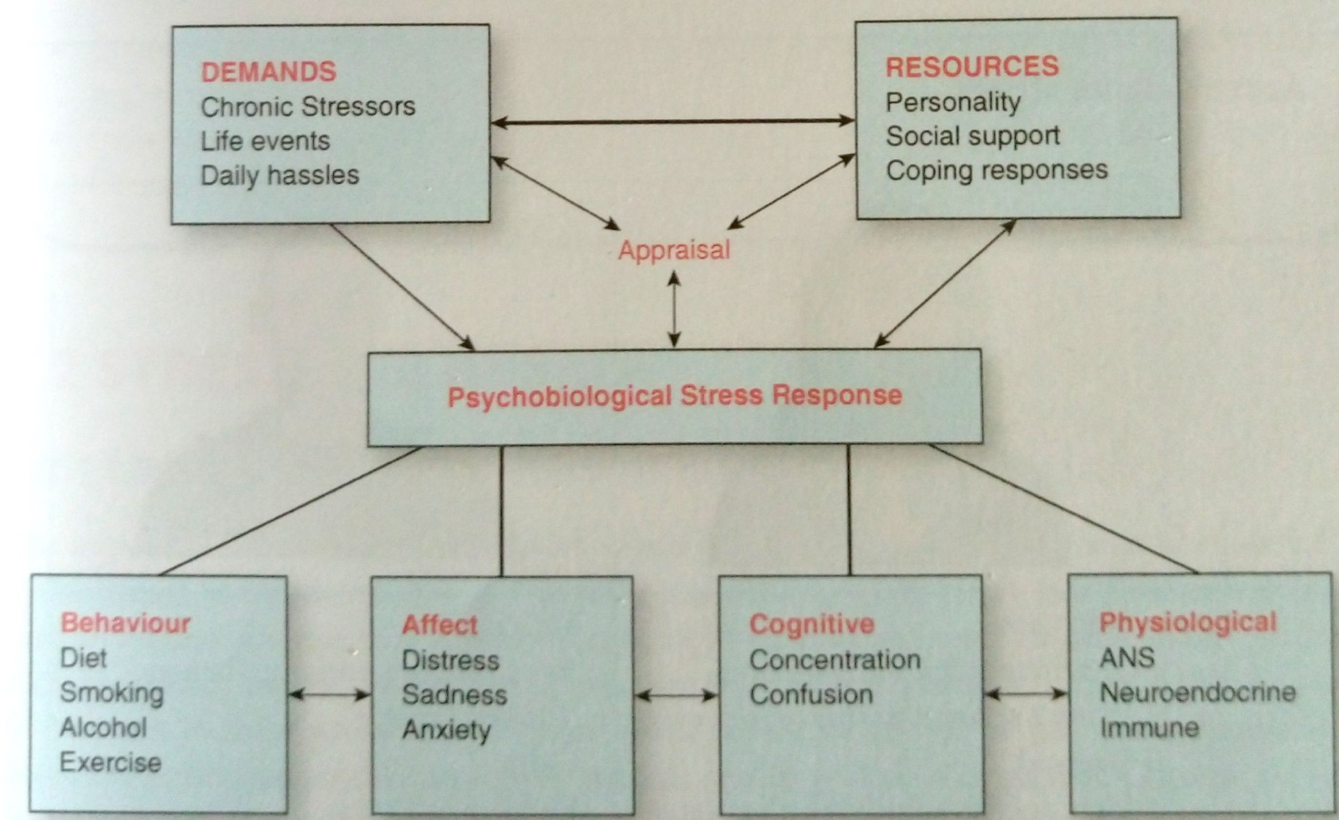
Stress as a person-environment interaction
Appraisal processes are central and explain the variation in people’s responses to stress.
Stress can be conceptualized as a dynamic process with constant interplay between appraisal, coping and reappraisal.

Slide 19
Stress and health
The impact of stress on physical health varies between illnesses. Evidence show that stress increases the morbidity of:
  Episodes of infectious illnesses (like colds)
  Cardiovascular disease
  Wound healing (slower it)
Additionally, stress worsens auto-immune conditions such as:
  Asthma
  Rheumatoid arthritis
  Inflammatory bowel disease
  HIV/AIDS
It is well known that chronic or severe stress can lead to a number of mental health problems including:
  Anxiety
  Depression
  Stress burnout
  Post-traumatic brain disorder (PTSD)

Slide 20
Stress and health
It is difficult to establish the definitive pathways between stress and health.
The first issue here is why is that if we put two people in the same circumstances, one person becomes stressed and the other not? Or that one person develops heart disease and another remains healthy?
It is believed that differences between individuals are explained by differences in appraisal, but the effects of stress are also moderated by other factors, such as situational characteristics, coping responses, and social support.

Slide 21
Stress and health
  The second issue is that it is usually not possible to say whether an illness is:
    Entirely due to stress
    Entirely to to other factors
  Illnesses usually have multiple causes, ranging from the genetic and biological to the environmental. The role of stress will vary widely in different illnesses depending as well on the particular individual, circumstances etc.
  A third issue is that the effect of stress on health can be due to behavioral, emotional, or physiological responses. For example people who are stressed besides having physiological symptoms are also more likely to smoke, drink alcohol, and have a poorer diet.*
Wardle, J et al. (2000), Stress, dietary restraint and food intake, Journal of Psychosomatic Research, 48: 195-202

Slide 22
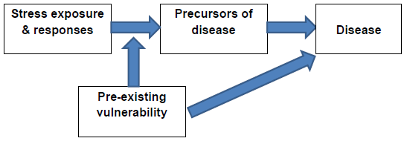
Stress and health
According to vulnerability-stress model stress will contribute to the development of disease thought an interaction with person’s physical vulnerability, psychosocial vulnerability, environment, coping responses, etc.

Slide 23
Factors that modify the effects of stress
Moderators of the effect of stress on health include:
  Personality
  Coping methods used by the particular individual
  Available social support
  Practicing of physical exercise
Personality – the dimensions of personality that have most effect on the response to stress are those involving negative emotions such as neuroticism.
Neuroticism is a personality trait involving high symptoms of anxiety, depression, hostility, and emotional instability.

Slide 24
Factors that modify the effects of stress
People high in neuroticism will generally report more pain and symptoms. There is also a consistent association between neuroticism and a range of health problems*:
  Arthritis and musculoskeletal pain
  Diabetes
  Asthma
  Coronary artery disease and other CVDs
  Headaches (including migraine)
  Kidney or liver disease
  Ulcers
  Chronic fatigue
  Gastrointestinal diseases (colitis, irritable bowel syndrome, gastroesophageal reflux disease)
*Friedman, H.S. & Booth-Kewley, S. (1987) The “disease-prone” personality: A meta-analytic view of the construct, American Psychologist, 43: 539-555
*Goodwin, R.D. et al. (2006) Neuroticism and physical disorders among adults in the community: Results from the national comorbidity survey, Journal of Behavioral Medicine, 29: 229-238
*Turk Charles, S. et al. (2008) Physical health 25 years later: The predictive ability of neuroticism, Health Psychology, 27: 369-378

Slide 25
Factors that modify the effects of stress
Coping – defined as any attempt to cope with a stressor irrespective of whether it is successful or not, it partially determines our physiological and emotional responses to stress.
The various coping strategies may be best conceptualized as falling into two big categories:
  Emotion-focused strategies: they concentrate on reducing distress (e.g. not thinking about it; eliciting emotional support).
  Problem-focused strategies: concentrate on dealing with the problem (e.g. information seeking; problem solving).

Slide 26
Factors that modify the effects of stress
A useful approach for medical practice is between:
  Approach coping strategies: try to deal with situations pro-actively (shares some overlap with problem-focused strategies)
  Avoidant coping strategies: try to avoid the problem (e.g. denial; not wanting to talk about it – repression)
A person who is predominantly and avoidant coper may find it very difficult to discuss their illness, the side effects of treatment, or any potential complications.
On the contrary, an approach coper will want to know everything about his/her disease and treatment (may come to consultations with extensive information gathered from internet or elsewhere).

Slide 27
Factors that modify the effects of stress
Coping strategies associated with reduced mortality in healthy people and better outcomes in people with chronic illness are those which:
  Enable person to feel more in control
  Increase positive affective states (e.g. emotional well-being, positive mood, joy and happiness)
  Increase positive personality dispositions (hopefulness, optimism and humor)
  Decrease negative mood
It is simplification to say that one coping style is better than other. Avoidant coping strategies are very good for reducing anxiety and distress in the short term. Before an operation this can be helpful because it keeps anxiety levels down and once the operation is over the stress of this is gone. For someone with a chronic illness however, avoidance can lead to a lack of adherence to treatment regimens and thus increase illness problems.

Slide 28
Factors that modify the effects of stress – social support
Social relationships are vital to our quality of life and health. Negative relationships involving abuse or conflict are among most potent stressors. Traumatic events that involve personal harm from others (e.g. rape, assault, torture) are more likely to cause post-traumatic stress disorder (PTSD) than a natural disaster for example.
Social relationships also shape the way we respond to stress. Attachment theory proposes that babies are born with an instinct to turn to their parents or caregivers when they are stressed or feel in danger. Children with disturbed attachment (e.g. abandoned or abused) are more likely to develop insecure and chaotic responses to stress.
Parents constantly continue to shape children's responses to stress. Parents and children exposed to the same stressor show very similar responses. Increasing evidence shows that anxious parents raise anxious children through having controlling parenting styles. Conversely, children who feel supported by their parents cope better with stressful events by using more active coping and positive reappraisal.

Slide 29
Factors that modify the effects of stress – social support
For adults, social support can dramatically reduce the impact of stress. People who have a lot of social support are less likely to get stressed, and if this happens, they are more likely to cope with it successfully.
Social support also has a direct effect on health. Many studies have reported a relationship between:
  Social support and disease progression (negative correlation)
  Social support and recovery from illness (positive correlation)
  Social support and mortality (negative correlation).
Social support is therefore a critical factor in both stress and health.

Slide 30
Factors that modify the effects of stress – physical activity
Physically active people are at lower risk of obesity, CVD, breast cancer, and diabetes and live longer.
Besides, physically active people are less likely to smoke, more likely to have a healthy diet and more likely to have social support.
Using exercise as a method of coping with stress has positive effect on health. Evidence shows that exercise reduce anxiety, depression, and is associated with increased self-esteem and self-confidence.
Exercise intervention programs have been used in a wide range of conditions including CVDs, depression, learning disabilities, dementia, arthritis, back pain, Parkinson’s disease, cancer, and schizophrenia.

Slide 31
Stress in medicine
Medicine is an inherently stressful profession: it involves dealing with health crises and making life and death decisions. As already mentioned, stress is associated with a range of negative psychological states including anxiety, depression, PTSD and burnout.
Stress burnout is experienced by approximately 20% of adults and has three main symptoms:
  Emotional exhaustion: feelings of physical exhaustion, being depleted, worn out.
  Depersonalization: having an unfeeling, impersonal approach to co-workers or patients, cynicism, and a lack of engagement with the job or people.
  Reduced personal accomplishment: poor sense of effectiveness, involvement, commitment and engagement and a poor belief in one’s ability to change or improve work patterns or environments.
Burnout leads to high job dissatisfaction, absenteeism, and staff turnover. Symptoms of exhaustion are associated with other physical symptoms (headaches, gastrointestinal disorders, hypertension, colds or flu, sleep disturbances etc.)

Slide 32
Stress in medicine
The workplace is critical to whether people develop burnout and this is particularly relevant for healthcare professionals. Nearly 30 % of hospital consultants in the UK report burnout and psychological problems (feeling overloaded, poorly managed, poorly resourced, and having problems outside work). Burnout is more common in consultants who feel poorly trained in their communication and management skills.
Areas such as intensive or palliative care (e.g. oncology) tend to have higher rates of burnout.
Medical students also face many stressors: constant evaluation by exams, staff and patients; dealing with death, suffering, and difficult ethical issues etc.
Students who are likely to report more stress and burnout are those who are:
  Disorganized/havr poor time managemen
  feel overwhelmed
  who are unsure of the demands of different tasks So are students who are self-critical,
  Neurotic and perfectionists.
Learning positive ways to manage stress is therefore extremely important for healthcare professionals.

Slide 33
Managing stress
There are six main approaches to stress management:
  Relaxation
  Physical fitness
  Cognitive restructuring
  Meditation
  Assertiveness training
  Stress inoculation
Stress inoculation interventions are based on exposing people to potentially stressful situations so they become inoculated against them (e.g. - paramedic training with rehearsals/”mock ups” of major traffic accidents).

Slide 34
Managing stress
Cognitive-behavioral techniques, such as cognitive restructuring, have the largest and most enduring effect on reducing stress, better communication skills with patients and greater satisfaction of the latter with the medical service provided to them.
Cognitive-behavioral stress management programs focus on appraisals and coping responses to help people manage their stress better. These can be very useful to assist people coping with illness.
However, evidence suggests that the results of cognitive stress management in patients with CVD, cancer and chronic headache are mixed (reduction od depression and improvement of self-esteem, but mixed effect on morbidity and mortality).

Slide 35
Managing stress
Cognitive behavioral therapy (CBT) is founded on behaviorism and cognitivism. Behaviorism (the first wave in CBT) focuses on people behavior and how it is learned and shaped by events. Behaviorism describes the processes through which people behavior is shaped, including classical conditioning, operant conditioning (shaping behavior by rewards or punishments) and modelling.
Behavioral therapy involves changing maladaptive behavioral responses and substituting these with new responses.
Cognitivism (the second and currently dominant wave of CBT) views thought as being central to how we feel and behave. According to cognitivism appraisal and personal meaning of events are central in the development and maintenance of psychopathology, including the stress related one.

Slide 36
Managing stress

Slide 37
THANKS☺

