Slide 1
INTRODUCTION TO BIOETHICS
MEDICAL UNIVERSITY – PLEVEN
FACULTY OF PUBLIC HEALTH
distance learning Centre
Department of Public Health Sciences
LECTURE No1
Prof. Dr. Silviya Aleksandrova-Ybankulovska, DM, PhD, DSc, MAS

Slide 2
THE 65-YEAR OLD MOTHER

Slide 3
65-year old woman after successful IVF with donor’s ova and sperm, performed in 2010 (at 62-years of age), requested new procedure.
In patient’s view the sibling would provide support to the already born child in case of mother’s death.
Patient refuses consultation with a psychologist.
You are the physician in this case. What will you do?

Slide 4
WHAT ADDITIONAL INFORMATION DO YOU NEED?

Slide 5
The patient herself is a psychiatrist and she is firmly convinced in the rightness of her decision.
The patient believes that it is better to invest her savings in second IVF procedure and new pregnancy than to provide for the already born child.
The patient is retired and lives alone with her child. No relatives.

Slide 6
LIFE COURSE PERSPECTIVES

Slide 7
LIFE COURSE-APPROACH
Socially structured sequence of phases and trajectories
Linked to social statuses, roles, options, and responsibilities
Normative framework for personal choices and life decisions (“biographical schedule”)

Slide 8
LIFE COURSE-APPROACH I AGE NORMS
Normative standards of age-appropriate behaviours.
- Deontic perspective
Gender differences (double standard of aging)
Subject to historical and intercultural variation

Slide 9
LIFE COURSE-APPROACH Ii PHASE IDEALS
Evaluative measures of wellbeing and self-fulfillment at different life stages.
Hedonistic perspective
Biographical context
Subject to historical and intercultural variation

Slide 10
LIFE COURSE-APPROACH III DEVELOPMENTAL TASKS
Milestones of personal development and biographical timing.
Between deontic and hedonistic (teleological)
Individual life course
Intersubjective approval/disapproval

Slide 11
AGE NORMS PERSPECTIVE
Perceived naturalness of procreative phase and parent-child relation
Negative normative evaluation of postponed parenthood
Relation to responsibilities towards (prospective) children.
She is “too old” to reproduce.
It is not what women at this age are supposed to do.
It is “unnatural”.

Slide 12
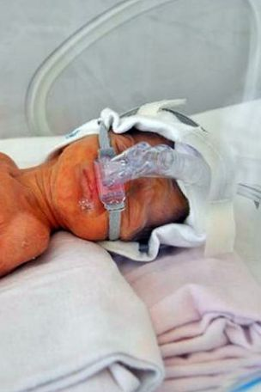
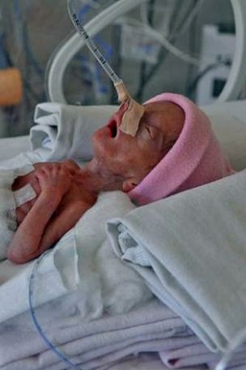
Backward-looking story 2010
The patient – 62-year-old psychiatrist K.D. – Bulgaria’s oldest first-time mother
The authorities had refused to let her adopt a child because of her age
5th of May 2010 K.D. gave birth (in regional hospital) by caesarian section to Merry (900 gr.) and Jacqueline (500 gr.)
Hypertension, respiratory problems, operated mioma uteri in the past ⇒ Difficult delivery
K.D. was initially impregnated with triplets but medics decided to remove one of the embryos.
Jacqueline died soon; Merry was transferred to capital city hospital

Slide 13
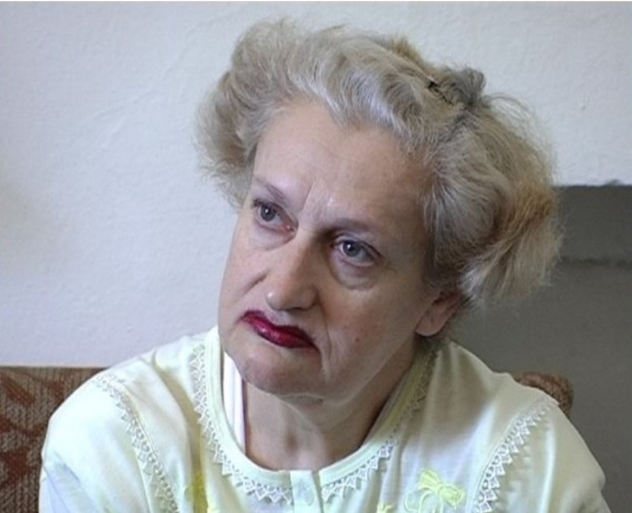
The motherhood status
„I wanted a family but when I was frustrated by the adoption service, I realised the only way to make this happen would be to give birth to my own children.”
„Age was not an obstacle for me. I so much wanted to have children. I would not like to look too much in the future. I hope that the babies will be well.”
She considers herself the mother even though not genetically related: monistic gestationalism + incorporation argument of parenthood + intentionalism + causalism

Slide 14
The motherhood status
Why not earlier? K.D. had conservative parents who were against conception without marriage. – An incorporated norm that she dared to challenge just after her parents’ death. Can you be a family of your own? Does everyone have a right to have a family?
But now she has a FAMILY and the responsibility to this family doesn’t allow her to take the risk of the second IVF?! – Family centered perspective because she is the only provider/carer in the family

Slide 15
CARE ETHICS / FAMILY ETHICS
ethics of care emphasize the importance of relationships;
the person depends on others and others dependent on her. The subject understands herself through her connection and involvement with the others;
ethical problems are considered to be tensions and breaks in the relational network within which people are situated. Consequently, to resolve a case uncovering and understanding of the positions of everyone involved is necessary.

Slide 16
PHASE IDEALS
Parenthood as traditional element of good life in middle adulthood.
Late (postponed) parenthood as a new perspective for good life at older age.
She is supposed to be satisfied with what she had achieved by now: both professional realization and childbearing.
But does she have the family she wanted to? It seems that the answer is not, because she considers the child not having enough family support (now and in the future).
It seems that she had wanted bigger family at the very beginning (three embryos, one reduced, two left and born but one died).

Slide 17
DEVELOPMENTAL TASKS
Grandparenthood traditional stage in personal development/ generational cycle
Shifting relations between late (postponed) parenthood and grandparenthood
Simultaneity of parent and grandparent stage / role or blocked grandparenthood
At this age she is supposed to take care of grandchildren, not of her own young children
It is different kind of relation and responsibility
Is she discarding the chance to be grandmother subjecting herself to a new risky pregnancy?

Slide 18
The outcome
The outcome

Slide 19
Besides the patient and the physician in the discussion were involved the head midwife and two embryologists.
The discussion resulted in refusal of second IVF procedure even though the patient was persistent in her wish.
Re-assessment was not planned.

Slide 20
Team’s considerations
medical good for the patient
beneficence for the already born child
risk of orphanage for the already born child
Legal framework for artificial reproduction after menopause

Slide 21
Bulgarian law
Current legislation forbids transfer of embryos created with donor’s ova in postmenopausal women.
Paradoxically this legislation was adopted after the first IVF of this same patient which was widely discussed in the media at that time.

Slide 22
The law on assisted reproduction in Bulgaria at that time
Bulgarian Health Act: “Assisted reproduction is indicated where the health status of the man or of the woman does not allow natural reproduction.”
Age is not an element of the health status, it is a result of the normal process of human development.
The law forbade insemination of women above 45 years of age and ovarial puncture of women above 43 years. ⇒ The court: not a medical criterion, medical assessment is needed.
No requirement for official marriage. Allowed for single women.
2011: Transfer of embryos created with donor’s ova cannot be performed on women above 51 years of age; later substituted with “after menopause”. ⇒ risk of abuses since the woman can choose where to be assessed.

Slide 23
PRINCIPLISM APPLIED

Slide 24
DOMINANT THEORY IN BIOETHICS
Principalism (applied ethics)
Beauchamp & Childress 1979
Application of principles to problems of therapeutic practice, health care delivery, and medical and biological research.

Slide 25
The 4 Principles of bioethics
Respect for autonomy
Beneficence
Non-maleficence
Justice

Slide 26
RESPECT FOR AUTONOMY
It claims that individuals ought to be permitted personal liberty to determine their own actions according to the plans that they have chosen.
AUTONOMOUS /COMPETENT PATIENTS
NONAUTONOMOS /INCOMPETENT PATIENTS

Slide 27
Patients often have varying capacities to be autonomous, depending on internal and external constraints.
Internal constraints on patient autonomy are mental ability, level of consciousness, age, and disease status.
External constraints are the hospital environment, availability of nursing resources, the amount of information provided for informed choices, financial resources, etc.

Slide 28
HOWEVER be careful
AUTONOMY doesn’t necessarily imply independency of other people but being able to control you own life. It is a common misconception. “I do not need other people” – very American way of understanding autonomy.
It is rather: “Other people are objects of my desires. My self-interest involves other people. It might involve changing other people or wanting to be in certain relation to people.“ – relational autonomy.
During your life you incorporate the influence of the environment that you cannot at certain point even distinguish as “something not yours”.
THEN you have to deal not only with the patient but with the people around him/her (the family or close friends that are more connected to the patient than the family).

Slide 29
Beneficence and non-maleficence
1. Beneficence - it is the obligation to do good and to avoid doing harm /2. Non-maleficence/.
Medical good
Religious good
Social good
Societal good

Slide 30
Justice
Treat the equal equally and the unequal unequally but in such a way that as a result from the unequal behaviour even the worst off benefit.
- non-discrimination

Slide 31
Respect for autonomy
The patient was autonomous BUT
Is the patient’s desire alone a good reason for medical intervention?
How far do patient’s rights go? and Should we as professionals satisfy all patient’s desires?

Slide 32
Beneficence
The mother: Fulfilled existential goal
The child:
Is it better to exists at any cost and any family situation or with the best possible future provided?
How important is the idea of traditional family?
Parent with life experience and social security
The society:
New member
Intelligent and caring parent but short life expectancy

Slide 33
Non-maleficence
The mother:
Contraindications and side effects of hormone therapy
Burdens of pregnancy and delivery
Social stigmatization
The child:
Quality of parenthood
Too different generations ⇔ many children raised by grandparents
Risk of losing the only parent in early adolescence ⇔ many children, born by “normal parents”, are raised in institutions
Social integration ⇒ risk of social isolation and psychological trauma
Yes, but these are “accidental”. In our case we speak of wilful application of high technology despite the identified risks.
The society:
Resource allocation in relation to IVF – not only question of money
Endangered “traditional” values ⇔ tolerance to differences

Slide 34
Justice
Is the age limit a discrimination?
Bulgarian Health Act forbids discrimination based on the age in the provision of health care.
The menopause is a natural, biological process and cannot be regarded a disease ⇒ IVF after menopause is not a treatment but rather service ⇒ refusal is not discrimination
Parenthood as responsibility and not just a right? ⇔ How such a concept can be implemented in the other groups of “not qualifying” parents ⇒ if it can’t be applied to them, then denying access to IVF only on the basis of age, would be discrimination

Slide 35
Which ethical theories we have used/ mentioned?

Slide 36
Care ethics / Family ethics
Ethics of life course
Principlism
Deontology
Hedonism
Utilitarianism
…………
An ethics theory provides means to organize complex information, opposing values and interests of involved parties.

Slide 37
What knowledge and skills we have needed?

Slide 38
KNOWLEDGE
SKILLS
Medicine
Philosophy
Law
Psychology
Social sciences
Reasoning
Interpretation
(Socratic) Questioning
Analytical
Elicitation
Communication

Slide 39
What bioethics is?

Slide 40
Bioethics represents a dramatic revision of the centuries-old professional ethics that governed the behavior of physicians and their relationships with patients.
… the study of the ethical issues emerging from advances in biology and medicine.
… moral discernment as it relates to medical policy and practice.
… systematic study of moral dimensions – including moral intuitions, decisions, acts and policies – in life sciences and health care, employing different ethics methodologies in interdisciplinary context (Warren Reich).
Ethics is a science searching for the answer of the question “What is good?” in respect to human actions.

Slide 41
What the course of medical ethics consist of?

Slide 42
Length of the course
1 semester
15 academic hours lectures (7 1/2 meetings)
15 academic hours seminars (7 1/2 meetings)
Schedule with specified data available on the information board at the department

Slide 43
Aims
Acquiring general understanding of the object area of contemporary bioethics
Introduction to ethical documents
Enabling students to identify, analyze and suggest solution to ethical problems in medical practice

Slide 44
Requirements during the semester
Regular attendance of seminars and lectures
Lectures do not repeat the textbook – they provide additional information – read the textbook in advance
Two semestrial tests (one is training test for the exam)
One individual assignment on case analysis (obligatory)
Active participation is encouraged

Slide 45
Exam
Two independent parts – test and case analysis
Test pass threshold– 60%
Assessment form for the case analysis – getting familiar with during the semester
Final mark = (0,30 x A*) + (0,60 x B*) + (0,10 x C*) + lecture bonus
A - mark on case analysis
B - mark on the examination test
C - average mark of the semester

Slide 46
Question number | Attributed points | Total points
Questions 1 to 3 | 0.50 each | 1,5
Questions 4 to 6 | 1 point each | 3
Questions 7 to 11 | 1,5 point each | 7,5
Questions 12 to 16 | 1 point each | 4
Questions 17 to 19 | 1 point each | 4
Questions 20 to 24 | 1 point each | 5
Question 25 /open-ended question requiring 5 short answers in free style/ | 0.50 each right answer | 2,5
Question 26 /open-ended question requiring 5 short answers in free style/ | 0.50 each right answer | 2,5
Maximum total points |  | 30

Slide 47
Number of points Mark
18 3.00
19 3.25
20 3.50
21 3.75
22 4.00
23 4.25
24 4.50
25 4.75
26 5.00
27 5.25
28 5.50
29 5.75
30 6.00

Slide 48
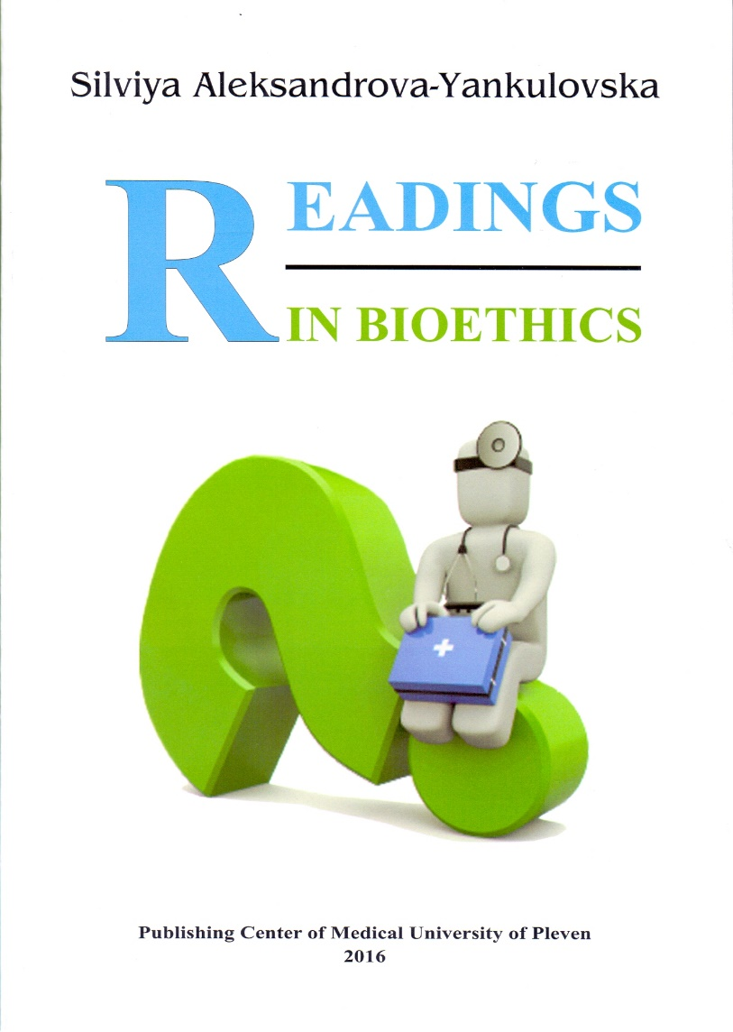
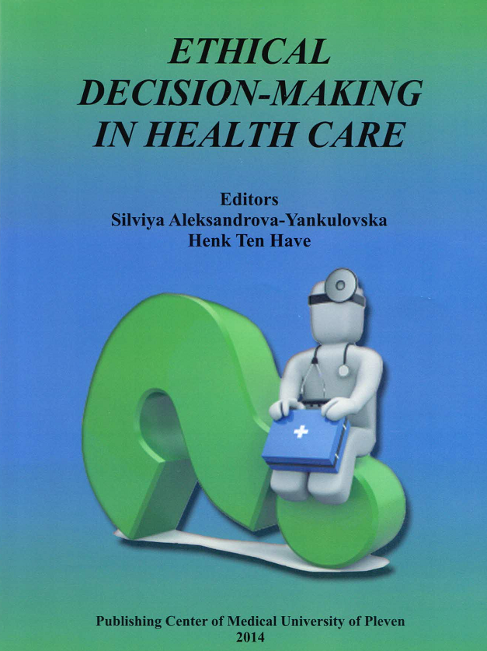
Reference materials

Slide 49
Thank you for your attention! COME PREPARED

