Slide 1
MEDICAL UNIVERSITY – PLEVEN
FACULTY OF PUBLIC HEALTH
distance learning Centre
Department of Public Health Sciences
LECTURE No3
Prof. Dr Silviya Aleksandrova-Yankulovska, MD, PhD, DSc, MAS

Slide 2
The space shown here on the right is video. Please follow the link https://youtu.be/6gi2T0ZdKVc
Notes:
https://youtu.be/6gi2T0ZdKVc

Slide 3
What was this movie about?
Discrimination
Stereotypes
Prejudice
Stigma

Slide 4
Discrimination
“treatment or consideration of, or making a distinction towards, a person based on the group, class, or category to which the person is perceived to belong.”
Racism, sexism, homophobia, ageism etc.
People can discriminate because of prejudice, stereotypes or implicit bias.

Slide 5
Protected characteristics

Slide 6
Reverse discrimination
Discrimination against members of a dominant or majority group, in favor of members of a minority or historically disadvantaged group.
Hiring with higher preference women or afro-americans etc.

Slide 7
Discrimination in health care
Refusing or stop providing care because of any of the protected characteristics
Lower quality of service
Behaving in a way which causes distress or offends or intimidates the patient
Punishing you because you complain about discrimination, or help someone else complain
The GP makes it more difficult for a patient to get an appointment because of any of the protected characteristics…. or charges more
Mentally ill are often transferred to a psychiatric unit even though their current problem is of another origin

Slide 8
Stereotypes
“A generalization about the attributes of a particular social identity group without regard to individual diversity within the group. Usually is negative, but in all cases is limiting and ignores the history and social context for its creation.”
Stereotypes are sometimes based on a limited experience with a group. ( i.e. student-athletes don’t care about school, all black athletes are fast etc.)

Slide 9
Prejudice
“An attitude, opinion or feeling without adequate prior knowledge, thought or reason.”
Hating gay people
Suspicious of all muslims

Slide 10
Implicit Bias
“Implicit bias is the bias in judgment and/or behavior that results from subtle cognitive processes (e.g., implicit attitudes and implicit stereotypes) that often operate below conscious awareness and without intention.”
Explicit bias “reflects the attitudes or beliefs that one endorses at a conscious level.”
Notes:
Important to note that sometimes people don’t realize/know they are prejudice, discriminatory, stereotyping or bias toward others.

Slide 11
Stigma
“Social stigma is the disapproval of, or discrimination against, a person based on perceivable social characteristics that serve to distinguish them from other members of a society.”
Individuals who are stigmatized usually feel different and devalued by others.
Stigma towards mentally ill

Slide 12
There is more about human rights (in health care)

Slide 13
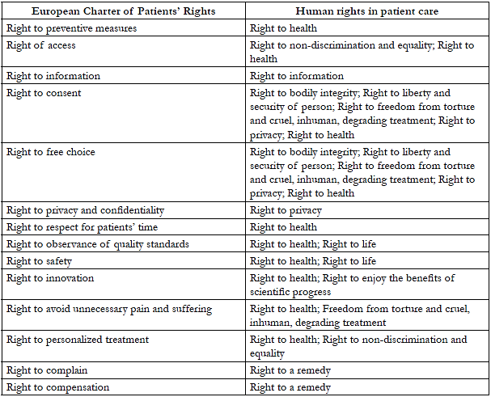

Slide 14
Movie – watch and answer
Which human and patient’s rights are violated in the movie?
The space shown here on the right is video. Please follow the link https://www.youtube.com/watch?v=sWeUDNyqo1I

Slide 15
Movie – watch and answer
Which human and patient’s rights were violated in the movie?
Right to liberty
Right to life
Right to highest attainable health
Right to freedom of torture
Right to effective remedy

