Slide 2
Plan of the lecture Part 1. Introduction Part 2.Measures of central tendency. Part 3. Measures of location: quantiles and percentiles

Slide 3
Part 1. Introduction There are two basic methods of summarization: numerical and graphical.

Slide 4
The objective of the numerical approach is to convert masses of numbers (raw data) into meaningful summary statistics (indices), reduced to a single number, that convey information about the average (typical) degree of a given variable and the degree to which observations differ (the degree of dispersion or spread).

Slide 5
After the collection of raw data they should be organized and presented in a meaningful way. Frequency distributions give a general picture of the pattern of the observations but sets of measurements cannot be adequately described only by the values of all individual measurements. For many purposes, the overall summary of a group's characteristics is of utmost importance.

Slide 6
The process of summarization is based on two main characteristics of quantitative data: 1. Firstly, this is the individual variability of observations in any set of measurements. 2. Secondly, despite the individual fluctuations, the values of the most quantitative variables tend to some typical “middle” level (central point or the most characteristic value) around which all the values are distributed. Measures of such distribution are referred to as measures of central tendency.

Slide 7
The central tendency is due to determining factors and causes inherent in all cases of a given sample or population while the variability or dispersion is due to specific factors which may occur in some cases but may be absent in others.

Slide 8
Part 2 MEASURES OF CENTRAL TENDENCY

Slide 9
BASIC TERMS: An array (a distribution) of a set of numbers is simply those numbers in ordered sequence from the lowest to the highest.

Slide 10
Each array (a distribution) has the following basic components: x - each individual raw score in a sample or in a population; n - the number of cases in a sample; N - the number of cases in a population; f - frequency (the number of observations with the same value); range - the difference between the largest and the smallest value in an array; Σx - the sum of all values in a sample or in a population

Slide 11
Before presenting the specific measures of central tendency, it is important to know the shape of the distribution and the dispersion of the scores in order to interpret the data correctly.

Slide 12
The three most commonly used measures of central tendency are: the arithmetic mean, the median, and the mode.

Slide 13
Arithmetic mean It is denoted by: x – for a sample and by µ - for a population. How to compute the arithmetic mean depends on the way on which the initial data are presented (raw or grouped data), and on the number of cases (statistical units).

Slide 14
Arithmetic mean In ungrouped data – small number of observations ( n<30) Example: The age of 10 primi-birth women is: 18, 21, 23, 23, 25, 27, 27, 28, 30, 33. x = 255/10 = 25.5

Slide 15
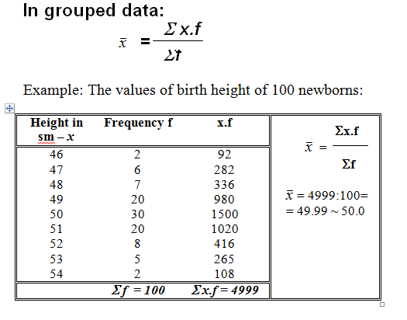

Slide 16
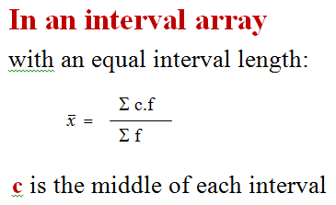

Slide 17
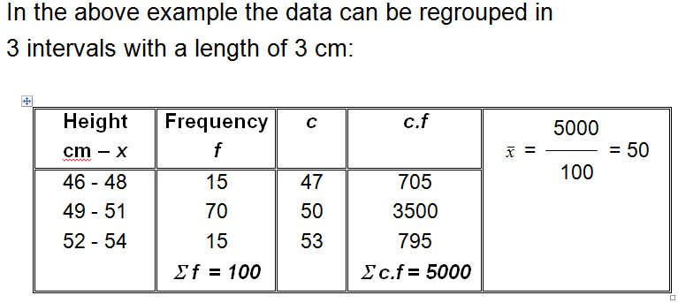

Slide 18
Characteristics of the mean 1. It is the most widely used measure of central tendency. It substitutes by one single number all the individual values of a given variable and describe its typical level in a data set.

Slide 19
2. For normal or roughly symmetric distributions the mean is the best measure of central tendency. 3. In skewed distributions, the mean can be misleading since it can be greatly influenced by scores in the tail. In such cases the median is more informative.

Slide 20
4. The mean can be affected by the presence of a small number of outliers (e.g. values that are different from the rest units) that can distort the mean. We can eliminate such extreme values and compute a new mean, which will be more typical. Such method is based on the criterion U - the ratio of the difference between the outlier and the mean and the standard deviation s. The computed criterion U is then compared with the table of critical values of u_{t} and if u≥u_{t}, the extreme value x_{i} is discarded as unusual. The mean is calculated without the discarded outlier.

Slide 21
5. The sum of the deviations of the scores in the distribution from the mean always is equal to zero because half of the distribution is above and half is below the mean.

Slide 22
6. If to each value of the frequency distribution the same number is added or subtracted, then the mean is increasing or decreasing by the same number.

Slide 23
7. The mean is not a “real” value and this makes the acceptance and interpretation of the data sometimes more difficult – e.g., a mean number of children in a sample might be 2.4, or an average number of limbs in a sample is 3.997.

Slide 24
Median The median (M_{e}) is the measure of central tendency which can be identified or determined by an inspection. It is a value that divides the array of observation in two equal part, e.g. it is the middle value.

Slide 25
The procedure to identify the median is to: 1. rearrange all observations from the smallest to the largest in an ordered series (all data values should be listed even though some values may repeat more than once);

Slide 26
2. Then we must determine whether the number of cases is odd or even; - when it is odd, the median is the value in the middle; - when it is even, the median is just a halfway of values of the two middle observations.

Slide 27
Characteristics of the median 1. The median is usually a realistic value, or measured in half-units (when the number of observations is even).

Slide 28
2. The median is more robust towards outliers (extreme scores). This makes the median a better measure than the mean for highly skewed distributions.

Slide 29
Example for outliers: 10 individuals who have been tested HIV positive reported the following number of sexual contacts in a 6-month period: 2 4 4 6 7 8 10 12 15 93 The mean value of 16.1 (Σx=161) is higher than that reported by 9 of the 10 individuals and yet far below that reported by the 10th individual. Such a mean in not, in any sense, typical or representative of any one in the study group. In a situation like this, the median value may well be more informative. Source: Thomas H. Hassard. Undetstandung biostatistics, Mosby Year Book, 1991, p.6

Slide 30
3. The median does not include all the individual values of a variable. So, it reflects only one value in odd number of cases or two values in even number of cases.

Slide 31
4. The median is preferred measure of central tendency when: - the lowest and highest values of a quantitative variable are far off of the rest values; - there is uncertainty in some values; - it is not possible to determine the exact shape of the distribution or when the distribution is highly skewed; - when the number of cases is small.

Slide 32
MODE The mode (M_{o}) is the observation in an array with the highest frequency of occurrence. Its meaning is obvious and it is determined by an inspection of a frequency distribution.

Slide 33
Although it is common for most distributions to contain exactly one mode (as in a normal distribution and large homogeneous samples), it is possible for more than one mode to exist. A distribution having one mode is called unimodal. A distribution having two modes is called bimodal.

Slide 34
CHARACTERISTICS OF THE MODE

Slide 35
1. The mode is a quick and easy method of determining the most popular score at a glance. 2. The mode is the only measure of central tendency that can be used with nominal data.

Slide 36
3. The mode is the weakest measure of central tendency as compared to the mean and median. This is true because, in some cases, the mode may be the lowest or the highest value in the distribution.

Slide 37
4. Many distributions have more than one mode and they are called multimodal. 5. The mode has a true meaning and this is very important in medicine and public health. For example, it is more important to determine which group has higher risk for some disease, e.g. to determine the mode in the age distribution instead of calculating the mean age of persons with the disease.

Slide 38
Comparison of measures of central tendency

Slide 39
The mean is the most stable. If repeated samples were drawn from a given population, the means would vary or fluctuate less than the modes or medians. Because of its stability, the mean is the most reliable estimate of the central tendency of the population.

Slide 40
The mean is the most widely used because it takes every score into account. The mean is the most efficient measure of central tendency for normal distributions and it is not appropriate for highly skewed distributions.

Slide 41
The median is useful because its meaning is clear and it is more efficient than the mean in highly-skewed distributions. However, it ignores many scores and is generally less efficient than the mean, the trimean, and trimmed means.

Slide 42
The mode can be informative but should almost never be used as the only measure of central tendency since it is highly susceptible to sampling fluctuations.

Slide 43
The level of measurement is very important to determine the appropriate index of central tendency: - the mode is appropriate for nominal scales; - the median is appropriate for ordinal scales; - the mean is appropriate for interval and ratio scales.

Slide 44
When a distribution is symmetric and unimodal, the mean, the median and the mode – coincide.

Slide 45
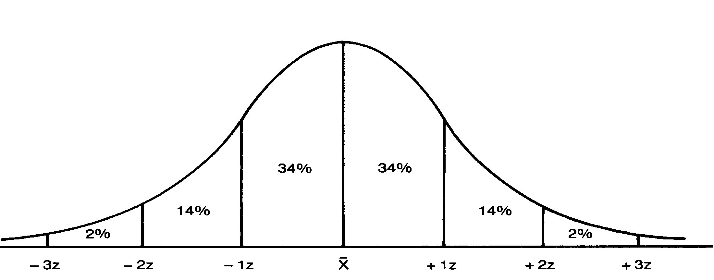

Slide 46
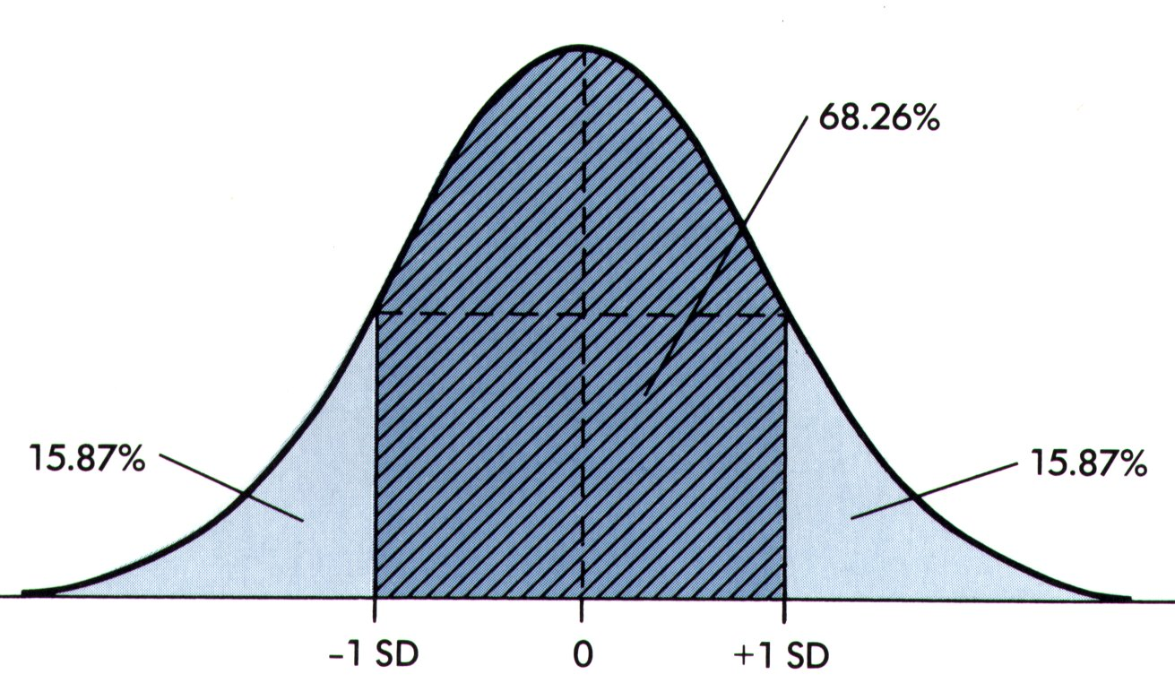

Slide 47
In skewed distributions, the values of the mode, median, and mean differ. The mean is always pulled in the direction of the long tail and it is higher than the median and mode. Thus, in positively skewed distributions mode<median<mean

Slide 48
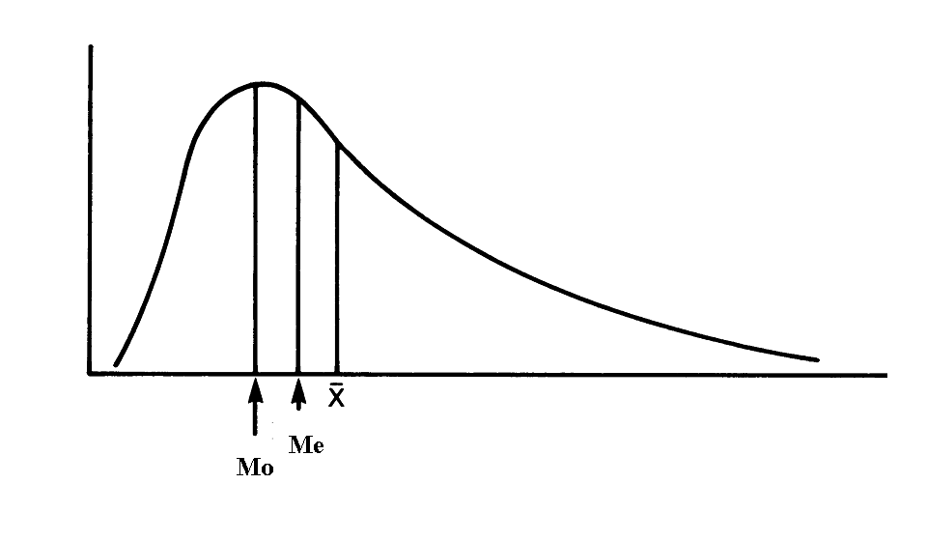

Slide 49
In negatively skewed distributions with most of the scores being high and with some scores spreading out towards the lower end of the distribution, e.g. the tail is directed to the left or negative side of the distribution the mean is lower than the median and mode – mean<median<mode

Slide 50
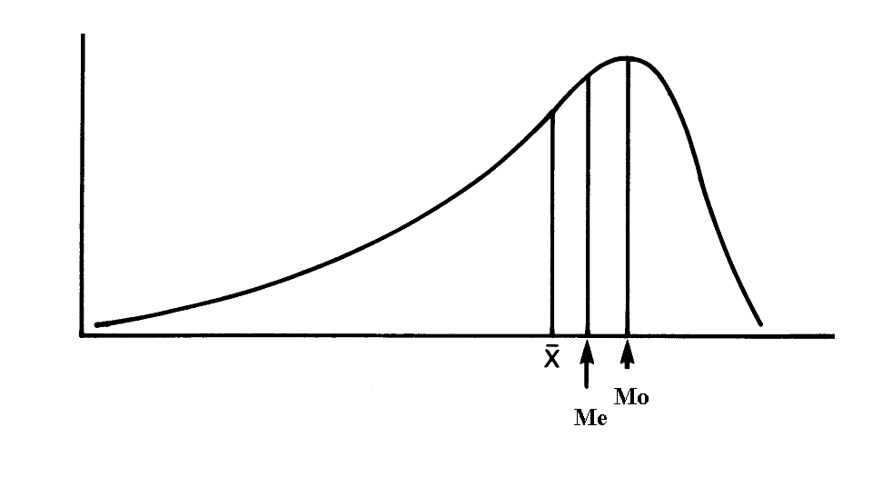

Slide 51
Part 3 MEASURES OF LOCATION: QUANTILES AND PERCENTILES

Slide 52
Quantiles (Q) Quantiles are special measures of location - points that divide the ordered series of data (from the lowest to the highest value) into subgroups of equal size. They mark the boundaries between consecutive subgroups in ordered series of data (an array).

Slide 53
Types of quantiles (Q) There are several types of quantiles: - terciles divide the distribution into three equal subgroups (called thirds); - quartiles - into 4 subgroups (quarters); - quintiles -into 5 subgroups (fifths); - deciles - into 10 subgroups (tenths); - centiles – into 100 parts (hundredths)

Slide 54
Quantile/s | Number of equal parts of a distribution | Number of quantiles of this type
Median | 2 | 1
Quartiles | 4 | 3
Deciles | 10 | 9
Percentiles | 100 | 99

Slide 55
Estimation of quantiles Quantiles are usually identified or determined. The procedure of identifying quantiles is as follows:

Slide 56
First, we need to rearrange all observations in an ordered series from the lowest to the highest value. Second, we must determine whether the number of cases is odd or even.

Slide 57
Example: Let’s have an observation on the age at first birth for a sample of 10 mothers: 1. Raw data on the array are as follows: 21, 23, 27, 30, 18, 23, 33, 23, 27, 28 2. Now let’s rearrange all observations according to the magnitude of a value of a variable we are observing in an ordered series of data from the lowest to the highest value: 18, 21, 23, 23, 25, 27, 27, 28, 30, 33 3. We need to determine if the number of cases is odd or even. In this example the number of cases is even.

Slide 58
4. We locate the central two observations (5th = 25 and 6th = 27) 18, 21, 23, 23, 25, 27, 27, 28, 30, 33 Afterwards we sum the values of these two units and divide the sum by 2. 25+27/2 = 26 So, the median is just a halfway of values of the two middle observations.

Slide 59
5. Then we can repeat exactly the same procedure in the lower half and in the upper half of the ordered series to locate the quantiles dividing the ordered series in four equal parts (quartiles). Numbers in green represent the other two quartiles, 18, 21, 23, 23, 25, 27, 27, 28, 30, 33

Slide 60
6. We can repeat the procedure until we divide the distribution in wanted number of equal parts.

Slide 61
Use of quantiles Quantiles are used in description of both - the central tendency and the dispersion of a distribution they are describing. Median (the quantile diving raw data in 2 equal parts) is used as a measure of central tendency in skewed distributions. Quartiles are used for quick estimation of the degree of dispersion in an array.

Slide 62
Quartiles - observations that divide the distribution into four equal parts. There are 3 quartiles - Q₁, Q₂ and Q₃. Example: If we have an array of 23 cases: the first quartile Q₁ is the 6th observation; Q₂ is the 12th observation, and Q₃ is equal to the 18th observation.

Slide 63
Percentiles Percentiles (also called centiles) - points that divide an array into 100 equal parts. There are 99 percentiles, denoted as Р₁, Р₂, ... Р₂₅,...Р₅₀,...., Р₇₅, ....Р₉₉.

Slide 64
Characteristics of percentiles 1. A percentile tells us the relative position of a given observation. 2. It allows us to compare scores on tests that have different means and standard deviations (e.g., the 10th percentile exceeds 10% and is exceeded by 90% of the observations, the 75th percentile exceeds 75% of the data, etc.)

Slide 65
Use of percentiles Percentiles are used to establish the reference limits of normality in clinical and other areas of investigation. The establishment of “normal ranges” of values for health data permits the selection of appropriate action in medical practice or allows for accurate estimate of many clinical and laboratory indicators.

Slide 66
For this purpose usually seven main percentiles are used: P₃, P₁₀, Р₂₅, Р₅₀, Р₇₅, Р₉₀ and Р₉₇ – to form the upper and lower limits of seven reference groups of population.

Slide 67
Percentiles have an advantage as compared to the other methods of determining “normal” values as they are applicable to any form of distribution (not only to normal distribution).

Slide 68
Comparison between different types of quantiles Р₂₅ corresponds to Q₁ Р₅₀ corresponds to Q₂ and to the median Р₇₅ is equal to Q₃ Taking into account that the median (M_{e}) is the second quartile (Q₂), then the median of the lower half of the data gives the first quartile (Q₁), and similarly, the median of the upper half of the data gives the third quartile (Q₃).

Slide 69
Important! I am asking very kindly the representatives from groups 7, 8, 10, 4 and 13 to come to me after the lecture.

Slide 70
Test examples

Slide 71
1. In case there are too many outliers in the data set, the most representative average value is
A. Mean
B. Mode
C. Median
2. Given a set of nominally scaled scores, the most appropriate measure of central tendency is the:
A. mean
B. mode
C. standard deviation
D. range

Slide 72
3. Which of the following statements is true?
A. The mode is the most useful measure of central tendency.
B. The variance is the square root of the standard deviation.
C. The median and the 50th percentile rank have different values.
D. The mean is more affected by extreme scores than the median.
4. Given the group of scores 1, 4, 4, 4, 7, it can be said of the mean, the median, and the mode that:
A. the mean is larger than either the median or the mode
B. all are the same
C. the median is larger than either the mean or the mode
D. all are different
E. the mode is larger than either the median or the mode

Slide 73
5. Inferential statistics are used to describe specific characteristics of the data.
A. True B. False
6. Select the statement which you believe to be true. The arithmetic mean of a set of values:
A. Is a useful summary measure of central tendency (of location) if the data are symmetrical.
B. Is always greater than the median
C. Cannot be calculated if the data set contains both positive and negative values.

Slide 74
7. Central tendency describes the ‘typical’ value of a set of scores.
A. True B. False
Example: A nurse recorded the number of analgesic preparations taken by patients in a surgical ward. The resulting data were: 5, 2, 8, 2, 3, 2, 4, 12.
Questions 8-11 refer to this data.
8. The mode for this distribution is:
A. 2
B. 3
C. 8
D. there is no mode
9. The median is:
A. 2.00
B. 3.50
C. 3.00
D. 3.25
10. The mean is:
A. 3.52
B. 5.43
C. 4.75
D. 4.15
11. The range is:
A. 9
B. 10
C. 12
D. 2

Slide 75
12. Descriptive statistics are used to describe specific characteristics of the data.
A. True B. False
13. With nominal data, the mean should be used as a measure of central tendency.
A. True B. False
14. The mode represents the most frequently occurring score in a distribution.
A. True B. False
15. With ordinal data we can use both the mode and the mean as a measure of central tendency.
A. True B. False

Slide 76
16. When the data are interval or ratio, we can use the mean as a measure of central tendency.
A. True B. False
17. If a continuous distribution is highly skewed, the median might be the appropriate measure of central tendency.
A. True B. False
18. When a frequency distribution is positively skewed, the mean is greater than the median or the mode.
A. True B. False
19. Given a normal distribution, the three measures of central tendency are equivalent.
A. True B. False

Slide 77
20. If we subtract the value of the mean from every score in a set of scores the sum of the remaining values will be:
A. impossible to determine
B. equal to the mean
C. a measure of the dispersion around the mean
D. zero
21. Given a normally distributed continuous variable the best measure of central tendency is the:
A. mode
B. median
C. mean
D. standard deviation

Slide 78
22. Select the statement which you believe to be true. The arithmetic mean of a set of values:
A. Cannot be calculated if the data set contains both positive and negative values.
B. Is always greater than the median.
C. Coincides with the median if the distribution of the data is symmetrical.
23. Select the statement which you believe to be true. The median:
A. Is a measure of the spread of the data.
B. Is greater than the arithmetic mean when the data are skewed to the left.
C. Can be distorted by outliers.

Slide 79
24. In case there are too many outliers in the data set, the most representative average value is A. Mean B. Mode C. Median 25. One way to measure the spread is to calculate the difference between the third and first quartile. This measure is called A. The interquartile range B. The mid quartile C. The differential quartile 26. Since mode is the most frequently occurring score, it can be determined directly from a frequency distribution or a histogram A. True B. False

Slide 80
27. The 50th percentile score and the median will always be the same value. A. True B. False 28. Twenty five percent (25%) of the scores fall between Q1 and the median. A. True B. False 29. When the data are interval or ratio, we can use the mean as a measure of central tendency. A. True B. False 30. With nominal data, the mean should be used as a measure of central tendency. A. True B. False

Slide 81
Answers 1-C 11-B 21-C 2-B 12-A 22-C 3-D 13-B 23-B 4-B 14-A 24-C 5-B 15-B 25-A 6-A 16-A 26-A 7-A 17-A 27-A 8-A 18-A 28-A 9-B 19-A 29-A 10-C 20-D 30-B

