Slide 1

DESCRIPTIVE STATISTICS FOR QUANTITATIVE DATA. MEASURES OF SPREAD
MEDICAL UNIVERSITY – PLEVEN
FACULTY OF PUBLIC HEALTH
Department of Public Health Sciences
Centre for distant learning
LECTURE No4
Assoc. Prof. Gena Grancharova, MD, PhD

Slide 2
Plan of the lecture
Part 1. MEASURES OF SPREAD
Part 2. THE CONCEPT OF NORMS AND NORMAL GROUPS’ LIMITS

Slide 3
Part 1
MEASURES OF SPREAD (DISPERSION, VARIABILITY)

Slide 4
Why we need measures of dispersion?
Measures of central tendency do not give a total picture of a distribution.

Slide 5
1. Two sets of data with identical means could be very different from one another.
2. Two distributions with the same means could be very different in shape - they could be skewed in opposite directions.
3. Even when two sets of data have equal means, medians, modes, and the same form of distribution, they could be different from one another.

Slide 6
Consider the following two sets of data:
Set №1: 18, 21, 23, 23, 25, 27, 27, 28, 30, 33
Set №2: 23, 23, 24, 25, 26, 26, 27, 27, 27, 27
The means for the two samples = 25.5
The medians = 26
The modes = 27
But the two sets are very different: the range for set №1 is 33 – 18 = 15 the range for set №2 is 27 – 23 = 4

Slide 7
So, the knowledge of summary measures, describing the central tendency in a sample or in a population is not enough without a measure of the extent of variability or spread of the measurements around these summary indices.

Slide 8
This means that no description of any health data by summary measures is complete without the measures of variability.

Slide 9
The most common measures of variability or spread include the following:
- the range
- the standard deviation
- the variance
- the inter- and semiquartile range
- the coefficient of variation.

Slide 10
Range
The range is simply the difference between the highest and the lowest values in an array of the variable in a given empiric distribution.

Slide 11
The range can be easily computed but a single outlier may have a large impact on the range.
Another disadvantage is that it ignores completely the variations in scores between the highest and the lowest values, as it takes into account just the two extreme values.

Slide 12
For these reasons, the range is used only as a gross descriptive index and is typically reported in conjunction with other measures of variability.

Slide 13
Standard deviation and variance
The standard deviation (denoted by SD or s for a sample and σ for a population) is the most commonly reported measure of variability, especially with interval or ratio data.

Slide 14
Standard deviation describes the degree of variation among the individual observations in the sample around the mean, and like the mean it considers every score in a given distribution.
For this reason, means and standard deviations are generally reported together in the text or in tables.

Slide 15
The calculation of SD includes the following steps:
1. Firstly, we calculate how much each individual varies from the mean by subtracting the mean from each individual value (x – x).

Slide 16
2. Secondly, we add the individual variations together.
∑(x – x).
To calculate the average deviation, the sum should be divided by the number of scores - ∑(x – x) n

Slide 17
Unfortunately, summing the differences of deviations will always lead us to zero.
The reason is that those individuals who have values larger than the mean will simply cancel out those that have values below the mean.

Slide 18
3. Third, to overcome this problem, we can square each difference and calculate the sum of squared deviations around the mean.
∑(x – x)²

Slide 19
4. Fourth, the sum of squares has to be related to the number of results under study.
So, to allow fair comparisons between studies of different sizes, we should take the study size into account by calculating an “average” variation, called variance – s².

Slide 20
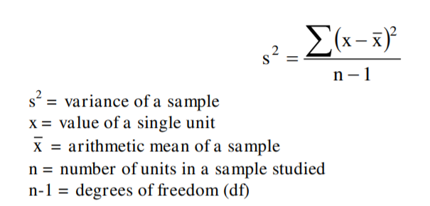
Calculation of variance

Slide 21
5. Fifth, the variance measures variation in squared units which is not convenient. To solve this problem, we take the square root of the variance and we finally come to the most meaningful and most widely used measure of variability - the standard deviation – s or SD.

Slide 22
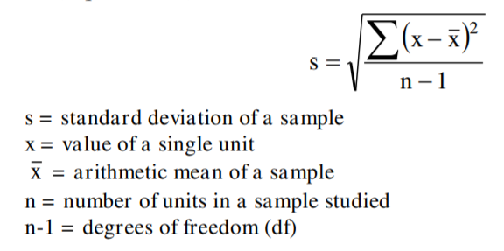
Calculation of standard deviation

Slide 23
In summary, the standard deviation is a useful index of variability and also can be used to interpret the score of the performance of an individual in relation to others in the sample. It is a stable estimate and is also used in more advanced statistical procedures.

Slide 24
The standard deviation is the preferred measure of distribution’s variability but it is appropriate only for variables measured on interval or ratio scale.

Slide 25
Interquartile range
The interquartile range (IQR) is the difference between the third (Q₃) and the first (Q₁) quartiles in a dataset (where quartiles are the values that divide the data into four equal sized parts).

Slide 26
Characteristics of IQR
1. Тhe advantage of the IQR over the range is that it is quite robust to outliers.
2. Тhe IQR is commonly quoted in conjunction with the sample median.

Slide 27
The semiquartile range
The semiquartile range (SQR), used as a term in many statistical texts instead of IQR, is half of the distance between Q₁ and Q₃.

Slide 28
Because these two measures of variability are based on middle cases rather than on extreme scores, they are considerably more stable than the range.

Slide 29
Coefficient of variation
The standard deviation s and the variance s² have the same measurement units as the mean and because of this they are not appropriate for comparing the relative variability of different distributions where the variables are measured in different units (height in cm, weight in kg, blood pressure in mm mercury, etc.).

Slide 30
This problem can be overcome by calculating another measure of variation called the coefficient of variation (denoted by C_{V}), also known as relative variability.

Slide 31
It expresses the sample standard deviation as a proportion or percentage of the mean value and can be calculated very easily by the following formula: s
C_{V} = ----------- x 100
X

Slide 32
The main advantage of the coefficient of variation is its independence of any unit of measurement, and thus, it is useful for comparison of variability in two or more distributions having variables expressed in different units.

Slide 33
For example, if we measure height and weight in a sample, it is not possible to say which variable varies greatly because these two variables have different measurement units. Using the coefficient of variation we can transform the standard variations in comparable units, expressed in percent.

Slide 34
Interpretation of C_{V}:
1. When the value of C_{V} is less than 10%, it means that the degree of variation is low and the sample is quite homogeneous.
2. In a situation when 10%< C_{V} <30% - the variation is moderate.
3. When C_{V} >30% the variation is considerable, and this is a clear evidence of heterogeneity of the sample or population under study.

Slide 35
SUMMARY
Measures of central tendency and variability are the two essential measures of location for describing and representing frequency distributions.

Slide 36
The mode and the median are used as measures of central tendency for discrete data, and the mean for continuous data.
The range, the variance, the standard deviation, the inter- and semiquartile range, and the coefficient of variation are measures of variability.

Slide 37
The mean and the standard deviation are the most appropriate for interval or ratio data when the distribution is normal or nearly normal.
The median and the inter- or semi-quartile range are used when the data was measured on an ordinal scale, or when interval or ratio data has a highly skewed distribution.

Slide 38
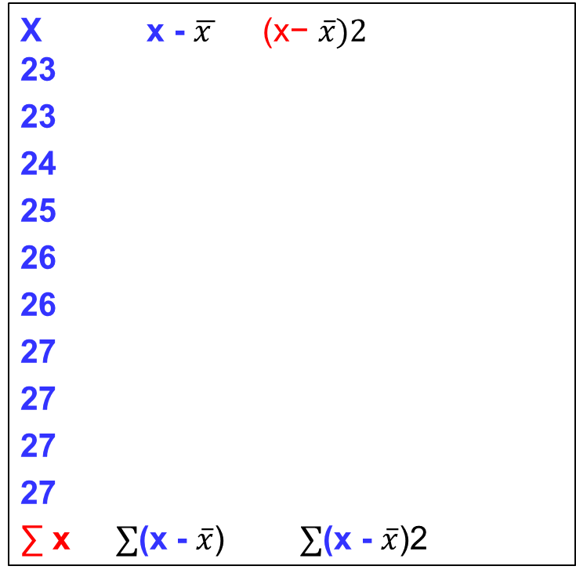
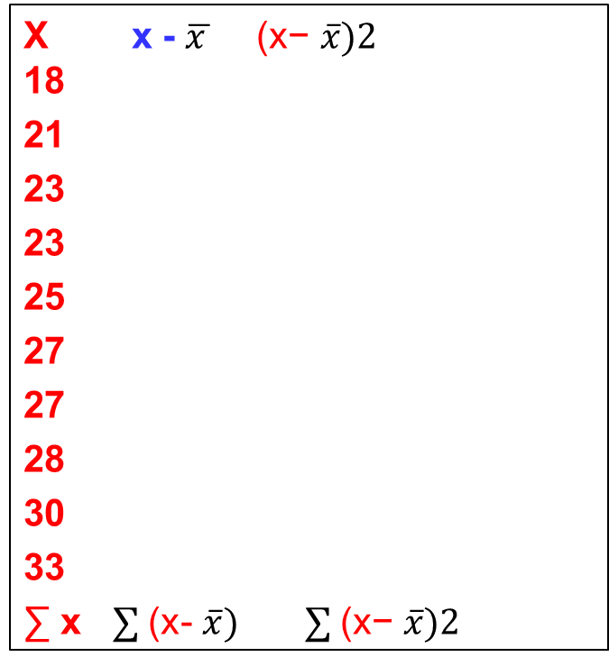
Practical assignment
Determine the measures of central tendency and spread
Data set 1
Data set 2
X x - $\overline{x } \text{(}\text{x}\text{−} \overline{x})2$
18
21
23
23
25
27
27
28
30
33
∑ x $∑$(x- $\overline{x}) ∑ \text{(}\text{x}\text{−} \overline{x})2$
X x - $\overline{x } \text{(}\text{x}\text{−} \overline{x})2$
23
23
24
25
26
26
27
27
27
27
∑ x $∑$(x - $\overline{x}$) $∑$(x - $\overline{x}$)2

Slide 39
Part 2.
THE CONCEPT OF NORMS AND NORMAL GROUPS’ LIMITS

Slide 40
Basic principle of a normal distribution
In a normal or nearly normal distribution there are fixed percentages of cases that fall within certain distances from the mean.

Slide 41
NORMAL DISTRIBUTION

Slide 42
Using this principle, we can easily create “normal limits” and interpret individual scores for clinical and laboratory tests.
Using the basic principle of normal distribution, we can determine the limits of different groups of normality.

Slide 43
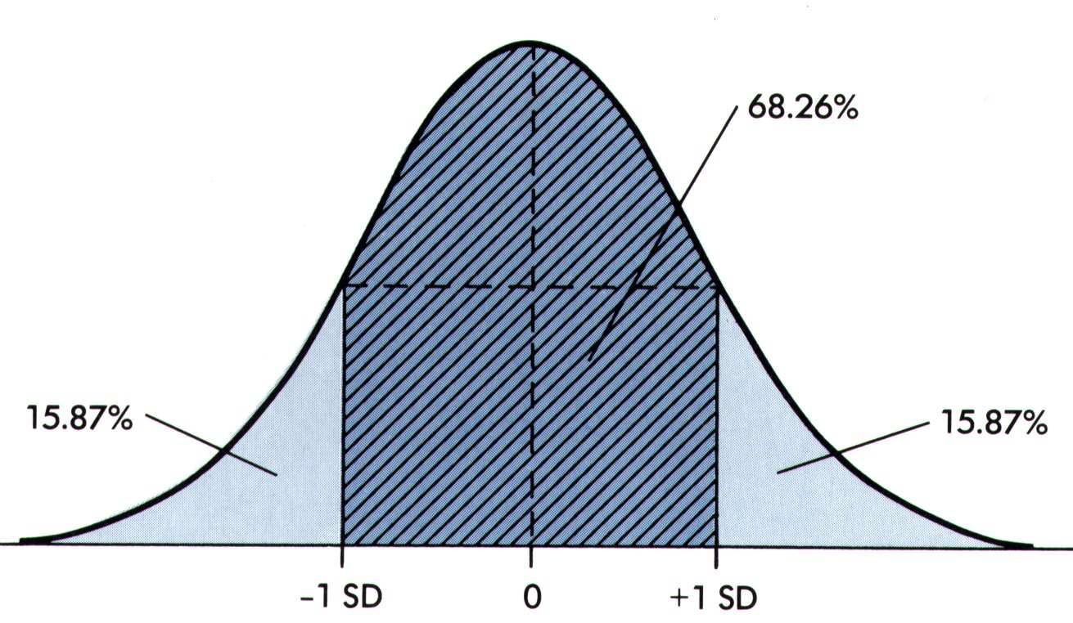

In case of three groups of normality:
normal, above the norm and below the norm
Mean $± 1 s (SD)$

Slide 44
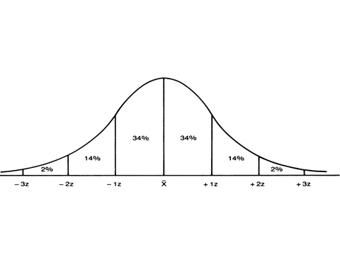
In case of five normative groups

Slide 45
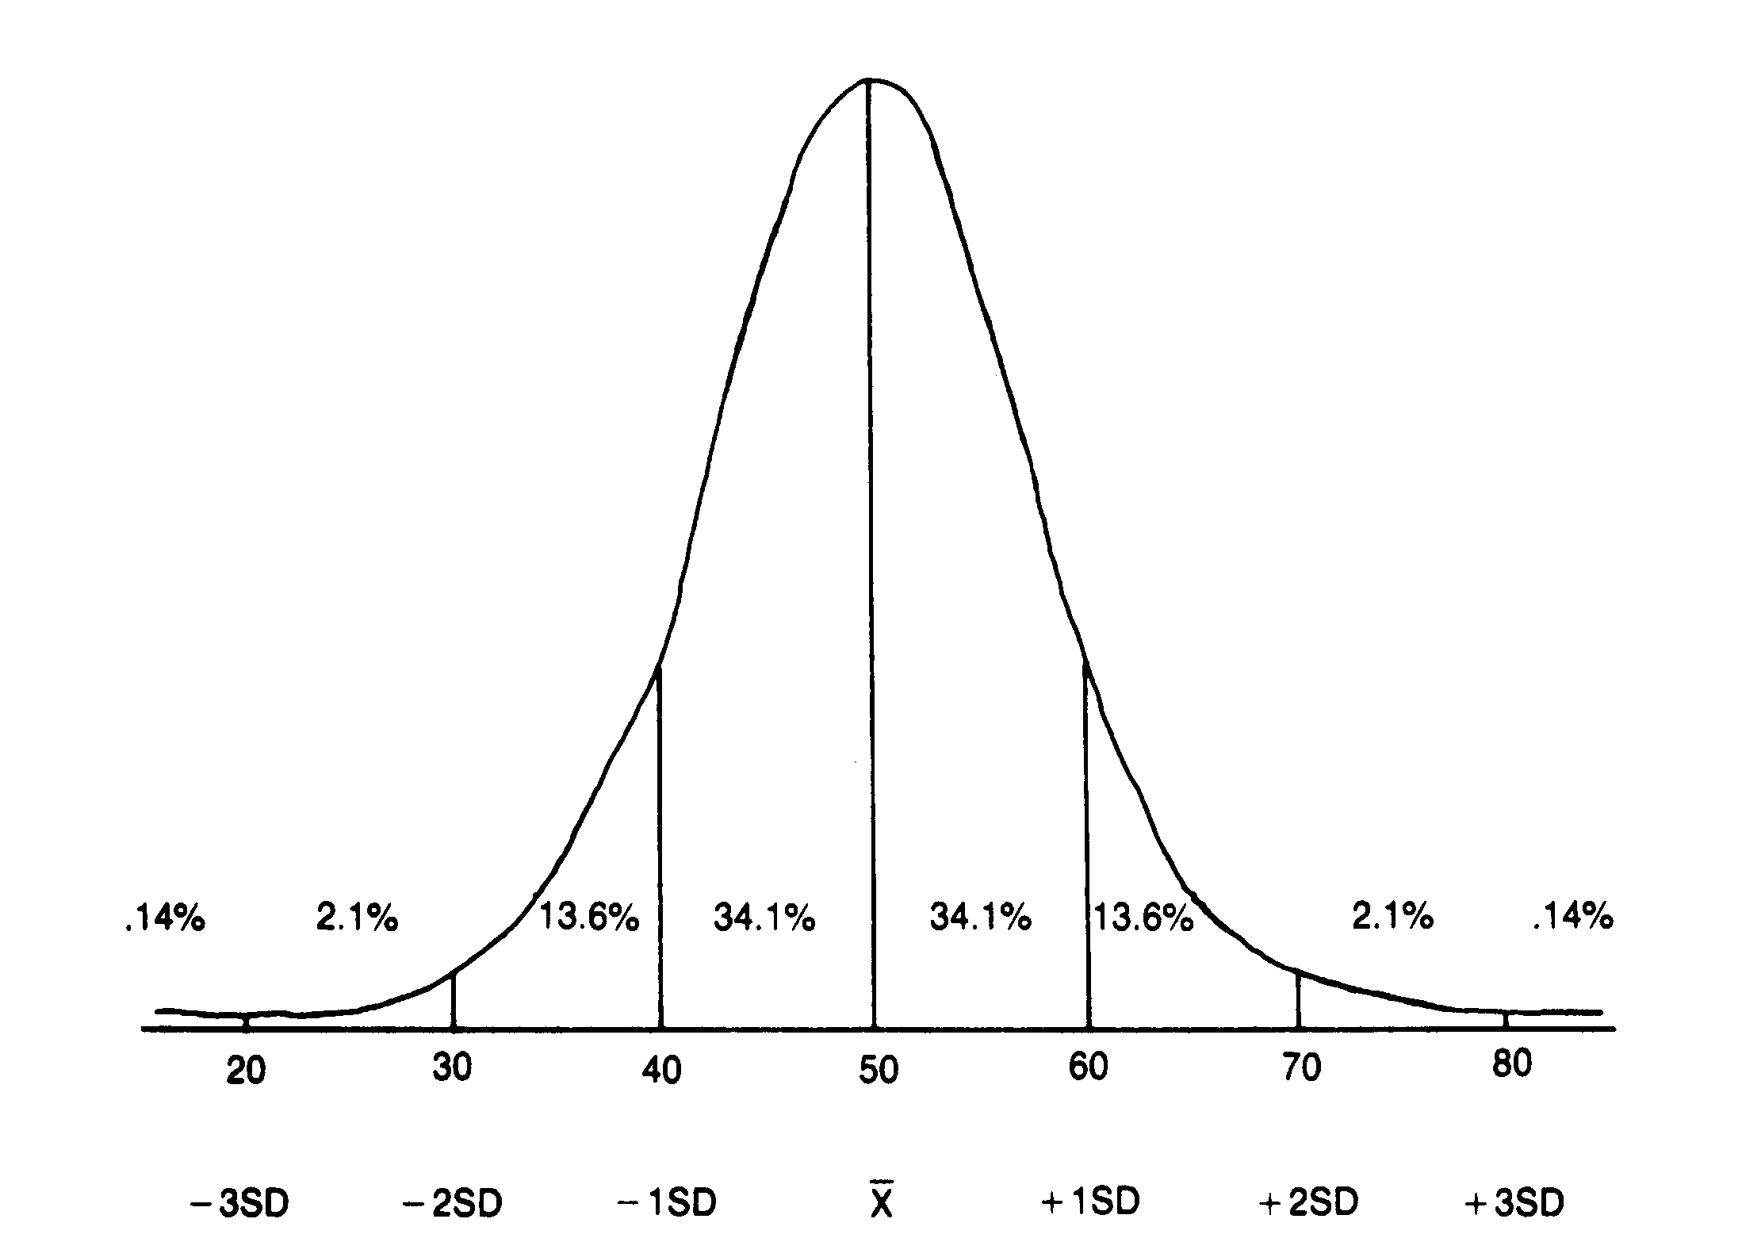
In case of seven normative groups
-0.5 SD
+0.5 SD

Slide 46
Practical assignment
Using the basic principles of the normal distribution, determine the limits of 7 normative groups for a variable “weight” for males based on a sample of 1000 males aged 60-69 years with a mean =80 kg and a standard deviation=8 kg

Slide 47
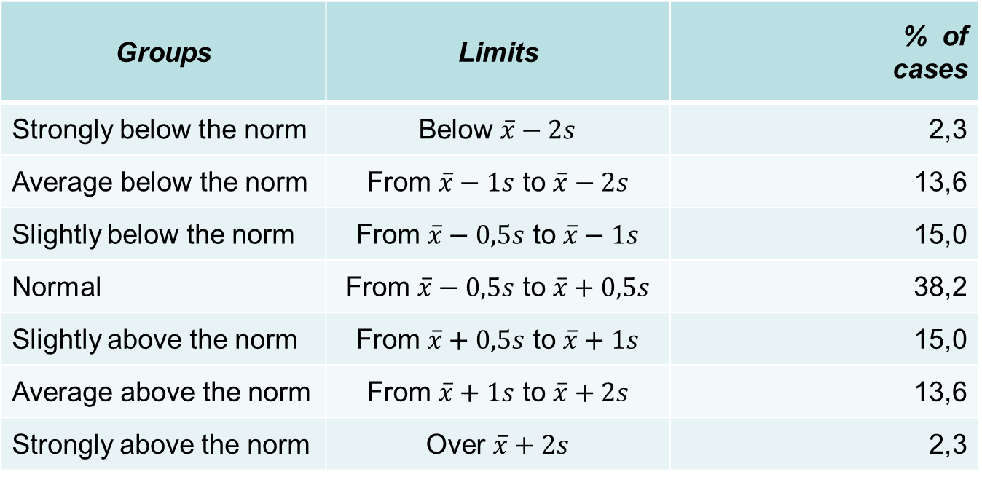
The Concept of “Norms” or “Normal Limits”
Groups | Limits | % of cases
Strongly below the norm | Below $\overline{x}−2s$ | 2,3
Average below the norm | From $\overline{x}−1s$ to $\overline{x}−2s$ | 13,6
Slightly below the norm | From $\overline{x}−0,5s$ to $\overline{x}−1s$ | 15,0
Normal | From $\overline{x}−0,5s$ to $\overline{x}+0,5s$ | 38,2
Slightly above the norm | From $\overline{x}+0,5s$ to $\overline{x}+1s$ | 15,0
Average above the norm | From $\overline{x}+1s$ to $\overline{x}+2s$ | 13,6
Strongly above the norm | Over $\overline{x}+2s$ | 2,3

Slide 48
In other words,
- 38,2% percent of all cases fall within 0.5 SD of the mean;
68,2% percent of all cases fall within 1 SD of the mean;
- 95% of the scores fall within 2 SDs from the mean (exactly 1.96 SD);
- only a handful of cases – about 2% at each extreme.

Slide 49
What can be done when the shape of a distribution is skewed to the left or right?
In such situations it is recommended to use percentiles to determine the limits of different groups of normality.

Slide 50
Percentiles
Percentiles (also called centiles) - points that divide an array into 100 equal parts. There are 99 percentiles, denoted as Р₁, Р₂, ... Р₂₅,...Р₅₀,...., Р₇₅, ....Р₉₉.

Slide 51
Characteristics of percentiles
1. A percentile tells us the relative position of a given observation.
2. It allows us to compare scores on tests that have different means and standard deviations (e.g., the 10th percentile exceeds 10% and is exceeded by 90% of the observations, the 75th percentile exceeds 75% of the data, etc.)

Slide 52
Use of percentiles
Percentiles are used to establish the reference limits of normality in clinical and other areas of investigation.
The establishment of “normal ranges” of values for health data permits the selection of appropriate action in medical practice or allows for accurate estimate of many clinical and laboratory indicators.

Slide 53
For this purpose usually seven main percentiles are used:
P₃, P₁₀, Р₂₅, Р₅₀, Р₇₅, Р₉₀ and Р₉₇ – to form the upper and lower limits of seven reference groups of population.

Slide 54
Percentiles have an advantage as compared to the other methods of determining “normal” values as they are applicable to any form of distribution (not only to normal distribution).

Slide 55
When the investigator prefers to use seven reference groups the limits of “normal” values are determined by Р₂₅ and Р₇₅ whereas Р₅₀ corresponds to the mean.

Slide 56
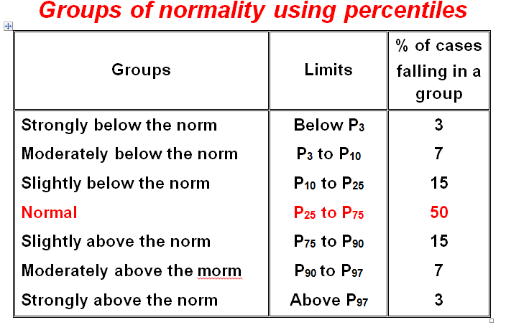

Slide 57
1. If a distribution is negatively skewed, then:
the median is greater than the mean
the mode is greater than the median
the mean is greater than the median
both A and B are true
none of the above are true
2. In a normal distribution, the mean, the median and the mode:
always have the same value
the mean has the higher value
the mean has the lower value
have no particular relationship
cannot take the same value

Slide 58
3. One way to measure the spread is to calculate the difference between the third and first quartile. This measure is called
The inter quartile range
The mid quartile
The differential quartile
4. A group of females aged 30-39 years has a mean weight of 60 kg and a standard deviation of s = 5 kg. What are the limits of a “norm’ in case of seven normative groups?
65 ÷ 70 kg
57.5 ÷ 62.5 kg
50 ÷ 70 kg

Slide 59
5. Select the statement which you believe to be true. The standard deviation:
A. Is a measure of central tendency (of location).
B. Is a measure of spread which is equal to the range.
C. Is unaffected by outliers.
D. Is an inappropriate measure of spread for skewed data.
6. The square root of the variance is called the standard deviation.
A. True B. False
7. Standard deviation indicates the extent to which scores are distributed about the mean.
A. True B. False
8. When a distribution consists of very different scores, standard deviation will be relatively large.
A. True B. False

Slide 60
9. Select the statement which you believe to be true. The standard deviation of a set of observations:
A. Is a measure of central tendency (of location).
B. Is the square root of the variance.
C. Is a measure of spread which is equal to the range.
D. Is unaffected by outliers.
10. Select the statement which you believe to be true. The standard deviation of a set of observations:
A. Is a measure of central tendency (of location).
B. Has the same units of measurement as the raw data.
C. Is a measure of spread which is equal to the range.
D. Is unaffected by outliers.

Slide 61
11. The smaller the variance the less spread of the data around the mean.
A. True B. False
12. Since mode is the most frequently occurring score, it can be determined directly from a frequency distribution or a histogram.
A, True B. False
13. The mean of the sample means is
A. A biased estimator of the population
B. An unbiased estimator of the population mean
C. Neither biased nor unbiased

Slide 62
14. Select all of the following statements which you believe to be true. The arithmetic mean of a set of values:
A. Is a particular type of average.
B. Is a useful summary measure of location if the data are skewed to the right.
C. Is always greater than the median.
15. Select all of the following statements which you believe to be true. The arithmetic mean of a set of values:
A. Cannot be calculated if the data set contains both positive and negative values.
B. Is always greater than the median.
C. Coincides with the median if the distribution of the data is symmetrical.

Slide 63
16. Select all of the following statements which you believe to be true. The median:
A. Is a measure of the spread of the data.
B. Is a useful summary measure when the data are skewed to the right.
C. Is greater than the arithmetic mean when the data are skewed to the right.
17. Select all of the following statements which you believe to be true.
A. The first percentile has 99% of the observations in the ordered set below it.
B. The first decile is equal to the 90th percentile and has 10% of the observations in the ordered set below it.
C. The median is equal to the 50th percentile.

Slide 64
18. Select all of the following statements which you believe to be true.
A. The median is equal to the 50th percentile.
B. The first percentile has 99% of the observations in the ordered set below it.
C. The first decile is equal to the 90th percentile and has 10% of the observations in the ordered set below it.
19. Select all of the following statements which you believe to be true.
A. The range is the difference between the 1st and 99th percentiles.
B. The interquartile range lies between the 1st and 3rd quartiles.
C. Quartiles divide the data set into 100 equally sized groups

Slide 65
20. The more dispersed, or spread out, a set of scores is:
A. The greater the difference between the mean and the median
B. The greater the value of the mode
C. The greater the standard deviation
D. The smaller the interquartile range
21. Select all of the following statements which you believe to be true. The standard deviation of a set of observations:
A. Is unaffected by outliers.
B. Has the same units of measurement as the mean.
C. Is a measure of spread which is equal to the range.
22. The range is calculated by adding the lowest score to the highest score in a distribution.
A. True B. False

Slide 66
23. Standard deviation indicates the extent to which scores are distributed around the mean.
A. True B. False
24. The mean must have a value equal to one of the scores in the distribution.
A. True B. False
25. When a distribution consists of very similar scores, standard deviation will be relatively low.
A. True B. False
26. The range is the simplest indicator of variability.
A. True B. False

Slide 67
27. Which of the following statements is true?
A. The mode is the most useful measure of central tendency.
B. The variance is the square root of the standard deviation.
C. The median and the 50th percentile rank have different values.
D. The mean is more affected by extreme scores than the median.
28. The mean height of a student group is 167 cm. Assuming that height is normally distributed this enables us to deduce that:
A. Approximately half of all students are taller than 167 cm B. Approximately half of all students are shorter than 167 cm
C. Both statements are true

Slide 68
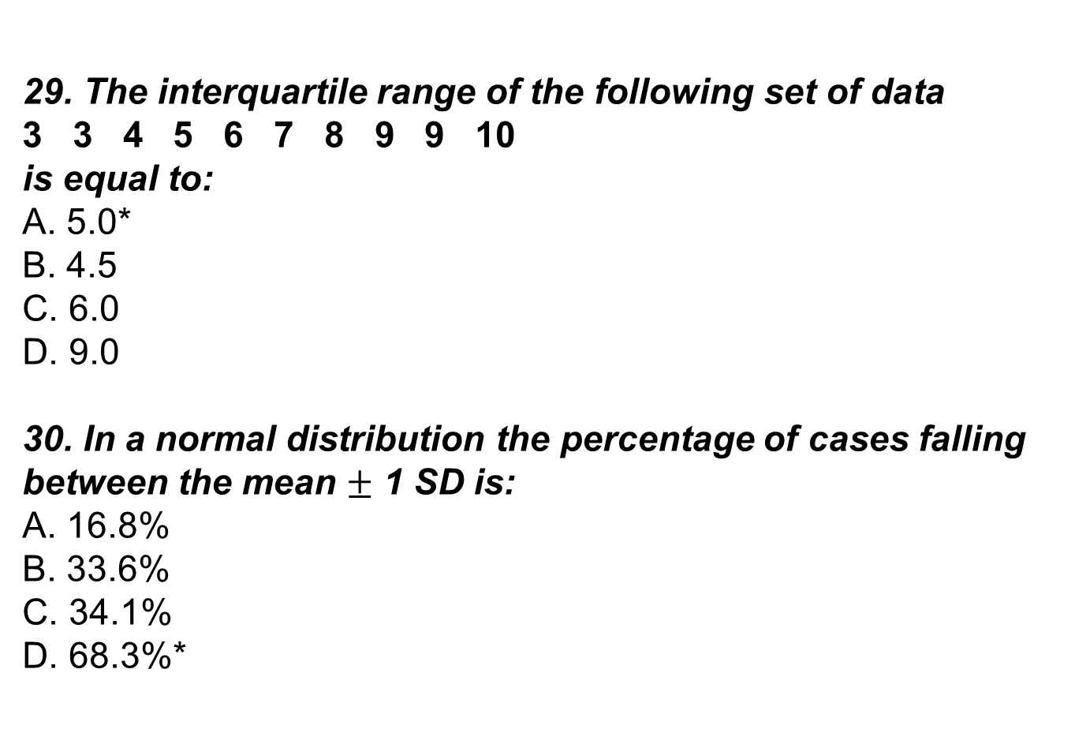
29. The interquartile range of the following set of data
3 3 4 5 6 7 8 9 9 10 is equal to:
A. 5.0*
B. 4.5
C. 6.0
D. 9.0
30. In a normal distribution the percentage of cases falling between the mean $±$ 1 SD is:
A. 16.8%
B. 33.6%
C. 34.1%
D. 68.3%*

Slide 69
Answers:
1-C 11-A 21-B 2-A 12-A 22-B
3-A 13-B 23-A
4-B 14-A 24-B
5-D 15-C 25-A
6-A 16-B 26-A
7-A 17-C 27-D
8-A 18-A 28-C
9-B 19-B 29-A
10-B 20-C 30-D

