Slide 1
INFERENTIAL STATISTICS. STATISTICAL ESTIMATION: FROM SAMPLE TO POPULATION
MEDICAL UNIVERSITY – PLEVEN
FACULTY OF PUBLIC HEALTH
Department of Public Health Sciences
Centre for distant learning
LECTURE No6
Assoc. Prof. Gena Grancharova, MD, PhD

Slide 2
INFERENTIAL STATISTICS
STATISTICAL ESTIMATION: FROM SAMPLE TO POPULATION

Slide 3
INFERENTIAL STATISTICS
WHY DO WE NEED TO STUDY SAMPLES?
- Limited time, limited financial and technological resources;
- Very often the population is not accessible and studying samples may be the only possible method to collect information.

Slide 4
INFERENTIAL STATISTICS
Statistical estimation - definition
Statistical estimation or generalization is a process of drawing conclusions for the population characteristics from the facts based on samples.

Slide 5
INFERENTIAL STATISTICS
Statistical estimation - definition
Statistical estimation is based on the results from studying relatively small samples as an indication for the levels of corresponding indicators in large populations.

Slide 6
STATISTICAL ESTIMATION
TWO TYPES OF ESTIMATION:
- POINT ESTIMATION
INTERVAL ESTIMATION

Slide 7
STATISTICAL ESTIMATION
The mean and the standard deviation for the sample are called estimation indicators or statistics for unknown parameters of the population.
 | Sample | Population
 | Known | Unknown
 | Statistics | Parameters
Mean | $$\overline{x}$$ | µ
Standard deviation | s | σ

Slide 8
POINT ESTIMATION
Point estimation is an estimation of a population parameter based on a value that is most probable to occur and such value is most commonly expressed by sample statistics (mean, proportions, etc.).

Slide 9
POINT ESTIMATION
Point estimation doesn’t take into account the representative error in the sample studies. Because of this, it cannot serve as a correct value of the population parameter and has no separate application.
It serves as a base for interval estimation.

Slide 10
INTERVAL ESTIMATION
Interval estimation is based on a number of values, concentrated around the point estimation that form an interval, in which at the accepted level of probability we can expect the true value of the population parameter to be situated.

Slide 11
BASIC CONCEPTS
Standard (sampling) error
Probability
Probability coefficient
Degree of freedom
Confidence interval

Slide 12
Sampling error
Inference from sample statistics to population parameters necessarily involve the possibility of sampling error.
Thus, sampling error represents the discrepancy between sample statistic and population parameter.

Slide 13
Sampling error
The most common is the standard error of the mean.
What does it mean?
If from the same population several samples are drawn and the mean for each sample is calculated, then the standard deviation of these means is called standard error of the mean.

Slide 14
Sampling error
The value of the standard error depends:
on the variability of individual measures in the sample and
on the sample size.
It is expressed by the formula:

Slide 15
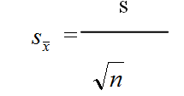
s
=
Sampling error

Slide 16
Probability
PROBABILITY is expressed as a proportion between 0 and 1, where 0 means an event is certain not to occur, and 1 means an event is certain to occur.
The probability of any event occurring is given by the formula:
$$p \left(A\right)= \frac{Number of occurrences of A}{Total number of possible occurrences}$$

Slide 17
Probability
Sometimes the probability can be calculated
a priori (before the event) by reasoning alone.
Example: If we buy a lottery ticket in a draw where there are 100 000 tickets, the probability of winning first prize if the lottery is fair (all tickets have an equal chance of being drawn by random selection) is:
$$p \left(1^{st} prize\right)= \frac{1}{100 000}=0.00001$$

Slide 18
Probability
How to calculate the probability of dying of a specific condition?
We need previously obtained empirical evidence, e.g. a posteriori (after the event).
For instance, if it is known that the percentages for causes of death are distributed in a particular way, then the probability of a particular cause of death for a given individual can be predicted.

Slide 19
Probability
Example: Causes of death for persons over 65 (hypothetical statistics for a community) are the following:
Cause of death Percentage of deaths
Coronary heart disease 50%
Cancer 25%
Stroke 10%
Accidents 5%
Infections 5%
Other causes 5%

Slide 20
Probability
Given the above data, we can calculate the probability of a selected individual of over 65 years of age dying of any of the specified causes.
For instance, the probability of a given individual dying of coronary heart disease is:
$$p \left(dying of heart disease\right)= \frac{50\%}{100\%}=0.5$$

Slide 21
Probability
We can use the normal curve model to determine the proportion or percentage of cases up to, or between, any specified scores.
For a normally distributed continuous variable, probability is defined as the proportion of the total area cut off by the specified scores under the normal curve.

Slide 22
Probability
Example: Let’s try to specify the frequency distribution of neonates' weight. Let’s assume that the distribution is approximately normal, with the mean ($\overline{x}$) of 3.5 kg and a standard deviation (s) of 0.6 kg. We are interested in the probability of a randomly selected neonate having a birth weight of 2.5 kg or under (borderline for low birth weight).

Slide 23
Probability
The area A under the curve corresponds to the probability of obtaining a score of 2.5 or under.
To calculate proportions or areas under the normal curve, we firstly need to translate the raw score of 2.5 into a z score.
$$z= \frac{x−\overline{x}}{s}= \frac{2.5−3.5}{0.6}=−1.67$$

Slide 24
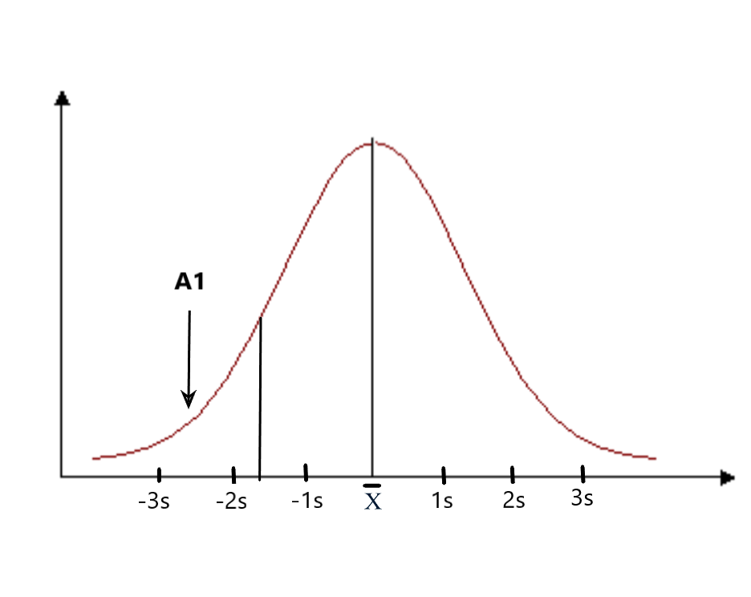
Probability
Fig. 1 Frequency distribution of neonate birth weights. Area A corresponds to z ≤ 1.67

Slide 25
Probability
Using the table of critical values for
z = - 1.67, we can find that area A is 0.4525. We can say that the probability of a neonate having a birth weight of 2.5 kg or less is
0.50 – 0.4525 = 0.0475
Another way of stating this outcome is that the chances are about 4.75 in a hundred (or 4.75%) for a child having such birth weight.

Slide 26
Probability
We can also use the normal curve model to calculate the probability of selecting scores between any given values of a normally distributed continuous variable.
For instance, if we are interested in the probability of birth weights being between 4 kg and 5 kg, this can be represented on the normal curve - Area A2.

Slide 27
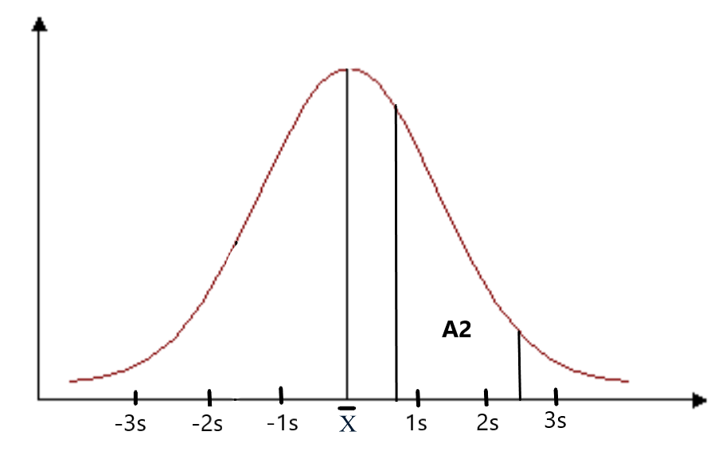
Probability
Fig. 2 Frequency distribution of neonate birth weights. Area A2 corresponds to probability of weight being between 4-5 kg

Slide 28
Probability
To determine this area, we calculate firstly z₁ and z₂ , corresponding to 4 kg and 5 kg.
$$z_{1}= \frac{x−\overline{x}}{s}= \frac{4−3.5}{0.6}=0.83$$
$$z_{2}= \frac{x−\overline{x}}{s}= \frac{5−3.5}{0.6}=2.5$$

Slide 29
Probability
Using the table for z, we determine that the area between $z_{1}$ and $\overline{x}$is 0.2967 and area between $z_{2}$ and $\overline{x}$ = 0.4938.
The required area A₂ = 0.4938 - 0.2967 = 0.1971
We can conclude that the probability of a randomly selected child having a birth weight between 4 kg and 5 kg is p = 0.1971. So, there is a chance of 19,71 in a hundred or about 20% that the birth weight will be between 4 kg and 5kg.

Slide 30
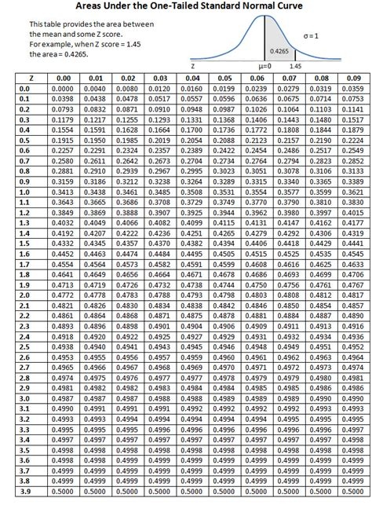
Percent of Total Area of Normal Curve Between a z-Score and the Mean

Slide 31
Probability
The above examples demonstrate that if the mean and standard deviation are known for a normally distributed continuous variable, then this information can be applied to calculating the probability of any set of events related to this distribution.

Slide 32
FROM SAMPLE TO POPULATION
It has been shown by mathematicians that if n>30 the sampling distribution can be considered an approximation of a normal distribution.
When n<30, instead of normal distribution, we can use the ‘t’ distribution, which takes into account the variability of the shape of sampling distribution due to low number of cases (n).

Slide 33
FROM SAMPLE TO POPULATION
The ‘t’ distributions are a family of curves, representing the sampling distributions drawn from a population when n is small (n<30).
A ‘family of curves’ means that the shape of t distribution varies with sample size. It has been found that the distribution is determined by the ‘degrees of freedom’ of the statistics.

Slide 35
FROM SAMPLE TO POPULATION
Characteristics of t-distribution:
1. The t-distribution is symmetrical about the mean.
2. The values of t along the x axis cut off specific areas under the curve, just as for z.
3. The t-distribution approaches a normal one as n becomes larger. When n>30, for the practical purposes the t and z distribution coincide.

Slide 36
PROBABILITY COEFFICIENT
The level of probability (in %) in a normal distribution corresponds to exact values of Student’s t. In large samples (more than 120 cases) the relation between the probability and t-value are as follows:
Value of t | Probability in %
0.5 | 38.2%
1.00 | 68.2%
1.64 | 90.0%
1.96 | 95.0%
2.58 | 99.0%
3.29 | 99.999%

Slide 37
DEGREE OF FREEDOM
The degrees of freedom (df) for a statistic represents the number of scores which are free to vary when calculating the statistic.
The degree of freedom is used to define the value of the probability coefficient when looking up to the table of critical values of t.
For the t-distribution, df is equal to n - 1
(the sample size, minus one).

Slide 38
CONFIDENCE INTERVAL
CONFIDENCE INTERVAL (CI) is a range of scores which includes the true population parameter at a specific level of probability.
The precise probability is decided by the researcher, and indicates how certain he or she can be that the population mean in actually within the calculated range.
Commonly CI in medicine uses the probability level of 95% (p=0.95) and 99% (p=0.99).

Slide 39
FROM SAMPLE TO POPULATION
Example: A researcher is interested in the systolic blood pressure (BP) levels of heavy smokers. She takes a random sample of 100 heavy smokers (who smoke more than 10 cigarettes per day) in her district, and finds that the mean BP=148 mmHg for the sample, with a standard deviation of s=10 mmHg.

Slide 40
FROM SAMPLE TO POPULATION
The researcher wants to generalize the data to the population of all heavy smokers. The mean for the sample is 148. But because of sampling error, 148 is not the exact population parameter (μ).
The researcher needs to calculate a confidence interval: a range of BP that will include the true population mean at a given level of probability.

Slide 41
FROM SAMPLE TO POPULATION
Example: n=100, BP=148 mmHg, s=10 mmHg.
What is the confidence interval (CI) for μ at the 95% probability level?
df=100-1=99
t-value from the table of critical values at 0.05 for df=99 is between 2.00 and 1.98. We can take 1.99
Then we can replace the data in the formula
$$μ= \overline{x}±t S_{\overline{x}}$$

Slide 42
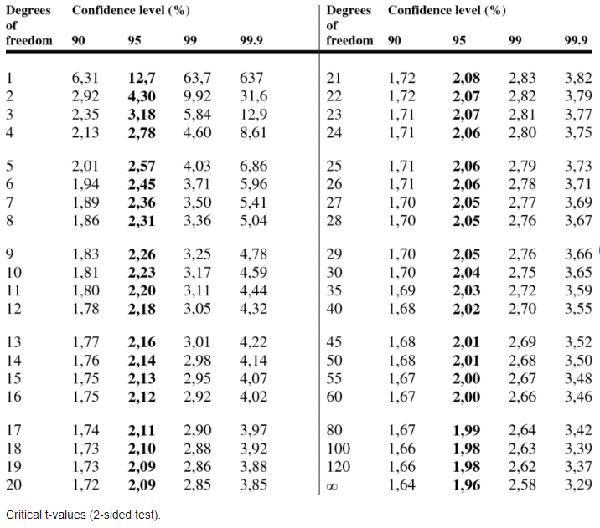

Slide 43
Level of significance for H0 in two-tailed test
 | P=0.1 | 0.05 | 0.02 | 0.01 | 0.005 | 0.002 | 0.001
Level of significance for H0 in one-tailed test
K (df)↓ | Р=0.05 | 0.025 | 0.01 | 0.005 | 0.0025 | 0.001 | 0.0005
3 | 2.353 | 3.182 | 4.541 | 5.841 | 7.453 | 10.214 | 12.924
4 | 2.132 | 2.776 | 3.747 | 4.604 | 5.498 | 7.173 | 8.610
5 | 2.015 | 2.571 | 3.365 | 4.032 | 4.773 | 5.893 | 6.869
6 | 1.943 | 2-447 | 3.143 | 3.707 | 4.317 | 5.208 | 5.959
7 | 1.895 | 2.365 | 2.998 | 3.499 | 4.029 | 4.785 | 5.408
8 | 1.860 | 2.306 | 2.896 | 3.355 | 3.833 | 4.501 | 5.041
9 | 1.833 | 2.262 | 2.821 | 3.250 | 3.690 | 4.297 | 4.781
10 | 1.812 | 2.228 | 2.764 | 3.169 | 3.581 | 4.144 | 4.587
15 | 1.753 | 2.131 | 2.602 | 2.947 | 3.286 | 3.733 | 4.073
20 | 1.725 | 2.086 | 2.528 | 2.845 | 3.153 | 3.552 | 3.850
25 | 1.708 | 2.060 | 2.485 | 2.787 | 3.078 | 3.450 | 3.725
30 | 1.697 | 2.042 | 2.457 | 2.750 | 3.030 | 3.385 | 3.646
40 | 1.684 | 2.021 | 2.423 | 2.704 | 2.971 | 3.307 | 3.551
60 | 1.671 | 2.000 | 2.390 | 2.660 | 2.915 | 3.232 | 3.460
120 | 1.658 | 1.980 | 2.358 | 2.617 | 2.860 | 3.160 | 3.373
∞ | 1.645 | 1.960 | 2.326 | 2.576 | 2.807 | 3.090 | 3.291

Slide 44
Basic steps in interval estimation
1. Calculate the standard error of the sample mean.
2. Choose the probability level.
3. Define the degrees of freedom.
4. Choose the value of the t - criterion from the table of critical values of t at the given degree of freedom and at the accepted level of probability.
5. Calculate the confidence interval CI.
6. Formulate a conclusion for the population parameters.

Slide 45
Estimation of rates and proportions
The steps are the same as for the mean. Only the symbols of sample statistics and population parameters are different:
 | Sample | Population
 | Known | Unknown
 | Statistics | Parameters
Rates/proportions | р | π
Standard deviation | s | σ

Slide 46
Test examples

Slide 47
1. A method of using samples to estimate population parameters is known as:
A. Statistical interference
B. Statistical inference
C. Statistical appliance
2. Probability values fall between 0 and 1.
A. True
B. False
3. Statistical inference involves the estimation of population parameters from sample statistics.
A. True
B. False

Slide 48
4. Using the sample mean as an estimate for the population mean is an example of statistical inference. A. True B. False 5. If a random selection method is used, sampling error will be zero. A. True B. False 6. The 95% confidence interval from a particular experiment is 72 ÷ 79. Therefore: A. The probability is 0.05 that population mean falls between72 ÷ 79. B. The probability is 0.95 that the interval 72 ÷ 79 contains the sample mean C. The probability is 0.95 that the interval 72 ÷ 79 contains the population mean

Slide 49
7. Compared to a 99% confidence interval, a 95% CI is: A. larger B. smaller C. more likely to contains the population mean D. less likely to contain the sample mean. 8. A random sample of 225 clients is selected, and their systolic blood pressures measured. The mean BP is 135 mmHg, with a standard deviation 10. What is the standard error of the mean? A. 2 B. 0.67 C. 2.5 9. A random sample of 225 clients is selected, and their systolic blood pressures measured. The mean BP is 135 mmHg, with a standard deviation of 10. In order to calculate the 99% confidence interval of the mean, what t score will be used? A. 2.326 B. 2.576 C. 2.807

Slide 50
10. A random sample of 225 clients is selected, and their systolic blood pressures measured. The mean BP is 135 mmHg, with a standard deviation of 10. What is the 99% confidence interval of the mean in this sample? A. 110.0 ÷ 135.0 B. 133.3 ÷ 136.7 C. 111.6 ÷ 118.4 D. 113.0 ÷ 117.0 11. A random sample of 625 University students is found to have a mean of IQ of 110, with a standard deviation of 10. What is the standard error of the mean for a sample of this size? A. 1 B. 2 C. 0.4 D. 2.5

Slide 51
12. A random sample of 625 University students is found to have a mean of IQ of 110, with a standard deviation of 10. In order to calculate the 99% confidence interval of the mean, what t score will be used? A. 1.645 B. 2.326 C. 2.576 D. 2.807 13. A random sample of 625 University students is found to have a mean of IQ of 110, with a standard deviation of 10. The standard error of the mean is 0.4. Between what two possible scores the true mean IQ for the students at the University lies at the level of probability 99%? A. 100.0 ÷ 120.0 B. 90.0 ÷ 130 C. 108.97 ÷ 111.03 D. 104.1 ÷ 115.9

Slide 52
14. Sampling error of the mean: A. occurs because of poor sampling techniques B. decreases as sample size increases C. is independent of the standard deviation D. is always equal to 1. 15. Which of the following statements is true: A. The standard error is computed solely from sample attributes. B. The standard error is equal to the standard deviation. C. The standard error is a measure of central tendency. 16. In a random sample of 900 men the mean weight is 70 kg and the standard deviation of the sample is 6 kg. What is a sampling error of the mean? A. 1.5 B. 0.2 C. 0.8

Slide 53
17. In a random sample of 900 men, the mean weight is 70 kg with a standard deviation 6 kg. In order to calculate the 95% confidence interval of the population mean, what t score will be used? A. 1.645 B. 2.326 C. 1.960 18. In a random sample of 900 men the mean weight is 70 kg and the standard deviation of the sample is 6 kg. The standard error of the mean is 0.2. What is the 95% confidence interval? A. 69.61 ÷ 70.39 B. 68.08 ÷ 71.39 C. 68.68 ÷ 72.39 19. Select the statement which you believe to be true. A. A sample statistic is a point estimate of a population parameter. B. For a given data set, the standard deviation is always greater than the standard error of the mean. C. Both statements are true

Slide 54
20. The standard error of the mean:
A. Provides a measure of the precision of the sample mean as an estimate of the population mean.
B. Can only be estimated if we take repeated samples from the population
C. Will increase in value as the sample size increases.
21. As sample size increases:
A. The sampling error decreases
B. the population become more accessible
C. the sample becomes more biased
22. Select the statement which you believe to be true.
A. A sample statistic is a point estimate of a population parameter.
B. Sampling error arises when we transcribe data incorrectly.
C. The inferential process involves drawing conclusions about the sample.

Slide 55
23. Select the statement which you believe to be true. A. For a given data set, the standard deviation is always greater than the standard error of the mean. B. The inferential process involves drawing conclusions about the sample. C. Random sampling implies a haphazard approach to the data analysis. 24. When we calculate the 95% confidence interval for the population mean: A. We are 95% certain that the sample mean lies within the interval. B. We are 95% certain that the true population mean lies within this interval. C. We are 95% certain that the sample mean equals the population mean.

Slide 56
25. When we calculate the 95% confidence interval for the population mean: A. We are 95% certain that the sample mean lies within the interval. B. We are 95% certain that the sample mean is equal to the population mean. C. There is a 5% chance that the population mean lies outside this interval 26. The bigger the sampling error the smaller the confidence interval. A. True B. False 27. Generally speaking, the higher level of confidence we have that an interval contains the population mean, the larger is that interval. A. True B. False

Slide 57
28. The bigger the sampling error the larger the confidence interval. A. True B. False 29. The higher level of confidence we choose that an interval contains the population mean, the smaller is that interval. A. True B. False 30. With the increase of the confidence level, the t-value for the same degrees of freedom: A. Increases B. Decreases C. Remains unchanged

Slide 58
Right answers
1 – B 2 – A 3 – A
4 – A 5 – B 6 – C
7 – B 8 – B 9 – B
10 – B 11 – C 12 – C
13 – C 14 – B 15 – A
16 – B 17 – C 18 – A
19 – C 20 – A 21 – A
22 – A 23 – A 24 – B
25 – C 26 – B 27 – A
28 – A 29 – B 30 – A

