Slide 1

Hypofunction and hyperfunction of the pituitary gland
MEDICAL UNIVERSITY - PLEVEN
FACULTY OF MEDICINE
CLINIC OF ENDOCRINOLOGY AND METABOLIC DISEASES
COURSE IN ENDOCRINOLOGY
Lecture #1
Lecturer
Assoc. Prof. Katya Todorova dm
Lecture course for virtual training of medical students from IV year
Academic year 2020-2021

Slide 2
Introduction to endocrinology
The endocrine system is involved in the regulation of all vital functions and the maintenance of metabolic’s homeostasis.
The endocrine glands, 7 in total, secrete hormones that are released in insignificant concentrations and enter the circulation directly.
Endocrine regulation is effected by a change in the concentration of hormones or in the number of corresponding cellular receptors.
Hormonal regulation is by including positive or negative feedback between the pituitary tropic hormone and its corresponding peripheral hormone or by increasing or decreasing the number of receptors.

Slide 3
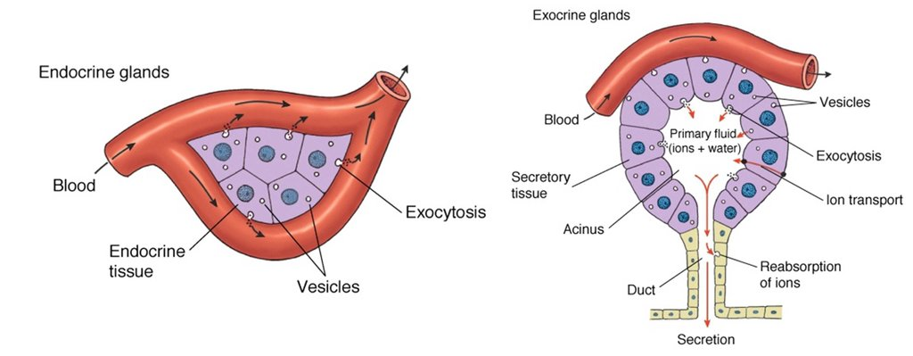
A. Endocrine glands are ductless
B. Hormones release directly into bloodstream https://www.slideshare.net/roger961/endocrine-system-outline-of-major-players

Slide 4
General physiological characteristics
Hormones are biochemically derived from amino acids, peptides or steroids.
They carry specific information and participate in intercellular signaling by acting as first mediators. But in addition, they induce the activity of intracellular information molecules so call second messengers.
Hormones regulate: physical development and growth, biological reproduction and biochemical metabolism of the body, energy metabolism and metabolism of the salts and water.
The physiological significance of the endocrine system is to maintain the body's adaptation to changing in environmental conditions.

Slide 5
Specificity of hormonal action
Each hormone has a specific activity and affinity.
It binds to the receptors on hormone-sensitive cells of the target organs. They are located of the cell membrane, in the cell cytosol and in the nucleus.
The hormone-receptor complex activates the first and the second mediators, which act as intracellular messengers of information and affect the permeability of cell membranes, hormone synthesis, the activity of various cellular enzymes and others.

Slide 6
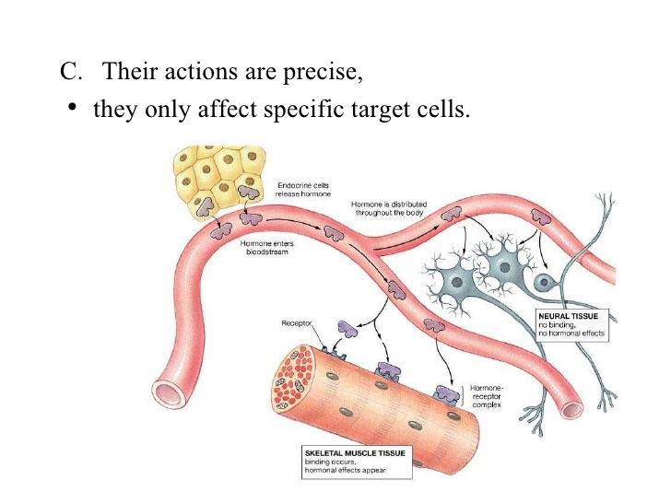
https://www.slideshare.net/roger961/endocrine-system-outline-of-major-players

Slide 7
Pituitary- hypothalamus system

Slide 8
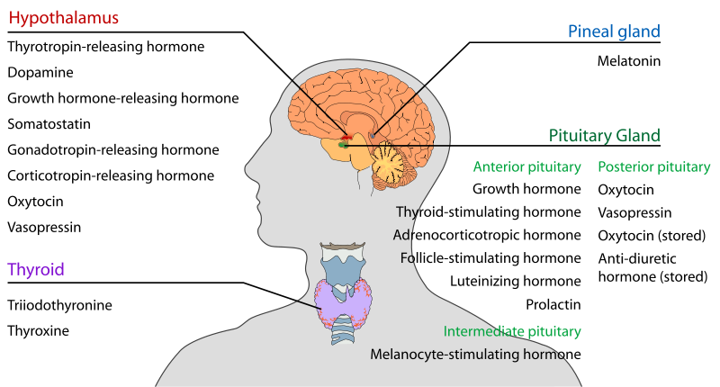
Pituitary- hypothalamus system
From Wikipedia
Notes:
Endocrine system is controlled by the hypothalamus of which are secreted the hormones :
CRH,
GnRH,
TRH,
GRH,
All of these hypothalamic hormones act on the pituitary gland.
Damage to the hypothalamus may impact any of these hormones and the related endocrine systems.
Hypothalamic disease therefore affects the functioning of the pituitary and the target organs controlled by the pituitary, including the thyroid and adrenal glands, ovaries and testes.

Slide 9
Hypothalamus system
The hypothalamus is the control center for several endocrine and neurological functions.
Damage to the hypothalamus may cause dysfunctions in:
body temperature regulation,
growth regulation,
weight regulation,
sodium and water balance,
milk production,
emotions,
sleep cycles

Slide 10
Symptoms of hypothalamic disorders
1.Neurologic symptoms,
2. Endocrine changes,
3. Metabolic abnormalities such as hyperthermia and hyperphagia.

Slide 11
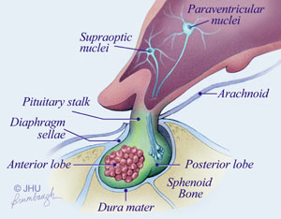
Hypothalamo-Pituitary Axis 'master' endocrine glands
Notes:
The size of a hypophyses and its weighing is 0.5 grams in humans. The pituitary gland is protected by a bony structure called the sella tucica, covered by a dural fold (diaphragma sellae).
The pituitary is functionally connected to the hypothalamus by the median emminence via a small tube called the infundibular stem (Pituitary stolk). The hypothalamic tropic factors are released to descend down the pituitary stalk to the pituitary gland where they stimulate the release of pituitary hormones
The pituitary gland secretes nine hormones that regulate homeostasis.

Slide 12
Functional physiology
The adenohypophysis is made up of endocrine cells that synthesize and secrete 6 hormones
It is functionally linked to the hypothalamus, which secretes peptides that regulate its function by stimulating or blocking the production of hormones by the anterior pituitary gland.

Slide 13
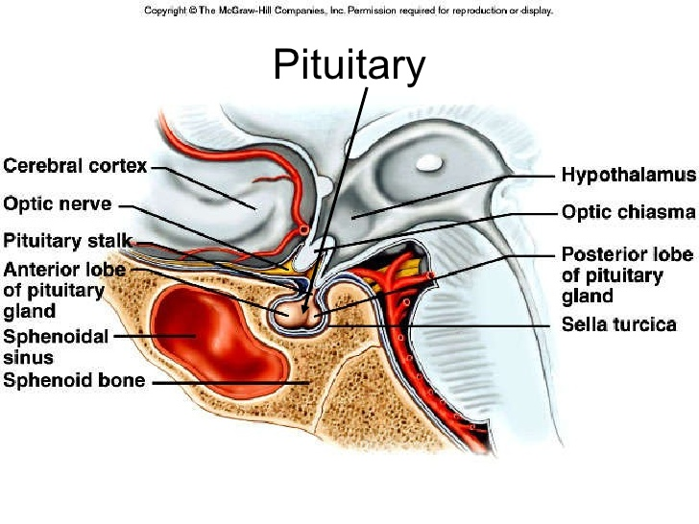
Anatomy of the pituitary gland https://www.slideshare.net/roger961/endocrine-system-outline-of-major-players

Slide 14
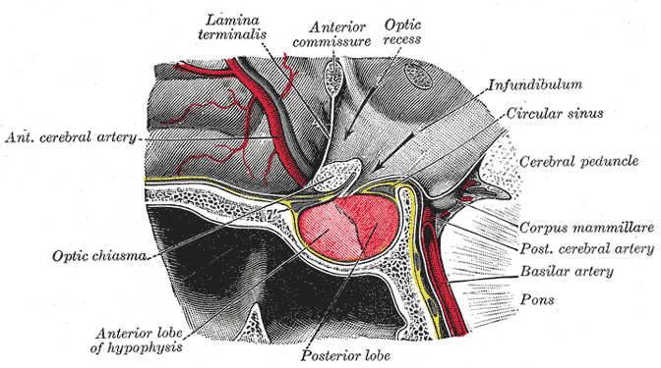
Vascularisation of the pituitary gland
From Wikipedia
Notes:
the anterior pituitary (or adenohypophysis) and
the posterior pituitary (or neurohypophysis), and
is functionally linked to the hypothalamus by the pituitary stalk, or simply the "infundibulum".
For instance, in fish, it is believed to control physiological color change.
In adult humans, it is just a thin layer of cells between the anterior and posterior pituitary. The intermediate lobe produces
Melanocyte stimulating hormone (MSH), although this function is often attributed to the anterior pituitary.
The pituitary gland is known as the 'master' endocrine gland, but both of the lobes are under the control of the hypothalamus;
The anterior pituitary receives its signals from the parvocellular neurons
The posterior pituitary receives its signals from magnocellular neurons.

Slide 15
Hormones of the adenohypophysis
Most adenohypophyseal hormones have a direct effect on other endocrine glands. They are called glandotropic (or tropic) hormones. These are:
Thyroid Stimulating Hormone (TSH);
Adrenocorticotropic hormone (ACTH);
Gonadotropic hormones - follicle-stimulating hormone (FSH) and luteinizing hormone (LH).
Two more hormones are secreted from the adenohypophysis, which do not have target glands on which to act directly, but they have a common effect and are therefore called effector. These are growth hormone (GH) or (somatotropic hormone,) and prolactin (PRL).

Slide 16
Biological regulation of glandotropic hormones
Thyroid-stimulating hormone (TSH) - by chemical structure is a glycoprotein. It stimulates the thyroid gland. The synthesis of TSH is regulated by the hypothalamus by releasing thyrotropin-stimulating hormone (TRH)and somatostatin, which blocks its production;
Adrenocorticotropic hormone (ACTH) - a peptide that stimulates the secretion of adrenal glucocorticoids and partially mineralocorticoids. The hypothalamus stimulates the secretion of ACTH by secreting corticotropin-releasing hormone;
Follicle-stimulating hormone (FSH) - by chemical structure is a glycoprotein. FSH stimulates the maturation of ovarian follicles and the secretion of estrogen in women, and in men it stimulates spermatogenesis.
Luteinizing hormone (LH) - a glycoprotein that stimulates the development of the corpus luteum, ovulation, progesterone production in women, and in men stimulates testosterone production.
FSH and LH are stimulated by hypothalamic gonadotropin-stimulating hormone.

Slide 17
Biologic Activity of Growth hormone
GH performs its action
1). by binding to specific cytokine receptors in cartilage, bone, muscle and liver, or
2). by producing specific mediators: insulin-like growth factors 1 and 2 (IGF-1 and IGF-2).
Growth hormone secretion is regulated by secretions from the hypothalamus - somatostatin and somatotropin-releasing hormone.

Slide 18
Biologic Activity of Prolactin
Prolactin is synthesized in lactotrophic cells, which make up about 15-20% of all cells in the adenohypophysis.
It acts on: the mammary glands, ovaries, and central nervous system. It stimulates the development of the mammary glands during pregnancy and stimulates milk secretion after birth.
Prolactin secretion is inhibited by dopamine and somatostatin.
Prolactin production is stimulated by prolactin-releasing hormone, thyrotropin-releasing hormone and oxytocin.

Slide 19
Diseases of the pituitary gland

Slide 20
І. Hypopituitarism
Definition:
Hypopituitarism is a condition of partial or complete insufficiency of hormonal secretion from the anterior pituitary gland.
Frequency:
In Bulgaria, between 200-300 people get sick every year.
The incidence in Europe is between 300-500 per 1,000,000 population, with 20-30 people getting sick each year.

Slide 21
Etiology
Idiopathic or congenital hypopituitarism in children (gene mutations: POUF-1 or PROP-1 causing hyposomatotropism),
Traumatic or post-surgical tissue damage due to pituitary adenomectomies,
Post-stroke destruction after radiotherapy of brain tumors or inoperable pituitary adenomas,
Destruction from tumors and metastases, incl. apoplexy in pituitary adenoma
Infiltrative injuries
Autoimmune and inflammatory processes
Acute hemorrhage during childbirth

Slide 22
Clinical significance of timely diagnosis
Early detection of pituitary hormone deficiency is vital to prevent life-threatening conditions, especially an adrenal crisis.
Patients with hypopituitarism have high cardiovascular morbidity and mortality, despite timely initiation of conventional hormone replacement therapy.
Many of them have a poor quality of life, invariably due to the applied therapy.

Slide 23
Clinical picture of hypopituitarism
Sequence of pituitary hormone loss: GH, FSH, LH, TSH, ACTH and PRL.
ADH failure is a manifestation of severe damage or lesions involving the hypothalamus and / or infundibulum
GH deficiency
Fine facial wrinkles, thin skin, decreased muscle mass, increased visceral adipose tissue, insulin resistance. Osteoporosis. Reduced bone remodeling activity. Hyper- and dyslipidemia, predisposition to atherosclerosis. Increased cardiovascular mortality.

Slide 24
Clinical picture of hypopituitarism
Deficiency of LH and FSH.
Clinic of hypogonadotropic hypogonadism
Men - Decreased muscle mass, decreased bone mineral density, loss of libido, erectile dysfunction, oligospermia, decreased erythropoiesis, visceral obesity and early atherosclerosis.
Women - Breast atrophy, reduced pubic hair, predisposition to osteoporosis, oligo / amenorrhea and infertility.

Slide 25
Clinical picture of hypopituitarism
TSH deficiency - a clinic of hypothyroidism .
Intolerance to cold, fatigue, muscle pain, adipose tissue deposition in the hips and thighs, myxedematous swelling of the soft tissues in the face and around the eyes, rough, pale, dry and flaky skin,
delayed reflexes,
decreased memory, concentration, depression, constipation, heart failure, etc.
Hyponatremia, normochromic, normocytic anemia, pericardial effusion.

Slide 26
Clinical picture of hypopituitarism
ACTH deficiency.
The clinic is determined by the deficiency of cortisol and adrenal androgens
Fatigue, weakness, headache, anorexia, weight loss, nausea, vomiting, abdominal pain, myalgia, decreased concentration.
Hypoglycemia, hyponatremia, decreased renal clearance of free water.
Reduced hair in women.
Important! In contrast to primary hypocorticism, these patients did not have melanodermia and no hyperkalaemia .

Slide 27
Basic research of pituitary hormones
Adrenocortical axis :
ACTH and serum cortisol (at 6.00 and 22.00).
Thyroid axis :
TSH, free fractions of T4 and T3,
Gonadal axis :
men - LH, FSH and testosterone (9.00 am);
women - LH, FSH, estradiol 1-5 days in menstruation) and progesterone (21 days in menstruation)
Prolactin

Slide 28
Dynamic hormonal diagnostics
Diagnosis of hyposomatotropism:
Measurment of GH, and conducting a stimulation test with insulin hypoglycemia (gold standard).
Diagnosis of hypogonadism:
Examination of LH, FSH, T, E2 and LH-RH test,
Diagnosis of hypothyroidism:
Measurment of TSH and FT4,
Diagnosis of hypocorticism:
Measurment of ACTH and cortisol.
Cortisol levels below 100 nmol / L. are evidence of hypocorticism, between 100 and 500 nmol / l. require a Synacthenic test.

Slide 29
Interpretation of hormonal tests
Adrenal axis : Low ACTH and low serum cortisol levels at 6.00 and 22.00.
Thyroid axis : Low TSH and low / normal FT4. Sometimes low peripheral hormones are accompanied by normal levels of TSH, which indicates the secretion of biologically inactive TSH.
Gonadal axis : men - Low levels of LH, FSH and testosterone; women - Low levels of LH, FSH, estradiol and progesterone.
Low GH: IGF-1 lower than the lower limit
Insulin test (0.1U / Kg) STH <5.1 ng / ml
Glucagon stimulation test (1mg) STH <3 ng / ml
Low prolactin
Measure of plasma and urinary osmolality and clearance of free water

Slide 30
Treatment of hypopituitarism
Treatment of the leading cause
Hormone replacement therapy
        Aim of treatment:
Achieving normal hormone levels
Restoration of normal physiology and metabolism
Restoration of the quality of life through education of the sick
CV risk prevention

Slide 31
Treatment of hypocorticism
Replacement therapy with corticosteroids alone is performed. No replacement with mineralocorticoids is required.
Hydrocortisone - 20 mg. or 30 mg.d. three times a day (10 + 5 + 5 mg).
Prednisone twice daily, between 5 and 7.5 mg / day.
Effect of the treatment - The monitoring of the therapy is based on the clinic due to the lack of an objective laboratory indicator.
Measurement of 24 hours of urinary free cortisol - a marker for overdose
Often there are overdoses and side effects - osteoporosis, obesity, impaired glucose tolerance.
During mild illness, it is recommended to increase the oral dose 2-3 times. In case of serious diseases / traumas, operations / intravenous applications of hydrocortisone 100-150 mg / d or methylprednisolone are used: 80-120 mg. days
It is mandatory for patients to constantly wear a bracelet that indicates their disease, so that in an emergency they can be given a corticosteroid !!!

Slide 32
Treatment of hypothyroidism
Before initiating thyroid substitution with L-thyroxine, cortisol deficiency should be ruled out so as not to provoke an Addison's crisis due to accelerated cortisol clearance. Prednisolone or hydrocortisone therapy should precede L-thyroxine.
Daily dose of L-thyroxin : in young people 100 µcg , in adults - initially by 25 µcg and gradually increasing the dose to the required.
Therapy control : Measurement of fT4 - a marker for adequate dose. To be kept within the upper limit of the norm.
In case of thyroid hormone overdose, an adverse effect on CCC (atrial fibrillation) and bone density (especially against the background of other preconditions such as hypogonadism and growth hormone deficiency) is possible.

Slide 33
Treatment of hypogonadism
Women over 40 - standard hormone replacement therapy with a combination of synthetic estrogens and progesterone, after 50 - transdermal gels are preferred. In case of ACTH deficiency - addition of androgens.
Women under 40. If desired for fertility - recombinant forms of FSH and LH. In hypothalamic lesion - pulsating therapy with LH-RH.
Men - Testosterone enanthate 250 mg intramuscularly for 3 weeks. Oral testosterone undecanoate - 2-3 times a day. Partial hypogonadism. Testosterone - pellets (400-600 mg) sc up to 6 months, with mandatory testing of prostate-specific antigen.

Slide 34
Treatment of hyposomatotropism
GH deficiency - only patients with severe biochemically proven GH deficiency who undergo replacement therapy with synthetic hormones covering the deficiency of other pituitary hormones and who have a severe impairment of quality of life are eligible for treatment.
The goal of treatment is to normalize IGF-1 levels for a given age.
Initial dose of GH - 0.2-0.3 mg sc in the evening.
Effect control every 4-6 weeks (IGF-1)

Slide 35
Hypopituitary crisis
Reasons:
In patients with acute acute hypopituitarism: infection, stress, trauma or surgery,
In previously healthy patients: acute pituitary stroke, haemorrhage, trauma, surgery or postpartum necrosis (Simmonds-Sheehan syndrome)

Slide 36
Clinical picture
Symptoms range from life-threatening hemorrhagic infarction to chronic hypotension and hypovolemia, followed by cardiovascular collapse.
ACTH deficiency: hypoglycaemia, hyponatraemia, hypotension,
TSH deficiency: confusion and coma, hypothermia, bradycardia, hyponatremia, edema and lethargy
Gonadotrophin deficiency: decreased muscle mass and muscle strength, hair loss, decreased libido,
GH deficiency: decreased muscle mass, lethargy
Prolactin deficiency - cessation of lactation

Slide 37
Treatment of hypopituitary coma
ACTH replacement
Hydrocortisone 50-100 mg iv
Methylprednisolone- 120 mg iv, divided into two injections in the morning and evening
TSH replacement
Levothyroxine 1.6 mg / kg days.
LH / FSH replacement
Testosterone (Male) Transdermal Patches or Test. Cypionate 200 mg every 2 weeks, i.m. injections
Estrogen (women) in various forms
Replacement with GH - no urgent indications
For chronic use: synthetic analogue of GH at a dose of 0.05 mg / kg / day

Slide 38
Insipidus diabetes
Definition: diabetes insipidus is a chronic disease that occurs with polyuria and polydipsia due to inability to concentrate urine from the kidneys.
It is due to decreased or absent secretion of vasopressin, also called antidiuretic hormone (ADH) or reduced sensitivity of the renal tubules to its action.

Slide 39
Classification
І. Central diabetes insipidus (vasopressin sensitive).
It is due to decreased or absent secretion of vasopressin, also called ADH
1. Primary:
idiopathic
autoimmune
hereditary (inherited autosomal dominantly)
2. Secondary (symptomatic) due to pituitary tumors or other tumors (germinoma), or metastases. Combines with hypopituitarism.

Slide 40
Classification
ІІ. Nephrogenic insipid diabetes mellitus (vasopressin-resistant) due to insensitivity of ADH receptors in the distal renal tubules.
1. Congenital - transmitted by the X chromosome or by autosomal recessive pathway.
2. Acquired - in kidney diseases with damage to the tubules (pyelonephritis, renal polycystosis, hypercalcemia, hypokalemia, etc.)

Slide 41
Classification
III. Primary polydipsia is due to suppressed ADH secretion due to excessive water intake. Divided into:
Dipsogenic Insipid Diabetes (ID)
Psychogenic ID
IV.Gestational ID, occurs due to accelerated degradation of vasopressin by the enzyme vasopresinase secreted by the placenta, which causes a partial deficiency of ADH during pregnancy

Slide 42
Physiological regulation
ADH is secreted in the hypothalamic nuclei and stored in the neurohypophysis
ADH increases the reabsorption of water from the primary urine into the distal renal tubules. About 20 liters of primary urine is formed around the clock.
As a result of the action of ADH there is a concentration of urine and excretion of about 1.5 liters of final urine / 24 h.
ADH secretion depends on plasma osmolarity. (Norm from 280 to 295 mosm / l.)
At plasma osmolarity below 280 mosm / l ADH secretion stops and urine is not concentrated
When plasma osmolarity increases above 295 mosm / l, ADH secretion increases and urine is concentrated

Slide 43
Physiological regulation
ADH increases water permeability in the collecting and distal tubules.
It acts on proteins called aquapurins and in particular on aquapurine 2 as follows: ADH binds to the V2 G-protein-binding receptor in the distal collecting ducts, raising the level of c AMP, which binds to protein kinase A, stimulates the translocation of aquapurin 2 the tubules from the cytoplasm of the distal and collecting tubules to the apical part of the membrane.
These transcribed channels allow water to pass through the cells of the collecting channels.
Thus, by increasing the permeability, the reabsorption of water into the bloodstream is facilitated, and thus the urine is concentrated.

Slide 44
Pathophysiology
In case of ADH deficiency or vasopressin receptor defect, water reabsorption does not occur. A large amount of low relative weight urine is excreted. Dehydration of the body occurs, followed by thirst and intake of large amounts of water.
There are three different types of vasopressin receptors:
V1a. Signal pathway : G associated with Phosphatidyl-inositol / calcium; Localization : main muscles, thrombocytes, liver, myometrium; Function : vasoconstriction, tr. aggregation, glycogenolysis
V1c. Signal pathway : G associated with Phosphatidylinositol / calcium; Localization: adenohypophysis; Function : production of ACTH, prolakin and endorphins
V2. Signal pathway : adenylate cyclase / cAMP; Localization : basolateral membrane of the collecting ducts, vascular endothelium and vascular smooth muscle; Function : Capture of aquapurine (ACP) -2 water collection channels on the apical membrane, induction of ACP - 2 synthesis, release of f. of Willebrand and F.VІІІ, vasodilation

Slide 45
Clinical picture
1. Polyuria - excretion of a large amount of urine between 4 and 20 liters / 24H. Urine is light, with low relative weight (from 1001 to 1005). Plasma osmolarity rises above 285 mosm / l and urine osmolarity falls below 200 mosm / l.
2. Polydipsia - intake of large amounts of fluids due to strong thirst. This is a compensatory mechanism to prevent dehydration. If you do not drink a lot of fluids (loss of consciousness, trauma, anesthesia), severe dehydration, hypotension, hyperthermia, neurological manifestations and seizures occur.
If combined with hypopituitarism, polyuria is suppressed because renal blood flow is reduced.

Slide 46
Diagnosis
Diagnostic criteria:
Hypotonic polyuria - over 4 liters / 24 hours
Urinary osmolarity below 200 mosm / l
The relative weight of urine is below 1005
Plasma osmolality above 295 mosm / l
Positive clearance of free water
In central insipid diabetes, low ADH is found,
In nephrogenic insipid diabetes, urine is not concentrated after administration of physiological doses of vasopressin or an analogue (Adiuretin SD).
Visualization: MRI

Slide 47
Differential diagnosis
1. Diabetes mellitus - urine has a high relative weight over 1025, due to glucosuria, blood sugar is elevated
2. Polyuric phase in chronic renal failure - residual nitrogen bodies are increased, creatinine clearance is reduced, there is anemia.
3. Hyperparathyroidism - there is hypercalcemia, the relative weight of urine is over 1010.
4. Primary polydipsia - occurs with polyuria and polydipsia, as a result of increased water intake. There are two forms: dipsogenic form (there is a disorder in the center of thirst) and psychogenic form (due to mental illness)

Slide 48
Differential diagnosis
To differentiate between central and peripheral diabetes insipidus and psychogenic polydipsia, the thirst test is used, at the end of which a synthetic vasopressin analogue is used.
The thirst test tests the ability of the hypothalamus to produce vasopressin in response to dehydration and the ability of the renal tubules to concentrate urine after exogenous vasopressin (desmopressin).

Slide 49
Differential diagnosis
The thirst test is a way to distinguish ID from other causes of excessive polyuria.
If there are no changes in the amount of water excreted, the use of desmopressin allows an answer to the question of whether the ID is due to:
defect in ADH production or
defect in the renal response to ADH:

Slide 50
Treatment
Application of the synthetic analogue of vasopressin - Desmopressin, in the form of:
Nasal spray 5-40 mcg. days
Tablets: 0.2-1.2 mg. days
Ampoules for parenteral administration: 2-4 mcg.dn
In nephrogenic ID: Hydrochlorothiazide
In psychogenic ID: Carbamazepine 3 times 200 mcg. days

Slide 51
ІІ. Hyperfunction of the pituitary gland

Slide 52
Pituitary adenomas
Pituitary function is controlled by hypothalamic releasing hormones. Therefore, with increased production of releasing hormones from the hypothalamus, an adenoma may form, secreting the corresponding hormone.
Mutations in the genes responsible for the proliferation of tropic hormone-producing cells in the adenohypophysis (MEN-1).
Overexpression of receptors that stimulate hormone production - for example, in prolactinomas there is evidence of gene overexpression of receptors for TRH and PRL, in ACTH-secreting adenomas there is evidence of overexpression of CRH receptors.
Harvey Cushing's theory
Hypothalamic hypersecretion causing pituitary glandular hypertrophy

Slide 53
Pathogenesis of pituitary tumors
Pituitary tumors represent on average 10% of all intracranial neoplasms.
Those adenomas that secrete hormones autonomously. Prolactinomas are the most common.
According to their size they are divided into:
microadenomas, less than 1 cm
macroadenomas over 1 cm.
Some of them are functionally "silent", they are discovered by chance, so-called incidentalomas.
They are mostly benign, grow slowly and may have spontaneous regression (prolactinomas)
Some of them can be aggressive with local invasion or compression to the underlying structures (adenomas originating from corticotrophic cells).

Slide 54
Clinical manifestation of pituitary tumors
1. Symptoms related to hormonal overproduction - symptoms of hypercortisolism in patients with ACTH- producing adenomas; symptoms of acromegaly with adenomas secreting PH .
2. Symptoms associated with mechanical effects of the growing tumor inside and outside the sella turcica (compression) - headache, visual disturbances, paresis of the FM nerves and benign intracranial hypertension.
3. Symptoms of impaired pituitary function . The appearance of waste symptoms is observed in macroadenomas and is due to the suppression of the relevant hormonal zones, as a result of hormonal overproduction of hormones from other zones. Classic examples are: hypogonadism in patients with prolactinomas or acromegaly.

Slide 55
Prolactinoma Clinical picture - women
Galactorrhea - leakage of milk secretion from one or both breasts outside of pregnancy, childbirth and cessation of breastfeeding. It is observed in about 80% of women.
Infertility - increased estradiol production and decreased progesterone secretion.
Amenorrhea - lack of ovulation, decreased libido, vaginal dryness.
Abdominal obesity - lack of estrogen
Decreased bone density / effect of PRL on bone metabolism? /

Slide 56
Prolactinomas - diagnosis
Measurement of serum prolactin - after 10 hours in the morning and compliance with the other conditions,
IMAGINE / computer perimetry /
Radiography of the Turkish saddle: "bombing" of the Turkish saddle forward and down
Contrast- enhanced MRI (gadolinium)
CT with mandatory contrast contrast enhancement

Slide 57
Prolactinomas –Treatment
Drug treatment is the tool of choice
Brormocriptine (Parlodel) tablet 2.5 mg. - preferred drug when the level of PRL is moderately elevated. Due to its side effects, it is applied mainly before bedtime, daily.
Cabergoline (Dostinex) tab. 0.5 mg. without side effects, already applicable for the treatment of infertility. It is applied once or twice a week.

Slide 58
Surgical treatment
Method of choice when drug treatment has not given a satisfactory result (adenomas with mixed procuration of PRL and GH).
Unsuccessful effect : Macroadenomas - recurrences (adenomas with mixed procuration of PRL and ACTH).
Indications for surgical treatment:
Macroadenomas with acute hemorrhage (after birth)
Macroprolactinomas and pregnancy planning,
Progression in the size of the adenoma, despite treatment,
Visual symptoms disappeared due to compression of the visual chiasm.

Slide 59
Acromegaly - History
Pierre Marie (1886) was the first describe Acromegalia

Slide 60
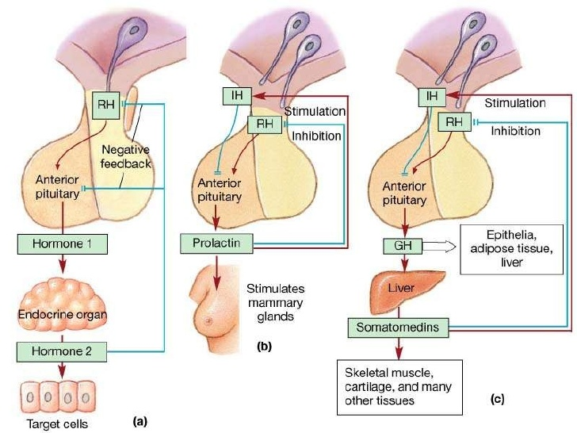
Regulation of secretion

Slide 61
Acromegaly - clinical feature
Acromegaly is a disease that occurs as a result of increased production of growth (somatotropic) hormone from the anterior pituitary gland due to an adenoma.
The word "acromegaly" is of Greek origin and means enlarged limbs, as this is one of the symptoms of the disease.
If the pathological increase in the level of growth hormone occurs before the end of puberty and the closure of the cartilaginous growth zones in the long bones, the state of gigantism is observed.

Slide 62
Acromegaly - pathophysiological characteristics
  Elevated levels of GH, through the action of somatomedin or insulin-like growth factor 1, lead to an increased anabolic effect and an increase in the volume of bones and internal organs.
  Growth hormone is a counterinsular hormone. It raises blood sugar levels and stimulates the over-secretion of insulin by islet cells in the pancreas, leading to their depletion. These pathogenetic mechanisms are leading to the onset of symptomatic diabetes mellitus.
  The increase in the volume of the adenoma leads to the manifestation of a clinic characteristic of a space-interacting intracranial process. Its severity depends on the location of the adenoma and its size.

Slide 63
Acromegaly - clinical symptoms
Skin folds (cutis gyrata);
Coarse facial features - so. "Lion's face" (facies leontina). The palms, soles, and skull enlarge;
Thicken the lips and tongue, the speech of the sick becomes protracted; The jaws and the distances between the teeth increase;
There is an increase in internal organs;
Pain and paresthesias in the wrists and hands due to carpal tunnel syndrome;
Impaired glucose tolerance and diabetes mellitus;
Early menopause and secondary amenorrhea;
Heart failure due to hypertrophic cardiomyopathy;
Pulmonary hypertension and sleep apnea,
High incidence of colon tumors.

Slide 64
Drug treatment of acromegaly with somatostatin analogues
Octreotide (Sandostatin) or Lanreotide (Somatuline) are synthetic forms of the hormone somatostatin, which stops the production of PX.
They are long-acting forms for intramuscular injection every 2-4 weeks.
With prolonged use, Octreotide inhibits the secretion of enzymes from the gastrointestinal tract and the function of the pancreas and causes digestive problems.
About 25% of patients develop asymptomatic cholelithiasis. In some cases, treatment with octreotide may cause diabetes because somatostatin and its analogues may inhibit insulin release.
On the other hand, octreotide may reduce the need for insulin in patients with acromegaly.

Slide 65
Drug treatment of acromegaly with PX receptor antagonists
The newest direction in the medical treatment of acromegaly is the use of antagonists of the hormone receptors of PX.
The only member of this family is the pegvisomant (Somavert ). It blocks the binding of PX to its receptors and controls the activity of acromegaly in almost all patients.
Pegvisomant is given subcutaneously by injection once a day. It is possible to combine long-acting somatostatin analogues and weekly injections of pegvisomant.

Slide 66
Surgical treatment for acromegaly
The surgery is most successful in patients:
with GH levels below 40 ng / ml before surgery and
with pituitary tumors no larger than 10 mm in diameter.
Success depends on the skill and experience of the surgeon.
The best criterion for surgical success is normalization of GH and IGF-1 levels. Ideally, the GH should be less than 2 ng / ml after oral glucose loading.
Complications of the operation :
liquorice,
meningitis and
pituitary hypofunction.

Slide 67
Radiation therapy
Radiation therapy is indicated for primary treatment, as well as for combined treatment - surgery or medication.
It is preferred in patients with residual tumor or recurrence.
Radiation therapy is administered in divided doses for 4-6 weeks.
This treatment reduces RH levels by about 50% for 2 to 5 years.
Patients who have been observed for more than 5 years show significant further improvement.
Complications:
vision loss
brain trauma,
pituitary hypofunction

Slide 68
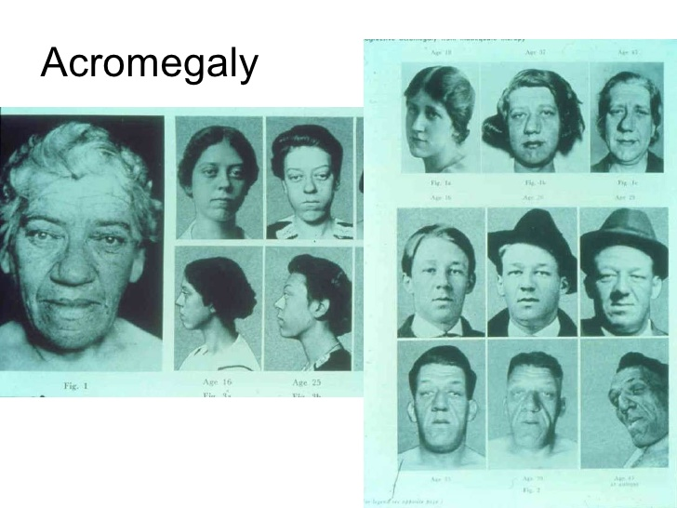
https://www.slideshare.net/roger961/endocrine-system-outline-of-major-players

Slide 69
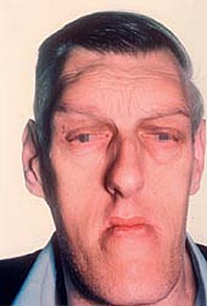

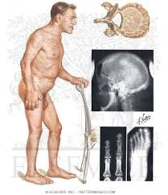
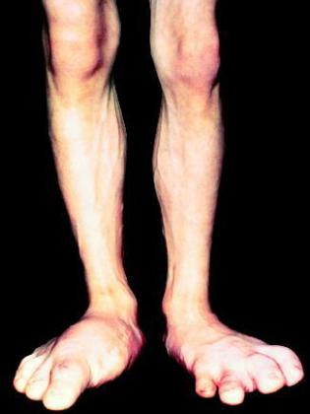
Acromegaly https://www.slideshare.net/roger961/endocrine-system-outline-of-major-players
https://mrt-v-spb.ru/akromegaliya/

Slide 70
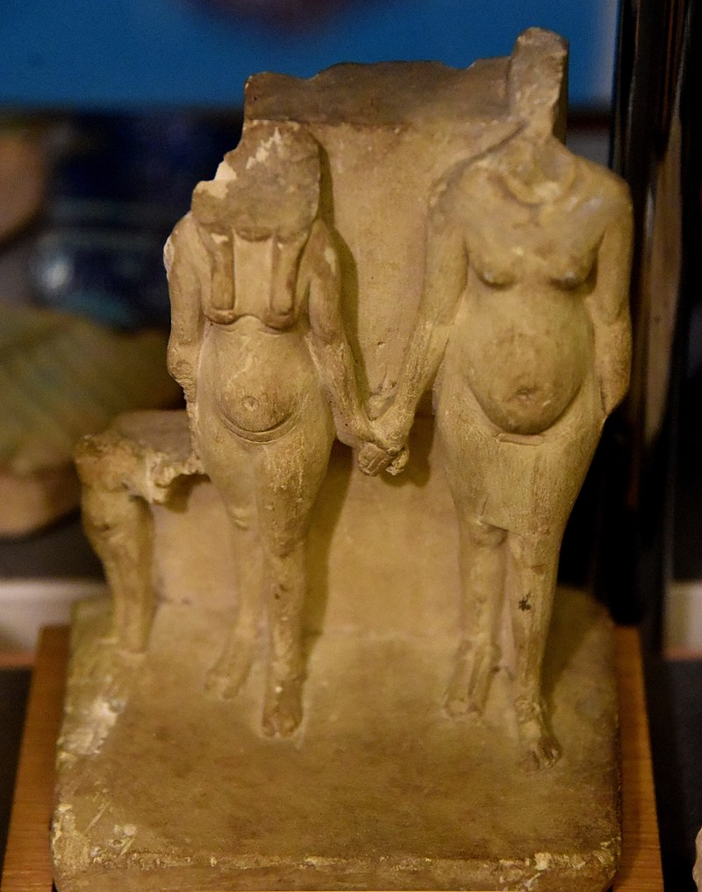

Slide 71
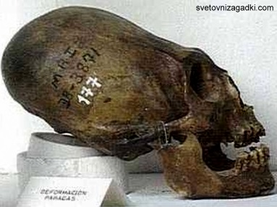
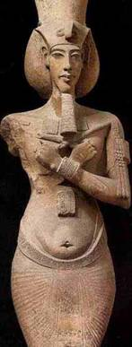

Historical figures who are thought to have suffered from acromegaly

Slide 72
Thank you for your attention
Questions?
Opinions?
Suggestions?

